Slide 1
Plant Disease Detection
CSE 465 Section 1 Zareen Sharar Cynthia
ID: 1610814042

Slide 2
Objective
Pattern recognition can be used in many aspects of agriculture, one of which is Plant disease detection
The objective of the project is to use pattern recognition and neural network to train a model on a large dataset of leaf images so it can identify if a plant has a disease and if yes. Which disease.

Slide 3
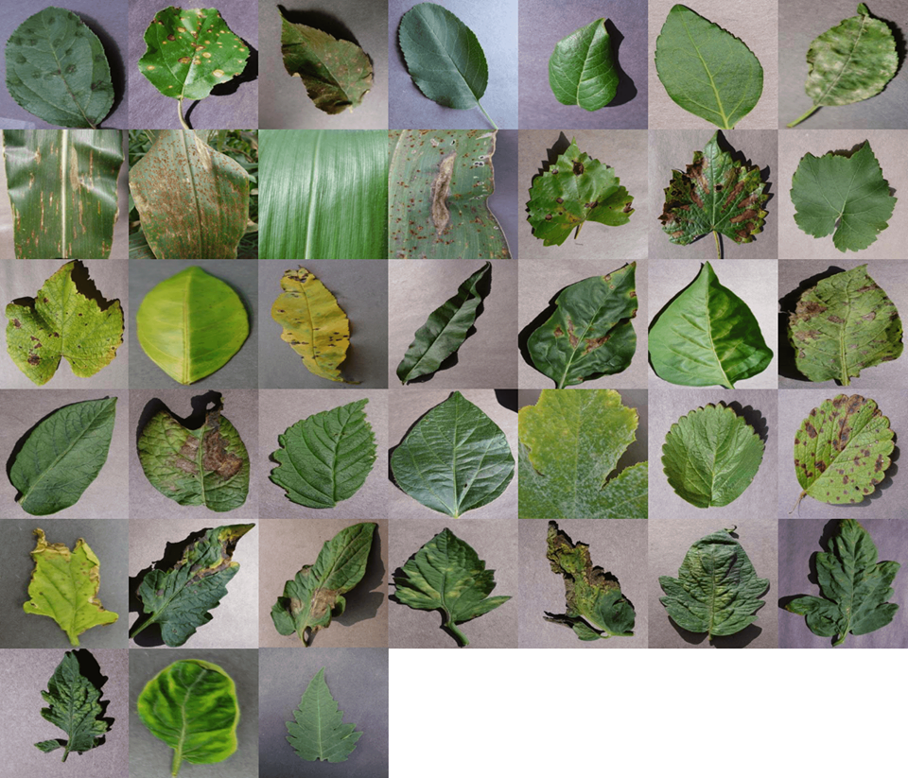
Dataset Description
We are using the PlantVillage dataset. The dataset has 38 different classes.
Due to limitations of time and expertise, a subset of the dataset is being used. This subset contains 15 classes. The dataset size is 350MB.

Slide 4
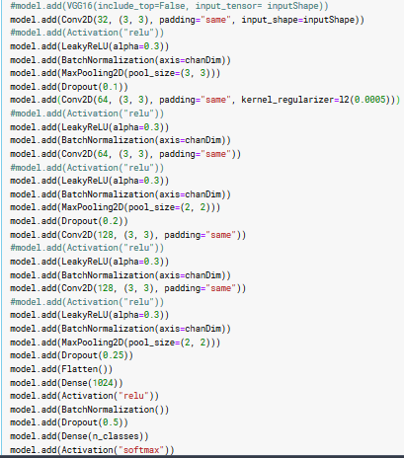
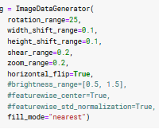
Model Description
The data is preprocessed by splitting it into 70% training and 30% testing
Data Augmentation was carried out as dataset is small.
A Convolutional Neural Network is being applied to the dataset
The layers are as follows are shown on the left

Slide 5
Model Description
TensorFlow is a free and open-source software library, that is used in the model. Keras is an open-source neural-network library that can be used on top of TensorFlow
Conv2D is used to build the convolution layers. The method takes the parameters filter and kernel size and other optional parameters such as stride and padding
Activation functions: RelU activation function was initially used to avoid missing gradient. Later 5 out of 6 RelU activations was replaced by Leaky RelU =0.3. The noise was slightly lower comparatively but the two activations had almost same results.
Batch Normalization: Batch normalization reduces the amount by what the hidden unit values shift around. It makes computation faster

Slide 6
Model Description
Max Pooling: The objective is to down-sample an input representation by reducing its dimensionality and allowing for assumptions to be made about features contained in the sub-regions. 4 of these layers were used and dimensions reduces from 256x256 to 21x21. The purpose is to find the most activated pixel in the subregion.
Dropout: It is a form of regularization that prevents overfitting. Scope can be altered using the parameter “keep_prob”. As the dimension got smaller layer by layer, I increased the value of keep_prob, to preserve more units. Dropout was lowered for the initial layers and the test accuracy increased and the fluctuations decreased as well.
Softmax: Used for multiple class classification output

Slide 7
Features Added after Mid Project Progress
L2 regularization added
RelU replaced by Leaky RelU
Dropout keep-prob decreased
Trained on a higher number of epochs
Attempted to pass data through VGG-16 and then customized model, but did not work

Slide 8
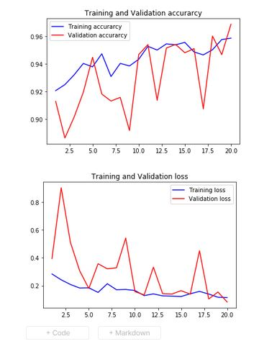
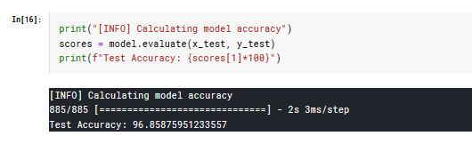
Results (step by step progress)
Dropout decreased

Slide 9
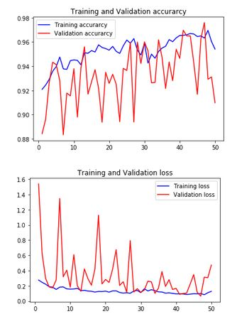
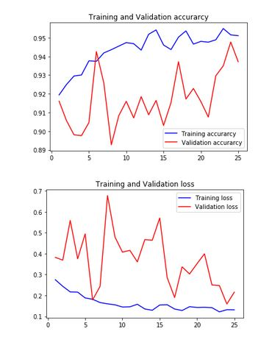

Results (step by step progress)
Leaky RelU = 0.2
Leaky RelU=0.3

Slide 10
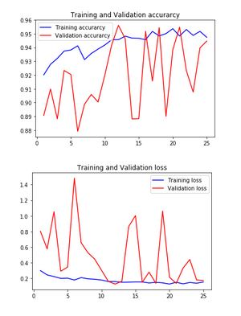
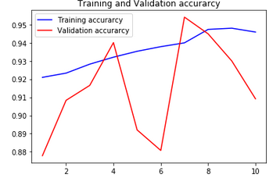
Results
After Mid Project Progress Presentation
Till Mid Project Progress Presentation
Dropout decreased, Leaky RelU=0.3 and L2 reguraization added
Model was trained for 10 epochs
Final accuracy was 90.9%
Model Trained for 25 epochs
Test Accuracy:
94.5%

Slide 11
Problems Faced
Was not able to use transfer learning due to dimensionality issues
Accuracy and Loss fluctuations were decreased but are still significant
Was not able to add VGG-16 on top of custom CNN model

Slide 12
THANK YOU!

