Slide 1
Plant Disease Detection
CSE 465 Section 1 Zareen Sharar Cynthia
ID: 1610814042

Slide 2
Objective
Pattern recognition can be used in many aspects of agriculture, one of which is Plant disease detection
The objective of the project is to use pattern recognition and neural network to train a model on a large dataset of leaf images so it can identify if a plant has a disease and if yes. Which disease.

Slide 3
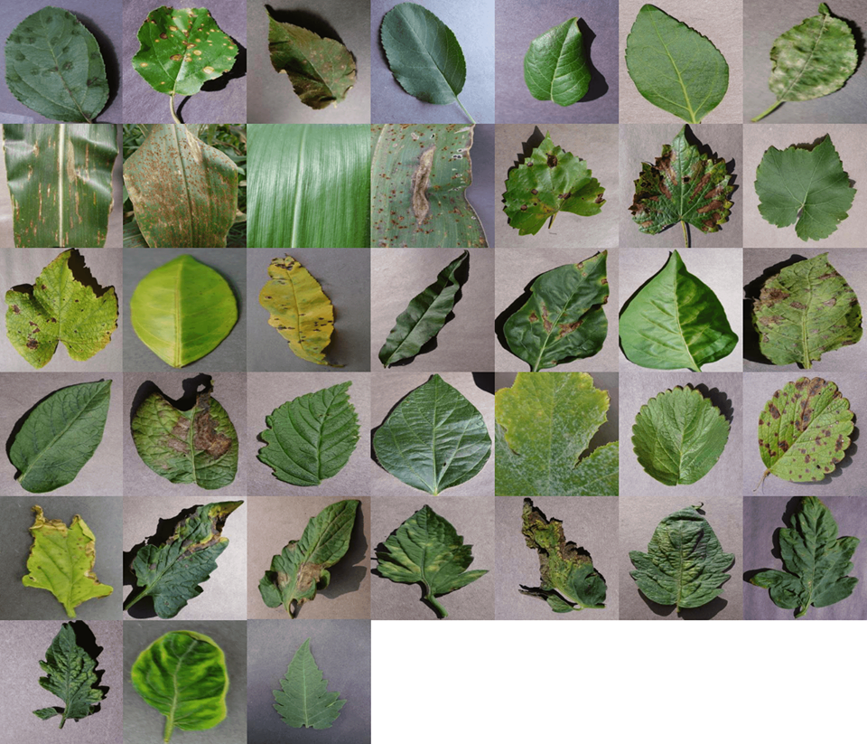
Dataset Description
We are using the PlantVillage dataset. The dataset has 38 different classes.
Due to limitations of time and expertise, a subset of the dataset is being used. This subset contains 15 classes. The dataset size is 350MB.

Slide 4
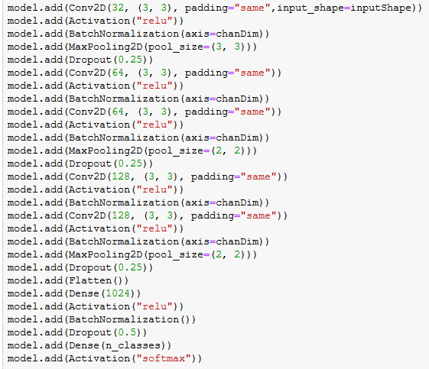
Model Description
The data is preprocessed by splitting it into 70% training and 30% testing
A Convolutional Neural Network is being applied to the dataset
The layers are as follows:
Five 2D Conv layers, relu activation, batch normalization, max pooling and a softmax function at the end

Slide 5
Model Description
TensorFlow is a free and open-source software library, that is used in the model. Keras is an open-source neural-network library that can be used on top of TensorFlow
Conv2D is used to build the convolution layers. The method takes the parameters filter and kernel size and other optional parameters such as stride and padding
Activation functions are used to determine the output of neural network like yes or no. It maps the resulting values in between 0 to 1. RelU activation function is used to avoid missing gradient and the functon is more efficient than sigmoid
Batch Normalization: Batch normalization reduces the amount by what the hidden unit values shift around. It makes computation faster

Slide 6
Model Description
Max Pooling: The objective is to down-sample an input representation by reducing its dimensionality and allowing for assumptions to be made about features contained in the sub-regions. 4 of these layers were used and dimensions reduces from 256x256 to 21x21. The purpose is to find the most activated pixel in the subregion.
Dropout: It is a form of reguralization that prevents overfitting. Scope can be altered using the parameter “keep_prob”. As the dimension got smaller layer by layer, I increased the value of keep_prob, to preserve more units.
Softmax: Used for multiple class classification output

Slide 7
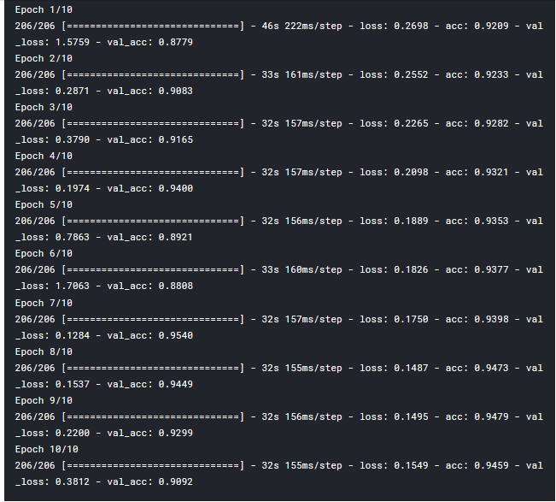
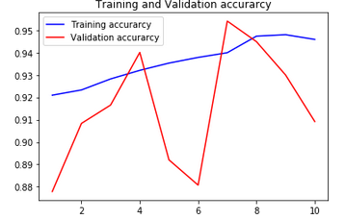
Results
Model was trained for 10 epochs
Final accuracy was 90.9%

Slide 8
Problems Faced
Training on CPU took lot of time as I had no access to Cuda. Therefore used Kaggle Kernel to make use of their GPU
Lack of knowledge about the dimensions of each layer and therefore trouble modifying layers as I want

Slide 9
Future Work
Adding a pretrained model for higher accuracy
Using other regularization techniques (Eg:L2) or activation functions (such as leaky RelU) to check how accuracy performs.
Train on a higher number of epochs

Slide 10
THANK YOU!

