Slide 1
CSE 465.1: Pattern Recognition and Neural Networks
Group Members:
Farzeen Naz Promi (1620225042) Zareen Sharar Cynthia (1610814042) Lubaba Bazlul (1611430042) Sazid Alam (1511394042)

Slide 2
The Topic
Plant Disease Detection Pattern recognition can be used in many aspects of agriculture, one of which is Plant disease detection. Image and pattern recognition techniques are applied to a dataset of images of a large variety of plants to train them to identify if a plant is diseased and if it is, to specify its disease.

Slide 3
Benefit to the Industry
Creation and implementation of such a model and subsequent release to those in the industry will allow those in the agricultural sector, particularly low income farmers to quickly and easily identify plant diseases before they are advanced and will allow them to seek a cure before the disease spreads to the rest of the harvest resulting in higher output of healthy crops.

Slide 4
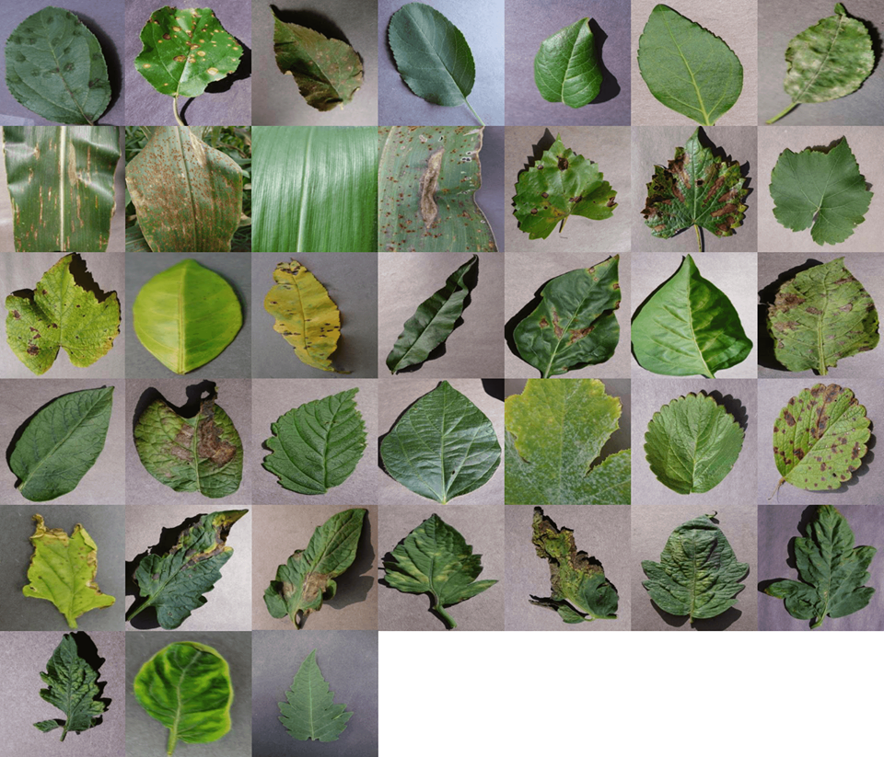
Dataset
The dataset we have chosen to use for our project is the Plant Village dataset
Sample images from all 38 classes:

Slide 5
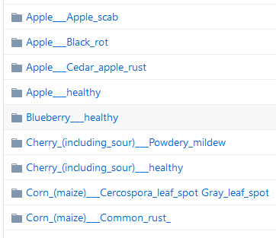
Dataset description
The dataset is divided into 38 classes including the following:
The data records contain 54,309 images. The images span 14 crops species: Apple, Blueberry, Cherry, Corn, Grape, Orange, Peach, Bell Pepper, Potato, Raspberry, Soybean, Squash, Strawberry, Tomato.
It contains images of 17 fungal diseases, 4 bacterial diseases, 2 mold (oomycete) diseases, 2 viral disease, and 1 disease caused by a mite. 12 crop species also have images of healthy leaves that are not visibly affected by a disease.

Slide 6
Project Milestones
Milestone | Completion date (tentative)
Dataset Selection | 26th October 2019
Model Selection | 16th November 2019
Applying models | 7th December
Comparing models | 7th December

Slide 7
References
Dataset:
https://github.com/spMohanty/PlantVillage-Dataset/tree/master/raw/color

