Slide 1
Twitter #Explorer
Natalia Sazanakova
Ryan Langford
Hamish McCulloch

Slide 2
Scope
Our Idea
Problem Solving Approach
Technology Choices
App Demo
Project Outcomes
Questions
Notes:
Overview of the presentation/demo

Slide 3
Our Idea
Network analysis of Tweets to establish links between disparate ideas.
Analysis of the sentiment (tone) of tweets associated with a topic.
Correlation of location information.
Notes:
Our main idea was to compete network analysis of tweets to establish links between disparate ideas.
A group of people may have interest in, or a particular attitude, towards different topics.
While this groups association with one topic may be obvious, this group/topic may be linked with other topics in a way that is not obvious.
Being able to ‘connect the dots’ in this way could be broadly applicable in social, business or political contexts.
We also thought that including sentiment analysis and location information would provide additional context to the analysis.

Slide 4
Approach
Brainstorming
Initial investigation and prototyping – individual
Design refinement
Iterative development
Exploration of analytical power (usefulness)
Notes:
How we approached the task….
Brainstorming
Coming up with the ideas on the previous slide.
Suggesting a few technologies that we might find useful.
Initial investigation and prototyping
Done individually over a coupe of days.
We determined that a location or map centric approach was not feasible
We all made progress in different areas (e.g., data modelling, UI, sentiment analysis)
Based on our initial efforts we refined our design and decided on the essential features we needed to implement within the timeframe allowed. You will see that it has both strengths and limitations.
We then developed the dashboard by starting with the most important features, and then adding additional features as time allowed.
Finally, we experimented with our dashboard to determine how useful it could be as an analytical tool.

Slide 5
Technology Choices
Data Acquisition / Data Wrangling
Tweepy (Python wrapper for Twitter API)
Pandas
Data Visualization
Plotly Dash (Python wrapper for React.js, Plotly.js, built on Flask)
Dash Cytoscape (Python library for network graphs)
Data Analysis / Machine Learning
Sentiment Analysis (pre-trained) – Text Blob, VADER
Pandas – Aggregation functions
Word Cloud
Notes:
We selected a range of Python based and web technologies, as follows.
Note, we used two different sentiment analysis libraries and were able to compare them.

Slide 6
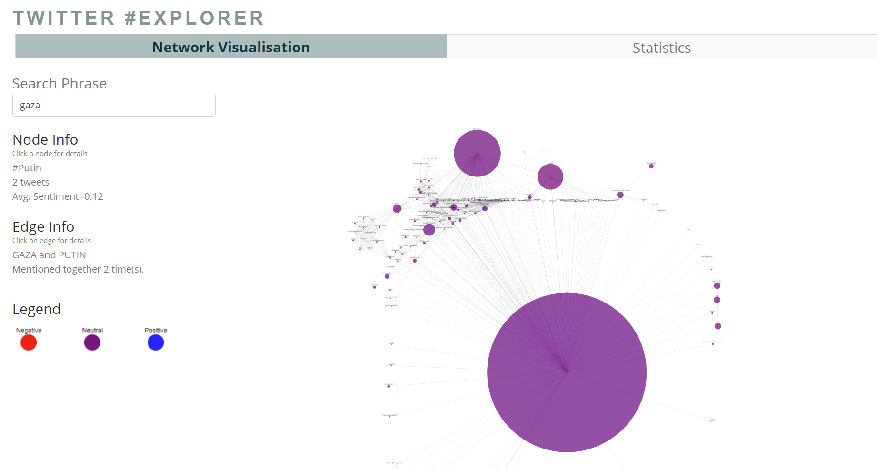
App Demo

Slide 7
Project Outcomes
Strengths
Interactive, graph-based visualization for analysis and exploration.
Identify linkages between different topics.
Determine attitudes towards a topic.
Effective for small searches.
Limitations
Average Sentiment – Neutral
Some searches return clusters of very similar topics.
Overwhelming – lots of hashtags per tweet.
Foreign languages – sentiment analysis accuracy?
Location information is not particularly accurate.
Notes:
See Jupyter Notebook for full explanation.

