Slide 1
Identifying Spatial and socio-economic drivers of Gentrification in Buffalo (2016–2024)
Sazzad Hossain
GEO 479-559
Instructor: Dr. Ling Bian

Slide 2
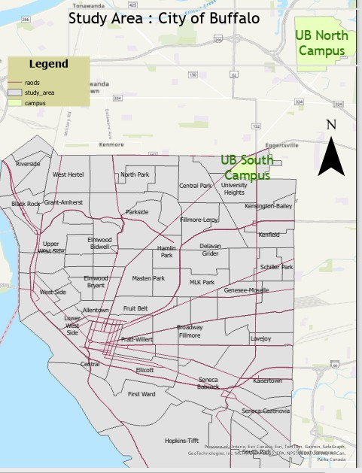
Study Area
Based on the 2015–2019 American Community Survey (ACS) 5-year estimates, the City of Buffalo is divided into 79 census tracts.

Slide 3
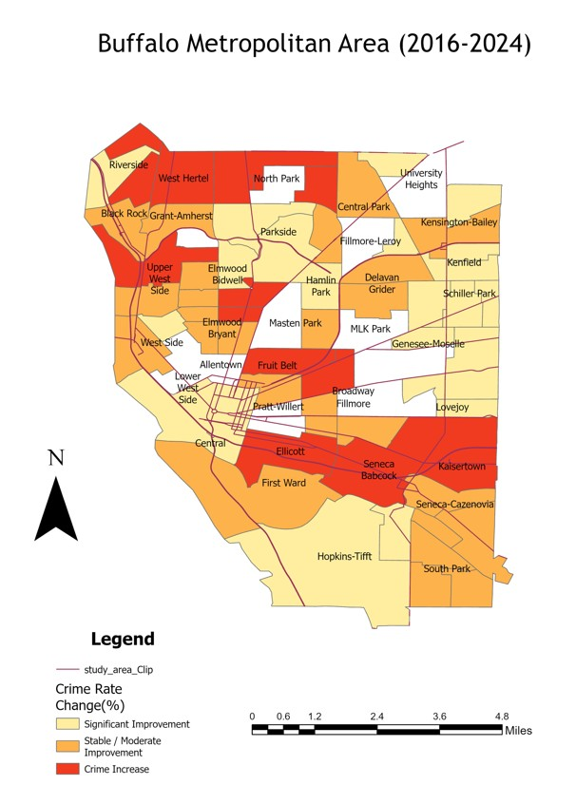
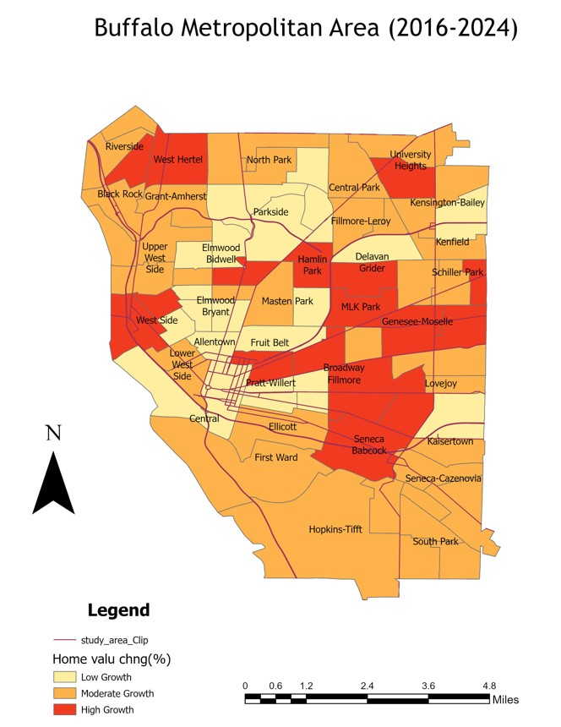
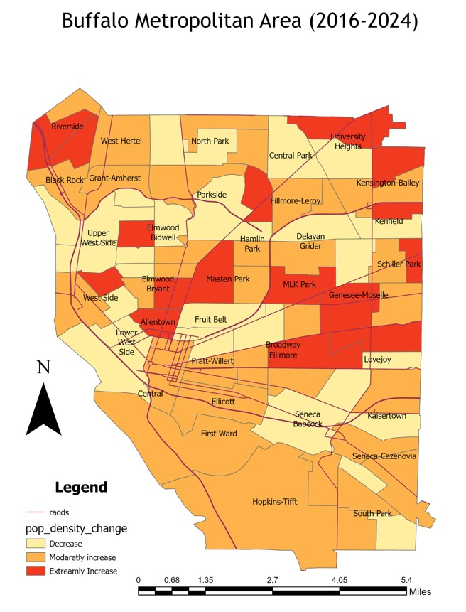
Motivation and Assumption
Crime Rate Decrease
Pop Density Change
House Price Increase

Slide 4


Data Source and Software
Data Category | Primary Source | Spatial Resolution
Demographics | US Census Bureau (ACS 5-Year Estimates) | Census Tract
Geospatial (SHP) | TIGER/Line Shapefiles | Census Tract
Environment & Safety | Open Data Buffalo (Parks, Crime, neighborhood) | Point/Neighborhood
Economic (Tax) | Buffalo Dept. of Assessment & Taxation | Parcel/Tract
Software

Slide 5
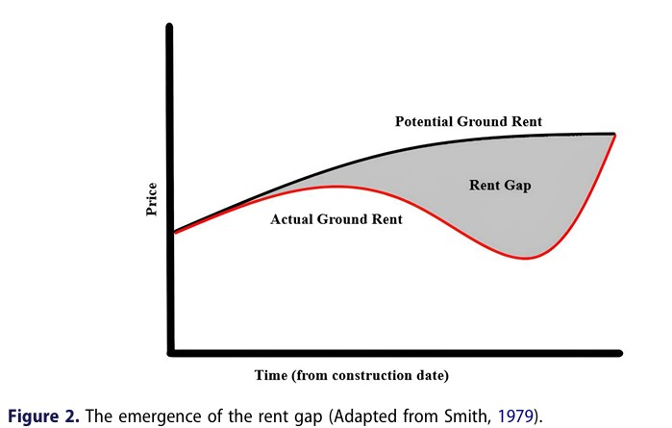
What is Gentrification & The Rent Gap Theory
Gentrification- "the process by which central urban neighborhoods that have undergone disinvestments and economic decline experience a reversal, reinvestment, and the in-migration of a relatively well-off, middle- and upper middle-class population”-Freeman, L. (2005)
Source: Çobangil & Ateş (2025).

Slide 6
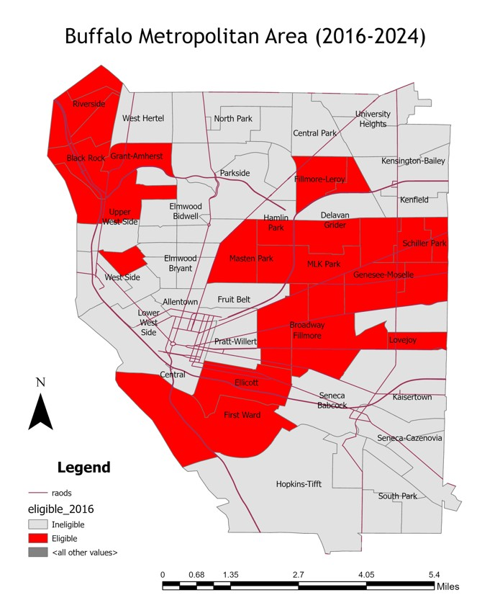
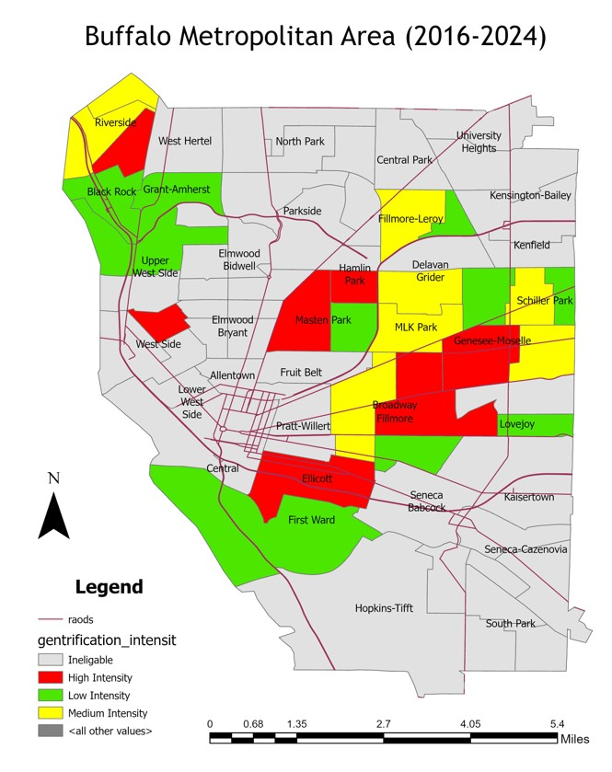
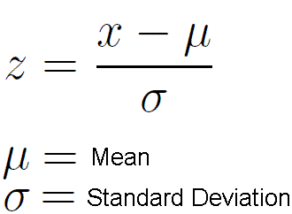
Moving from Binary Gentrification
Eligible Tracts
Continuous Gentrification
First- Identify Eligible or potential tract for Gentrification.
Second- Divide into High, Medium, Low Intensity by standard Z-score

Slide 7
Statistical Drivers
model <- lm( gentrification_score_std ~ median_income_16 + pop_density_16 + pct_white_16 + crime_count + house_age_16+ avgtax2019+ dist_downtown+ pct_park, data = data_eligible)
Independent Variables
median_income_16, pop_density_16, pct_white_16, crime count, house_age_16, Avgtax2019, dist_downtown, pct_park
Dependent Variables
gentrification_score_std

Slide 8
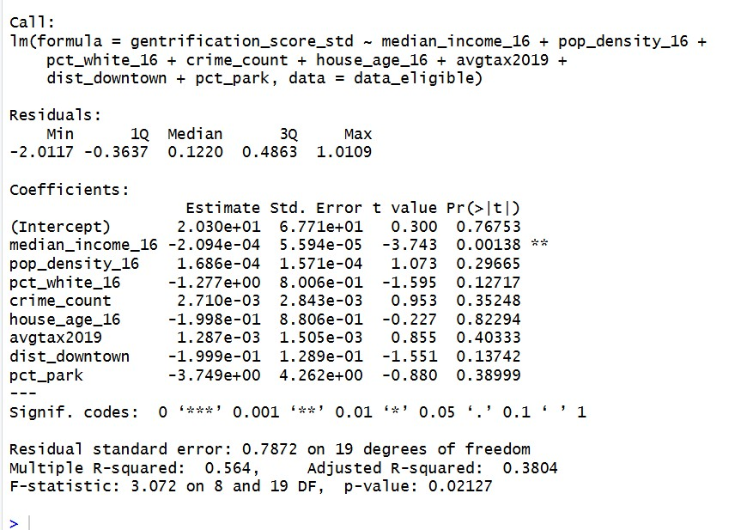
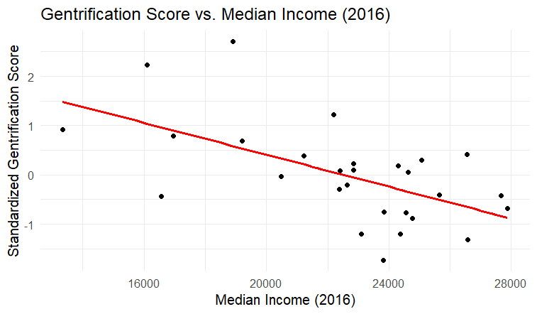
Statistical Drivers
This model explain 56.4 % of the variability

Slide 9
Impacts
Gentrification Intensity | Home Value Change |  | Income Change | Tax Spike ('24–'25) | White Pop | Black Pop | Asian Pop | Foreign-Born | Renter Pop | Crime Shift
Low Intensity | +133.0% |  | +49.2% | +$28.61% | -3.0% | -4.2% | +5.2% | +3.8% | +0.0% | -22.1%
Medium Intensity | +161.6% |  | +79.3% | +$84.7% | +0.9% | -15.6% | +10.9% | +7.5% | -4.0% | -10.5%
High Intensity | +257.5% |  | +133.1% | +176.43% | +8.8% | -16.5% | +2.8% | +1.5% | -4.6% | -20.2%

Slide 10
Limitation
we must be careful about our limitations. Our model definitively proves a stark demographic shift and neighborhood turnover at the census-tract level. However, people move for many reasons to migrate. Because we are using aggregate data, we can not say that weather a voluntarily migration or displacement. To prove displacement requires household-level data that tracks individual families for long period.

Slide 11
Future Work
For future work, the next logical step is to secure longitudinal tracking data to measure true involuntary displacement.

Slide 12
Literature
Smith, N. (1979). Toward a theory of gentrification: A back to the city movement by capital, not people. Journal of the American Planning Association, 45(4), 538–548. https://doi.org/10.1080/01944367908977002
Freeman, L. (2005). Displacement or succession? Residential mobility in gentrifying neighborhoods. Urban Affairs Review, 40(4), 463–491. https://doi.org/10.1177/1078087404273341
Çobangil, O., & Ateş, E. (2025). Airbnbfication and gentrification from the perspective of rent gap theory: The case of Beyoğlu, Istanbul. Urban Geography, 46(8), 1774–1798. https://doi.org/10.1080/02723638.2025.2481799

Slide 13
Literature
O'Neill, E., Cole, H. V. S., García-Lamarca, M., Anguelovski, I., Gullón, P., & Triguero-Mas, M. (2023). The right to the unhealthy deprived city: An exploration into the impacts of state-led redevelopment projects on the determinants of mental health. Social Science & Medicine, 336, 116238. https://doi.org/10.1016/j.socscimed.2023.116238
Vergara, J. V., Rodriguez, M. Y., Dohler, E., Phillips, J., Villodas, M., Blank Wilson, A., & Joseph, K. (2021). Promises and pitfalls of a new early warning system for gentrification in Buffalo, NY. arXiv preprint arXiv:2111.14915. https://doi.org/10.48550/arXiv.2111.14915
Adelman, R. M., Balta Ozgen, A., & Rabii, W. (2019). Buffalo’s West Side story: Migration, gentrification, and neighborhood change. City & Community, 18(3), 770–791. https://doi.org/10.1111/cico.12403

Slide 14
Literature
Coley, J., & Adelman, R. M. (2021). Gentrification in the “City of Good Neighbors”: Race, class, and neighborhoods in Buffalo. Sociological Inquiry, 91(4), 824–848. https://doi.org/10.1111/soin.12387
Zhang, Y., & Barr, C. (2024). Gentrification and crime: A spatial analysis of Buffalo, NY. PLOS ONE, 19(5), e0302832. https://doi.org/10.1371/journal.pone.0302832

Slide 15
Question & Suggestion
Thanks

