Slide 1
Transportation Accessibility and the Fixed-Link Corridor as potential Urban Decentralize
The Padma Corridor as a Spatial Transformer: Measuring Regional Accessibility
Sazzad Hossain
GEO 519

Slide 2
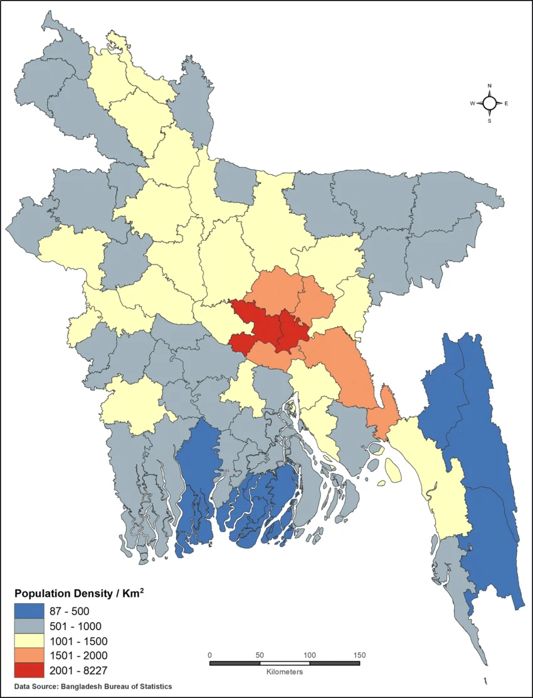
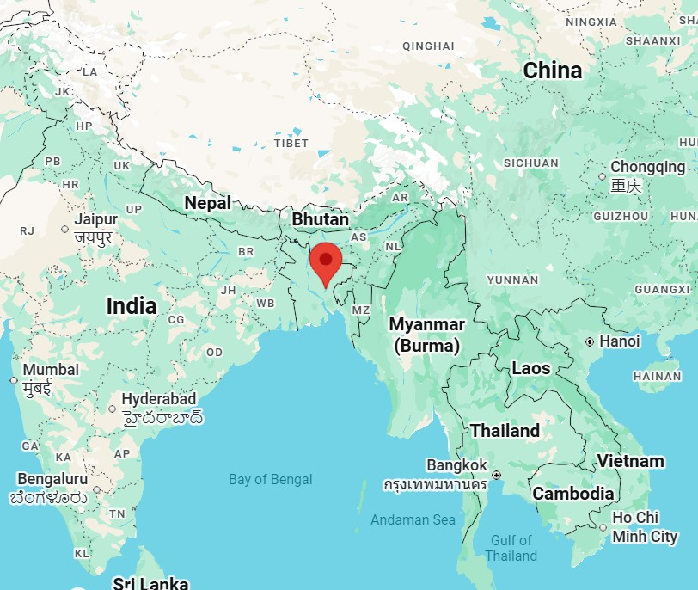
Study Area
USA is 60x large then Bangladesh and has only 2x population.
Bangladesh is one of the most densely populated country and capital Dhaka is most densely populated city of Bangladesh.
Suouce-Lightning hazard safety measures and awareness in Bangladesh-Md Sariful Islam

Slide 3
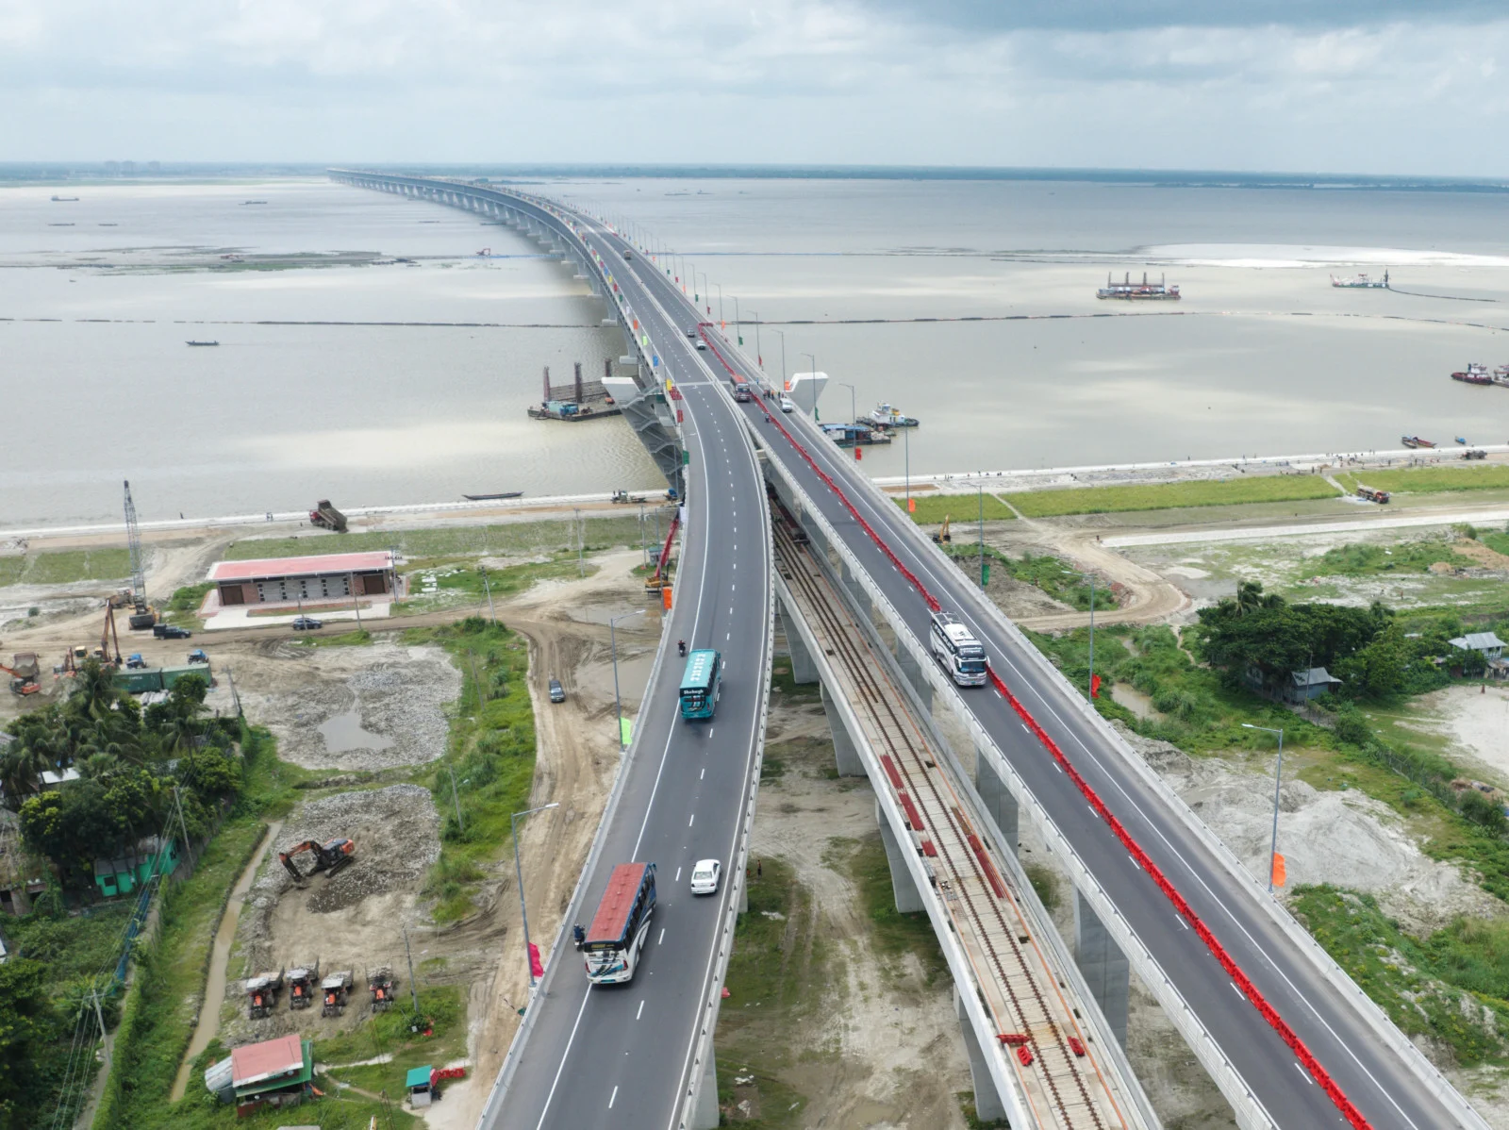
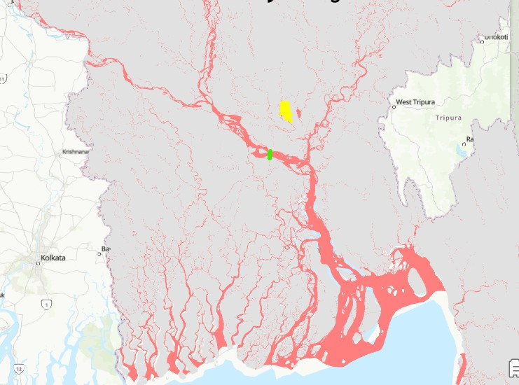
Study Area
Impact of Padma Bridge
Farmers are getting fair prices
Transport costs, time reduced
Investment in transportation increases
Housing sector booming
Two new EPZs are being set up
17 new economic zones are forming
RMG gets new route through Mongla Port
The Padma Bridge will add 1.23% to Bangladesh's gross domestic product and another 2% to the regional economy of 21 southwestern districts. If put together, economic gains from the bridge would be more than $10 billion during its economic life, more than three times its construction cost. From The Business Standard article

Slide 4
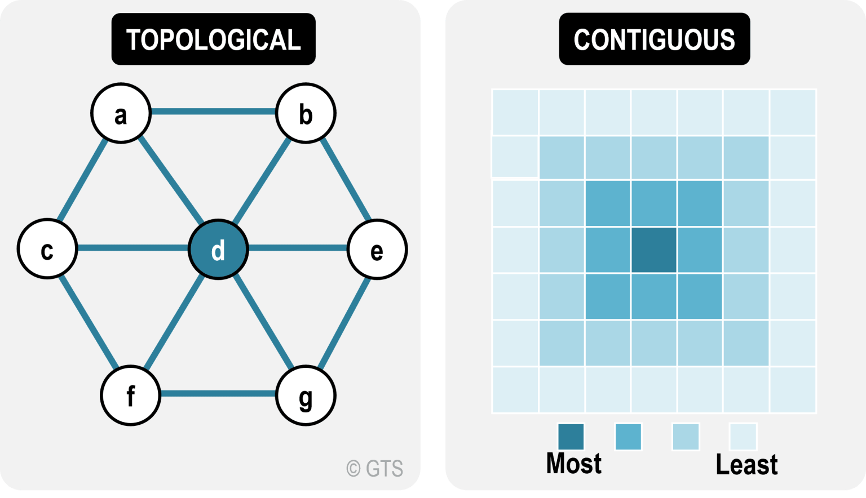
What is accessibility
Measurement Approaches
Accessibility
Topological
Contiguous
Potential Accessibility
Geographic
Accessibility is the Capacity of a location to be reached.- Rodrigue
Accessibility is the Potential of opportunities for interaction-. Rather than just measuring the physical ease of interaction- by Walter G. Hansen

Slide 5
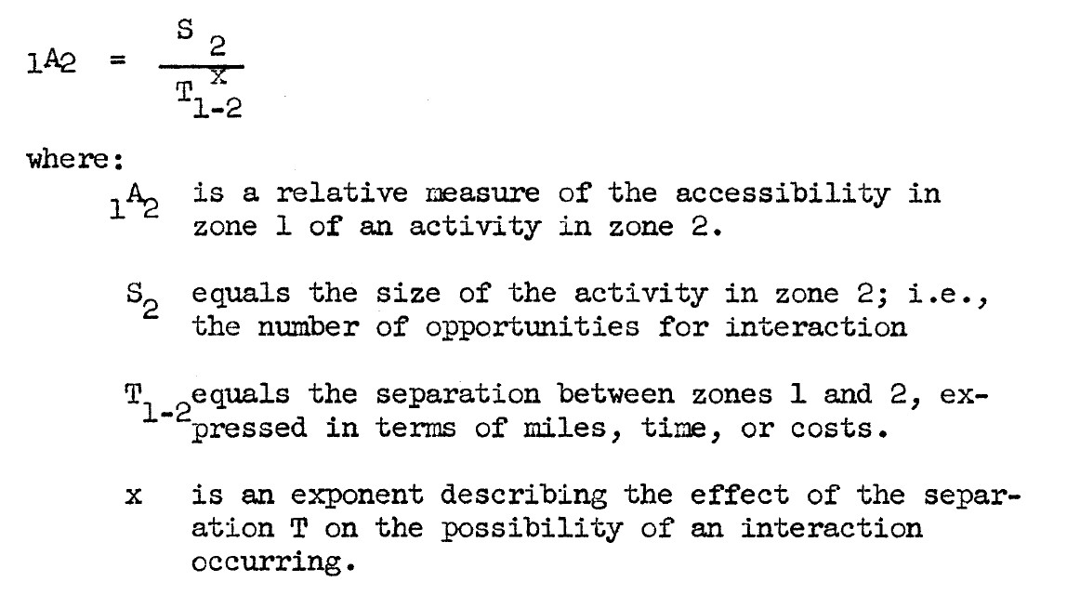
Our definition
Accessibility is the "potential of opportunities for interaction“, rather than just the ease of interaction- Walter G. Hansen
Why Hansen…?
The notion of accessibility:
Location- Consider other attributes of location.
Distance- Distance as time because people choice of trip depends on time not on distance.

Slide 6
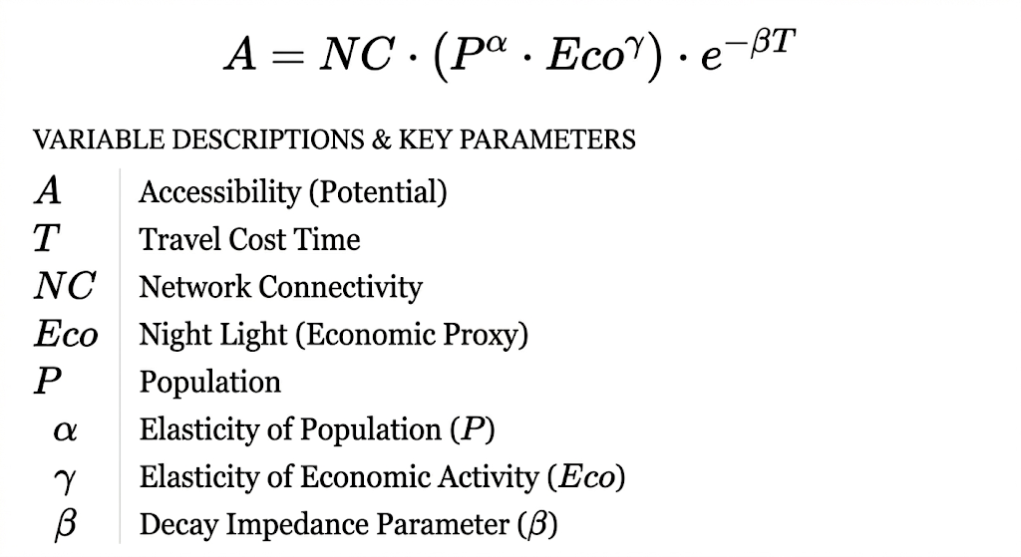
Our Equation

Slide 7
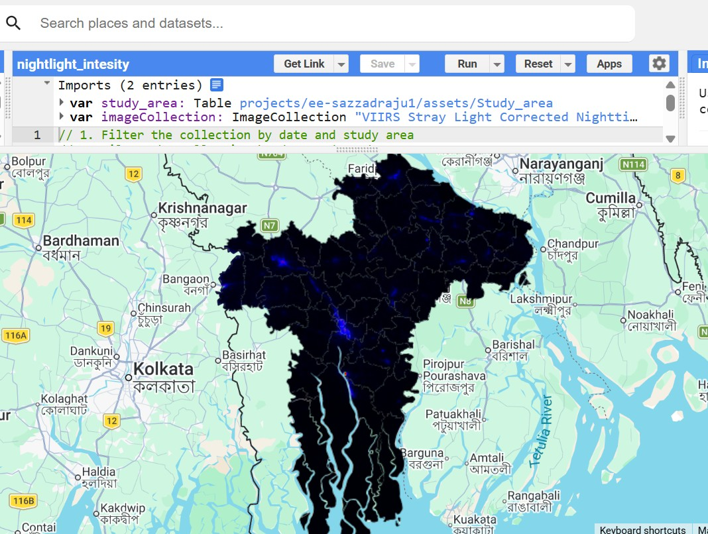
Data Source
Downloaded Raw Data
Population Data:
http://203.112.218.101/storage/files/1/Publications/others/PopulationHousingCensus2011%20vol-3.pdf
https://objectstorage.apdccgazipur1.oraclecloud15.com/n/axvjbnqprylg/b/V2Ministry/o/officebbs/2024/12/f376ca7e7ee5405f8311de650415b9d8.pdf
Satellite Imagery: Visible Infrared Imaging Radiometer Suite (VIIRS) Day/Night Band (DNB). ("NOAA/VIIRS/DNB/MONTHLY_V1/VCMSLCFG")

Slide 8
Data Source
Geographic Shapefiles: https://data.humdata.org/dataset/cod-ab-bgd
Distance Metrics: https://gis.rhd.gov.bd/dmt/
Processed & Calculated Data
Economic Proxy (Light Intensity): Mean light intensity calculated from the VIIRS data, acting as a direct proxy for economic growth and regional activity.
Connectivity (Road Density): Calculated as the total sum of road length divided by total area, Travel Time: Estimated using a uniform 60 km/hr speed across the network due to unavailable posted speed limits.
Distance Decay Coefficient (Beta): Set at 0.15 for the regional scale based on existing literature to represent how travel likelihood decreases as time increases.

Slide 9



Software
ArcGIS pro
R Studio
Google Earth Engine

Slide 10
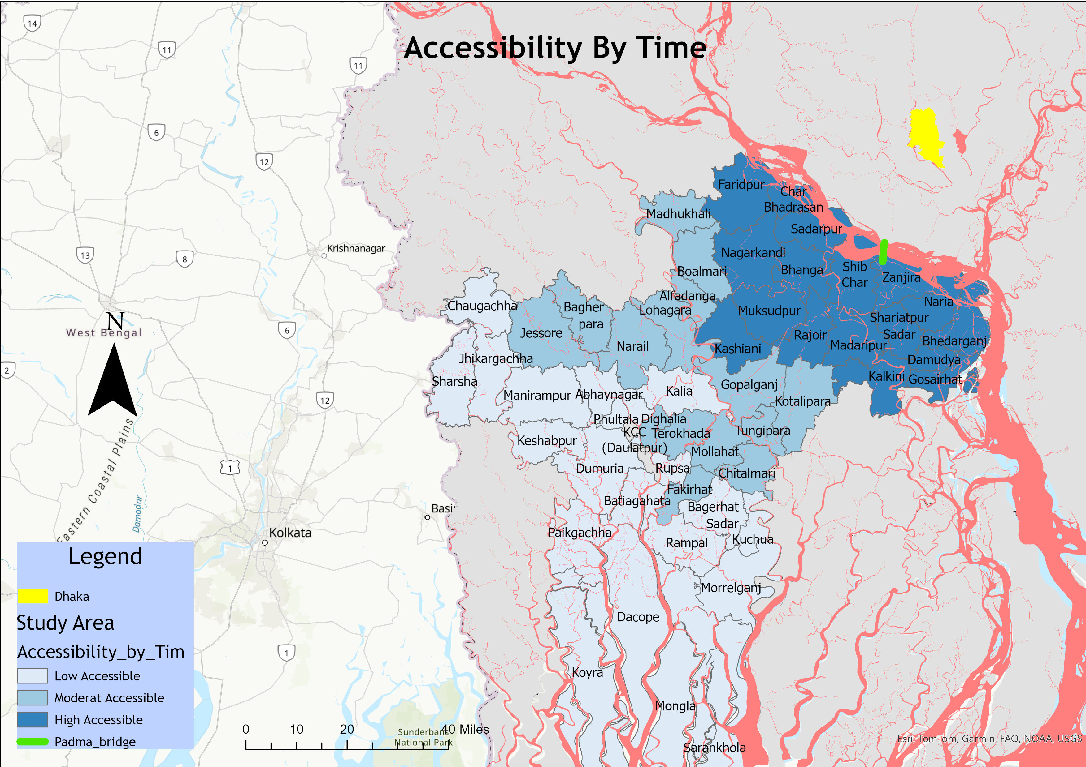
Result and Discussion
Accessibility By Travel Time
Geographic Accessibility- Closer higher accessible.

Slide 11
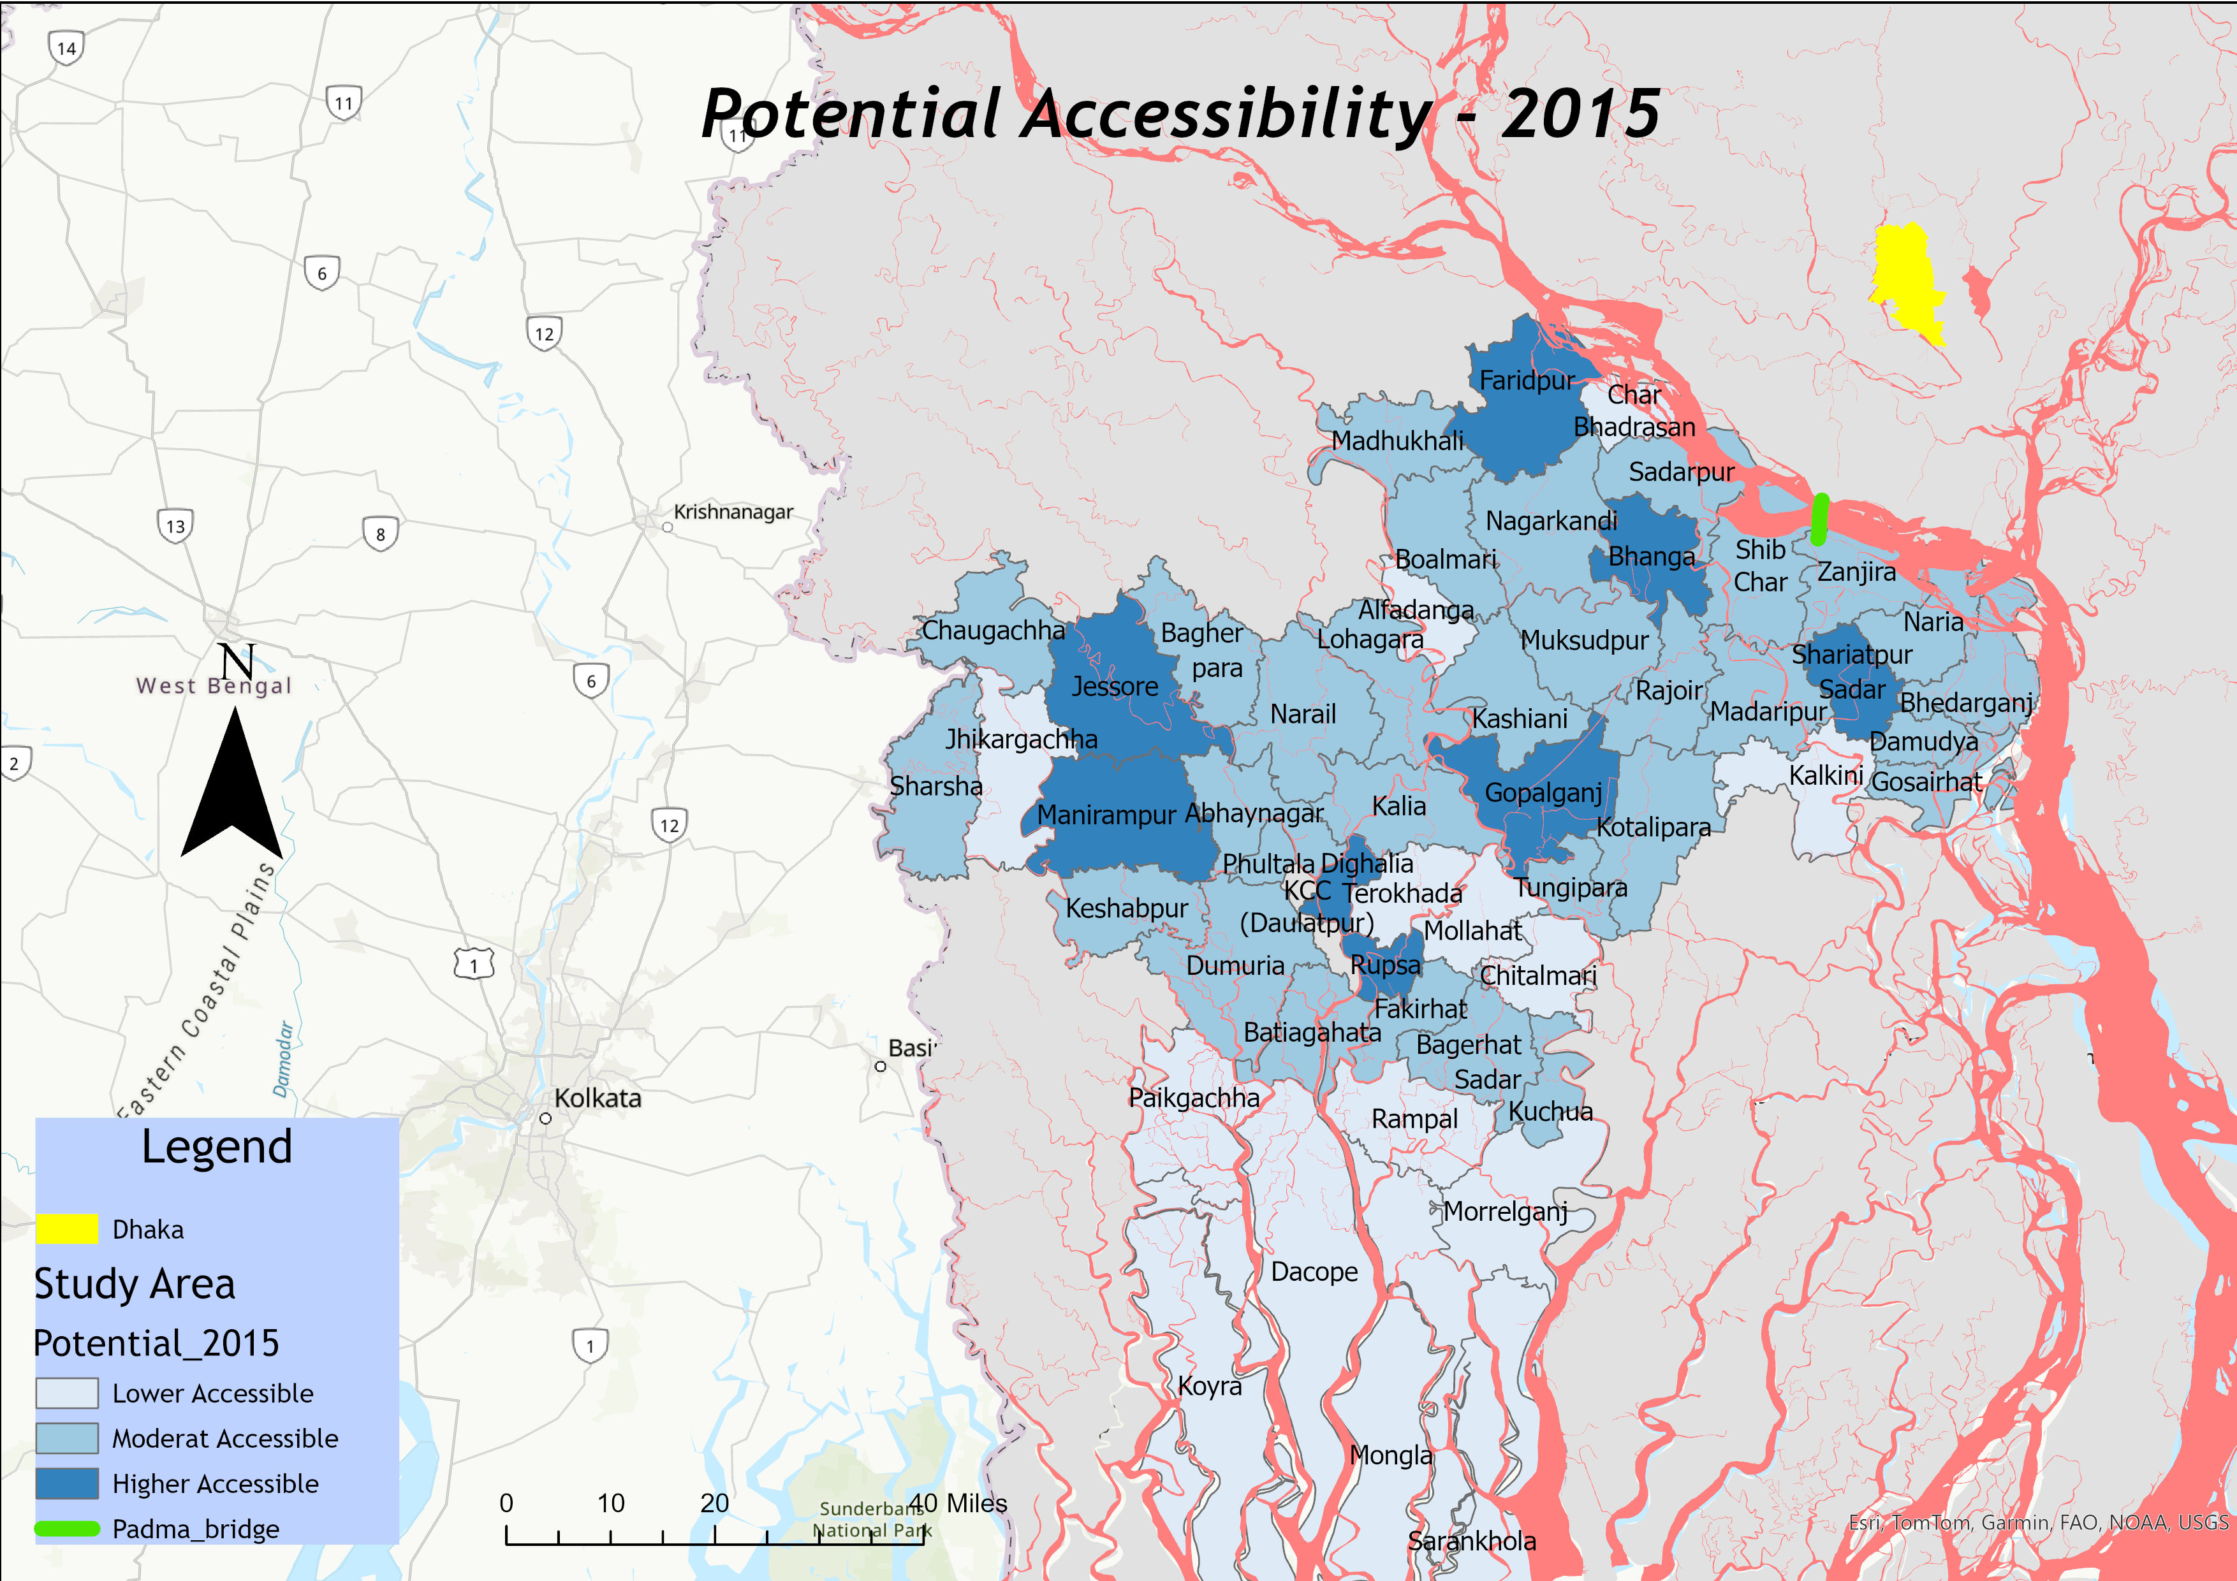
Result and Discussion
Potential Accessibility 2015
Jessore: Population, Economic Growth, Local Connectivity.
Khulna: Urban-industrial zones, Connectivity
Gopalganj: , Local Connectivity, Moderate Travel Time
Banga: Major highway junction, gateway node toward the southwest, Shorter travel time

Slide 12
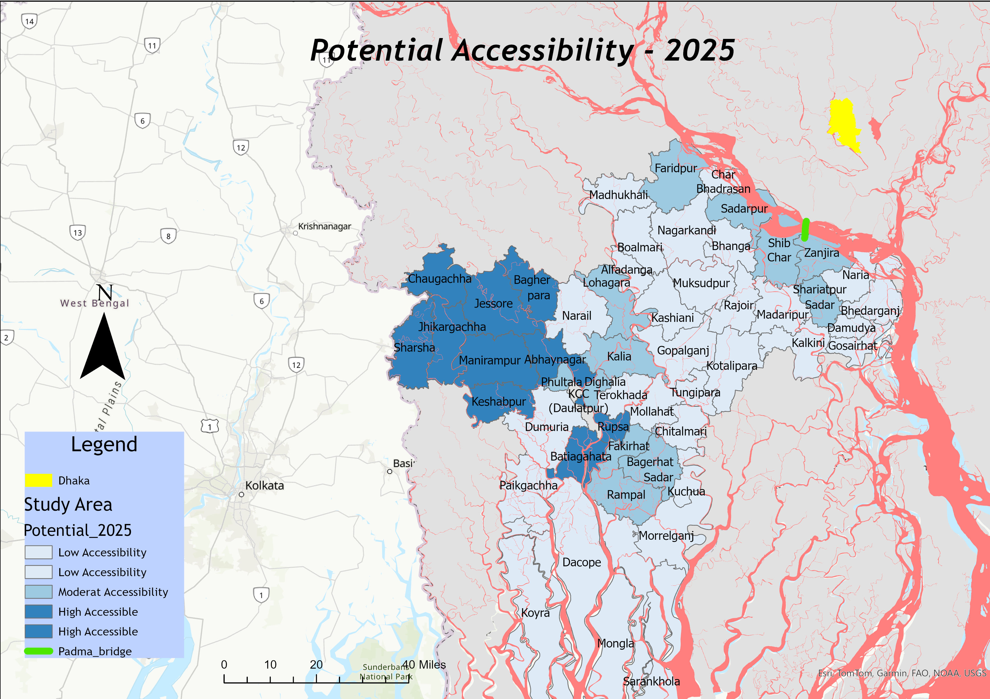
Result and Discussion
Potential Accessibility 2025
Jessore Region- Massive Travel Time Reduction, network Connectivity. Local Economic Hub.
Khulna Region- Port and Industrial Zone, Network Connectivity.
Faridpur Region- Increase Connectivity, Travel Time deduction.

Slide 13
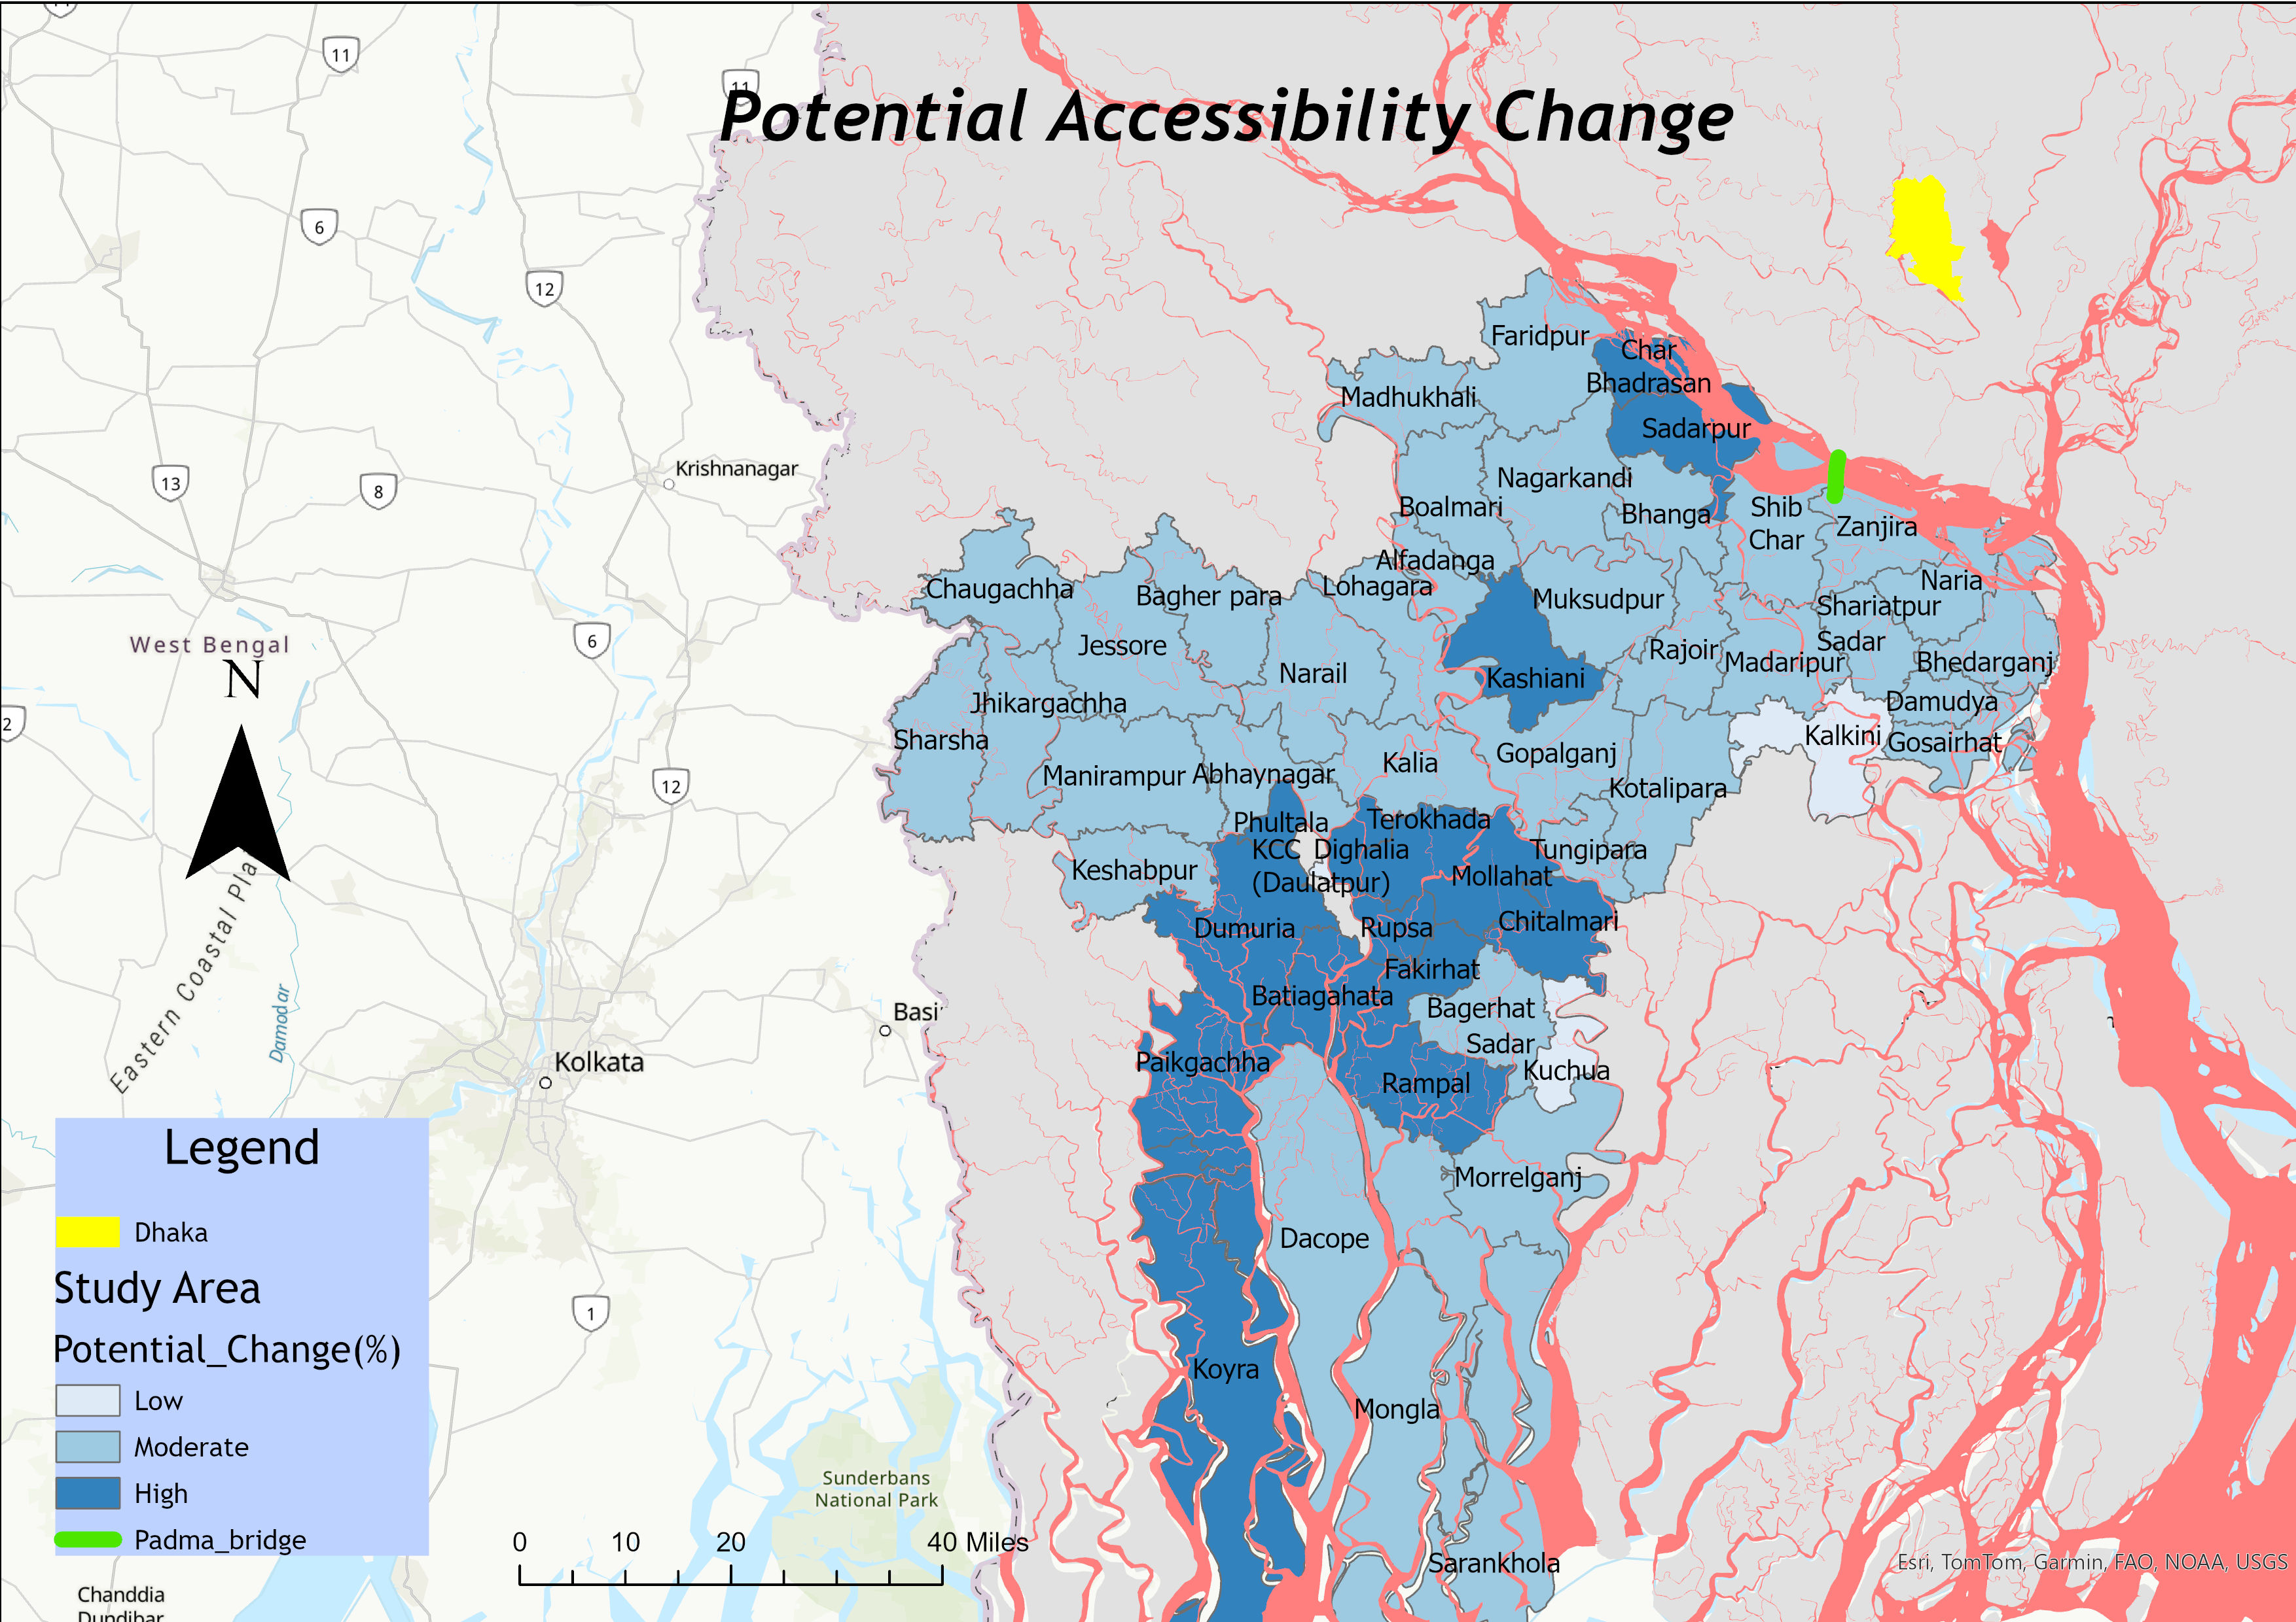
Result and Discussion
Potential Accessibility Change
Increase in Population,
Increase Connectivity
Massive Economic Growth.
Notes:
High % increase → area improved a lot (even if previously low)
Low % increase → already developed or less improvement

Slide 14
Limitation
Density Metric Flaws: Calculating road density strictly by area penalizes regions with large uninhabitable zones
Travel behavior Coefficient: Set to 0.15 for regional scale, based on established literature review
Travel Time Assumptions: Due to a lack of posted speed limit data, a flat speed of 60 km/hr. was assumed across the network and ferry time 4.5 hr.

Slide 15
Future Work
A Remote Sensing Land Use Land Cover Change Analysis

Slide 16
Literature
Book: The Geography of Transport Systems- Jean Pal Rodrigue(https://transportgeography.org/)
Hansen, W. G. (1959). How accessibility shapes land use. Journal of the American Institute of Planners, 73–76.
Banister, D., & Berechman, Y. (2001). Transport investment and the promotion of economic growth. Journal of Transport Geography, 9, 209–218.
Boisjoly, G., & El-Geneidy, A. M. (2017). How to get there? A critical assessment of accessibility objectives and indicators in metropolitan transportation plans. Transport Policy, 55, 38–50.
Cobb, C. W., & Douglas, P. H. (1928). A theory of production. The American Economic Review, 18(1), 139–165. [suspicious link removed]
Donaldson, D., & Hornbeck, R. (2016). Railroads and American economic growth: A "market access" approach. The Quarterly Journal of Economics, 131(2), 799–858.
Geurs, K. T., & van Wee, B. (2004). Accessibility evaluation of land-use and transport strategies: Review and research directions. Journal of Transport Geography, 12, 127–140.
Henderson, J. V., Storeygard, A., & Weil, D. N. (2009). Measuring economic growth from outer space (NBER Working Paper No. 15199). National Bureau of Economic Research. http://www.nber.org/papers/w15199
Levinson, D. M. (1998). Accessibility and the journey to work. Journal of Transport Geography, 6(1), 11–21.
Mellander, C., Lobo, J., Stolarick, K., & Matheson, Z. (2015). Night-time light data: A good proxy measure for economic activity? PLoS ONE, 10(10), Article e0139779. https://doi.org/10.1371/journal.pone.0139779

Slide 17
Literature
Vickerman, R., Spiekermann, K., & Wegener, M. (1999). Accessibility and economic development in Europe. Regional Studies, 33(1), 1–15. https://doi.org/10.1080/00343409950118878
Vickerman, R., Spiekermann, K., & Wegener, M. (1999). Accessibility and economic development in Europe. Regional Studies, 33(1), 1–15. https://doi.org/10.1080/00343409950118878

Slide 18
Thank you
Questions?

