Slide 1
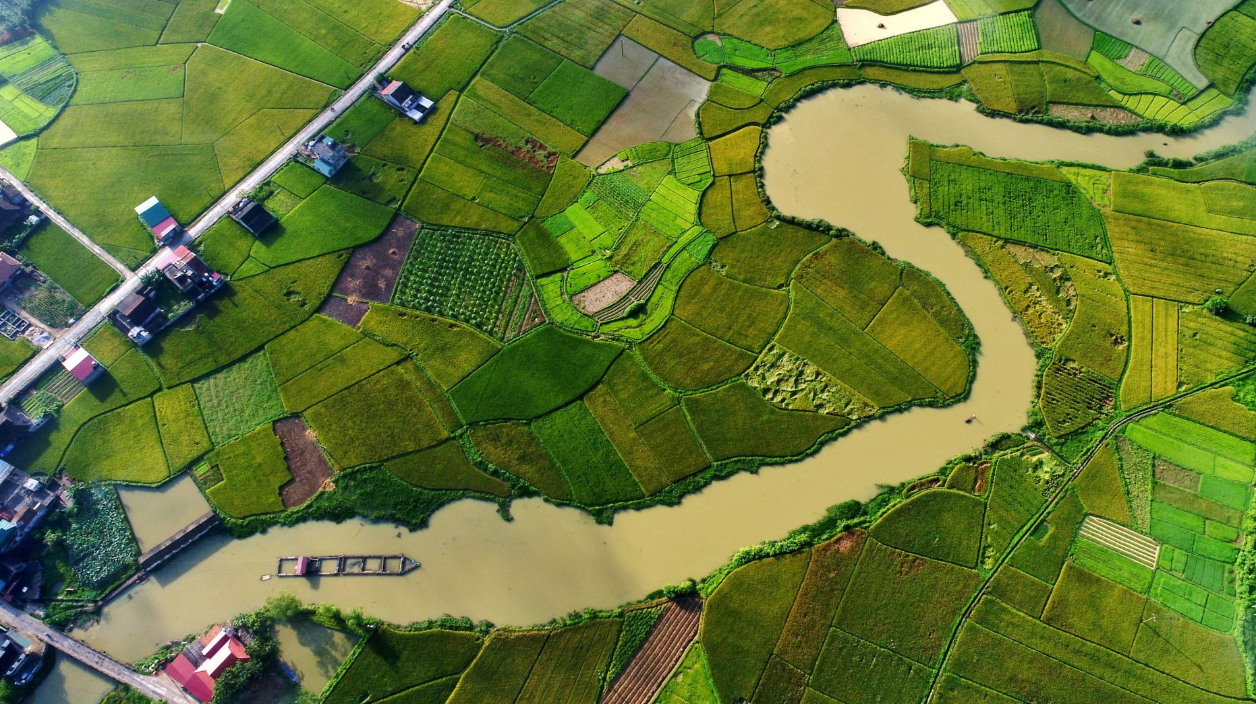
The Padma Corridor as a Spatial Transformer: A Remote Sensing Analysis of LULC Change of
Southern Bangladesh
SAZZAD HOSSAIN

Slide 2
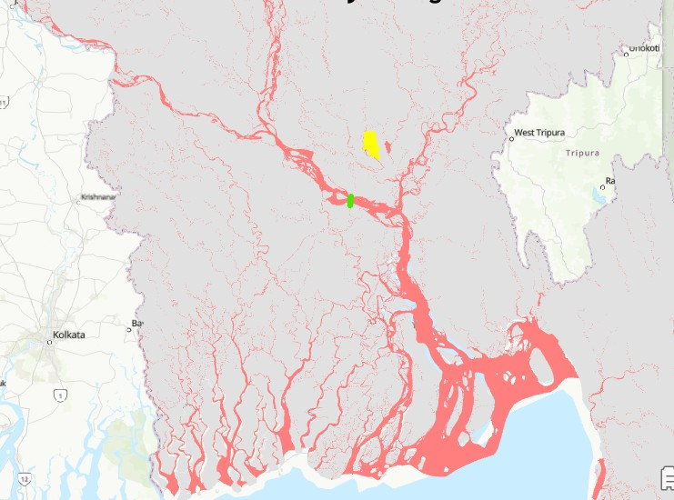
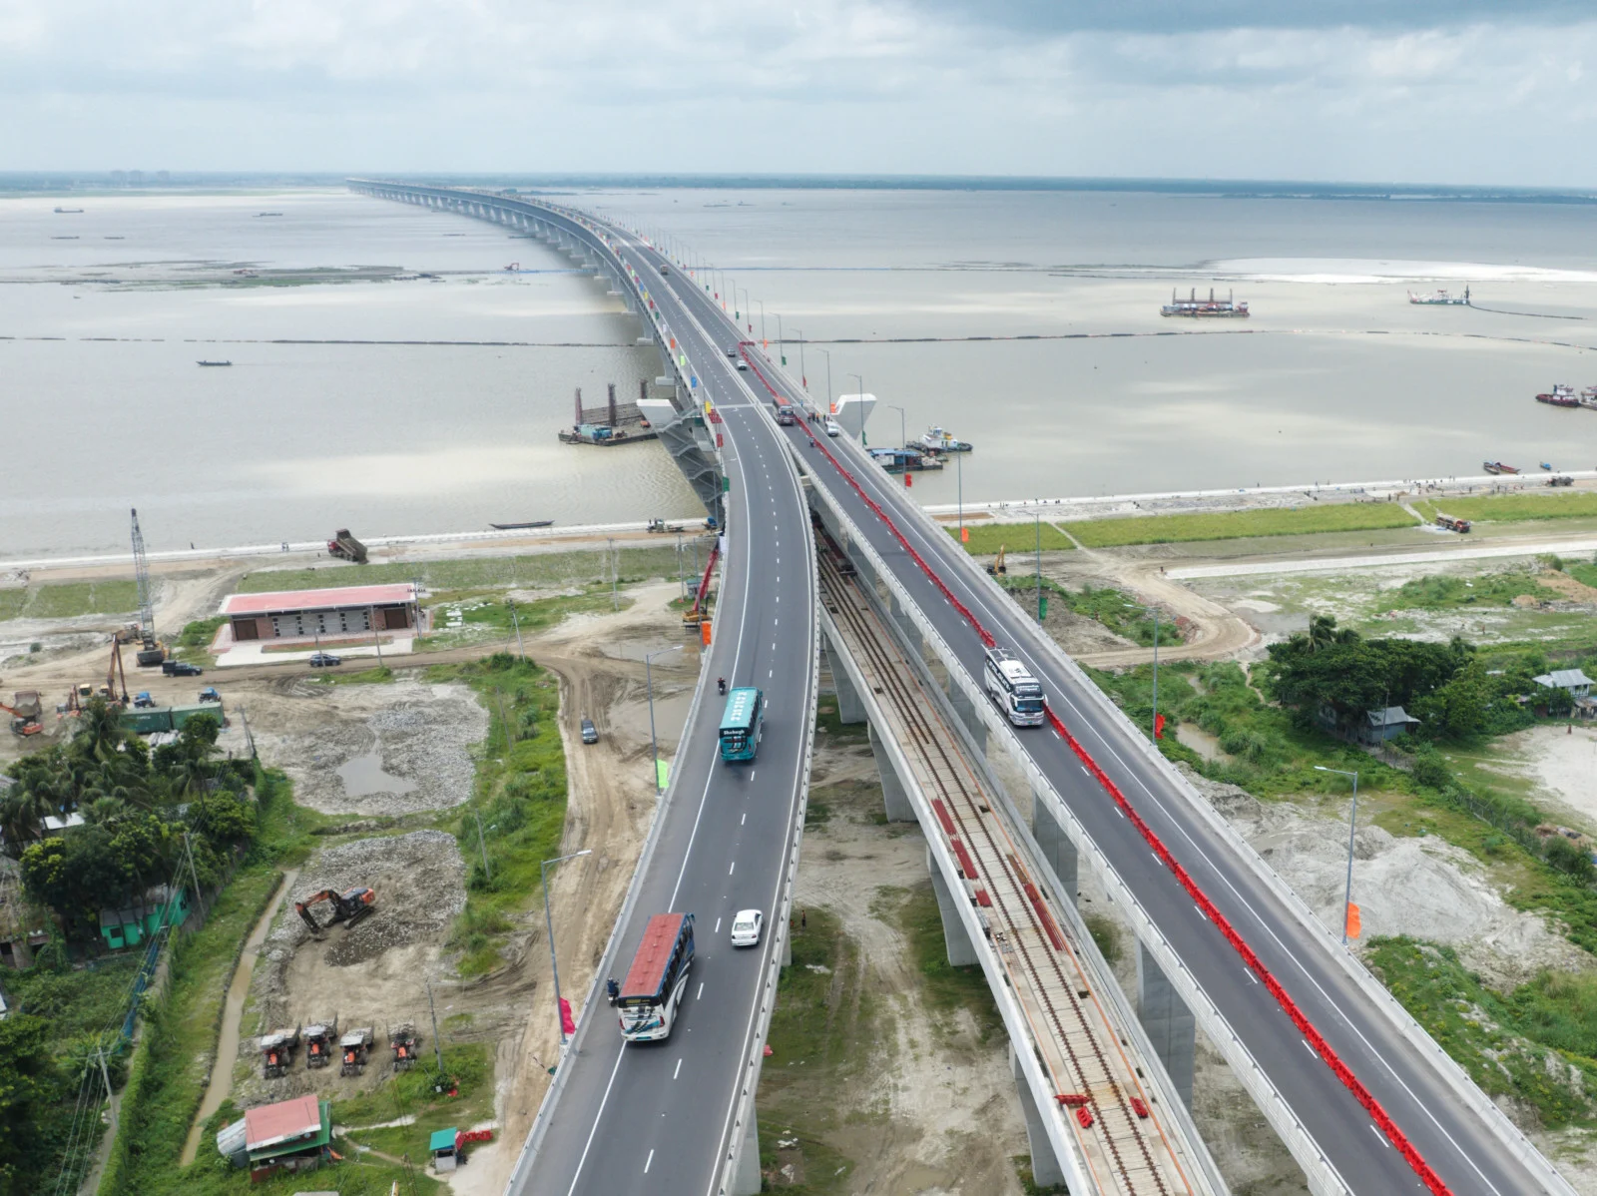
Motivation
Impact of Padma Bridge
Farmers are getting fair prices
Transport costs, time reduced
Investment in transportation increases
Housing sector booming
Two new EPZs are being set up
17 new economic zones are forming
RMG gets new route through Mongla Port
The Padma Bridge will add 1.23% to Bangladesh's gross domestic product and another 2% to the regional economy of 21 southwestern districts. If put together, economic gains from the bridge would be more than $10 billion during its economic life, more than three times its construction cost. From The Business Standard article

Slide 3
Research Question
In another study I identify the regions that gain higher accessibility.
This study will try to look for
The relationship between accessibility gain and LULC pattern.

Slide 4
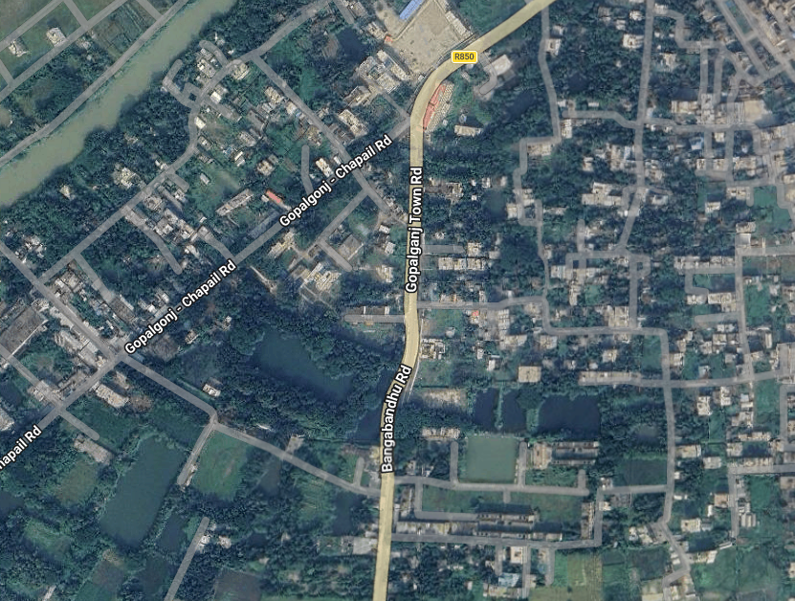
Choosing Satellite Image
First Choice- Landsat 8 ( because image is available from 2015 )
But 30m resolution is too poor for the complex landscape of the study area.
Then, I chose sentinel 2 and select initial date 2017
And for Night Light intensity- VIIRS

Slide 5
Methodology
Classes
Waterbody
Vegetation
Impervious
Training samples are collected differently for each year within the same time frame, considering seasonal variability.

Slide 6

Training–Testing Data
Training Samples are divided into two subsets:
Training Data (80%)
Testing Data (20%)

Slide 7
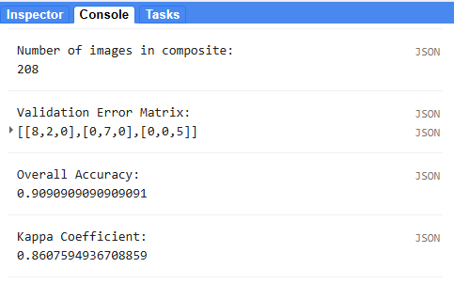
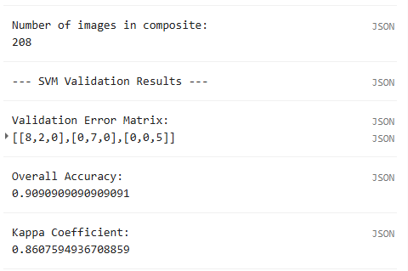
Classification Approaches
Two classification techniques were tested:
  Random Forest
  Support Vector Machine (SVM)
Both models were trained using the same training dataset (Training-80%, Testing- 20%)
Evaluation Findings:
Both are coming with same Accuracy
Final Decision:
  Selected Random Forest for further analysis
  Because it require sample training sample.

Slide 8
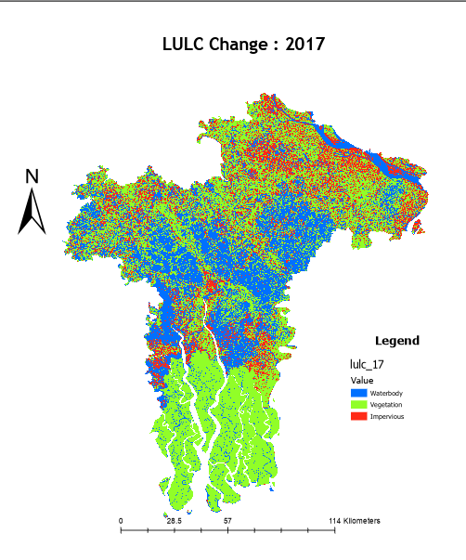
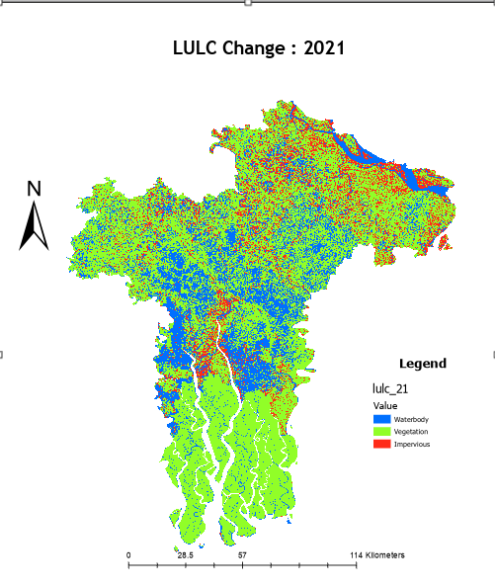
LULC Results (2017 - 2021)
Variable | 2017 Area | 2021 Area | Change
Waterbody | 5792.3682 | 4329.1111 | -1465.25
Vegetation | 9043.1522 | 11456.4846 | 2413.33
Impervious | 3256.3166 | 2306.2413 | -950.07

Slide 9
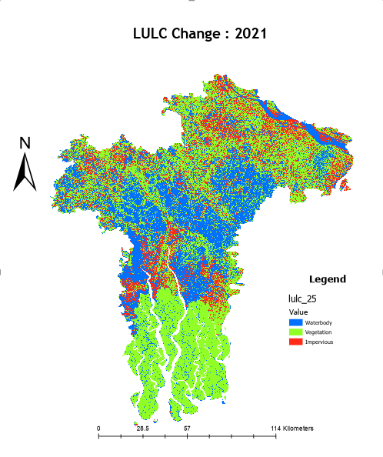
LULC Results (2021 - 2025)
Variable | 2021 Area | 2025 Area | Change
Waterbody | 4329.1111 | 6076.9683 | 1746.89
Vegetation | 11456.4846 | 8933.745 | -2522.26
Impervious | 2306.2413 | 3081.1237 | 775.12

Slide 10
Change : 2017→ 2025

Slide 11
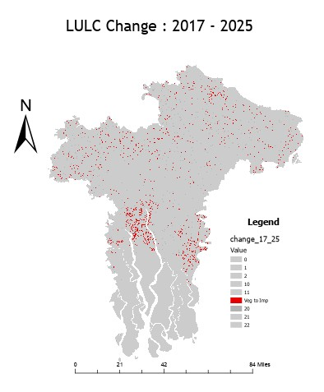
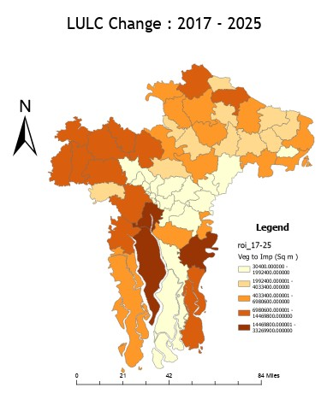
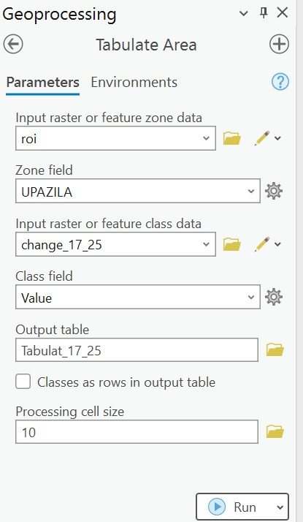
Raster Calculator -> Zonal Statistics

Slide 12
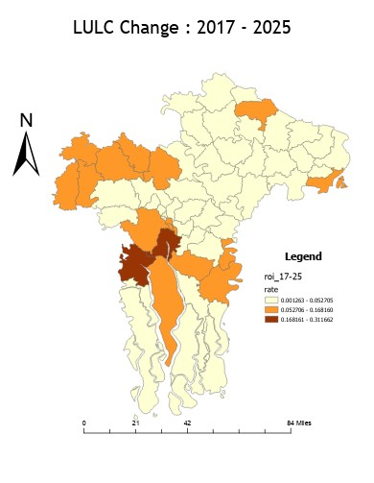
Change Rate (2017-2021)

Slide 13
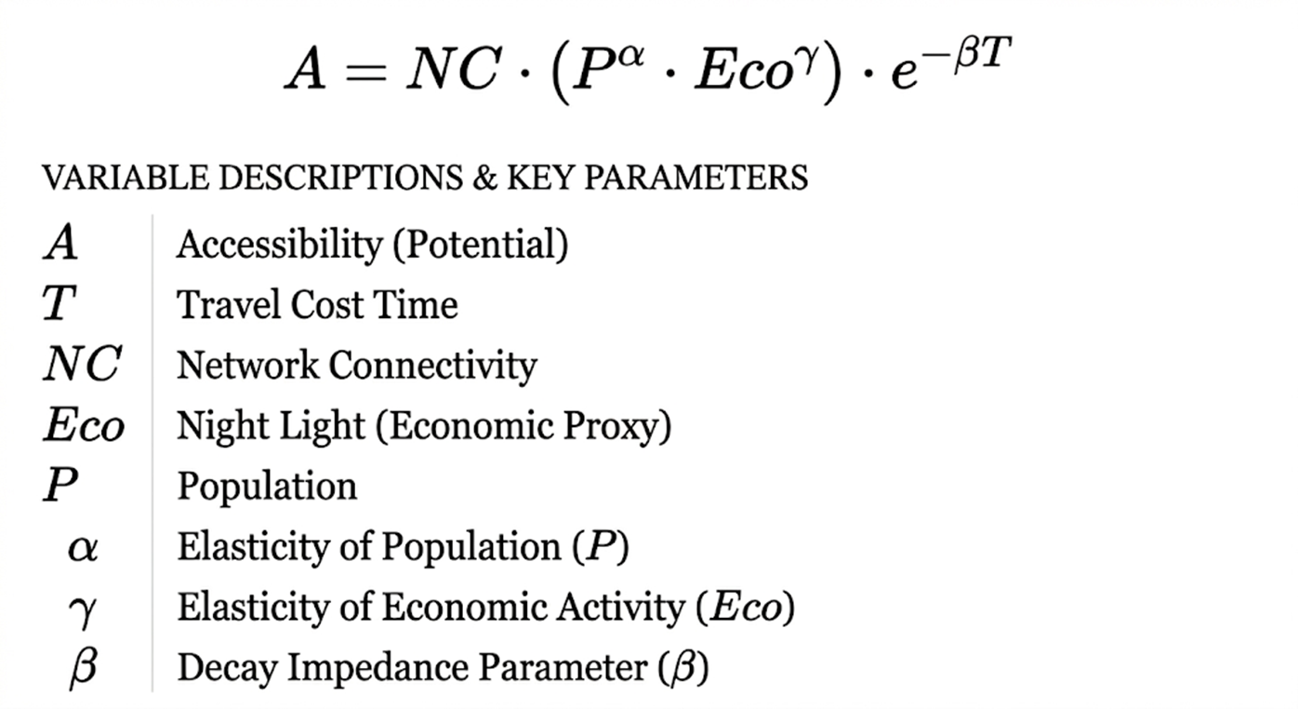
Result and Discussion

Slide 14
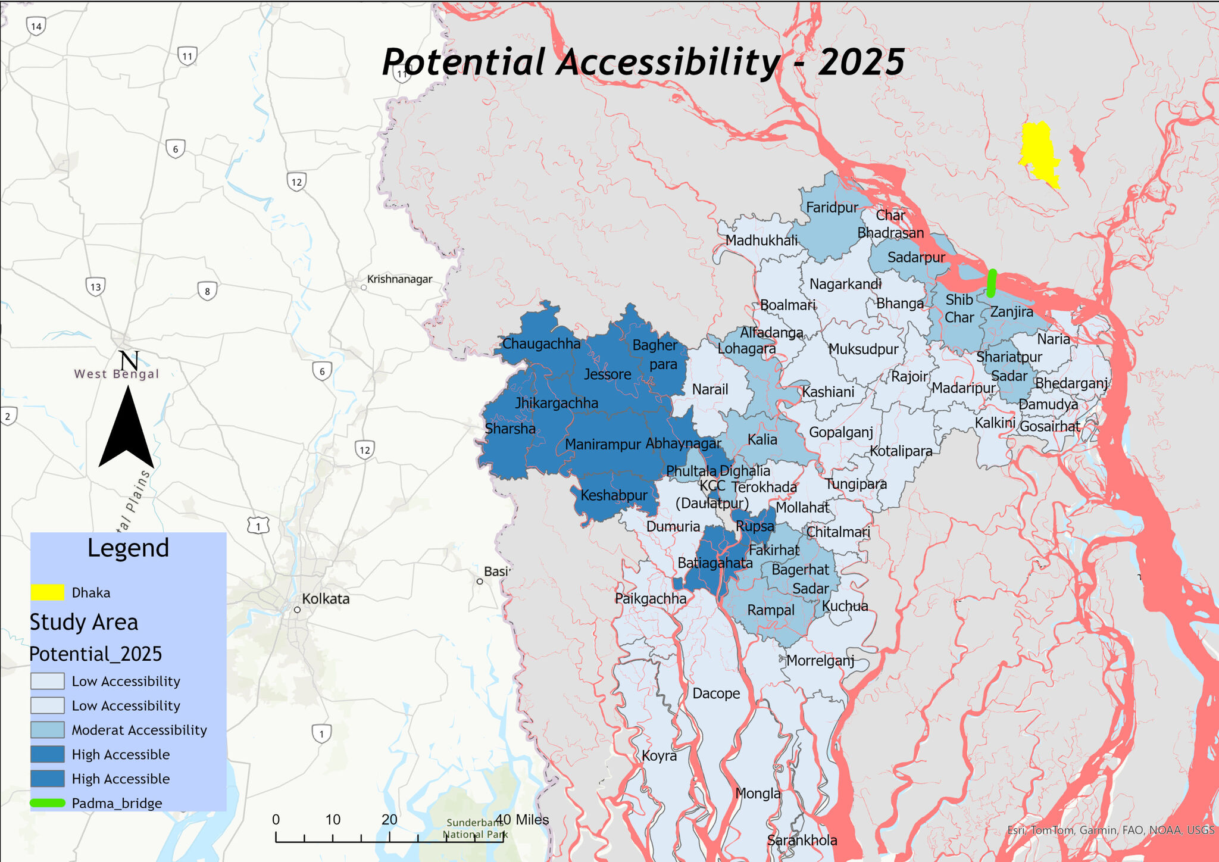
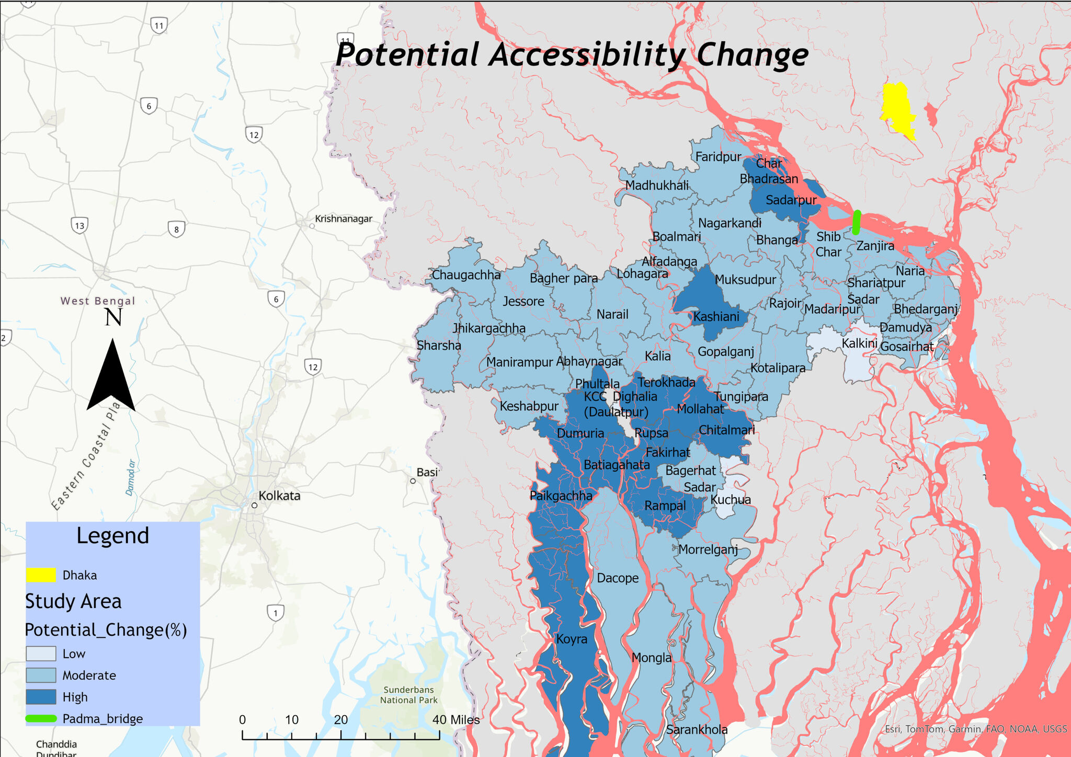
Result and Discussion

Slide 15
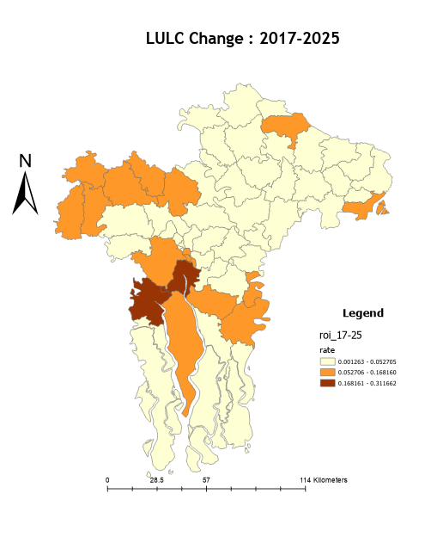
Result and Discussion

Slide 16
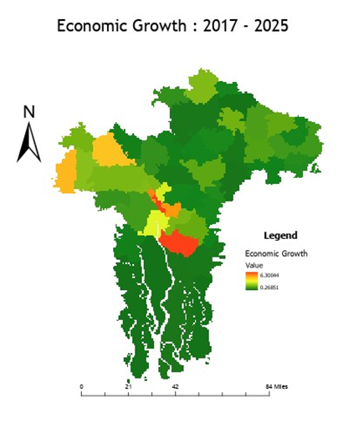
Result and Discussion

Slide 17
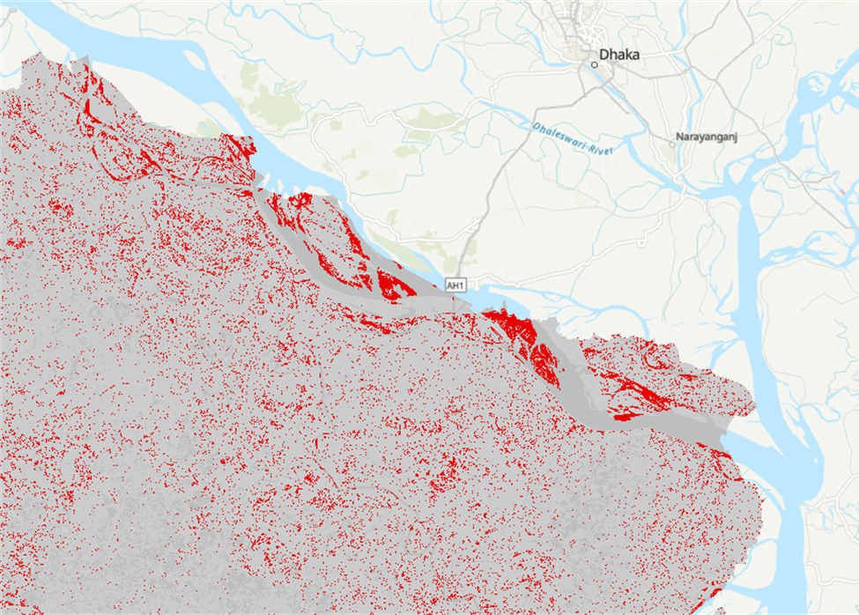
Limitations
Due to the spectral reflectance classify sands and impervious in some area
Only 3 class is not enough to capture the variability of surface.( Agricultural land and Bair soil)

Slide 18
Future Scope
I more robust classification can be done to measure the loss of agricultural land.

Slide 19
Q&A

