Slide 1


Student Voting system USING Basic Python Programming
NAME: SAZZAD hOSSAIN
Batch: CBF-024 Basic Python
Programming

Slide 2

INTRODUCTION
This system aims to provide a secure and user-friendly voting platform for students.
It facilitates easy registration, voting, and result viewing.

Slide 3
OBJECTIVES
Goal of the project
Enable student registration.
Allow students to vote for candidates.
Display voting results dynamically.
Ensure secure and efficient data handling.

Slide 4
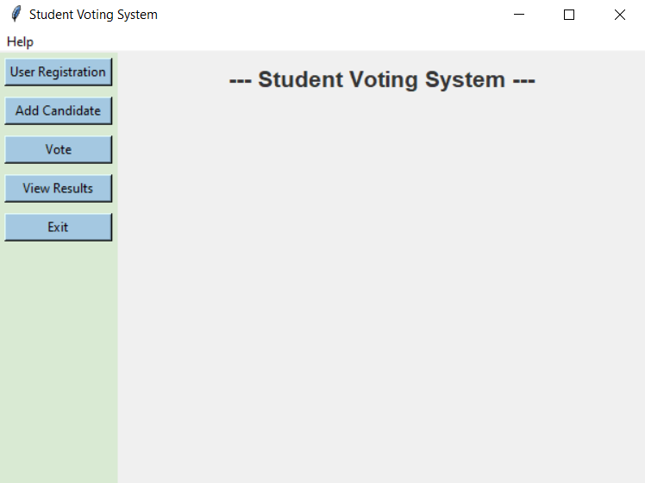
FEATURES
User Registration
Candidate Management
Voting Process
Results Viewing
Figure 1: Main Menu

Slide 5
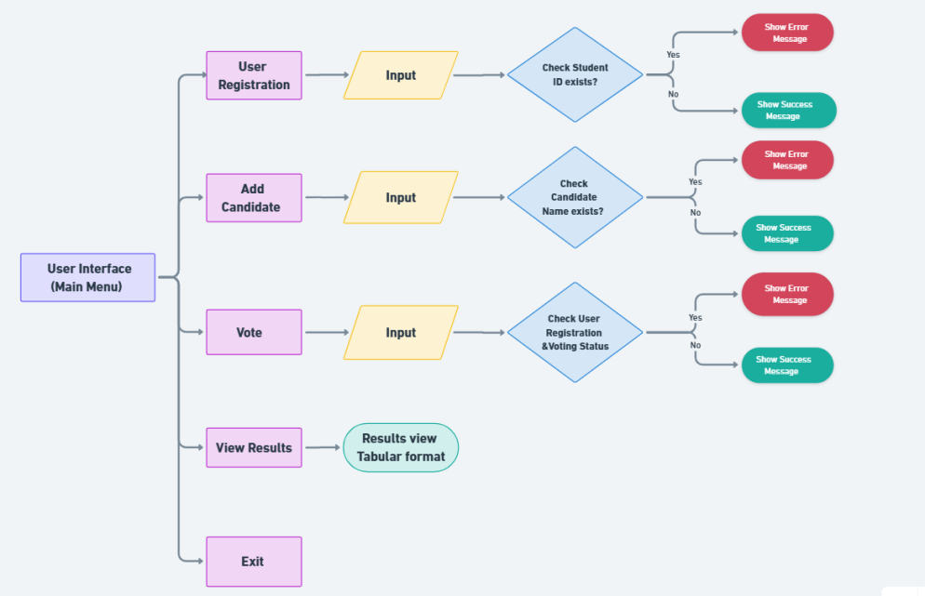
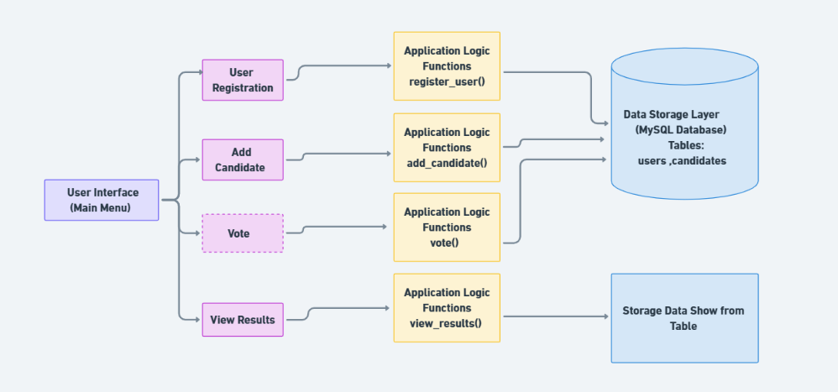
Student Voting System Process
Back-End Process Diagram
Font-End Process Diagram
Figure 2: Back End
Figure 3: Font End

Slide 6
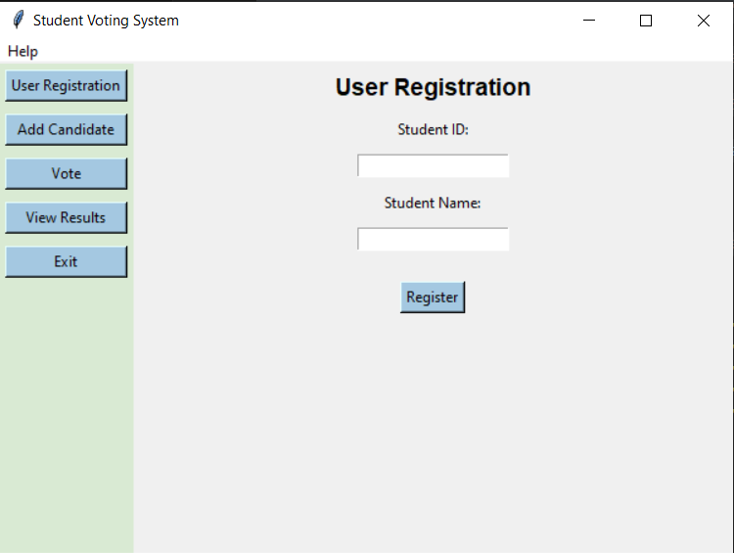
USER REGISTRATION
The registration process includes:
Input validation for student ID and name
Ensuring no duplicates in registration
Figure 4: User Entry

Slide 7
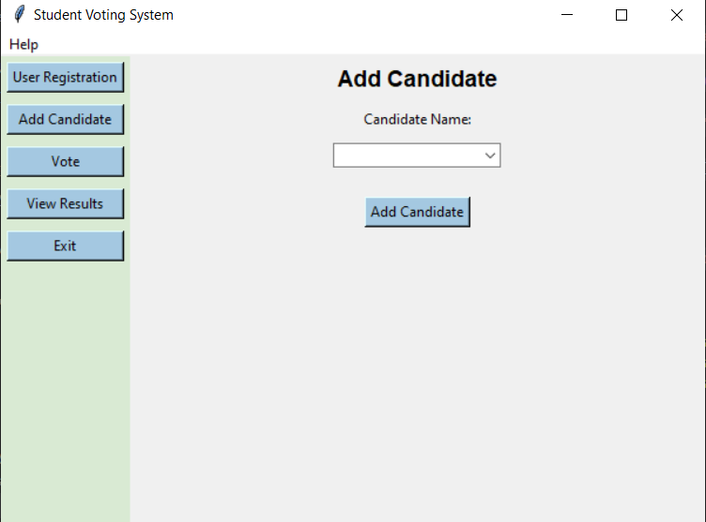
ADDING CANDIDATES
Candidates can be added through:
A dedicated form
Validation checks to prevent duplicates
Figure 4: Candidate Enter

Slide 8
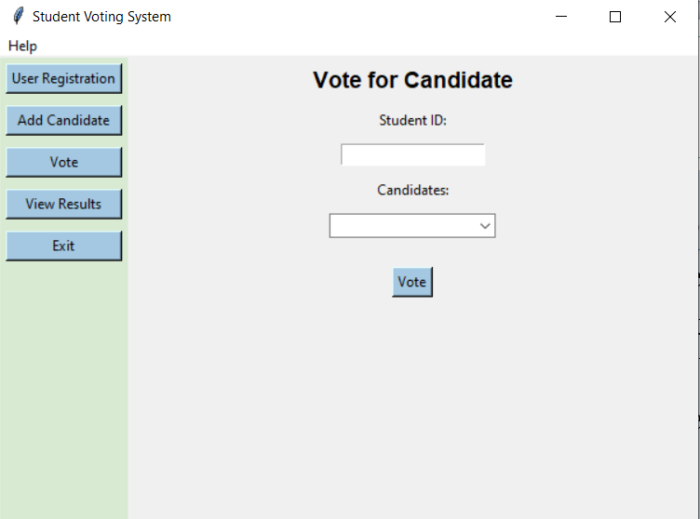
VOTING
The voting process includes:
User selects a candidate
Error handling for already voted users
Confirmation before finalizing vote
Figure 5: Vote Process

Slide 9
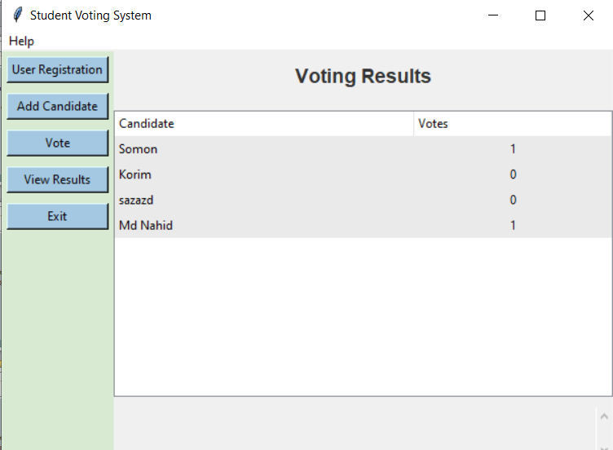
Results Viewing
Users can view voting results:
Display format using tables
Real-time updates on votes received
Figure 6: Result View

Slide 10

Technologies Used
Python for backend logic
Tkinter for GUI development
MySQL for database management
pymysql for database connectivity
Figure 7 : Using Technology

Slide 11
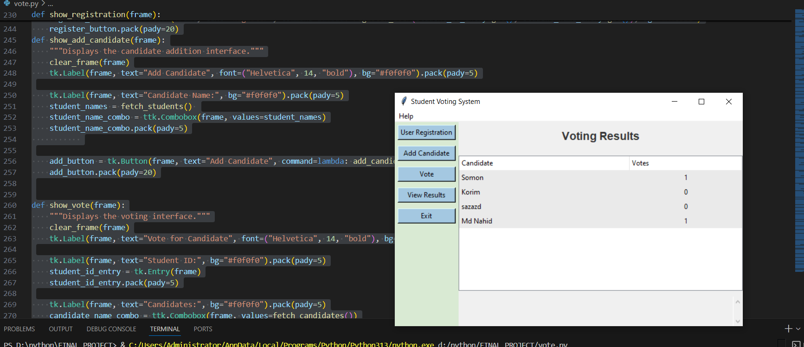
RESULTS
Figure 5: Text input
Figure 6: Spam Detected
Figure 8 : Results Output

Slide 12

CHALLENGES
Technical Issues :
Difficulty in integrating the voting system with existing student databases and management systems.
User Interface :
Creating an easy-to-use interface for all students, regardless of their tech skills.
Database Management :
Managing a reliable database to store user info and votes efficiently.

Slide 13

CONCLUSION
The Student Voting System provides a secure and efficient platform for student voting.
Future enhancements could include online voting and user authentication.

Slide 14

DISCUSSION
Q&A

Slide 15

THANK YOU!

