Slide 1
Students Software Management

Slide 2

Presentation on Students Software Management System
Course No: CSE-328
Course Title: Software Engineering Lab
Submitted by:
Md.Mahabubur Rahman ID:444
Ranjit Shing ID:400
Md.Sazzad Hossain ID:416
Md.Rakibul Basher ID:400
Mehedy Hasan Bappy ID:444
Sumaiya Khandoker Priya ID:400
Abul Kalam Azad ID:444
Supervised by:
Sudipto Chaki
Lecturer, Dept. of CSE, BUBT

Slide 3
Objective
To know student course and Result.
Update result to Admin.
Subject combination.
Manage combination.

Slide 4
Methodology

Slide 5
Admin
Admin
Change Password
Create
subjects
Subjects
Add Result
Result
Log in
Manage
subjects
Students
Manage
Results
Students
classes
Add
Subjects
combination
Add
Students
Manage
Students
Create Classes
Manage Classes
Log Out

Slide 6
Used Model
For our project we use incremental model.
Because at a time we develop our project according to C P M C D.
C
P
M
C
D

Slide 7
Used Model
Using incremental model purpose of:
This software will be generated quickly during the software life cycle.
Thought the development stages changes can be done.
Errors are easy to be identified.

Slide 8
Used Technology
For Our project we use
Xampp
Sql server-2012
Language
PHP
Html
CSS
Bootstrap
Java script

Slide 9

Each Steps
For this project at first we see two fields.
1.Admin Log in.
2.For Students.

Slide 10

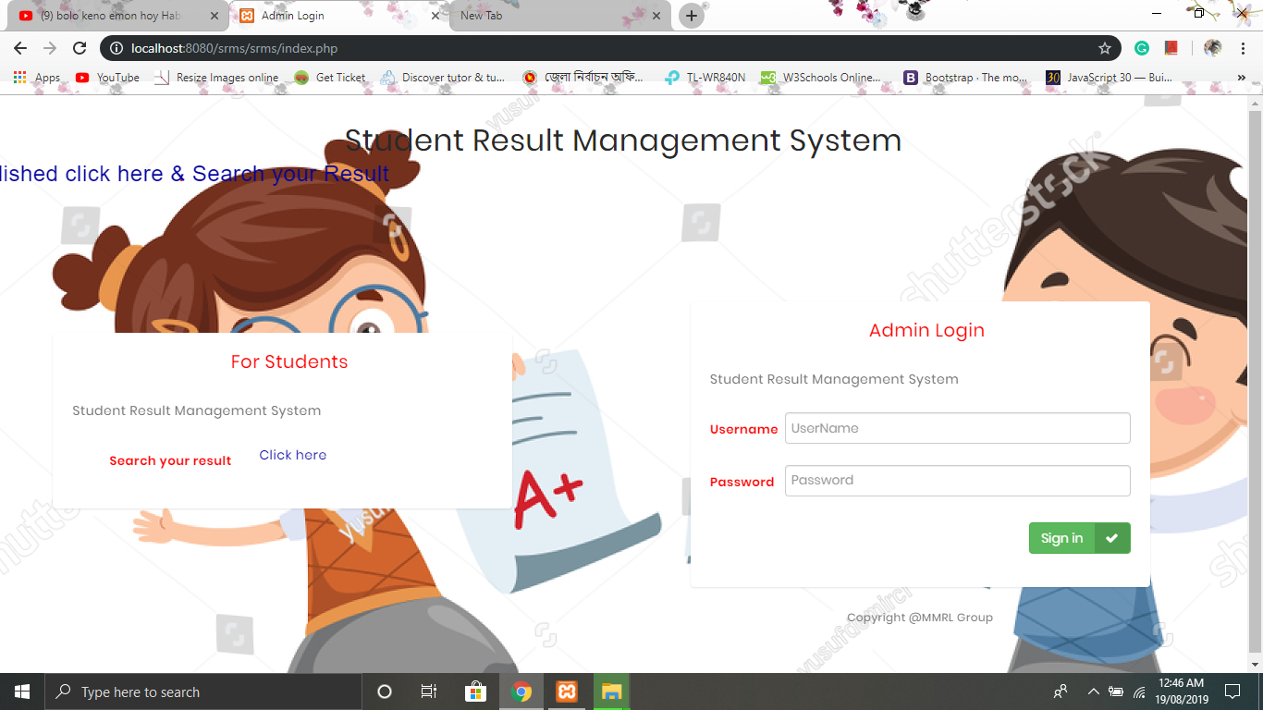
Each Steps

Slide 11
Each Steps
For students filed using ,students know their results.
For using admin log in fields.After log in we see four fields →
1.Registered users.
2.Subjects listed.
3.Total classes listed.
4.Result Declared.

Slide 12
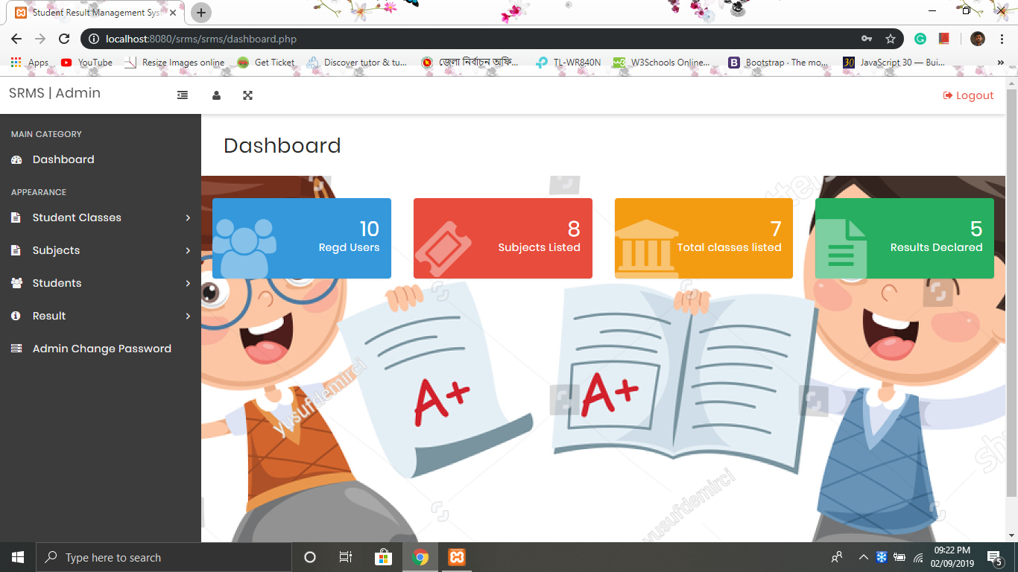
Each Steps

Slide 13
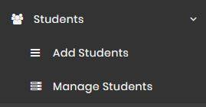
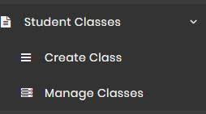
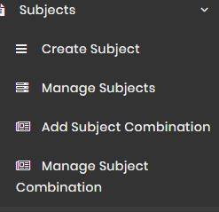
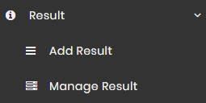
Each Steps
Students Student classes
Subjects Result

Slide 14
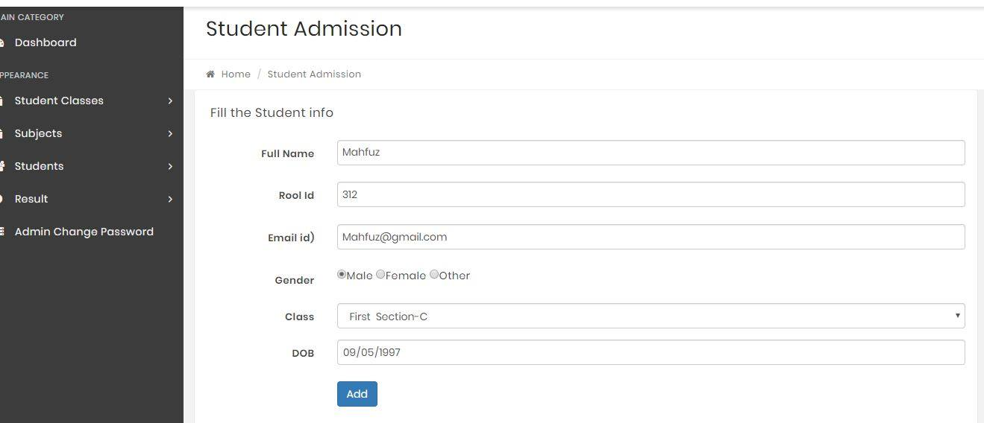
Current Database

Slide 15
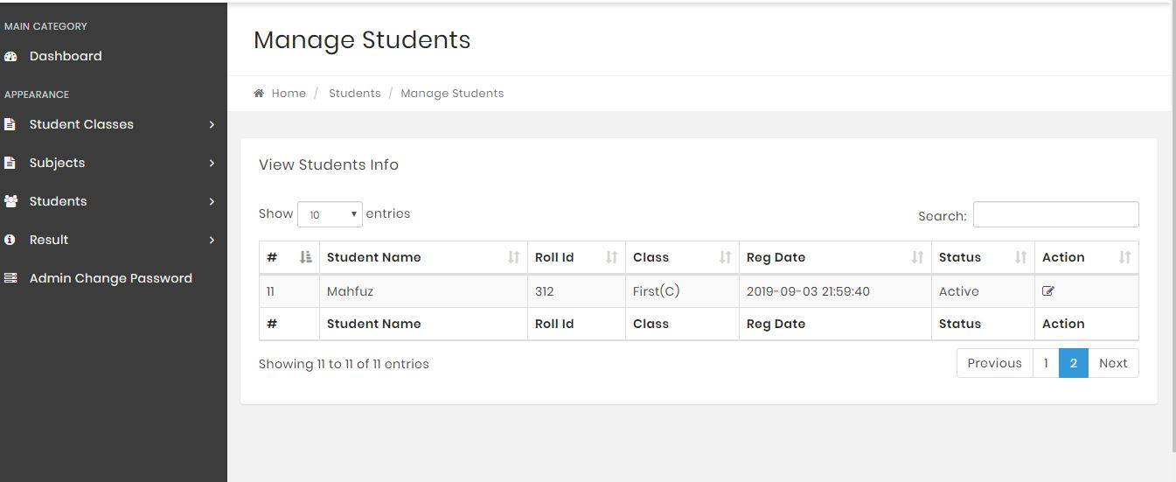
Current Database

Slide 17
Current Problems
Users can’t change password.
No log in form for users.
No payment system.
Admin only control whole system.
Users only audience this project.

Slide 18
Outcomes
Easy to access.
Simple project.
Students easily see results any time.
Admin change anything any time.
Users can respond to each building.

Slide 19
Conclusion
Better performance by the students.
Better communication.
Simplifying and streamlining all the tasks.
Easy access to all.

Slide 20
Future Works
We hope that in future this project will give more benefit , more helpful.
It creates new software to help all users.

Slide 21
References
Complete this project we use some references
https://www.w3schools.com/
https://www.google.com
https://www.youtube.com/
https://getbootstrap.com/

Slide 22


Slide 23

Any questions ??

