Slide 1
Computer Security Section – A Group - 1
MD. Murad Hossain (011192112)
Md Sazzad Mazumder (011201285)
Imtias Ahmed (011192069)
Golam Rezvi Rafi (011192105)

Slide 2
Intrusion Detection System
Overview of Intrusion Detection System (IDS) and its different detection methods, with a project to detect database intrusions.

Slide 3

Introduction to IDS
- IDS stands for Intrusion Detection System.
- It is used to monitor a network or system for malicious activity or policy violations.
- If any intrusion is detected, it reports it to the administrators.
Photo by Pixabay

Slide 4

Types of IDS
- There are two main types of IDS: NIDS (Network Intrusion Detection System) and HIDS (Host Based Intrusion Detection System).
- HIDS monitors important operating system files, whereas NIDS analyzes incoming network traffic.
Photo by Pixabay

Slide 5

Detection Methods and Applications
- IDS detection methods include Signature-based IDS and Anomaly-based IDS.
- Signature-based IDS uses patterns to detect an intrusion, while Anomaly-based IDS detects deviations from a model of "good" traffic.
- IDS can be used in a Java project to detect database intrusion, with an admin panel able to preview user information and an intruder triggering a warning message.
Photo by Pixabay

Slide 6
Problem Statement
- Current IDS not effective in detecting and preventing all types of cyberattacks
- System lacks ability to detect sophisticated and evasive attacks
- Generates a high number of false positives
- Need to develop and implement an improved IDS

Slide 7
Motivation
- Provide early warning and defense against cyberattacks
- Identify unauthorized access to computer systems or networks
- Provide insights into weaknesses in security posture
- Guide improvements to prevent future attacks

Slide 8
Literature Review of Intrusion Detection System
(1)The paper [1] showed an overview of detection methodologies, approaches and technologies for IDSs. Also mentioned two popular and open-source tools implemented by the rule-based approach (Snort and ClamAV). Snort explores the Aho-Cora algorithm for exact match signature detection and ClamAV uses a variant of the same algorithm to process the signatures with regular expression. These rule-based detection could be time consuming because these examines multi criteria in a rule. However, if IDS uses GPU along with CPU traffic processing throughput will raise efficiently.
(2)The paper[2] provides a literature review on machine learning (ML) and deep learning (DL) approaches for network intrusion detection systems (NIDS). The authors categorize the surveyed literature based on the ML and DL algorithms used in NIDS and compare their performance using different evaluation metrics. They also discuss the challenges and future directions in the field of NIDS.

Slide 9
Why we use JavaFX, Java Swing, and JDBC
JavaFX and Java Swing provide rich GUI for easy navigation and interaction with the software
JDBC allows for seamless integration with relational databases
Java is a widely used language with strong community support and regular updates

Slide 10

Plan
- Develop a database to store user information securely.
- Implement strong encryption methods to protect user data.
- Use access control to restrict unauthorized access.
- Build a programming class that enables user and admin login.
- Create a display table that shows user information.
- Ensure the programming class works seamlessly with the database.
Photo by Pixabay

Slide 11
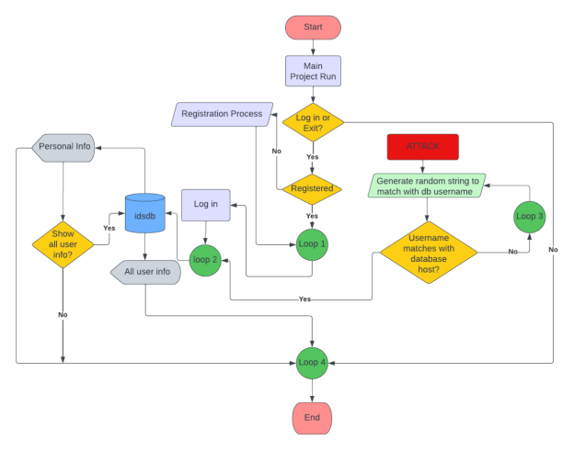
Design/Flowchart

Slide 12
Complex Engineering:
Complex Engineering Problems(P):
P1 | Depth of Knowledge required | Yes
P2 | Range of conflicting requirements | Yes
P3 | Depth of analysis required | Yes
P4 | Familiarity of issues | No
P5 | Extent of applicable codes | No
P6 | Extent of stakeholder involvement and conflicting requirements | No
P7 | Range of conflicting requirements | Yes
P1 | Software knowledge & Mathematical knowledge (K3, K4). Software design (K5) and development (K6). study of research on Mathematical problems(k8).
P2 | Involve wide-ranging or conflicting technical, engineering and other issues
P3 | Have no obvious solution
P7 | Subsystems (Test module, Analysis module etc.) worked independently, later coordinated

Slide 13
Complex Engineering Activities(A):
A1 | Range of resources | Yes
A2 | Level of interaction | Yes
A3 | Innovation | Yes
A4 | Consequences for society and the environment | No
A5 | Familiarity | No
A1 | Involve the use of diverse resources (People, money, equipment, materials, information and technology)
A2 | Require resolution of significant problems arising from interaction between wide-ranging or conflicting technical, engineering or other issues
A3 | Involve creative use of engineering principles and research-based knowledge in novel ways

Slide 14

Conclusion
- Successfully detects intrusion in databases
- Can manage and create connections with databases to store and preview information
- Can intrude as an admin to access all data present
- Limitation: Attacker cannot delete any stored data from the database
- Helps with building future projects efficiently
Photo by Pixabay

Slide 15
Thank you for your time 😊

