Slide 1
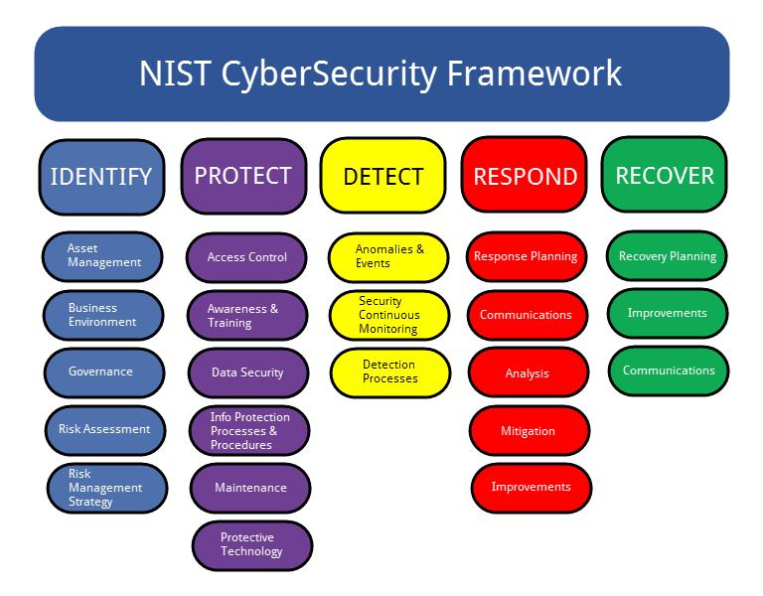
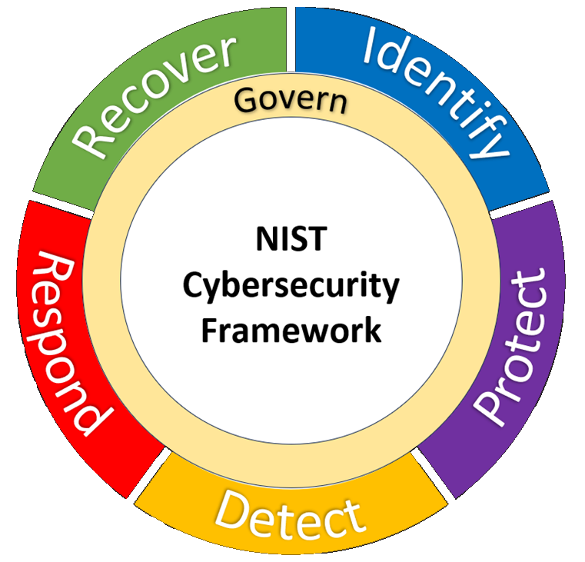
NIST CSF / RMF
Building a “Command Post CSF Profile”
Users & Uses
ID
Asset Inventory
ID.AM
ID.RA-02/03
Threat Assessment
Network Topologies
ID.AM
Existing Vulnerabilities
ID.RA
Risk Assessment
Plan
(Respond Recover)
Protect
Monitor
Residual Risks

Slide 2
MoD’s SbD
https://www.digital.mod.uk/secure-by-design/
SbD is only a coarse ‘checklist’ overlay on whatever
framework you use, not a process in itself
What you do and why
What you protect
How it’s used
Boundaries
Define Context
Threat Assessment
Risk Assessment
Risk Appetite
Controls
Manage
Residual Risks

Slide 3
“Intelligence Preparation of the Environment”
Threat Actors
(Who)
Locations
Information Environment
Human Environment
Physical Environment
COWARD
General Motivation
Operational Area Evaluation
Threat Assessment
Range/Reach
Centre of Gravity
Offensive
Situation Integration
Movement Corridors
Key / Critical Places & Spaces
Enemy Courses of Action
Target Lists
FACES
Indicators & Warnings
Monitoring
NAIs & TAIs
FACES: Evaluating Courses of Action
COWARD: Properties of Threat Actors to consider

Slide 4
IT Space
Actual,
Expected,
Potential
Users & Assets
Threat Assessment
Situation Integration
Offensive
Centre of Gravity
Attack Options
Target Lists
FACES
Defend
(Protect)
Monitoring
(Detect)
Residual Risks

Slide 5
Boundaries
What you do and why
Combined™ Battlefield Systems Assessment
What you protect
General & Specific Motivations
Routes in and out
Threat Actors
(Who)
How it’s used
Connections within
Locations
COWARD
Range/Reach
Space
Actual,
Expected,
Potential
Users & Assets
Threat Assessment
Situation Integration
Offensive
Key / Critical Places & Spaces
Centre of Gravity
Attack Surfaces, Vectors
Attack Options
Target Lists
Defend
(Protect)
FACES
Monitoring
(Detect)
Indicators & Warnings
Residual Risks

Slide 6





Technical
Physical
Controls
Administrative

