Slide 1

Ecuador's Biodiversity at Risk: Confronting the Urgent Threat of Climate Change
Climate change is no longer a future threat; it is a current issue that affects Ecuador, one of the most biodiverse countries in the world. According to the WMO (World Meteorological Organization), concentrations of carbon dioxide (CO₂), methane (CH₄), and nitrous oxide (N₂O) reached record levels in 2023.
NASA SPACE APP CHALLENGE
CYBER_CODE_WIZARDS

Slide 2
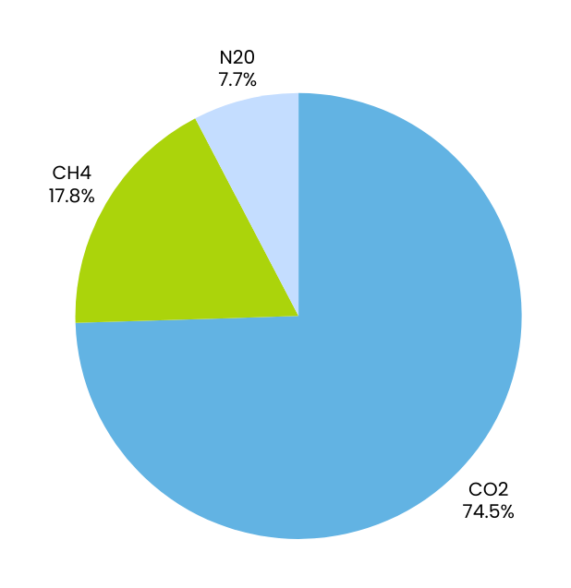
National Context
Direct Impact:
Public Health:
According to Savalnet, the greenhouse effect has increased the transmission of vector-borne diseases such as dengue in Ecuador, with a 371% rise in cases compared to the same period in 2023.
Food Production:
A 1% increase in global GHG concentrations can reduce Ecuador's agricultural output by up to 30%, affecting food security and rural economies.
Biodiversity:
The increase in GHG has caused coral bleaching in the Galápagos (ECOMARES) and the loss of 50% of glaciers in Ecuador, affecting endemic species such as the Galápagos penguins and the spectacled bear.
Main Emitting Sectors in Ecuador:
Energy (46.63%), Land Use and Forestry (25.35%), Agriculture (18.17%), Industrial Processes (5.67%), and Waste (4.19%) (FARO).
According to Ecuador’s National GHG:

Slide 3

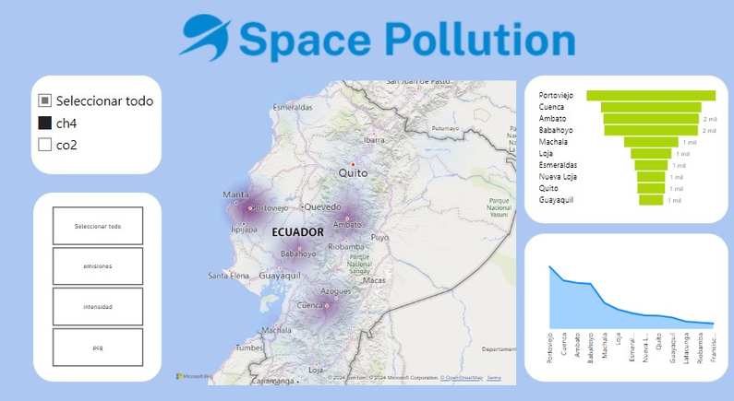


Our Solution: Space Pollution
At Cyber Code Wizards EC, we believe that the first step to solving a problem is being able to see it clearly. That’s why we created Space Pollution, a platform that uses satellite technology and real-time analysis to identify and track sources of greenhouse gas emissions, such as carbon dioxide and methane leaks. With this information, we empower organizations to make effective decisions that transform the environmental reality of their surroundings, aligning with Sustainable Development Goal (SDG) 13: Climate Action, to reduce emissions and promote a more sustainable future and (9) Industry, innovation and infrastructure.
Our web app identifies greenhouse gas emissions, empowering individuals and companies with accurate information.
ADVANTAGES
We identify sources of pollution so you can reduce your impact with precise data through our web app 'Space Pollution'.
General Public:
Real-Time Air Quality: Check the air quality you breathe and receive alerts on high pollution days.
Personalized Health Recommendations: Get specific health tips generated by AI.
Businesses:
Multi-Plant Satellite Monitoring: Oversee emissions across all your facilities and detect critical areas.
Heat Map Visualization: Identify emission hotspots for informed decision-making.
Early Warning System: Act immediately with recommendations when emissions exceed acceptable limits.

Slide 4




How does the app work?
What is the source of the provided data?
How does the web app work?
The web app features an interactive map of Ecuador displaying CO₂ and CH₄ pollution levels by province. Users can register to view general data or historical charts. The paid version offers detailed information, real-time alerts, and notifications about corrective actions and penalties. The platform is intuitive and allows users to customize their data visualization.
The information used is sourced from the NASA Space Apps Challenge and is based on open data from NASA and partner space agencies. This includes satellite data on CO₂ and CH₄ emissions (MODIS, OCO-2, VIIRS) and air quality. Additionally, it incorporates satellite imagery from the European Space Agency (Sentinel-5P) and regional data from the Mexican and Argentine Space Agencies. Locally, air quality and emissions data from Ecuador's Ministry of Environment and INAMHI are also integrated.
Where does the provided information come from?

Slide 5
Business Model and Value Proposition
BUSINESS STRATEGY: SCALABLE SUBSCRIPTION PLANS
He cost reflects the technological infrastructure necessary to process and store satellite data, develop emissions prediction and visualization algorithms, and overcome local challenges such as the geographical dispersion of industrial plants and the lack of integrated monitoring tools in Ecuador.
Target Market:
Companies, regulatory entities and the general public for emissions monitoring, regulatory compliance and information on air quality
Subscription Plans (Use two side-by-side sections)
Free Plan
Climate intelligence and environmental alerts for the general public.
Ideal for monitoring air quality and receiving personalized health recommendations.
Business Plan
$5,000 USD annually per monitored site.
Multi-site satellite monitoring, heat map visualization, early alerts for emission deviations, and environmental compliance certification.

Slide 6

KPIs and Success Metrics
Early Detection of Emissions:
Space Pollution uses satellite data and IoT sensors to detect CO₂ and CH₄ emission hotspots early, allowing for faster corrective actions.
Reduction of Industrial Emissions:
Measured in tons of CO₂ equivalent (CO₂e) mitigated annually at each monitored site.
User Adoption of Corrective Measures:
Percentage of companies implementing data-driven changes to reduce emissions.
Real-Time Air Quality Monitoring:
Tracks the Air Quality Index (AQI) in various locations and correlates it with company emissions data.
Impact in Ecuador:
National Monitoring Coverage:
Number of locations and industrial plants in Ecuador using continuous monitoring.
Regulatory Compliance:
Number of companies complying with environmental regulations due to monitoring and early alerts.
Environmental Certifications Issued:
Number of “Environmental Compliance Certificates” awarded to companies with sustained emission reductions.
Community Participation:
Number of citizen users contributing to collaborative traceability through the platform.

Slide 7
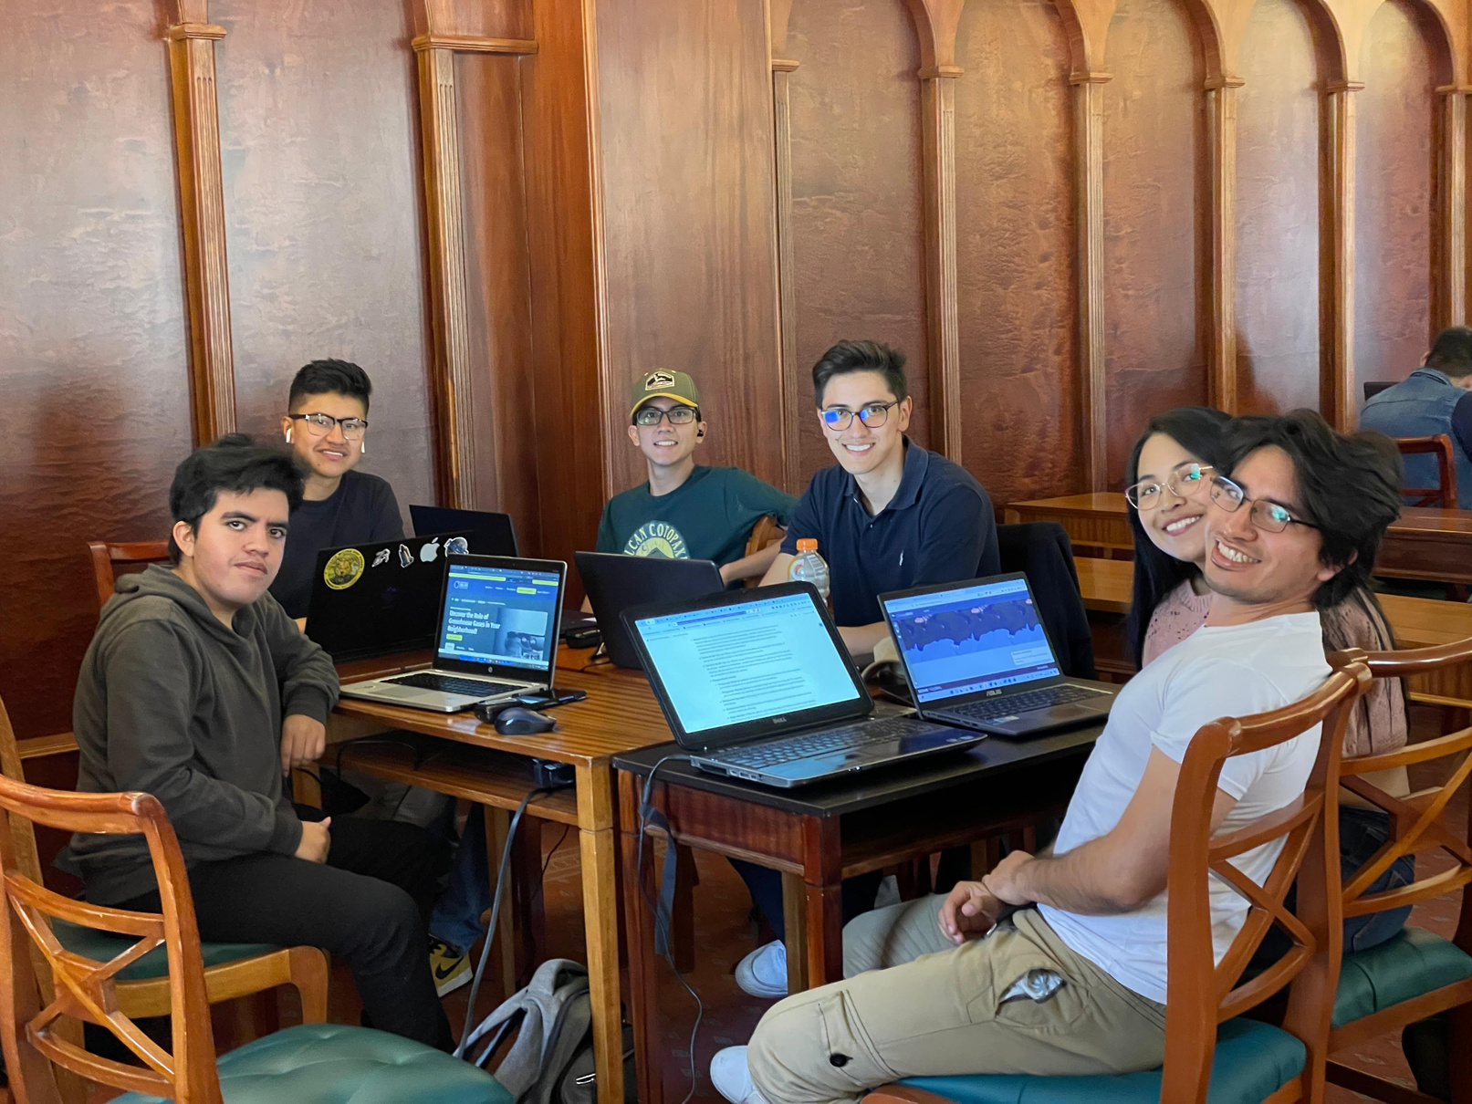
Team: Cyber_code_wizards
Alejandro Quishpe
Esteban Rivera
Marily Tituaña
Rafael Alomoto
Ethan López
Limber Gutierrez
Sebastian Rivera
NASA SPACE APP CHALLENGE
¡THANKS!

