Slide 1
Enhancing Data Security: A Capstone Project on Keylogger Implementation

Slide 2

Problem Statement
In today's digital age, where cybersecurity threats loom large, one of the significant concerns is the proliferation of keyloggers, stealthy software tools designed to monitor and record keystrokes on a user's computer without their knowledge.
Keyloggers pose a severe threat to individuals
and organizations as they can capture sensitive information such as passwords, credit card details, and other personal
data, leading to identity theft, financial loss, and privacy breaches.

Slide 3

Solution
The system improves keylogging implementation and security through error handling, modularization, optimized file writing, refined JSON usage, enhanced user interface and GUI, customizable logging, ethical considerations, compatibility testing, and thorough documentation.
Ethical considerations are prioritized to ensure responsible usage, with privacy warnings included to inform users about potential risks. Compatibility testing is conducted across various operating systems to guarantee seamless functionality across different environments. Thorough documentation, including detailed comments and explanations, is provided to facilitate understanding and ease of use for developers and users alike. These enhancements collectively contribute to a more robust, user-friendly, and secure keylogging system.

Slide 4


System Approach
Package the code for distribution. Provide comprehensive instructions for users on how to install and use the solution.
Continuously monitor user feedback. Promptly resolve any issues that arise. Regularly update the code to maintain effectiveness and relevance.

Slide 5
Algorithm
Initialization:
Initialize variables to store pressed keys, hold status, and key sequence.
Key Press Event:
Record pressed keys with "Pressed" label. If key held, record with "Held" label.
Key Release Event:
Record pressed keys with
"Pressed" label, if held, record with "Held" label, and generate JSON file.
Start Keylogger Function:
Initialize keyboard listener, update UI, and manage button states.
Stop Keylogger Function:
Stop keyboard listener, Update UI to indicate status. Manage button states.

Slide 6
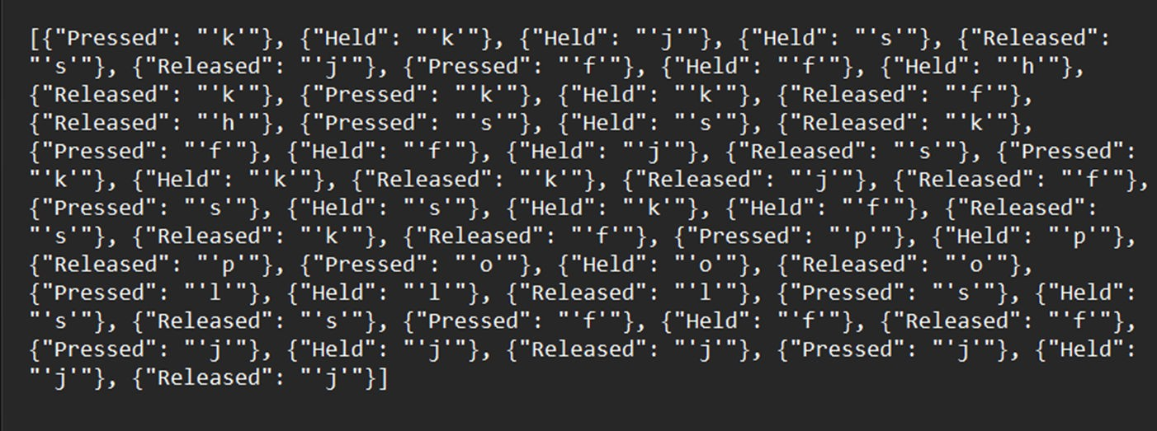
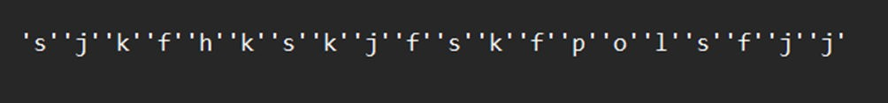
Result
Key_log.json
Key_log.txt

Slide 7
Future Implications
The future scope of keyloggers encompasses advancements in detection and prevention techniques, integration with machine learning for improved anomaly detection, proactive security measures such as behavior analysis, potential use in IoT security, and ethical applications like parental controls and employee monitoring. Overall, keyloggers are evolving as versatile security tools with a focus on enhanced cybersecurity resilience and ethical usage.

Slide 8
Conclusion
While keyloggers offer potential advantages in cybersecurity (detecting suspicious activity) and parental control (monitoring online safety), their ability to capture sensitive data raises ethical concerns. The future of keyloggers is uncertain.
Advancements in malware could bypass detection, making them harder to uninstall. Hardware integration (e.g., keyboards) could render them undetectable. Cloud storage of keystrokes might create new privacy risks.
Legal and ethical hurdles, including stricter regulations and emphasis on user consent, could significantly restrict keylogger use, particularly in workplaces.
To ensure responsible use, keyloggers should be employed for legitimate purposes with clear user consent. Robust security measures are essential to protect captured data. Transparency about keylogger monitoring is critical.
As public awareness of keyloggers grows, ethical considerations and potential misuse will likely receive more scrutiny, possibly leading to stricter regulations.

Slide 9
Thank You!

