Slide 1


Agentic AI: The Next Wave of Intelligence
This presentation explores the emerging field of agentic AI, its key characteristics, and potential to revolutionize how we interact with technology.
by Mosiuoa Wesi

Slide 2
What is Agentic AI?
Beyond Reactive
Proactive and Adaptive
Agentic AI goes beyond reactive AI, which simply responds to stimuli. It actively pursues goals and objectives, adapting its actions based on feedback and learning from experience.
Instead of passively waiting for instructions, agentic AI systems are proactive and adaptive. They can anticipate needs, generate solutions, and autonomously make decisions within defined parameters.

Slide 3
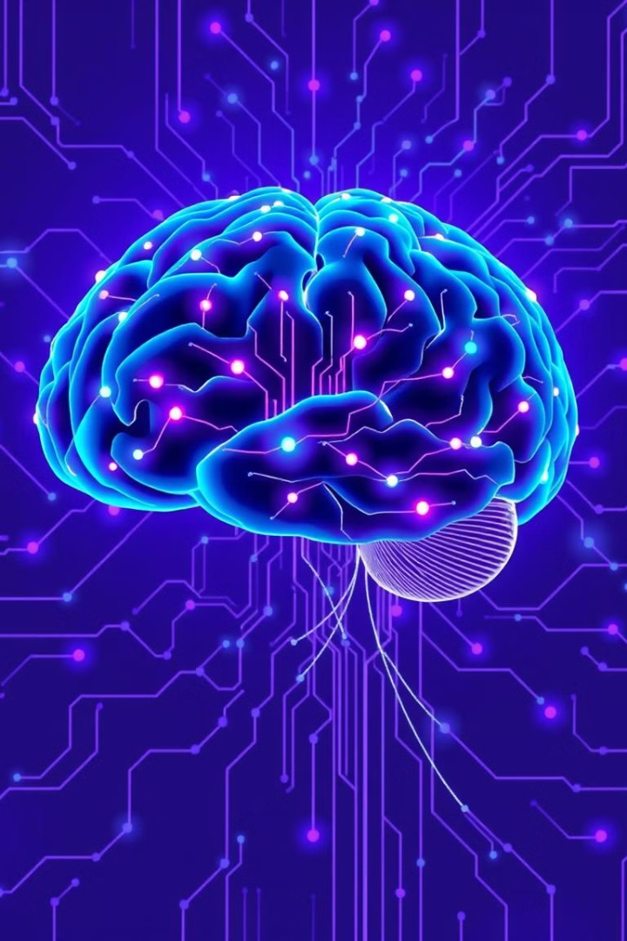
Key Characteristics of Agentic AI
1
Goal-Oriented
2
Autonomous
Agentic AI systems are designed with specific goals in mind, driving their actions and decisions.
They can operate independently, making decisions and taking actions without constant human intervention.
3
Self-Learning
4
Contextual Awareness
Agentic AI continuously learns and improves its performance based on data and feedback.
They can understand and adapt to changing contexts, making decisions based on real-time information.

Slide 4

Benefits of Agentic AI
Increased Efficiency
Enhanced Productivity
Agentic AI can automate tasks, optimize processes, and free up human resources for more strategic work.
By making intelligent decisions and taking proactive actions, agentic AI can boost productivity across industries.
Improved Decision-Making
Personalized Experiences
Leveraging data analysis and predictive modeling, agentic AI can support better informed decision-making.
Agentic AI can tailor experiences to individual needs and preferences, leading to greater customer satisfaction.

Slide 5





Agentic AI in Action: Use Cases and Examples
Manufacturing
Healthcare
Automated production lines, predictive maintenance, and quality control.
Personalized treatment plans, drug discovery, and patient monitoring.
Finance
Education
Fraud detection, algorithmic trading, and risk management.
Personalized learning, adaptive tutoring systems, and automated grading.

Slide 6
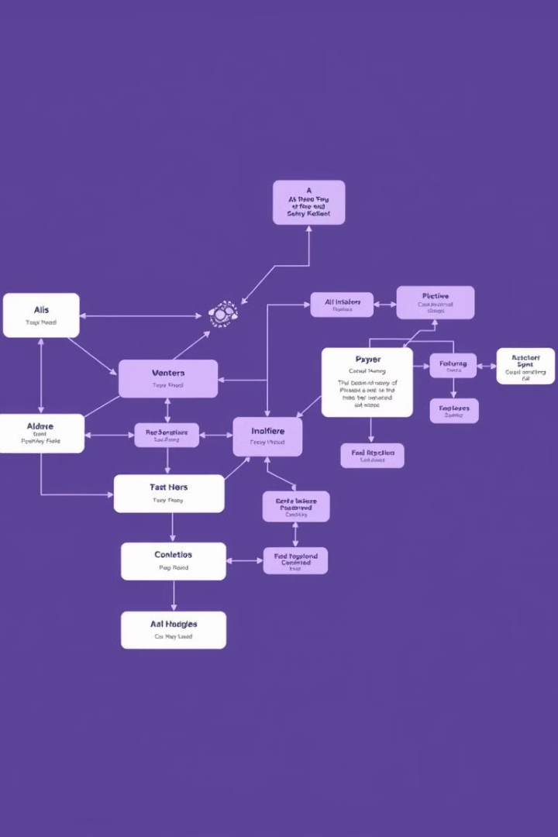
Agentic AI Design Patterns
1
Goal Decomposition
Breaking down complex goals into smaller, achievable tasks.
2
Reinforcement Learning
Training AI agents through rewards and penalties.
3
Hierarchical Planning
Organizing tasks and actions into a multi-level hierarchy.
4
Multi-Agent Coordination
Enabling multiple AI agents to work together towards a common goal.

Slide 7





Challenges and Considerations in Implementing Agentic AI
Ethical Implications
Bias, accountability, and responsible development.
Data Privacy and Security
Safeguarding sensitive data and preventing misuse.
Explainability and Transparency
Understanding how AI systems make decisions.
Integration and Compatibility
Seamlessly integrating AI systems with existing infrastructure.

Slide 8





The Future of Agentic AI and Emerging Trends
1
Human-AI Collaboration
2
Augmented Intelligence
3
Empowered Decision-Making
4
Adaptive Systems
5
Intelligent Automation

