Slide 1

Insights
Pre-work - 2

Slide 2
Agenda
Coupling
Interface
Rigidity
Fragility
Immobility
Duplicity
Opacity

Slide 3
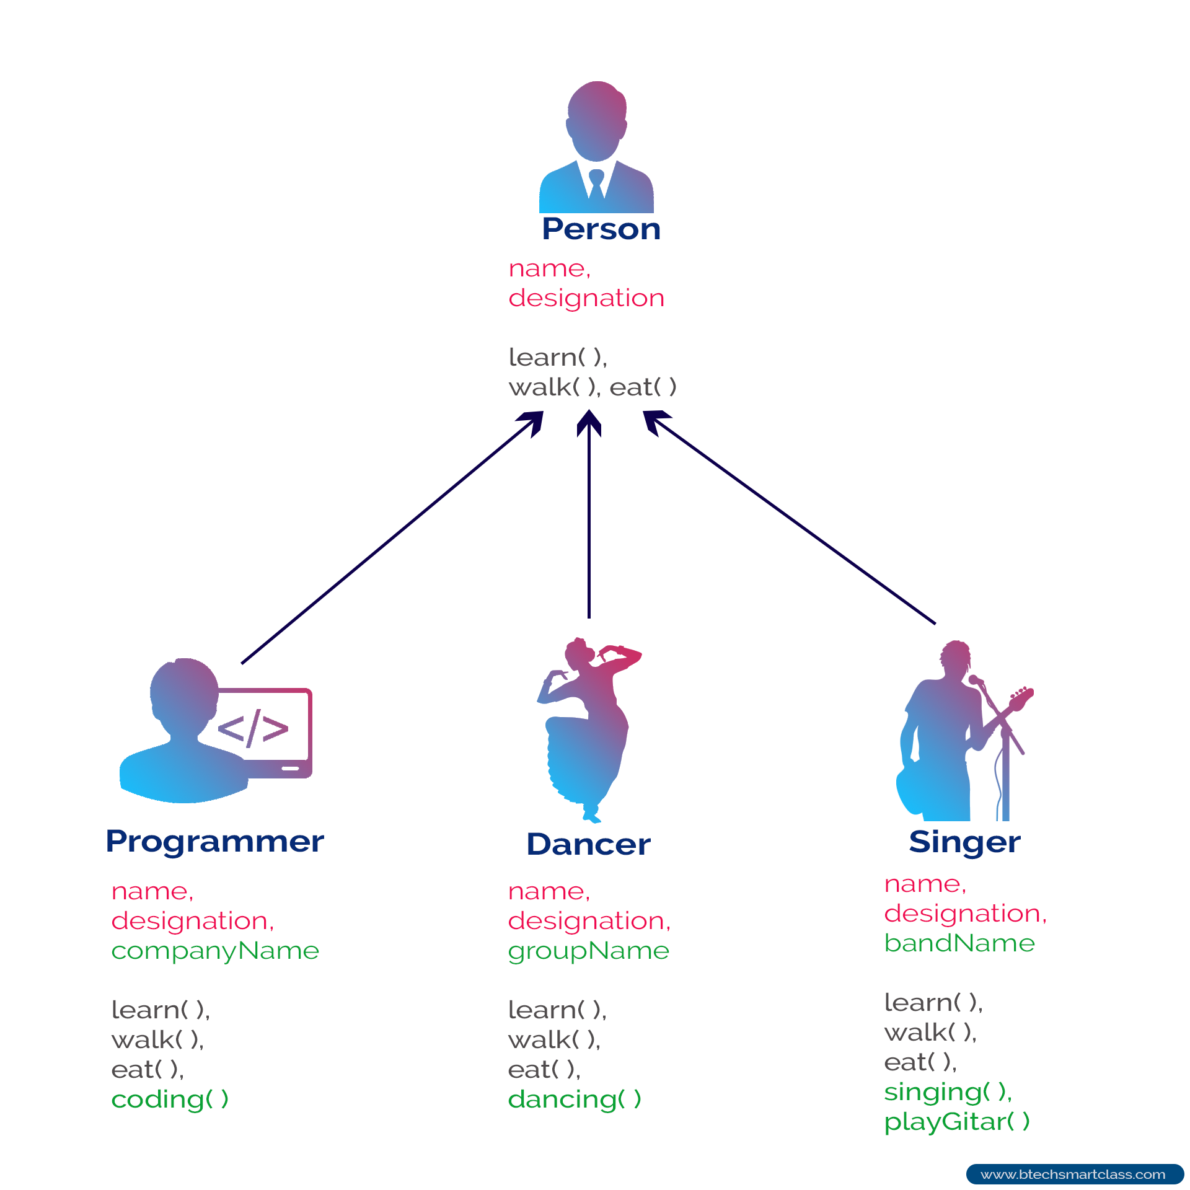
Inheritance

Slide 4
Coupling and Interfaces

Slide 5
Rigidity and Fragility – Code Walkthrough

Slide 6
Immobility

Slide 7
Duplicity and Opacity – Code Walkthrough

Slide 8
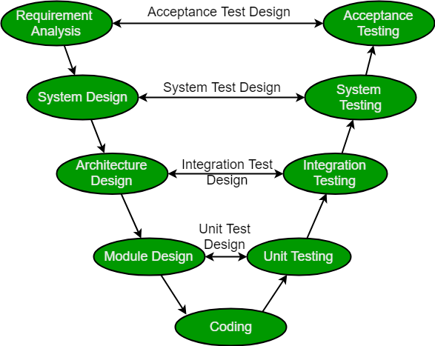
SDLC

Slide 9
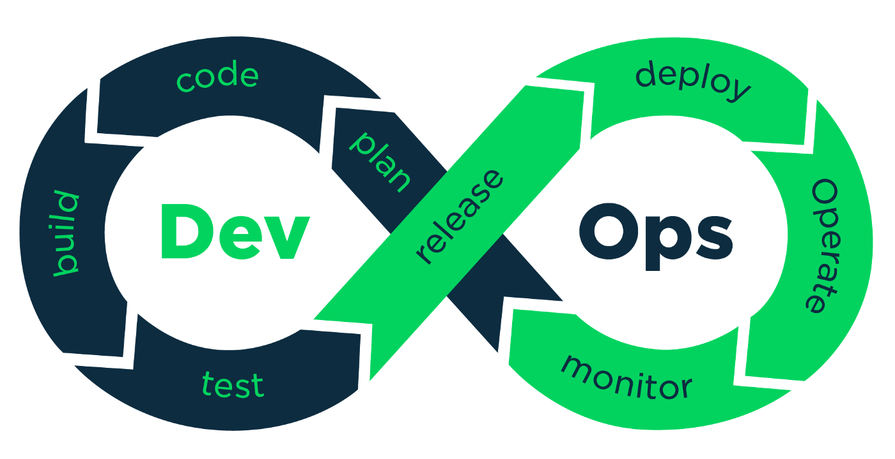

Slide 10
References https://docs.python.org/3/library/unittest.html https://docs.python.org/3/library/unittest.mock.html https://site.mockito.org/ https://docs.python.org/3/library/abc.html

