Slide 1
Project IV - GharBeti Solution to your Room Rental Problems
Presented By:
Bikash Gupta
Laxmi Gajurel
Pratik Subedi

Slide 2
Contents
Introduction
Abstracts
Objective
Features
Existing Systems
Tools
Gantt Chart(schedule)
Merits
Drawbacks

Slide 3
Introduction
GharBeti is a multi-platform app that can be run on Android, IOS, Windows and Browsers
It’ll help landlords and property managers to keep track of their rental units, tenants, and rental income
GharBeti makes it easy for landlords to manage their rentals online, from anywhere in the world
It is a flexible and scalable solution that can be customized to meet the specific needs of any landlord or property manager
Whether you manage one rental unit or one hundred units, GharBeti can help you save time and money

Slide 4
Abstract
GharBeti is aimed at providing a software solution for room rental businesses.
GharBeti will include the development of a software application that will allow users to manage their room rental business efficiently and effectively.
GharBeti will provide several features that will make it easy for users to manage their business, including the ability to add and remove rooms, set rental rates, track payments, and manage customer information.
GharBeti will also provide a report generation feature that will allow users to generate reports on their business activity.
The project is expected to be completed within 4 months.

Slide 5
Objectives
To reduce the hassle of searching for rooms on multiple websites.
To provide a platform for room owners to list their rooms and for renters to find rooms easily.
To offer a wide variety of rooms in different locations.
To give room owners the freedom to set their own prices.
To allow room renters to compare prices and reviews before making a decision.
To make it easier for room renters to pay for their rental.
To provide customer support for both room owners and renters.
To improve the overall experience of renting a room.
To allow room owners to manage their listings and renters to book rooms easily.
To provide a safe and secure platform for both room owners and renters.

Slide 6
Features
User-friendly interface: GharBeti has a user-friendly interface that makes it easy to find and book rooms for rent.
Advanced search options: GharBeti offers advanced search options that allow users to find rooms based on their specific needs.
Booking management: The portal provides a booking management system that helps landlords and renters to keep track of their rental agreements.
Payment gateway: The portal offers a payment gateway that allows users to pay for their room rental online.
Customer support: The Room Rental Portal offers customer support that helps users with any questions or problems they may have.

Slide 7
Existing Systems
99ACRES
NOBROKER
FLATCHAT
NESTAWAY
DalayDai

Slide 8
Tools
Frontend:
Flutter
Backend:
Django/ Firebase/Node.js

Slide 9
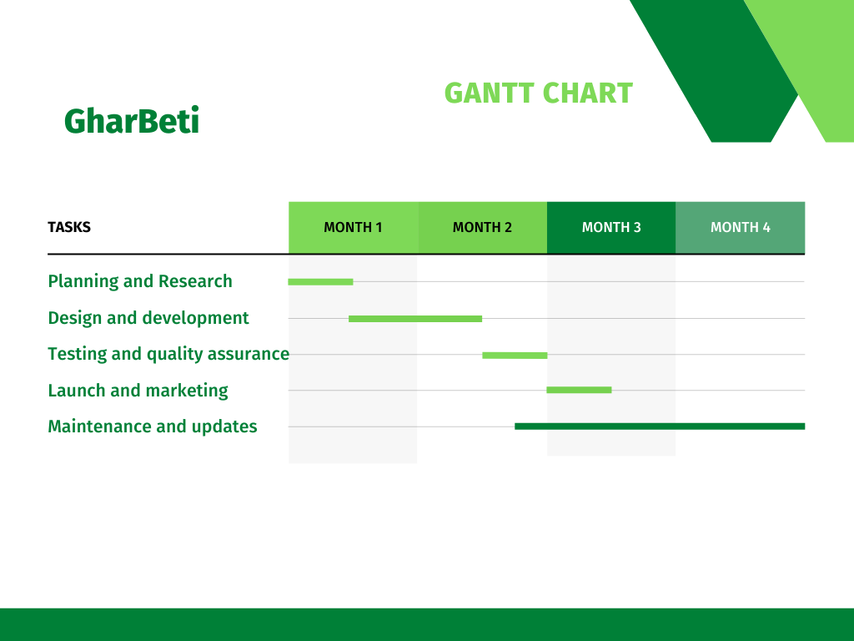
Gantt chart

Slide 10
Merits
GharBeti helps you keep track of your rental property and tenants.
You can use GharBeti to collect rent, track payments, and manage repairs and maintenance.
GharBeti can also help you find new tenants and market your property.
GharBeti can save you time and money by helping you run your rental property more efficiently.

Slide 11
Drawbacks
Doesn't contain any insurance module now.
Internet connection is required to appear places.

