Slide 1

Tribhuvan University
Faculty of Humanities and Social Sciences
A project presentation on
Smart Helpdesk
A Multi-Tenant Support Ticket Management System
Submitted by
Subham Bhandari (6-2-355-29-2021)
Utsav Karki (6-2-355-33-2021)
BCA 8th Semester, IV Year
Under the supervision of
Mr. Kamal Pathak
Department of BCA
Department of BCA, Everest College, Thapathali, Kathmandu | CACS452 Project III
Notes:
Greet the panel, introduce the team members and the supervisor, and state the title of the project.

Slide 2
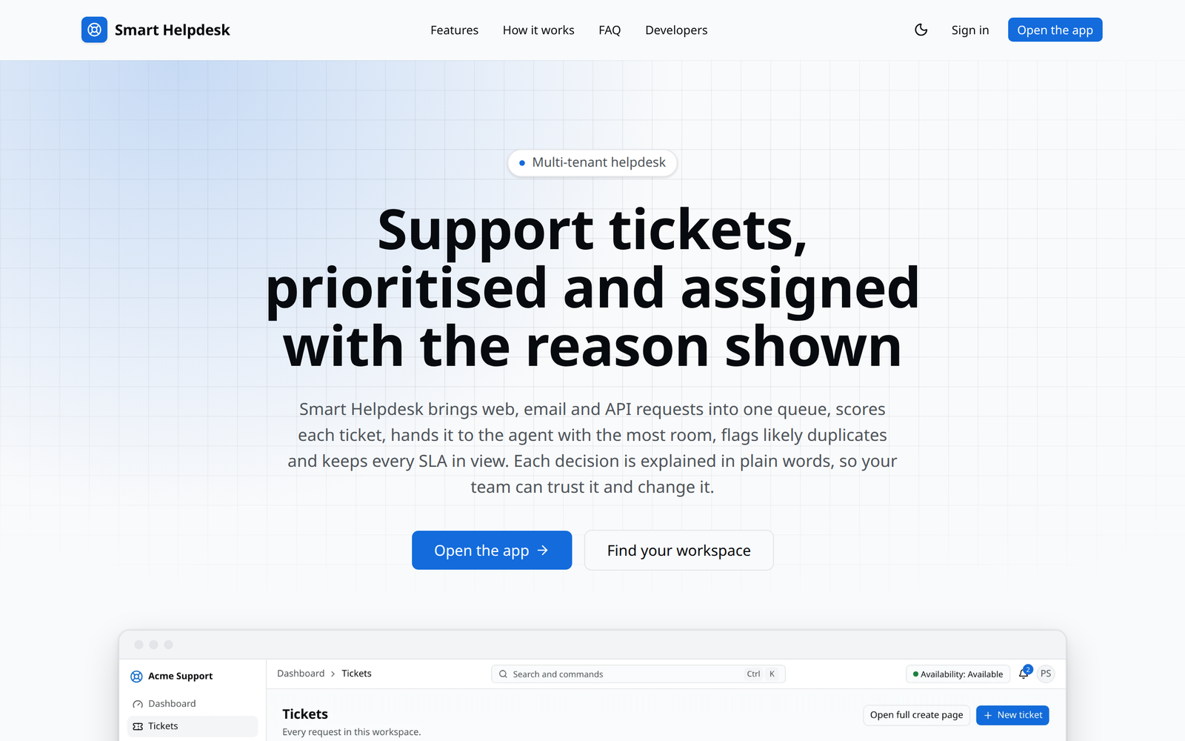
Introduction
Every organisation receives requests: a login that fails, an invoice that is wrong, a server that is down. A helpdesk turns them into tickets that can be prioritised, assigned, tracked against a promised response time and closed.
Smart Helpdesk is a web-based ticket management system for small and medium support teams.
One installation serves many independent organisations (tenants), each with its own users, agents, customers, tickets and settings.
It decides four things on its own and explains each decision: how urgent a ticket is, who should handle it, whether it repeats another ticket, and whether its SLA is at risk.
It also keeps the history of every record, reports, email notifications, email-to-ticket, a REST API and webhooks.
Built with Laravel, React and PostgreSQL, and deployed with Docker.
Landing page of Smart Helpdesk
Smart Helpdesk
Chapter 1: Introduction 1 / 13
Notes:
Section 1.1. Every organisation receives requests; a helpdesk turns them into tickets that can be prioritised, assigned, tracked against a promised response time and closed. Commercial platforms serve large enterprises; small teams rely on shared mailboxes or open-source tools that store tickets but leave decisions to people. Smart Helpdesk serves many organisations (tenants) from one installation and makes four decisions automatically, explaining each one.

Slide 3
Problem Statement
1
Inconsistent prioritisation
Priority is chosen by whoever creates the ticket, and a ticket does not become more urgent while it waits.
2
Unbalanced assignment
Tickets are assigned by hand or in rotation, so work piles up on experienced agents while skills and workload are ignored.
3
Duplicate tickets
One outage produces many tickets that describe the same problem in different words, and agents work on them in parallel.
4
Late SLA awareness
Response and resolution targets are checked in reports after the fact instead of warning agents before a breach.
5
Shallow reporting
Managers see current counts, but not how the backlog or a customer's record looked on a past date.
6
Isolation and deployment
A hosted helpdesk must keep each organisation's data separate, while some organisations need it on their own servers.
Smart Helpdesk
Chapter 1: Introduction 2 / 13
Notes:
Section 1.2. These problems came from reviewing how small support teams work and from the study of existing open-source helpdesks in Section 2.2.

Slide 4
Objectives and Scope
Objectives
Scope
1.
Design and implement a multi-tenant helpdesk in which each organisation's data is strictly isolated, and which runs on any virtual machine or on an organisation's own server.
Workspaces created and managed by a platform administrator
Sign-in, invitations, roles and permissions in each workspace
Contacts and organisations with customer tiers
Teams, skills, categories, agent capacity and shifts
The full ticket lifecycle with comments, attachments and history
The four algorithms, with explanations shown to agents
SLA policies with business calendars, warnings and breaches
Notifications, email-to-ticket and a media library
Dashboard and reports with drill-down and past views
REST API with client credentials and signed webhooks
Light and dark themes; deployment with Docker on AWS
2.
Implement simple, explainable algorithms for priority scoring, agent assignment, duplicate ticket detection and SLA monitoring with working-hours calendars.
3.
Provide the features needed for real use: the ticket lifecycle with replies and internal notes, a media library, email notifications and email-to-ticket, a dashboard, an audit trail, a REST API and signed webhooks.
4.
Build a reporting module that records every change to the main records and shows any record as it was at a past moment.
Smart Helpdesk
Chapter 1: Introduction 3 / 13
Notes:
Sections 1.3 and 1.4. Four objectives. The algorithms are intentionally minimal and replaceable, so they can be understood completely and later substituted with stronger techniques.

Slide 5
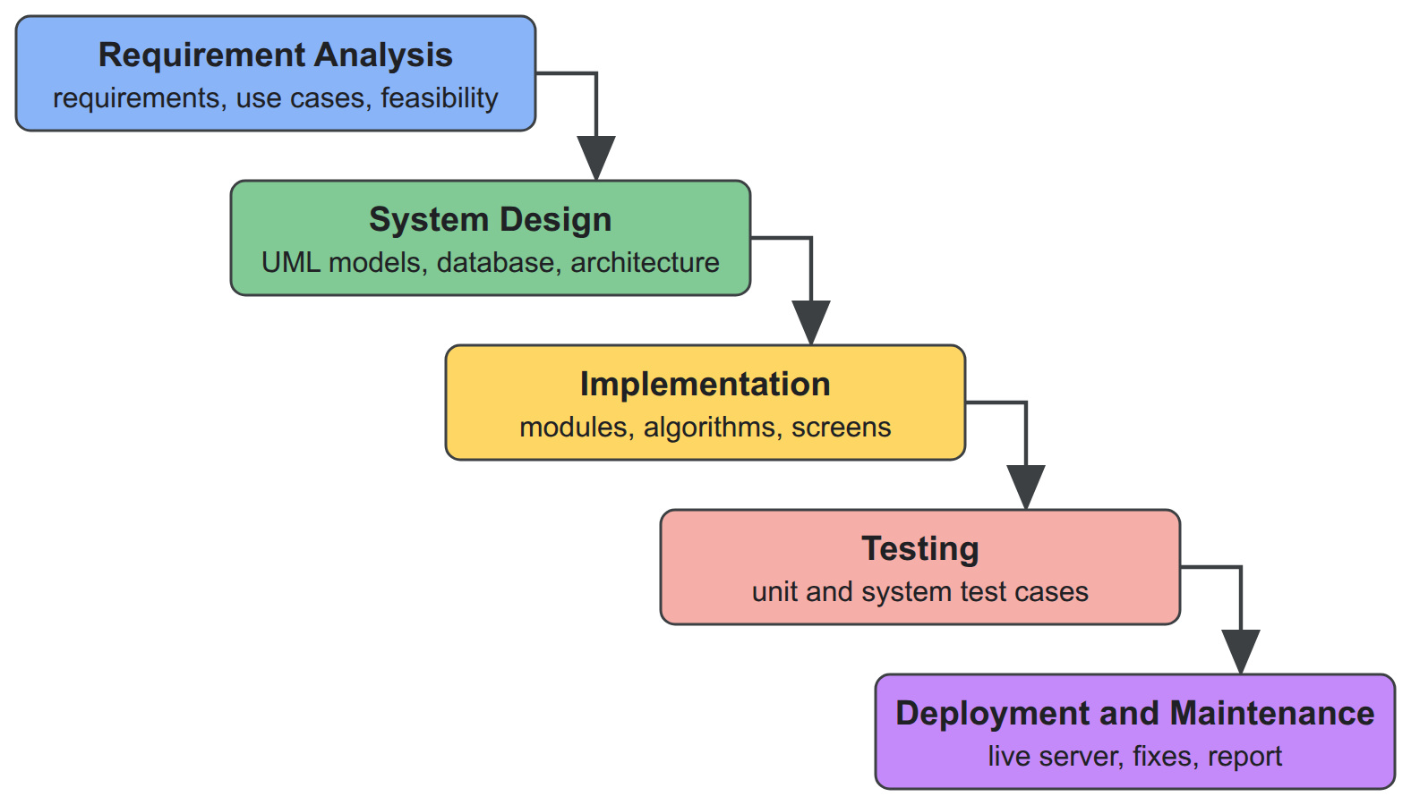
Development Methodology
We followed the waterfall model. The requirements were known at the start and the project had a fixed period of three months, so each phase was finished and reviewed before the next one began.
Phase | Period (2026) | Output
Requirement analysis | 16 Jun – 29 Jun | Requirement specification
System design | 30 Jun – 13 Jul | Design documents and diagrams
Implementation | 14 Jul – 24 Aug | Working system
Testing | 25 Aug – 7 Sep | Tested system and test report
Deployment and maintenance | 8 Sep – 15 Sep | Live system and project report
Figure 1.1: Waterfall model of the development
During implementation the two of us worked on separate features and reviewed each other's work before it was merged.
Smart Helpdesk
Chapter 1: Introduction 4 / 13
Notes:
Section 1.5. Requirements were known at the start from the problem statement and course requirements, and the project had a fixed period of three months (16 June to 15 September 2026). Phases were completed one after another, each ending with a reviewed document or product. The two members worked on separate features during implementation and reviewed each other's work before merging.

Slide 6
Background Study and Literature Review
Concepts the system builds on
Existing open-source helpdesks
Priority is usually derived from impact and urgency (ITIL, Jira); waiting time can be added as an ageing term.
Simple additive weighting scores an option as a weighted sum of its scaled criteria.
Least-loaded routing from contact centres sends work to the least busy agent with the right skill.
Jaccard similarity compares two texts by their shared words.
Row-level security in PostgreSQL lets the database itself keep tenants apart.
System | Priority | Assignment | Duplicates | SLA
osTicket | manual per help topic | by department, manual claim | none | overdue after a grace period
Zammad | three fixed levels | group rules, no workload | manual merge | timers with calendars
GLPI | urgency × impact matrix | rules pick a technician | none | attached by rules
FreeScout | minimal | workflow rules | none | paid module only
What is missing. Only GLPI computes priority, and without waiting time. None of them assigns by workload and skills, and none detects duplicates automatically. Machine-learning approaches in the literature need labelled history and are hard to explain, so a transparent baseline is a reasonable place to start.
Smart Helpdesk
Chapter 2: Background Study and Literature Review 5 / 13
Notes:
Sections 2.1 and 2.2. Impact and urgency are the usual priority inputs (Jira matrix); ITIL notes the backlog and target times also matter, motivating an ageing term. Simple Additive Weighting, least-loaded skill-based routing from contact centres, Jaccard similarity from information retrieval, and PostgreSQL row-level security. Of the four open-source helpdesks, only GLPI computes priority (fixed matrix, no waiting time); none assigns by workload and skills, and none detects duplicates automatically. Runeson et al. found about 30 % of duplicates among the top five suggestions using word comparison.

Slide 7
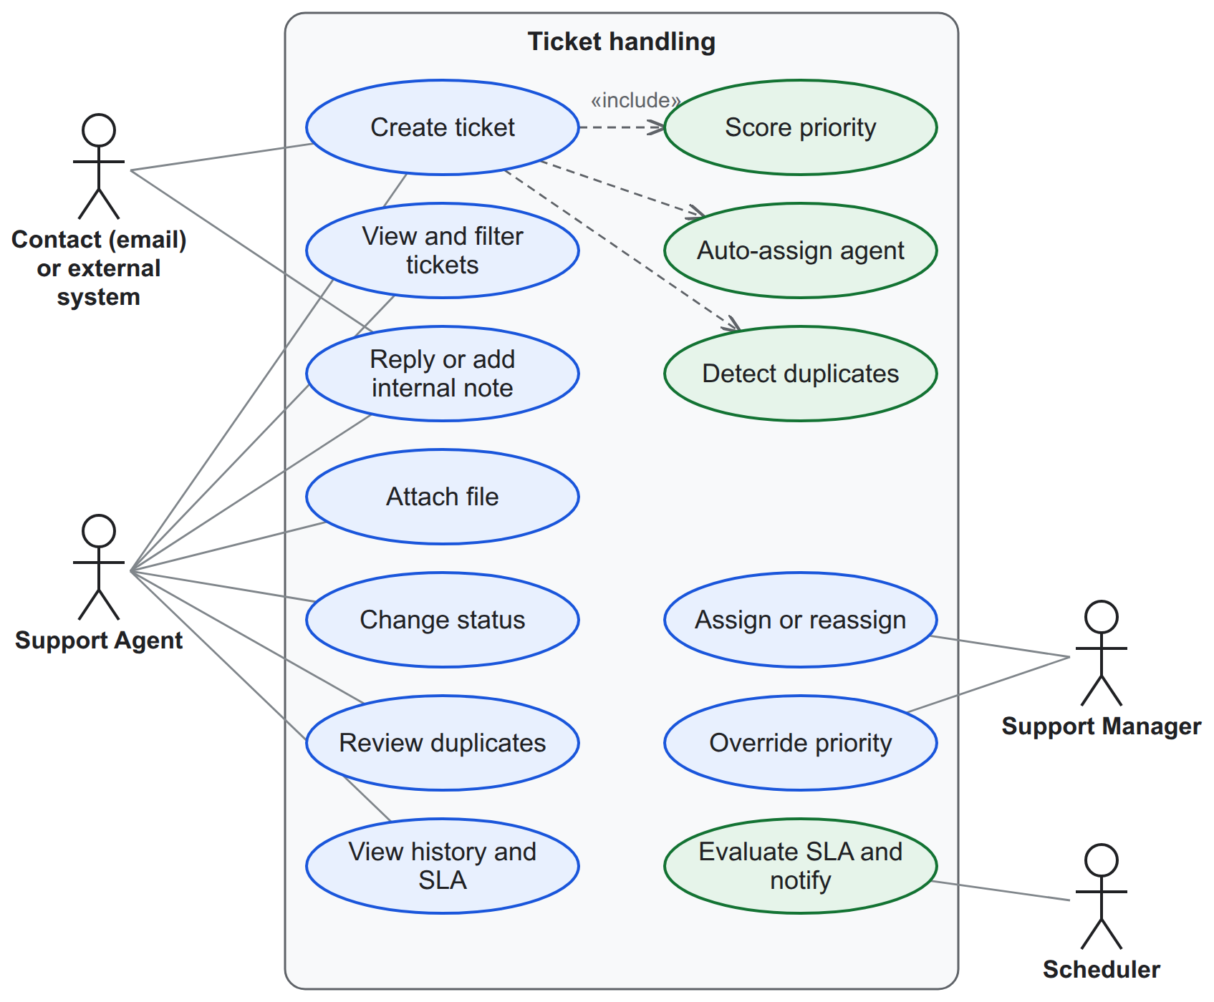
Requirement Analysis
Actors: Platform Super Admin, Tenant Admin, Support Manager, Support Agent, external systems, Contact (by email) and the scheduler.
Module | Functional requirement
Tenancy | Create, suspend and reactivate workspaces
Identity | Sign in, invitations, roles made of permissions
Contacts and agents | Organisations and tiers; teams, skills, capacity, shifts
Tickets | Lifecycle, replies and notes, attachments, history, search
Automation | Score priority, assign agents, suggest duplicates, explain
SLA | Policies, calendars, timers, pause while pending, warn, breach
Media and email | File library, notifications, email-to-ticket
Integrations | REST API, client credentials, signed webhooks
Reporting | Change history, reports, past views, CSV and XLSX export
Figure 3.1: Use cases of ticket handling and automation
Non-functional requirements: no access across workspaces and a permission check on every action; ticket list and creation within about one second; queued, retried background work and daily backups; light and dark themes with keyboard use; runs on any Linux machine with Docker.
Smart Helpdesk
Chapter 3: System Analysis and Design 6 / 13
Notes:
Section 3.1.1. Actors: Platform Super Admin, Tenant Admin, Support Manager, Support Agent, external systems, Contact (by email) and the scheduler. Table 3.1 lists the functional requirements by module; Tables 3.2 and 3.3 describe the Create ticket and Assign ticket use cases; Table 3.4 lists the non-functional requirements.

Slide 8
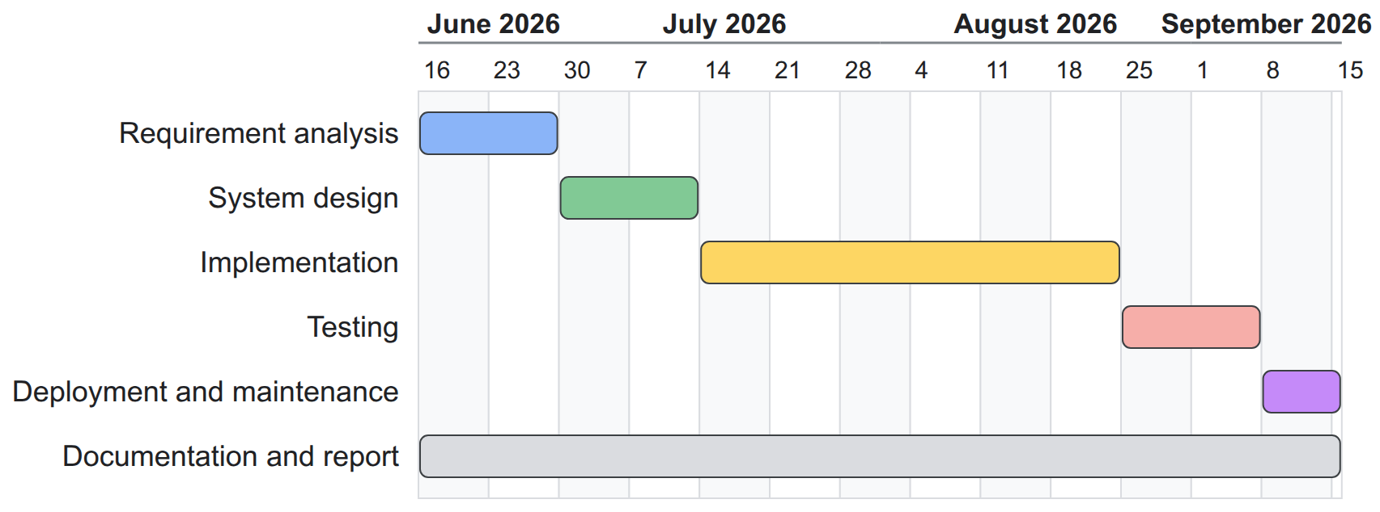
Feasibility Analysis and Schedule
Technical
Operational
Economic
Schedule
Mature open-source components run together with Docker Compose on one small virtual machine (2 vCPU, 2 GB on AWS).
It follows the workflow support teams already use, explains every decision and is configured through forms.
No licence fees. A suitable virtual machine costs about US$8–35 a month, or an own server can be used.
Three months, 16 June to 15 September 2026, in the waterfall phases, with documentation throughout.
Figure 3.3: Gantt chart of the project schedule
Smart Helpdesk
Chapter 3: System Analysis and Design 7 / 13
Notes:
Section 3.1.2. Technical: mature open-source components run together with Docker Compose on one VM; the live deployment uses an AWS instance with two vCPUs and 2 GB of memory. Operational: follows existing support workflows and explains every decision. Economic: no licence; a VM of the required size costs roughly US$8 to 35 per month. Schedule: three months, 16 June to 15 September 2026 (Table 3.5, Figure 3.3).

Slide 9
System Design: Architecture
Web browser
agents, managers, admins
External systems
REST API and webhooks
Contacts
by email
Design decisions
HTTPS
HTTPS
SMTP
The backend is split into modules with one-way dependencies; notifications, integrations, reports and the audit trail only react to events.
Each algorithm sits behind an interface and returns its decision together with an explanation.
Every change runs in one database transaction.
Every workspace table carries the workspace id and a row-level security policy.
The same containers run on a laptop, an own server or any cloud machine.
One virtual machine running Docker Compose (AWS in the live deployment)
Reverse proxy (Caddy)
HTTPS for every host; serves the React web application
Laravel application (one container image)
Platform
Tenancy
Identity
Contacts
Agents
Tickets
SLA
Automation
Media and mail
Reporting and audit
Algorithms
behind replaceable interfaces
Queue workers
mail, notifications, webhooks
Scheduler
SLA check and mail, every minute
PostgreSQL
data, row-level security
Valkey
cache and queues
RustFS
file storage
Stalwart
mail server
Smart Helpdesk
Chapter 3: System Analysis and Design 8 / 13
Notes:
Section 3.2. Clients reach one virtual machine over HTTPS. A reverse proxy terminates HTTPS for the application, API, administration, documentation, file and mail hosts and serves the React single-page application. The PHP application, queue workers and scheduler run from one container image; the backend is divided into modules with one-way dependencies, and notification, integration, reporting and audit only react to events. Each algorithm is an interface with a simple baseline implementation that returns its result and an explanation. PostgreSQL (with row-level security on every workspace table and the change-capture trigger), Valkey, object storage and the mail server run as separate containers on an internal network. The same arrangement runs on a developer computer, an organisation's own server or any cloud VM.

Slide 10
Priority Scoring and Agent Assignment
Weighted priority score
Least-loaded eligible agent
Input | Scaled to 0–1 | Weight
Impact (1–4) | (impact − 1) ÷ 3 | 0.40
Urgency (1–4) | (urgency − 1) ÷ 3 | 0.35
Customer tier | standard 0, premium 0.5, enterprise 1 | 0.15
Waiting time | min(1, hours ÷ 72) | 0.10
An agent is eligible when available, on shift, holding every skill the category needs, in the ticket's team and below capacity.
Eligible agents are ordered by open tickets per unit of capacity; a tie goes to the one assigned least recently.
Agents left out are listed with the rule they failed. If nobody is eligible, managers are notified.
Cost: O(A log A) for A agents.
score = 100 × Σ (weight × scaled value)
P1 from 75, P2 from 50, P3 from 25, otherwise P4
Example
Impact 2, urgency 3 and a premium customer give 13.3 + 23.3 + 7.5 + 3.3 = 47.5 (P3) after one day.
After three days the same ticket scores 54.2 and rises to P2. A manager can always set the priority by hand.
Example
Asha and Chen each have 3 of 10 tickets (0.30); Bikram has 2 of 5 (0.40).
Asha and Chen tie on load, and Chen was assigned earlier, so Chen receives the ticket.
Smart Helpdesk
Chapter 3: System Analysis and Design 9 / 13
Notes:
Sections 3.3.1 and 3.3.2. Priority: a weighted sum of four inputs scaled to 0–1 (simple additive weighting), computed on creation, when an input changes and hourly for open tickets; a manager's manual priority always wins; constant cost. Example: impact 2, urgency 3, premium customer gives 47.5 (P3) after 24 hours and 54.2 (P2) after 72 hours, showing ageing. Assignment: eligible agents are available, on shift if enforced, hold all required skills, are in the team and below capacity; the lowest open-to-capacity ratio wins, ties to the least recently assigned; cost O(A log A). Example: Asha and Chen 3/10, Bikram 2/5 = 0.40; Chen, assigned earlier than Asha, gets the ticket.

Slide 11
Duplicates, SLA Timers and History
Duplicate detection
SLA timer
History and time analysis
Each ticket becomes a set of words, without 117 common stop words and very short words.
Two tickets are compared by Jaccard similarity: shared words ÷ all distinct words.
Open tickets of the same workspace from the last 30 days scoring 0.35 or more are suggested, top five first.
"Cannot login after password reset" and "Login fails after resetting password" share half their words (0.50) and are suggested.
Each ticket has a first-response and a resolution timer, counted in all hours or only working hours.
A warning is sent at 75 % of the target and a breach is recorded at the deadline, each only once.
While a ticket waits for the customer the timer pauses, and the deadline moves by the time paused.
An 8-hour target from 09:00, paused 10:00–12:00, ends at 19:00 instead of 17:00.
A database trigger records every change to the main tables with the old and new values.
A record at any past moment is rebuilt by undoing, newest first, the changes made after it.
Each ticket's changes form periods of constant status, agent and priority.
From these periods come time in status, the backlog on any date and each agent's workload.
Smart Helpdesk
Chapter 3: System Analysis and Design 10 / 13
Notes:
Sections 3.3.3 to 3.3.5. Duplicates: title and description are lower-cased, split on non-letters/digits/hyphens, stripped of 117 stop words and words shorter than three characters; candidates are same-tenant tickets from the last 30 days that are not closed, at most 50; threshold 0.35, top five kept; cost O(K × W). SLA: first-response and resolution timers, each a state machine; deadlines through a calendar of all hours or working hours; the per-minute check reads only due timers and records sent notifications, so running twice has no extra effect. History: a trigger records each change with old and new values; a record at time t is rebuilt by undoing later changes newest first, O(k); ticket events are swept into intervals, O(e), for time in status, backlog and workload over time, with daily snapshots.

Slide 12
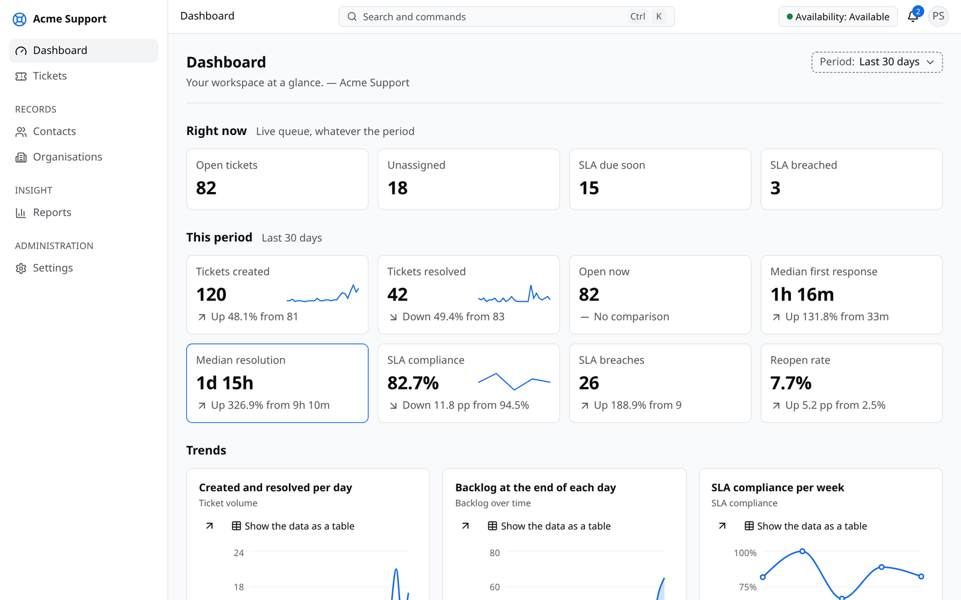
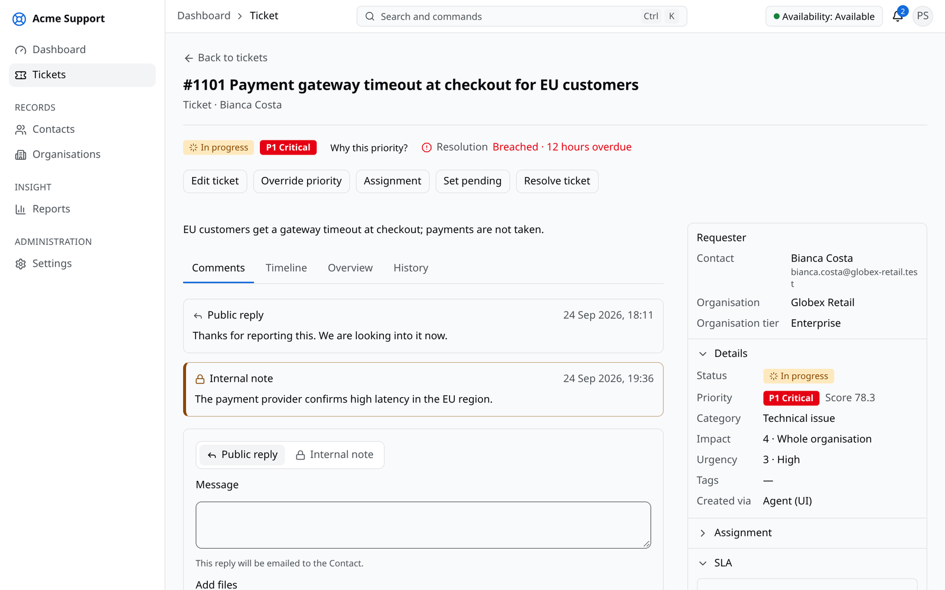
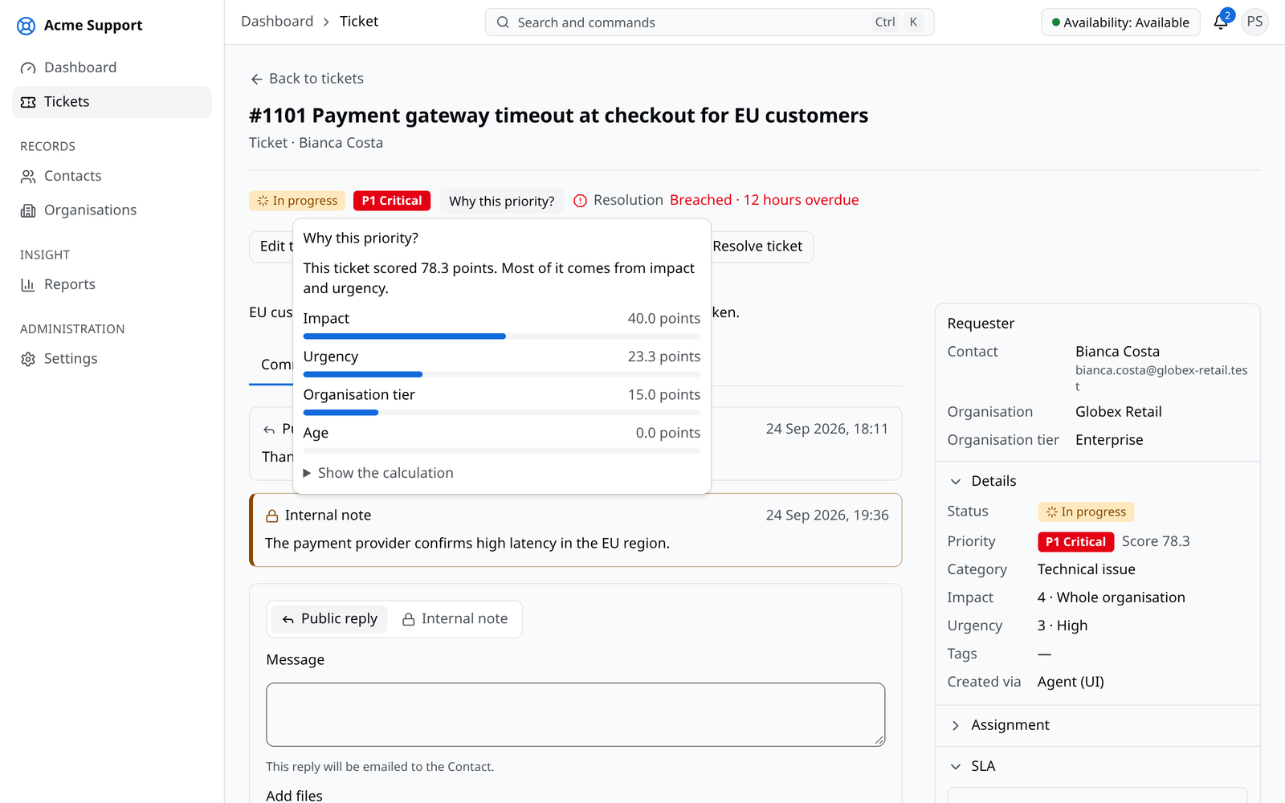
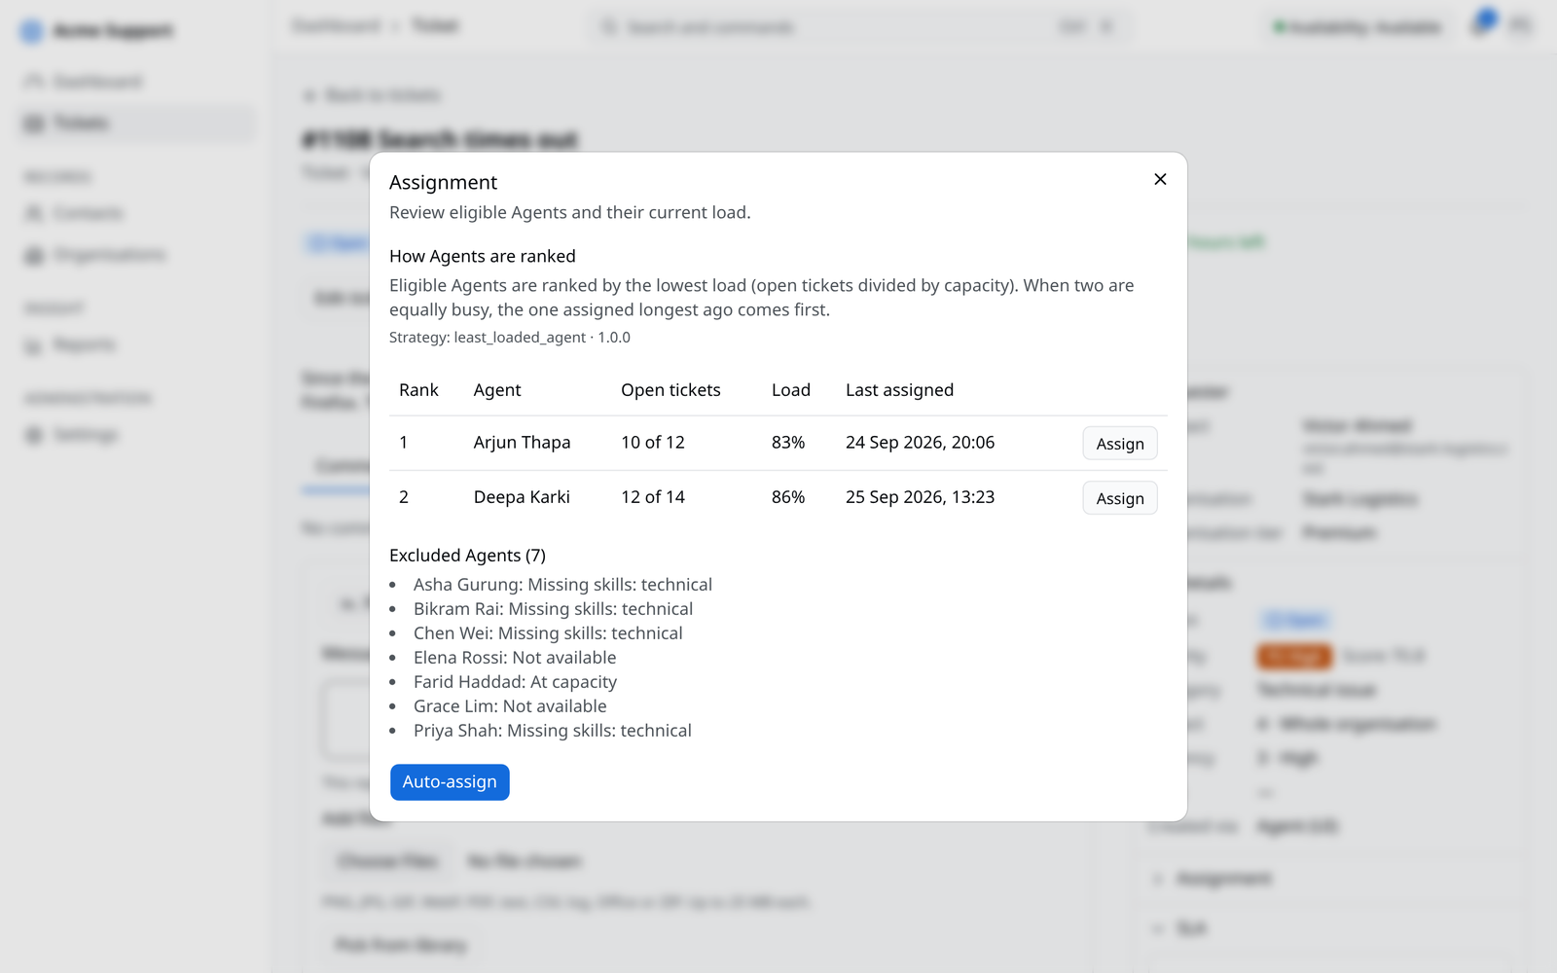
Implementation
Area | Tools
Backend | PHP 8.5, Laravel 13
Frontend | React 19, TypeScript, Vite, TanStack, Zod
Interface | Tailwind CSS, shadcn/ui, Lucide, Recharts
Database | PostgreSQL 18
Cache and queues | Valkey, Laravel Horizon
Files and email | RustFS, Stalwart mail server
API documentation | Scramble
Infrastructure | Docker Compose, Caddy, Ansible, OpenTofu
Diagrams | Mermaid
Development | Visual Studio Code, Git, GitHub
Management dashboard (Fig. 4.1)
Ticket with SLA timers (Fig. 4.2)
Each module has its own routes, models, rules and tables, and every change of data runs in one transaction, so a failure never leaves anything half saved.
Priority explanation (Fig. 4.3)
Assignment ranking (Fig. A.5)
Smart Helpdesk
Chapter 4: Implementation and Testing 11 / 13
Notes:
Section 4.1. Tools in Table 4.1. The backend is divided into modules with their own routes, models, rules and tables; each data change runs in one transaction; the algorithms are plain functions behind interfaces. Workspace comes from the session or API client, never the web address, and row-level security limits every query. Tickets: numbered per workspace, with priority, SLA timers, duplicates and assignment in the same transaction. Media: direct uploads to object storage through short-lived signed links. Mail: reply address identifies the ticket; incoming mail read every minute. Reporting: trigger-based history, CSV and XLSX exports. Integrations: client credentials and signed webhooks with retries. Frontend: features on a shared design system with light and dark themes.

Slide 13
Testing and Result Analysis
Unit test cases
System test cases
ID | Test case | Result
UT-01 | Sign in with correct details | Pass
UT-02 | Sign in with a wrong password | Pass
UT-03 | Create a contact | Pass
UT-04 | Contact without an email | Pass
UT-05 | Edit an organisation | Pass
UT-06 | Create a category | Pass
UT-07 | Delete a category in use | Pass
UT-08 | Create a ticket | Pass
ID | Test case | Result
UT-09 | Create a ticket without a title | Pass
UT-10 | Add a public reply | Pass
UT-11 | Add an internal note | Pass
UT-12 | Attach a file | Pass
UT-13 | Invite a user | Pass
UT-14 | Create a team | Pass
UT-15 | Create an SLA policy | Pass
ID | Scenario | Result
ST-01 | New user joins by invitation | Pass
ST-02 | Ticket from creation to closed | Pass
ST-03 | Automatic handling, explained | Pass
ST-04 | Duplicate suggested | Pass
ST-05 | Email reply lands on the ticket | Pass
ST-06 | Workspaces kept apart | Pass
ST-07 | Report exported as CSV | Pass
ST-08 | Live site over HTTPS | Pass
Results
All 15 unit and 8 system test cases passed on the development machine and on the live server, in both themes.
Priority levels matched our hand calculations, and new tickets went to the least-loaded eligible agent.
Similar tickets were suggested with their shared words; SLA timers paused, warned and breached at the expected times.
Reports agreed with the ticket list, and past views matched the earlier state of each ticket.
Smart Helpdesk
Chapter 4: Implementation and Testing 12 / 13
Notes:
Sections 4.2 and 4.3. Testing was manual: each function on its own (unit testing), then complete workflows through the web application on the development machine and the deployed server (system testing), in both themes in Google Chrome, repeated after each correction. All 15 unit and 8 system test cases passed. The algorithms were checked with worked examples calculated by hand. Limitations found: duplicates in completely different words are not detected, and behaviour under heavy load was not tested.

Slide 14
Conclusion and Future Work
Conclusion
Limitations
Future work
Smart Helpdesk serves many organisations from one installation and keeps their data apart in the application and the database.
All four objectives were met, and manual testing confirmed the features and the algorithms.
Explanations make automatic decisions easier to trust; time handling was the hardest part of SLA management.
Weights and thresholds are set by administrators, not learned.
Duplicates written in different words are missed.
No load testing; one small server.
No customer portal, live chat, knowledge base, custom fields or billing.
Designed for desktop and laptop screens.
Load testing and monitoring with many users.
Stronger algorithms: SLA-aware priority and duplicate detection that understands meaning.
A customer portal with live chat.
Weights learned from resolved tickets.
Layouts for phones.
Smart Helpdesk
Chapter 5: Conclusion and Future Recommendations 13 / 13
Notes:
Chapter 5. All objectives of Section 1.3 were met. The main lessons: explanations make automatic decisions easier to trust, time handling is the hardest part of SLA management, and data separation must be checked on every screen and API. Limitations from Section 1.4 and the results; future work from Section 5.2.

Slide 15
Thank You

