Slide 1
RoadMap
SWF
Why SWF
Architecture of SWF
How SWF Works
Terms Associated with SWF
Reference

Slide 2

SWF
Spring Web Flow is a subproject of the popular Spring Framework
http://www.springframework.org/webflow

Slide 3
Continued..
Spring Web Flow is so far the best solution for the management of web applications with complex page flow.
It provides a powerful controller to control the user navigation in case your application demands
Spring Web Flow allows to build high-level, reusable, self-contained controller modules called flows that are runnable in any environment
A flow encapsulates a sequence of steps that guide a user through the execution of some business task. It spans multiple HTTP requests, has state, deals with transactional data, is reusable, and may be dynamic and long-running in nature.
Flows can execute in parallel without intruding on each other
When the flow has finished, all allocated resources are automatically cleaned up

Slide 4
Why Spring Web Flow
Spring Web Flow provides a declarative flow definition language for authoring flows on a higher level of abstraction.
It allows it to be integrated into a wide range of applications without any changes (to the flow programming model) including Spring MVC, JSF, and even Portlet web applications.
The following are common issues observed in stateful web applications with navigation requirements:
Visualizing the flow is very difficult.

Slide 5
Continued..
The application has a lot of code accessing the HTTP session.
Enforcing controlled navigation is important but not possible.
Proper browser back button support seems unattainable.
Browser and server get out of sync with "Back" button use.
Multiple browser tabs causes concurrency issues with HTTP session data.
Spring Web Flow provides a solution to the above issues.

Slide 6
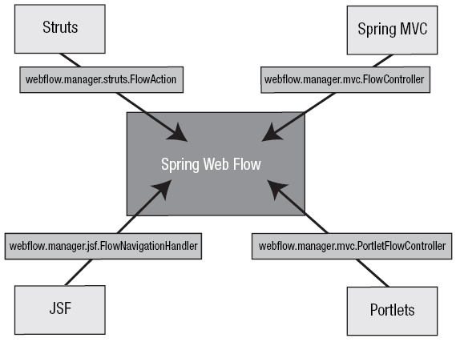
Architecture of Spring Web Flow
Spring Web Flow is very self-contained →
the entry points to other frameworks are consistent

Slide 7
Inside the SWF System
A central FlowExecutionManager façade is responsible for launching executions of flows
Flow executions = new user conversations with the server
Each conversation is given its own local data structure, called flow scope

Slide 8
How SWF Works
Spring Web Flow uses the Spring MVC framework. The DispatcherServlet handles the request.
The request is mapped to a particular Web Flow by the FlowHandlerMapping. The FlowHandlerMapping is provided an instance of FlowRegistry(has the definitions for the flow).
The FlowHandlerMapping maps the request to a FlowHandlerAdapter which is responsible for handling the flow requests.
The FlowHandlerAdapter is provided with an instance of FlowExecutor which is responsible for the actual flow lifecycle.

Slide 9
Terms Associated with SWF
Important classes :
FlowHandlerMapping – This is a HandlerMapping that creates a URL from the ids registered in the flow registry. It returns a FlowHandler if a matching id is found in the flow registry.
FlowHandler – This is a controller helper that has the reference to the actual flow. It handles the execution of the flow, its outcomes and exceptions.
FlowHandlerAdapter – This is the HandlerAdapter for web flows. It delegates work to the mapped FlowHandler.
FlowExecutor – This is the central class of the Flow and is the facade for the actual flow. It manages creating of new flows or resuming existing flows. It is an entry into the Spring web flow system.
FlowDefinition – This class stores the definition of the flow. It contains the set of states that form part of the flow. Each flow has one start state.
FlowRegistry – This class contains all the flow definitions.

Slide 10
Continued..
The web flow has three main parts –
States – States are points on the flow where an action happens or decision is made or a view is displayed. The end of a flow is also a state. Sometimes, to increase brewity, a subset of a flow can be combined together to form a sub-flow and then the sub-flow is a state in the main flow.
Transitions – Transition connects two states. A movement of request from one state to another is called a transition.
Data – Data is the information that is carried from one state to another. The life span of the data depends on the scope with which it is declared.

Slide 11
Continued..
Flow Data Scopes:
Flow Data can be stored as variables that can be created using the ‘var’ element or using the evaluate expression. Variable scope – The lifespan of the variable depends on the scope with which it is declared. The scopes available are:
Conversation – The conversation scope starts when a flow starts and ends when the flow ends. It is available in sub flows
Flow – Available within a flow. Not available in sub flows
Request – Available during the life of a request in a flow
Flash – Available during the lifetime of a flow. However, once a state is rendered, the variable is cleared.
View – Available only during the lifetime of a view. Created when a view is created and destroyed once a view is destroyed

Slide 12
Reference
Spring Web Flow Home http://www.springframework.org/webflow
Spring Web Flow - A Practical Introduction
http://www.ervacon.com/products/swf/intro/index.html
Book “Expert Spring MVC and Web Flow” http://www.amazon.com/Expert-Spring-MVC-Web-Flow/dp/159059584X
Spring IDE Web Flow Visualizer
http://www.springframework.org/node/429

