Slide 1
Data bases 2
JPA Optional Project
Group 91
Vincenzo Riccio (10804402) and Emanuele Triuzzi (10794440)

Slide 2
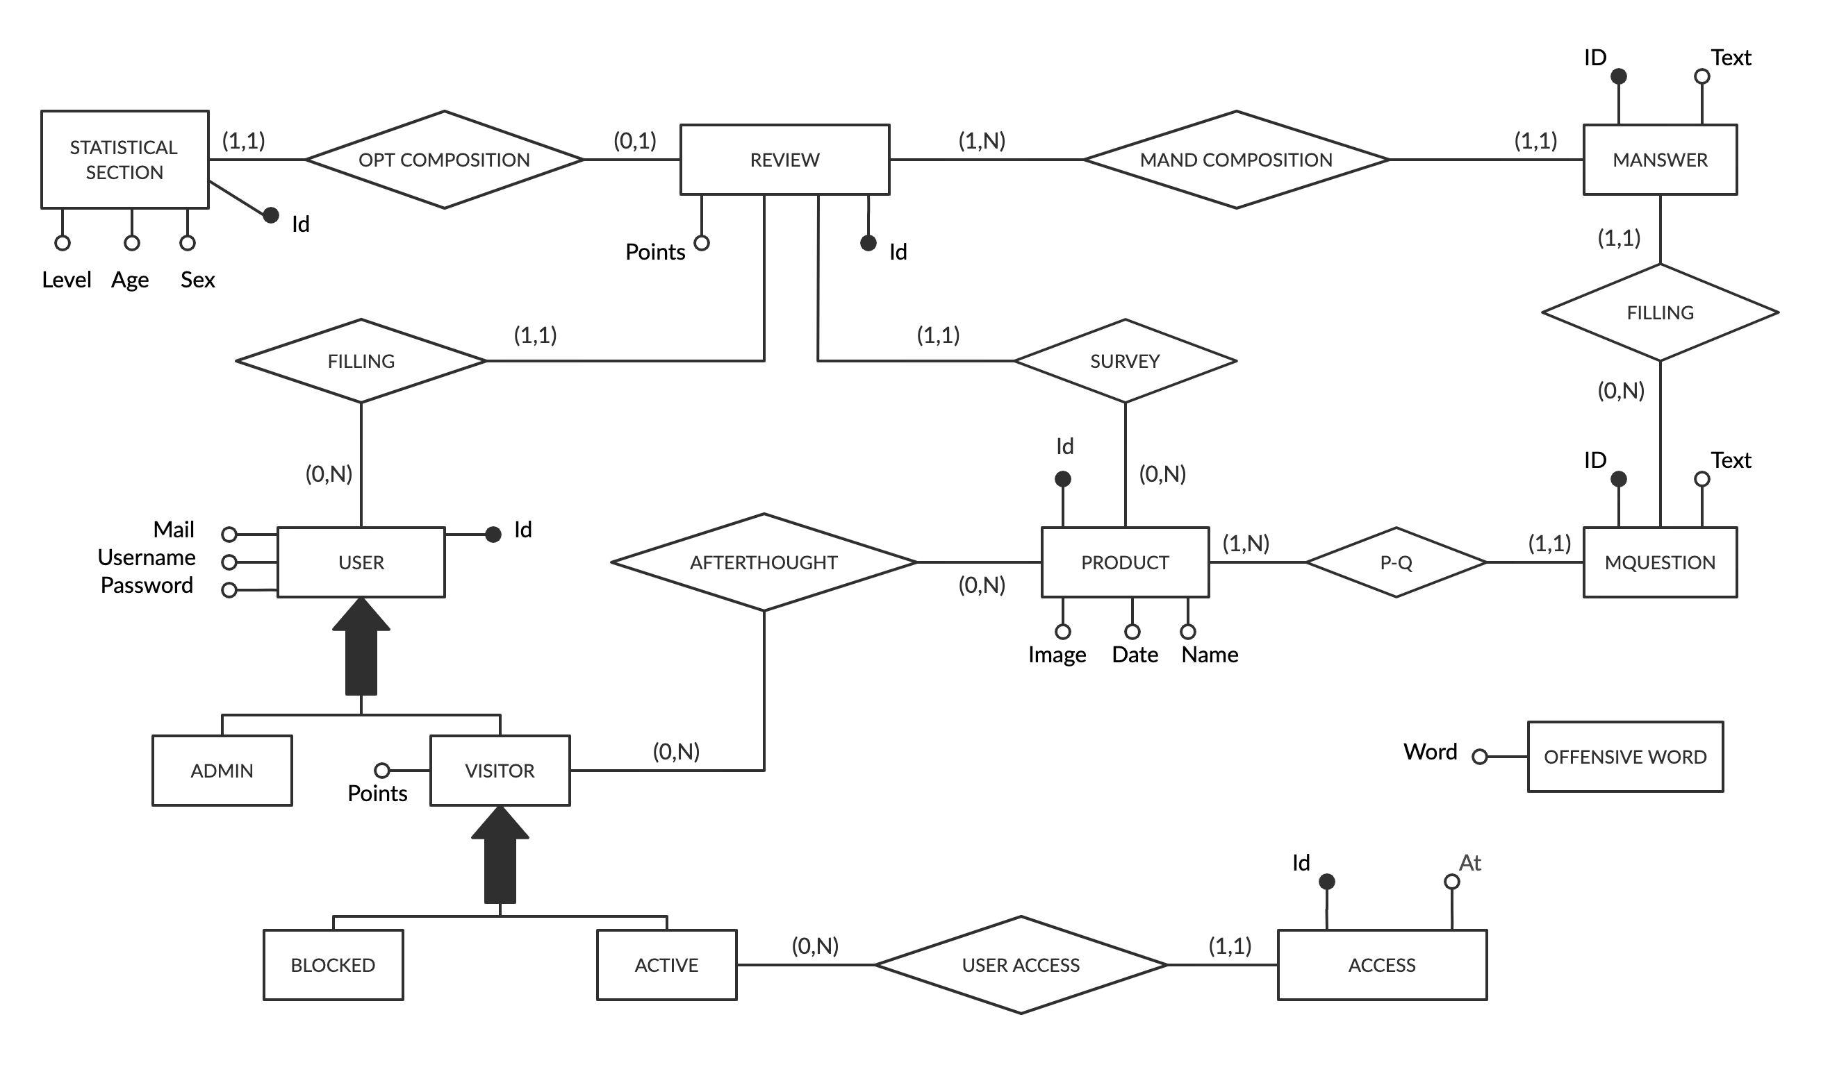
Entity Relationship

Slide 3
Relational model
access(id, user, at) offensive_words(word)
user(id, username, password, email, isAdmin, isBlocked, points)
deleted_reviews(id, user_id, product_id)
review(id, user, age, sex, level, points, product)
product(id, name, date, image)
Mquestion(id, text, product)
Manswer(id, review, question, text)

Slide 4
Relationship “rel1”
responsibility
A → B … describe ORM here
including annotations for the attributes and for the relationships, fetch type of attributes and of relationships, and operation cascading policies for relationships
B → A … describe ORM here
A
B
0:N
1:1
A
*
B
1
A
B

Slide 5
Entity Employee
@Entity
@NamedQueries({ @NamedQuery(name = “A.query", query = “ . . . "),
. . .})
public class A implements Serializable {
..
// attributes & their annotations
// relationships & their annotations
/*
clone this slide as may times as there are entities
*/

Slide 6
Entity method for doing something
// in entity A
public void method(Class arg, . . .) {
// code
}
// use if requested

Slide 7
Components
Client components
Login/Logout (if requested)
Servlets
Views
Business Components
BC1
(stateless or stateful)
Method BC11( params)
Method BC11( params)
BC2
(stateless or stateful)
Method BC21( params)
Method BC22( params)

Slide 8
Business method for doing something
public void method(Class arg, . . .) {
// code
}
// use if requested
/*
clone this slide as many tie as there are requested business methods
*/

