Slide 1
Data bases 2
JPA Optional Project
Group 91
Vincenzo Riccio (10804402) and Emanuele Triuzzi (10794440)

Slide 2
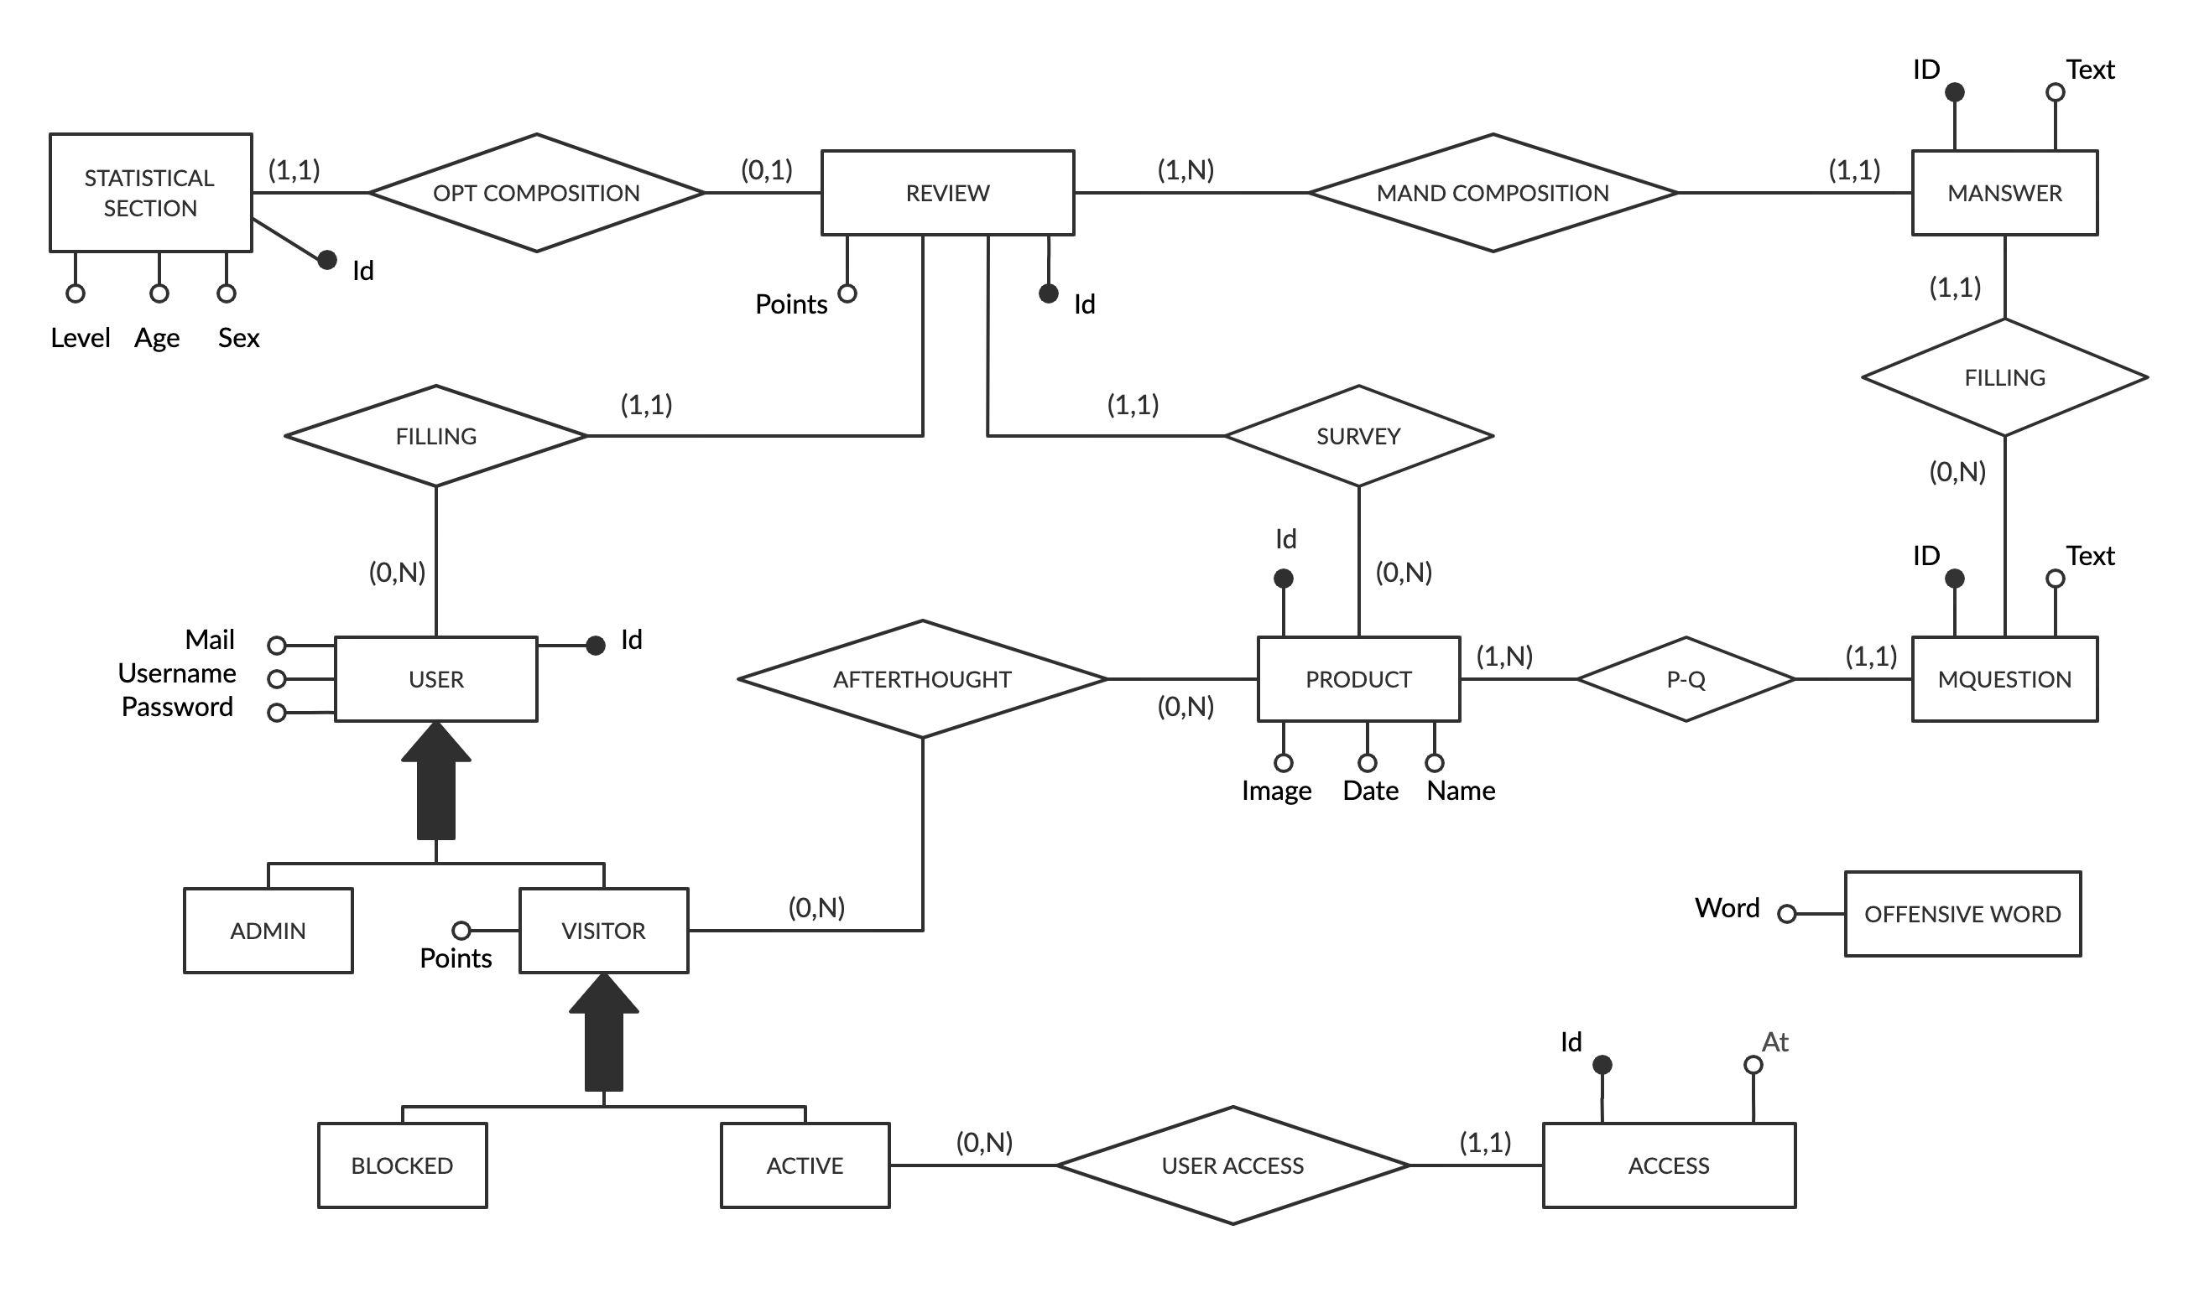
Entity Relationship

Slide 3
Relational model
access(id, user, at) offensive_words(word)
user(id, username, password, email, isAdmin, isBlocked, points)
deleted_reviews(id, user_id, product_id)
review(id, user, age, sex, level, points, product)
product(id, name, date, image)
Mquestion(id, text, product)
Manswer(id, review, question, text)

Slide 4
Relationship “rel1”
responsibility
A → B … describe ORM here
including annotations for the attributes and for the relationships, fetch type of attributes and of relationships, and operation cascading policies for relationships
B → A … describe ORM here
A
B
0:N
1:1
A
*
B
1
A
B

Slide 5
Entity Employee
@Entity
@NamedQueries({ @NamedQuery(name = “A.query", query = “ . . . "),
. . .})
public class A implements Serializable {
..
// attributes & their annotations
// relationships & their annotations
/*
clone this slide as may times as there are entities
*/

Slide 6
Entity method for doing something
// in entity A
public void method(Class arg, . . .) {
// code
}
// use if requested

Slide 7
Components
Client components
Login/Logout (if requested)
Servlets
Views
Business Components
BC1
(stateless or stateful)
Method BC11( params)
Method BC11( params)
BC2
(stateless or stateful)
Method BC21( params)
Method BC22( params)

Slide 8
Components: client side – login and permissions
SERVLETS
RegisterUser: register a new user if not already in the database.
CheckLogin: validates the content of the login form. It checks the credentials; if the user is an admin redirects to his home page, otherwise, it checks if the account has been blocked and, if not, redirects to the user home page
Logout: logs out the current user and invalidates the session
FILTERS. N.B: quello che c’è scritto fa riferimento a dopo l’eventuale modifica ai filtri!!!!!!!
CheckAdminPrivileges: checks if the logged user is an admin. It applies to all the admin pages
CheckUserPrivileges: checks if the logged user is a normal user (i.e., not an admin). It applies to all the user pages
LoginFilter: checks if an user has logged in. Applies to all the pages with the exception of the login page

Slide 9
Components: client side
RegisterUser: register a new user if not already in the database.
CheckLogin: validates the content of the login form. It checks the credentials; if the user is an admin redirects to his home page, otherwise, it checks if the account has been blocked and, if not, redirects to the user home page
Logout: logs out the current user and invalidates the session
GoToUserHomePage: shows the home page of a visitor. It finds the product of the current day and the possible review made by the logged user
GoToAdminHomePage: shows the home page of an administrator
GoToLeaderboardPage: shows the leaderboard page
GoToNewReviewPage: shows the first page of the review creation process for the product of the current day
GoToNewReview2ndPage: shows the second page of the review creation process for the product of the current day
SaveReview: completes the review creation process by saving the review. It also blocks the logged user if he used offensive words in the review (and in that case the review is not saved)
DeleteReview: deletes the review made by the logged user for the product of the current day

Slide 10
Components: client side
Search.html: shows one page of results and possibly the next/previous links
Photo.html: displays a photo and its collection of tags

Slide 11
Business method for doing something
public void method(Class arg, . . .) {
// code
}
// use if requested
/*
clone this slide as many tie as there are requested business methods
*/

