Slide 1
INDUSTRIAL ATTACHMENT

Slide 2



Slide 3
TEAM MEMBERS
Name | ID
M.A. Hasan Molla | 1204006
Md Abdul Quaum | 1204026
Ashfak Md Shibli | 1204028
Shuvashish Sarker | 1204108
A. S. M. Sadiqul Islam | 1204113
Supervisor: Nowrose Farhan Ninad

Slide 4
Working sector of the company
Banking Solutions
Outsourcing
Software
Mobile App
Ecommerce
SharePoint
Server Maintenance

Slide 5
Overview on our project
Project Name: Brain-CV Web App
The project was divided into the following modules:
1. CRS & SRS
2. TASK DISTRIBUTION
3. SYSTEM ARCHITECHTURE
4. APPLICATION DEVELOPMENT TOOLS
5. UAT

Slide 6
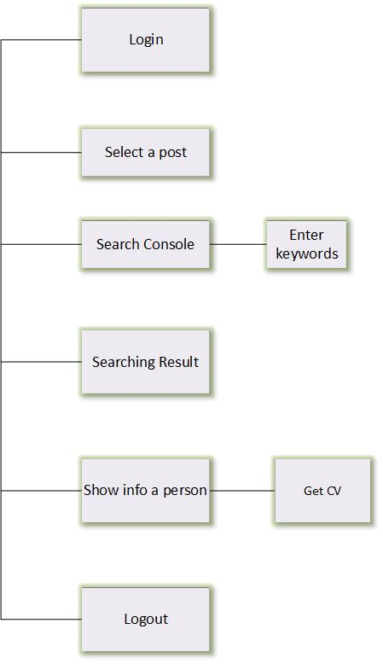
User Requirement Specification

Slide 7
TASK LIST
Design UI
Database Design
Web crawling and scrapping
Server management

Slide 8
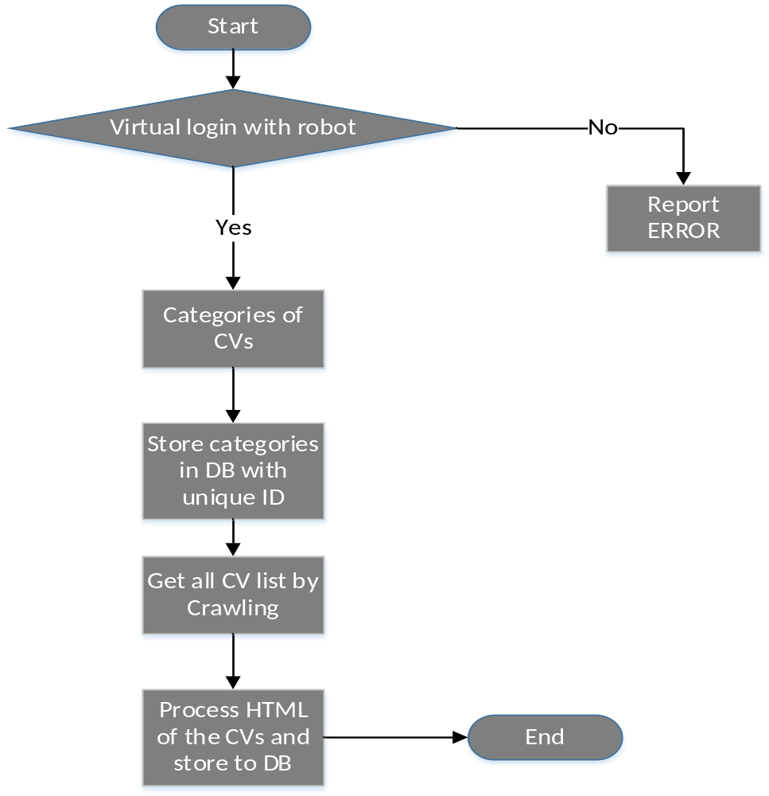
SYSTEM ARCHITECHTURE (Backend)

Slide 9
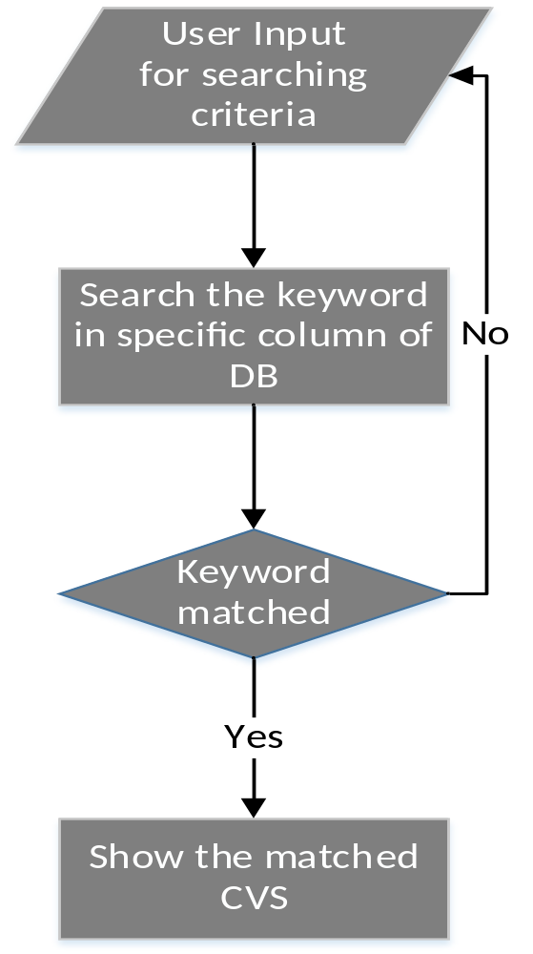
SYSTEM ARCHITECHTURE (Frontend)

Slide 10
APPLICATION DEVELOPMENT TOOLS
Tools required for development of the code:
Editors & IDE: PHPstrom, Sublime text
Language: PHP, HTML, CSS, Java script
Frame work: Laravel, Symfony
Server: Apache
DataBase: MySQL

Slide 11
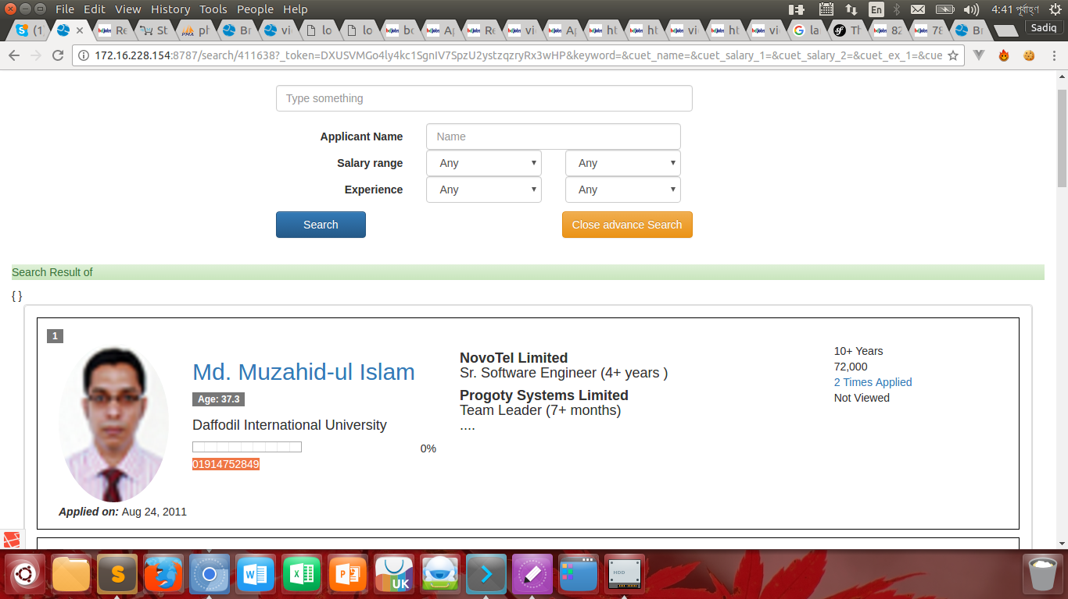
Brain-CV Web Application

Slide 12
USER ACCEPTANCE TESTING (UAT)
UAT constitutes of the following parts:
1.Modules name.
2.Function of the Application
3.UI testing
4.Action
5.Expected Result

Slide 13


