Slide 1
AIRLINE TRAVEL IS STILL SAFE!
Srilakshmi Bodduluru
DSC - 640

Slide 2
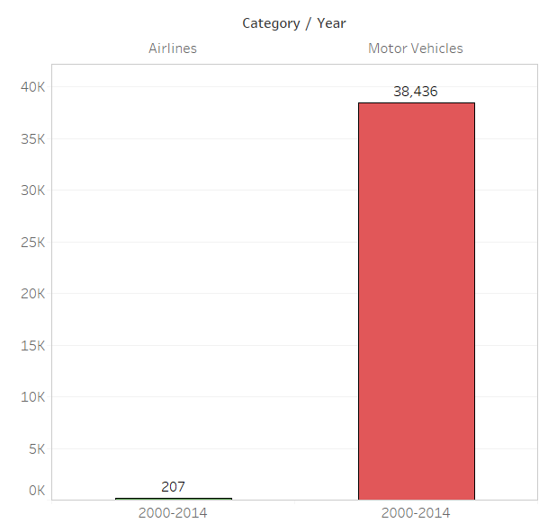
Negligible Fatalities
Average airline fatalities across the world in an year is about 207, whereas an average of 38,436 people die in car crashes every year in just one state in USA.

Slide 3
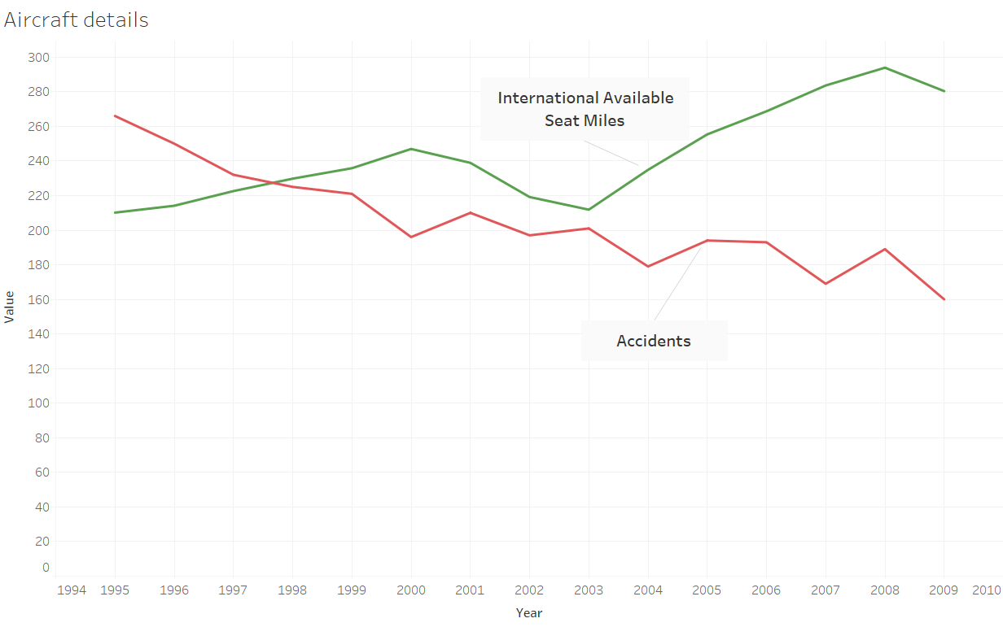
Declining Air Crashes
Even though airline travel has increased significantly, number of air crashes or accidents have been decreasing continuously.

Slide 4
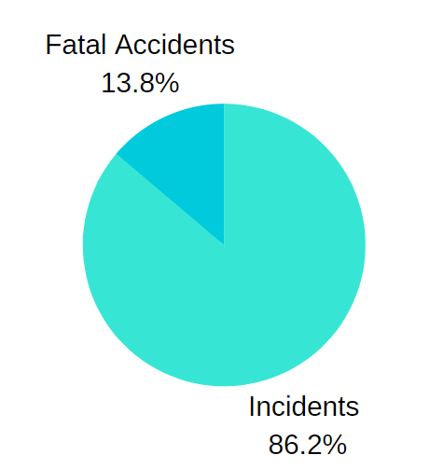
Very Few Fatal Crashes
Fatal crashes are very few. However, plane crashes grab our attention, induce fear, and tend to stick in our minds, giving us the false impression that these events are common occurrences no matter how infrequently they happen.

Slide 5
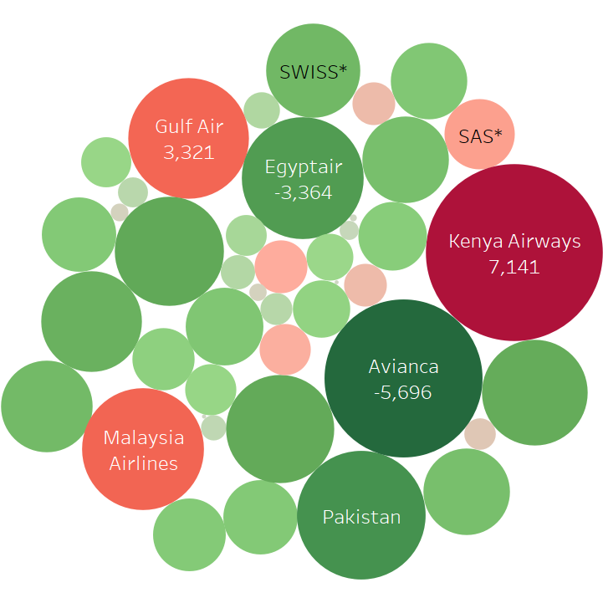
Improved Performance
Most of the airlines(green) are showing continuous improvement in performance. Over 90% airlines have shown continuous improvement on their performance.

Slide 6
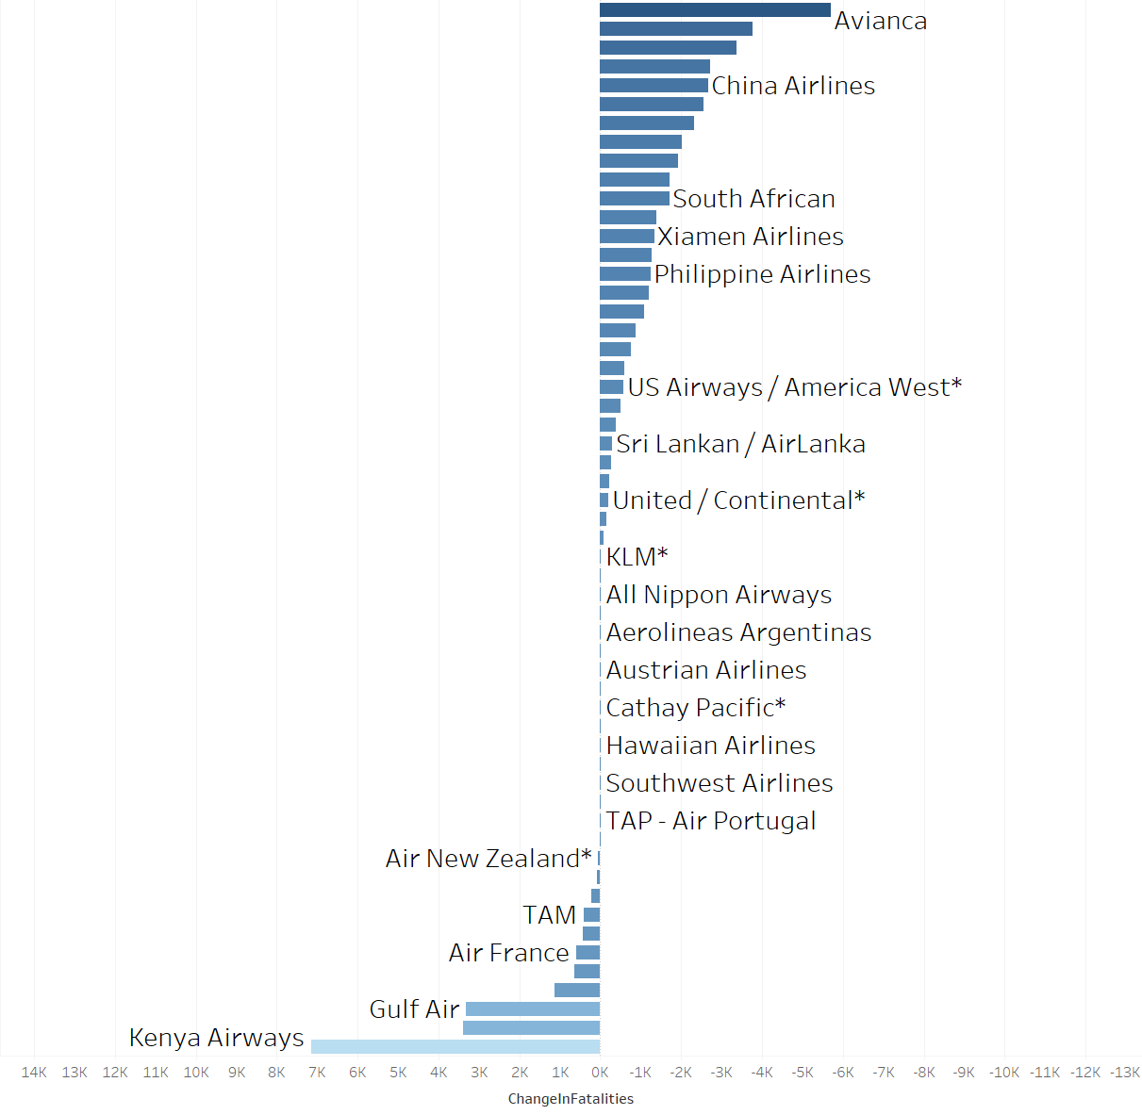
Very Few Risky Airlines
Number of risky airlines, based on the change in fatal crashes and fatalities, are decreasing continuously. Based on the dataset (2000-2014) risky airlines are only 9% of the total airline population.

Slide 7
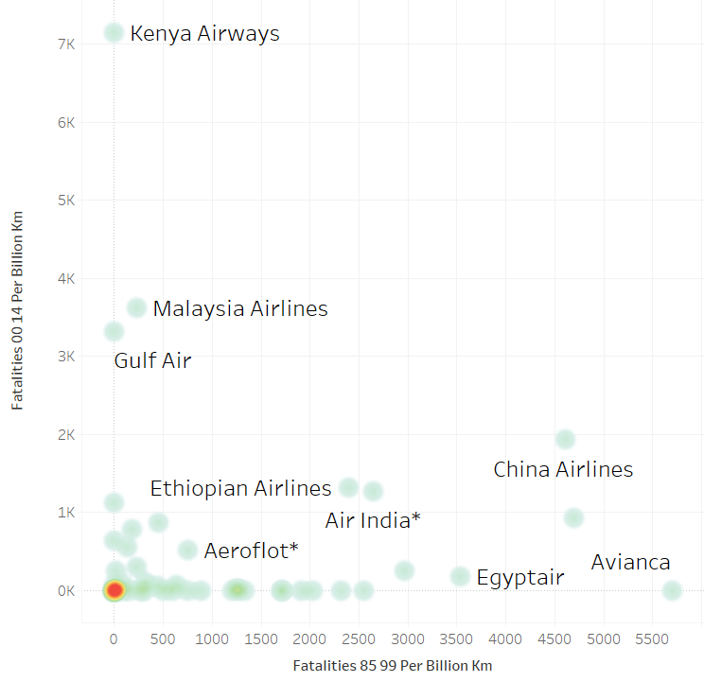
Fatalities By Airline
Average number of fatalities are very low for most of the airlines.

Slide 8
Conclusion
Overall, commercial airline travel is an extraordinarily safe means of transit. So if you're really worried about your safety while traveling, skip the road trip and head for the airport.

