Slide 1


Slide 2

EMPOWERING OUR COMMUNITY: ADDRESSING ELECTRICITY CHALLENGES AND SOLUTIONS
ICONS

Slide 3
7th goal of UNICEF SDI “ensuring access to clean and affordable energy”

Slide 4

A big challenge for everyone in the world today is to have access to clean and affordable energy while minimizing the use of fuels which emit greenhouse gases.

Slide 5
How would we solve this??
Power station called
VOLTEX

Slide 6
Flow diagram of the solution
Solar panel
inverter
Lithium battery station
Wind turbine

Slide 7


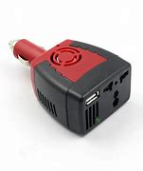
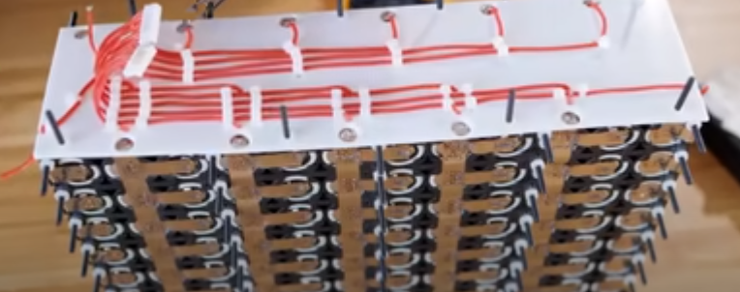
Cost efficient
Stores more energy
High degree of safety
Lithium-ion batteries
inverter
(DC to AC)
Lithium-ion battery system
Stores electrical energy
Solar energy (DC )

Slide 8
How Unique is it??
Portability
Highly efficient
Makes of use renewable energy resoures
Easy to use and maintain

Slide 9
BUSINESS MODEL

Slide 10
Cost structure
Research and development of new technologies
Sales and marketing
Application and Maintenance by receiving customers reviews
Customer relationship
Excellent customer maintenance service
Revenue streams
Sales of solar smart generator
Running ads on social media platform.

Slide 11
TRACTION (what have we achieved so far?)
Testing the volts generated in each motor
Improvement on the heating and cooling system
Searching for type of solar panel we need
Improvement on the motherboard

Slide 12

Ask for referrals.
Do campaign.
Form a coalition (get more people on board for renewable energy)
Discuss the benefits with neighbors.

Slide 13
Conclusion
In conclusion, Our business model offer a sustainable, cost effective solution to the electricity problem in our community while creating economic opportunity and fostering environmental stewardship. We invite you to join us on this journey towards a brighter future for all

Slide 14
Let's work together to create a future with reliable and accessible electricity for all

Slide 15
THANK YOU

