Slide 1
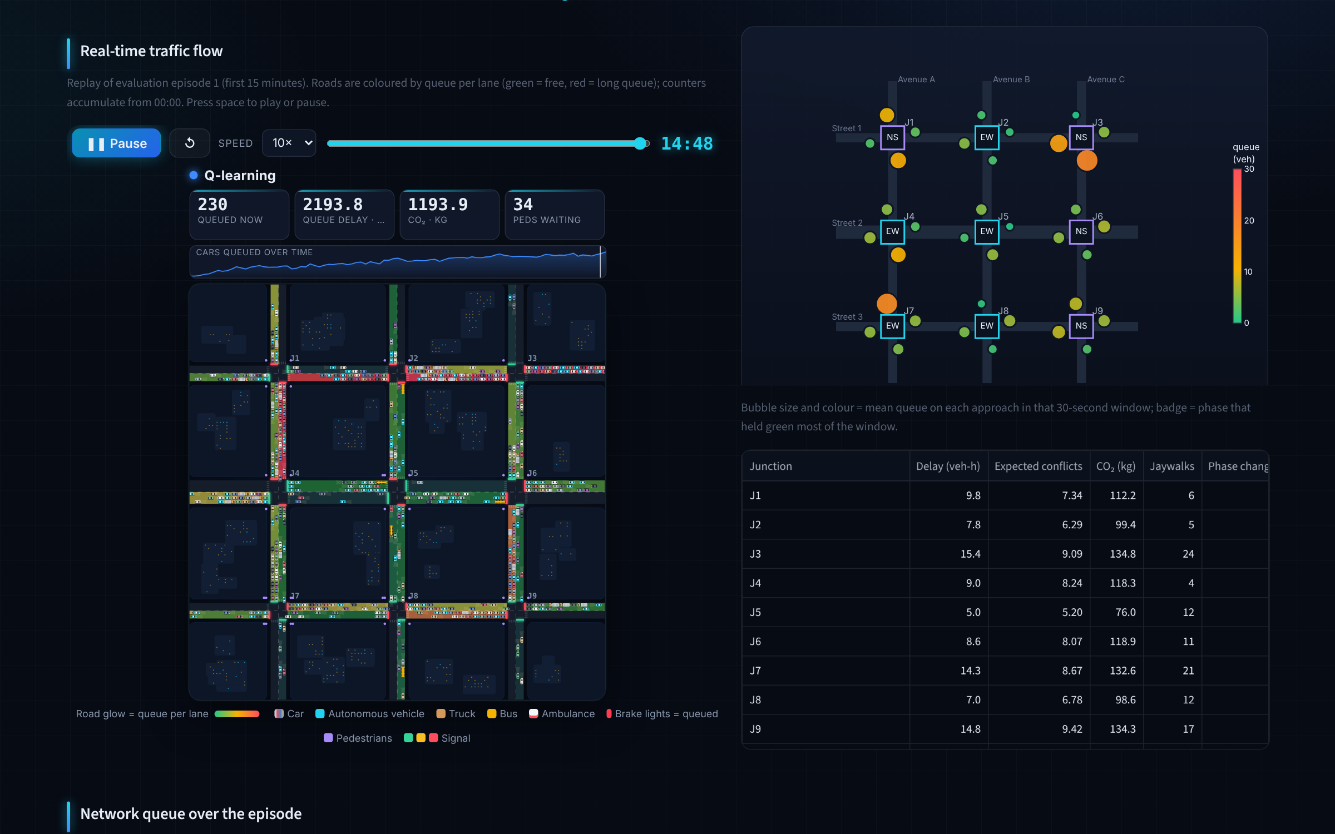
Smart Traffic Command Centre
GenAI-generated (Claude) · prompts in log
LIVE SIMULATION · ADAPTIVE SIGNAL CONTROL · 9 JUNCTIONS · 36 APPROACHES
Multi-agent Q-learning and SARSA for traffic lights, autonomous vehicles and buses, judged by a decision network on efficiency, safety and emissions
Group 2 · Siddal · Shashaank · Sparsh · Aradhana · Shirley · Reasoning and Decision Making under Uncertainty (MAIB DSC 103) · November 2026
Notes:
Open with the one-line story: cooperative autonomous-vehicle routing is the big, robust lever; RL signals learn the performance of a hand-tuned controller on their own; a safety supervisor makes RL as safe as actuated control at extreme demand; and a decision network tells the operator which combination to run. Everything you will see was simulated on a 3 x 3 Downtown-Dubai-style grid and is shown as a live simulation (a replay of simulated data, not live city feeds) in our dashboard.

Slide 2
What we set out to build
GenAI-generated (Claude) · prompts in log
1
2
3
4
5
Multi-agent system
Reinforcement learning
Decision network
Scenario experiments
Command dashboard
Traffic lights, autonomous vehicles and buses as learning agents
Q-learning and SARSA under peak hours, pedestrians, emergencies, weather
Influence diagram trading off efficiency, safety and emissions
Seven conditions, from normal flow to a sandstorm and an arena event
Live replays, decision analysis, KPIs and a simulation lab
LEAD
Siddal
LEAD
Shashaank
LEAD
Sparsh
LEAD
Aradhana
LEAD
Shirley
Goal: decide which control strategy a city should run, under uncertainty, and show the evidence honestly.
Reference article: Wairagade, A., Ugale, K. & Waghmare, R. (2025). AI-Powered Smart Traffic Management System for Urban Congestion Reduction. International Journal of Scientific Research & Engineering Trends, 11(2), 1997–2001.
Notes:
The brief had five parts and we delivered all five: the agent system, Q-learning and SARSA, a decision network, scenario-based experiments and a dashboard. Each part has one lead (next slide), but every one of us can explain the whole system. The project starts from the reference article by Wairagade, Ugale and Waghmare (2025), which proposes RL signal timing with an emergency override and a dashboard but reports no quantitative evaluation; we built and evaluated it.

Slide 3
Who did what: one lead per part of the brief
GenAI-generated (Claude) · prompts in log
PART
LEAD
RESPONSIBLE FOR
FILES
PRESENTS
Multi-agent system
Siddal
Agent design: states, actions, rewards for lights, AVs and buses; simulator and safety shield
config.py · traffic_env.py · agents.py
Slides 4–5
1
Reinforcement learning
Shashaank
Q-learning and SARSA training, model selection on validation runs, tuned baseline
experiments.py · robustness.py · extensions.py
Slides 6, 8–10
2
Decision network
Sparsh
Influence diagram, CPT learning, expected utility, value of information, sensing uncertainty
decision_network.py · sensing.py
Slides 7, 12
3
Scenario experiments
Aradhana
Seven scenarios, KPIs, statistics, AV and bus studies, data CSV
run_experiments.py · data/*.csv · notebook
Slides 11, 14
4
Command dashboard
Shirley
Streamlit dashboard, live-simulation replay, Simulation Lab, deployment
app.py · viz.py · sim_view.py · lab.py
Slides 13, 15
5
Every member can explain the whole pipeline end to end; the lead answers first on their part.
Notes:
One lead per part of the brief. Say your own contribution in one sentence, then hand over. If asked 'what did you personally do?', each lead answers for their part and can still explain the rest. (Group: edit the responsibilities so they match what each person actually did.)

Slide 4
Three kinds of agent share one road network
GenAI-generated (Claude) · prompts in log
Traffic lights × 9
Autonomous vehicles
Buses
STATE
STATE
STATE
Phase, green time, queues on green and red, arrivals, pedestrian / spillback flag (2,250 states)
Moves left, congestion on the two candidate links (64 states)
Schedule deviation, load, headway, signal ahead, cross queue (144 states)
ACTIONS
ACTIONS
ACTIONS
Keep or change phase every 5 s
Next link (cooperative routing), plus speed advisory and lane selection
Go, request priority, hold 20 s
REWARD (minimise)
REWARD (minimise)
REWARD (minimise)
Delay + 0.5 × pedestrian delay + conflicts + CO₂
Travel time + delay imposed on others
Passenger-minutes + schedule deviation + priority cost
Every controller passes the same safety shield: minimum green, pedestrian clearance, max green, emergency pre-emption, bus priority.
Notes:
Each agent has a state, actions and a reward, exactly as the brief asks. The signal reward weights pedestrians at half a vehicle and one expected conflict as 300 seconds of delay, so safety and emissions are inside the learning objective, not added afterwards. Autonomous vehicles now have three behaviours: cooperative routing, a speed advisory and lane selection. Buses can ask for priority or hold to even out headways.

Slide 5
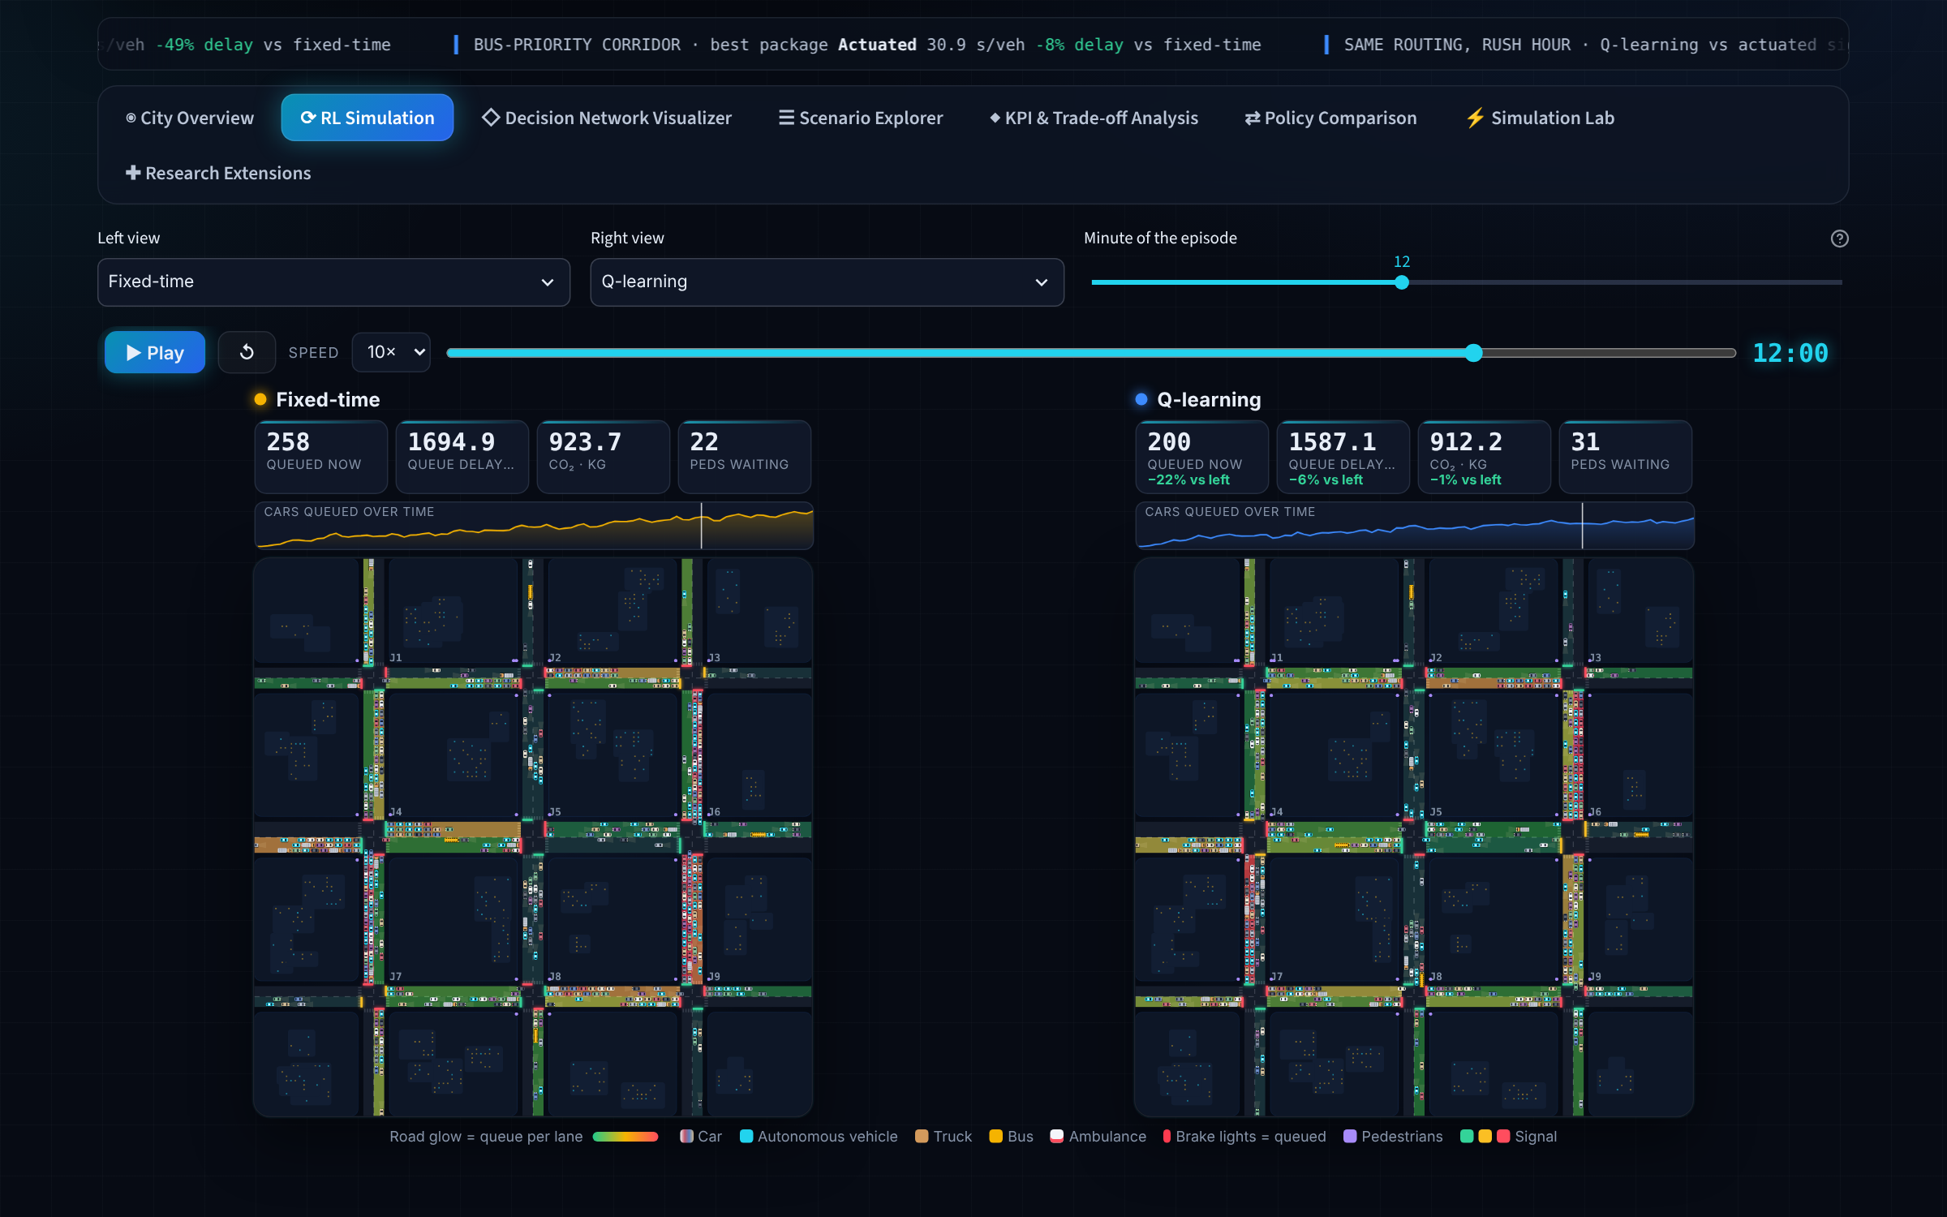
A Downtown-Dubai-style grid with seven operating conditions
GenAI-generated (Claude) · prompts in log
What the simulator models
Peak-hour demand ramps and a 3-lane corridor
Pedestrian crossings, waiting and jaywalking
Emergency-vehicle pre-emption
Rain and sandstorm capacity, speed and risk
Buses with stops, loads and a timetable
Scenarios
Normal flow
Rush hour
Incident
Rain
Sandstorm
Event surge
Pedestrian crossings and emergency vehicles run in every scenario (own sliders in the Simulation Lab). Same arrivals for every controller; 8 held-out test episodes.
Bus corridor
Notes:
Nine signalised junctions on 400 m blocks, modelled on Downtown Dubai and Business Bay. Each scenario is 30 simulated minutes. Pedestrian crossings and emergency vehicles are not separate scenarios: they run in every one of the seven, and the Simulation Lab has a slider for each. The screenshot is the dashboard replay: fixed-time on the left, Q-learning on the right, same arrivals, one clock. Cars show brake lights when queued, ambulances flash and overtake.

Slide 6
Agents learn on training runs and are judged only on unseen ones
GenAI-generated (Claude) · prompts in log
1
2
3
4
Pre-train
Adapt
Select
Report
280 episodes over every scenario, with randomised weather, pedestrians and demand
80 more episodes per scenario give a scenario-specific table
General or adapted table chosen on validation seeds 800,000+
8 test seeds 900,000+, never used to choose anything
2,250
15,120
72 → 82 s
states per junction: every decision can be read from the Q-table
rows in the main simulation log (junction × 30 s window)
rush-hour training delay rose with extra adaptation, so validation picked the general table
Notes:
Training is 280 pre-training episodes over all scenarios, then 80 adaptation episodes per scenario (not 360 pre-training episodes, as an earlier draft said). Why tables and not deep RL: 2,250 states per junction, every decision is inspectable, and training takes minutes on a CPU. The selection step matters: extra rush-hour training made the policy worse, and because we choose on validation episodes, not on the test episodes, the reported numbers are honest. Code: the Colab notebook linked on the last slide.

Slide 7
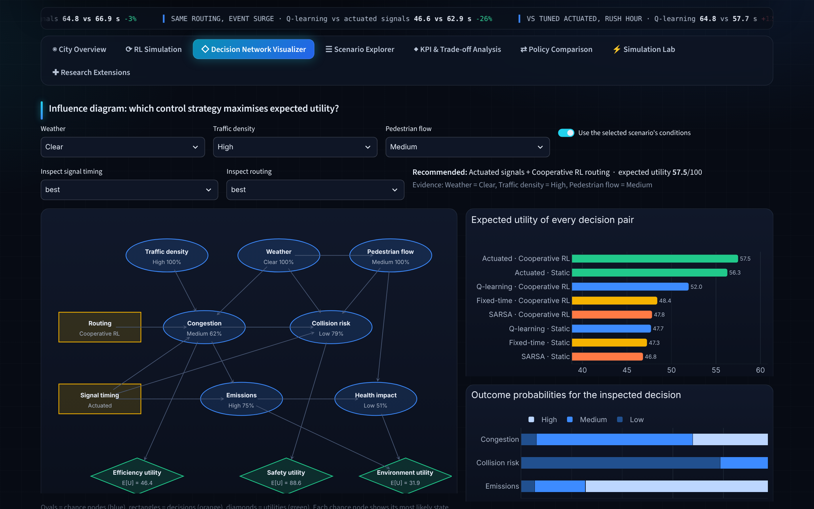
The decision network weighs efficiency, safety and emissions under uncertainty
GenAI-generated (Claude) · prompts in log
Chance: weather, traffic density, pedestrian flow → congestion, collision risk, emissions → health impact
Decisions: signal timing × routing (8 options)
Utilities: efficiency 0.40, safety 0.35, environment 0.25 (adjustable)
6 of 7
scenarios: best expected utility is actuated signals + cooperative RL routing (rain: actuated + static). Same pick in 22 of 27 weather × density × pedestrian conditions.
Probabilities learned from 11,664 simulated junction × 10-minute samples; value of information and weight sensitivity included.
Notes:
The influence diagram turns simulation results into a decision under uncertainty. Its recommendation, actuated signals with cooperative routing, is the same conclusion our fair-comparison experiment reaches later: the decision network saw it first. Two counts, both true: 6 of 7 scenarios, and 22 of 27 conditions when weather, density and pedestrian flow are crossed (the notebook's figure). The weights are on the dashboard sidebar and the ternary chart shows where the recommendation would flip.

Slide 8
RL packages cut delay most where demand spikes
GenAI-generated (Claude) · prompts in log
−41%
rush-hour delay, Q-learning package vs fixed-time (64.8 vs 109.3 s)
−49%
event-surge delay, Q-learning package vs fixed-time (46.6 vs 90.6 s)
In calm conditions all adaptive controllers are within a second or two of each other.
Notes:
Means over 8 held-out test episodes. A policy here is a package: Q-learning and SARSA mean RL signals plus cooperative AV routing; Actuated means actuated signals with static routes. The gains concentrate in rush hour and the event surge; in normal, rain and sandstorm conditions every adaptive controller is close. The next slide separates what the signals contribute from what routing contributes.

Slide 9
Cooperative AV routing is the biggest single lever
GenAI-generated (Claude) · prompts in log
−24%
routing alone under actuated signals (87.5 → 66.9 s)
−3%
Q-learning vs actuated signals with the same routing (66.9 → 64.8 s, p = 0.08, not significant)
Compare signal controllers only with the same routing, or the routing gain is credited to the signals.
Notes:
This is the most important analytical point in the project. The headline 41 % mixes two effects. Giving every controller the same routing shows routing does most of the work: 24 % under actuated signals. With routing held equal, Q-learning signals beat actuated signals by only 3 % in the daily peak, which is not statistically significant.

Slide 10
Against a tuned controller, RL signals tie: they learn expert performance unaided
GenAI-generated (Claude) · prompts in log
What we did
Tuned the actuated controller's four settings per scenario (81 combinations) on validation runs, then tested with the same routing as RL.
What it means
Event surge: a tie (46.6 vs 46.9 s)
Rush hour: tuned actuated is 11 % faster
RL reaches tuned-expert level without anyone hand-tuning it
Q-learning re-trained three times: rush hour 72.5 ± 2.1 s; we report this spread, not only the best run.
Notes:
A reviewer's first question is whether the baseline was fair: RL had 280 pre-training plus 80 adaptation episodes per scenario, the actuated rule had none. So we tuned it, choosing settings on validation runs only. The honest result: the event-surge win becomes a tie and tuned actuated is better in rush hour. Our claim is therefore not that RL beats experts, but that RL learns expert-level control without manual tuning, and that cooperative routing is the gain that survives. This agrees with the decision network.

Slide 11
AVs and buses do what the brief asks: speed, lanes and loads
GenAI-generated (Claude) · prompts in log
Autonomous vehicles
Bus loads
Safety model
−2.2%
35 → 1
90%
AV delay with lane selection (pass a waiting turner or a blocked exit)
passengers left behind per rush-hour window when buses run every 3 min
of 42 cases keep the same safest policy when any conflict mechanism is halved or doubled
Speed advisory: fewer stops, conflicts and CO₂, paid for with 7 % more AV delay. Effects grow with AV share.
Busiest buses are full whatever the holding strategy: capacity, not balance, is the constraint. RL buses keep the best on-time record (66 % vs 57 %).
Changes only swap the two non-learning controllers. The safety conclusion does not hinge on the uncertain parameters.
AV speed control, lane selection and bus load balancing are on the brief's agent list. Deployed Q-tables, 8 held-out test episodes, no retraining.
Notes:
These close the remaining review gaps. Autonomous vehicles now do speed control and lane selection, as the brief asks; at 25 % AVs the gains are small but real, and the Simulation Lab shows them growing with AV share. For buses, measuring loads showed the real problem is capacity, not balance. For the safety proxy, a sensitivity analysis shows our conclusions survive halving or doubling each conflict parameter.

Slide 12
Where is the uncertainty? Agents tested on wrong counts
GenAI-generated (Claude) · prompts in log
86%
of 84 scenario × sensing conditions keep the same verdict (RL package vs actuated) with counts 0.5–2× or noisy
+3% vs +1%
average delay change for RL vs actuated within 0.75–1.5× bias: RL leans on its counts more
47 → 60 s
Q-learning, event surge, 2× over-count; still ahead of actuated (65 s)
VOI ≈ 0
observing weather, density or pedestrians first would not change the decision network's choice
Worst case shown: event surge. Fixed-time uses no detectors (dashed). The traffic itself is unchanged; only what the controllers observe is wrong.
Also: safest policy unchanged in 90 % when the conflict model is halved or doubled; rush hour Q-learning 72.5 ± 2.1 s over three re-trainings; network probabilities are Laplace-smoothed estimates from simulation.
Notes:
Thirty-second answer to 'where is the uncertainty?'. Our agents normally see exact queue counts. Real counts come from detectors or phone data, and phone data has a likelihood bias: if the system assumes one phone per person and people carry two, it over-counts. So we re-ran the deployed agents with counts from half to double the truth, and with random counting noise, on the held-out test episodes of all seven scenarios. The verdict that matters, RL package versus actuated package, is unchanged in 86 % of the conditions; the flips are in calm scenarios where the two were already within a second. RL is more sensitive to bad counts than the simple actuated rule: in the event surge with a 2x over-count Q-learning goes from 47 to 60 seconds, still ahead of actuated at 65. So a real deployment would calibrate the counts or train on noisy ones. Other uncertainty evidence: value of information is about zero, the safety ranking survives halving or doubling the conflict model in 90 % of cases, re-training spread is 72.5 plus or minus 2.1 seconds, and the decision-network probabilities are smoothed estimates learned from simulation. Live: Simulation Lab, Sensing uncertainty.

Slide 13
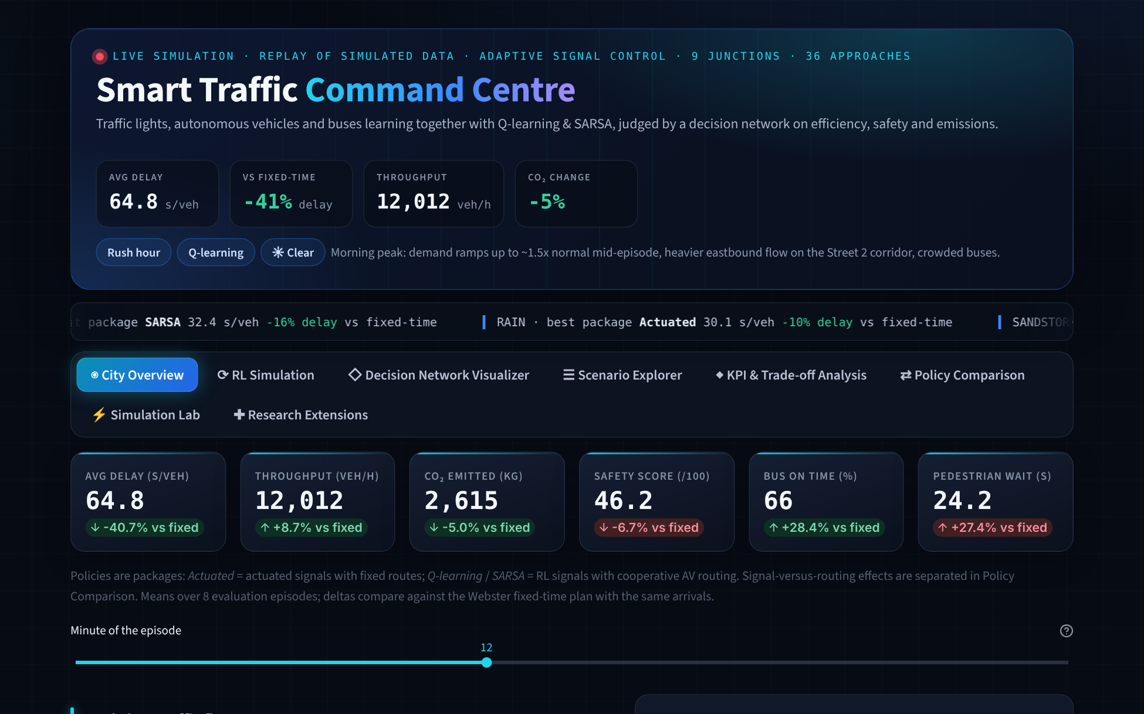
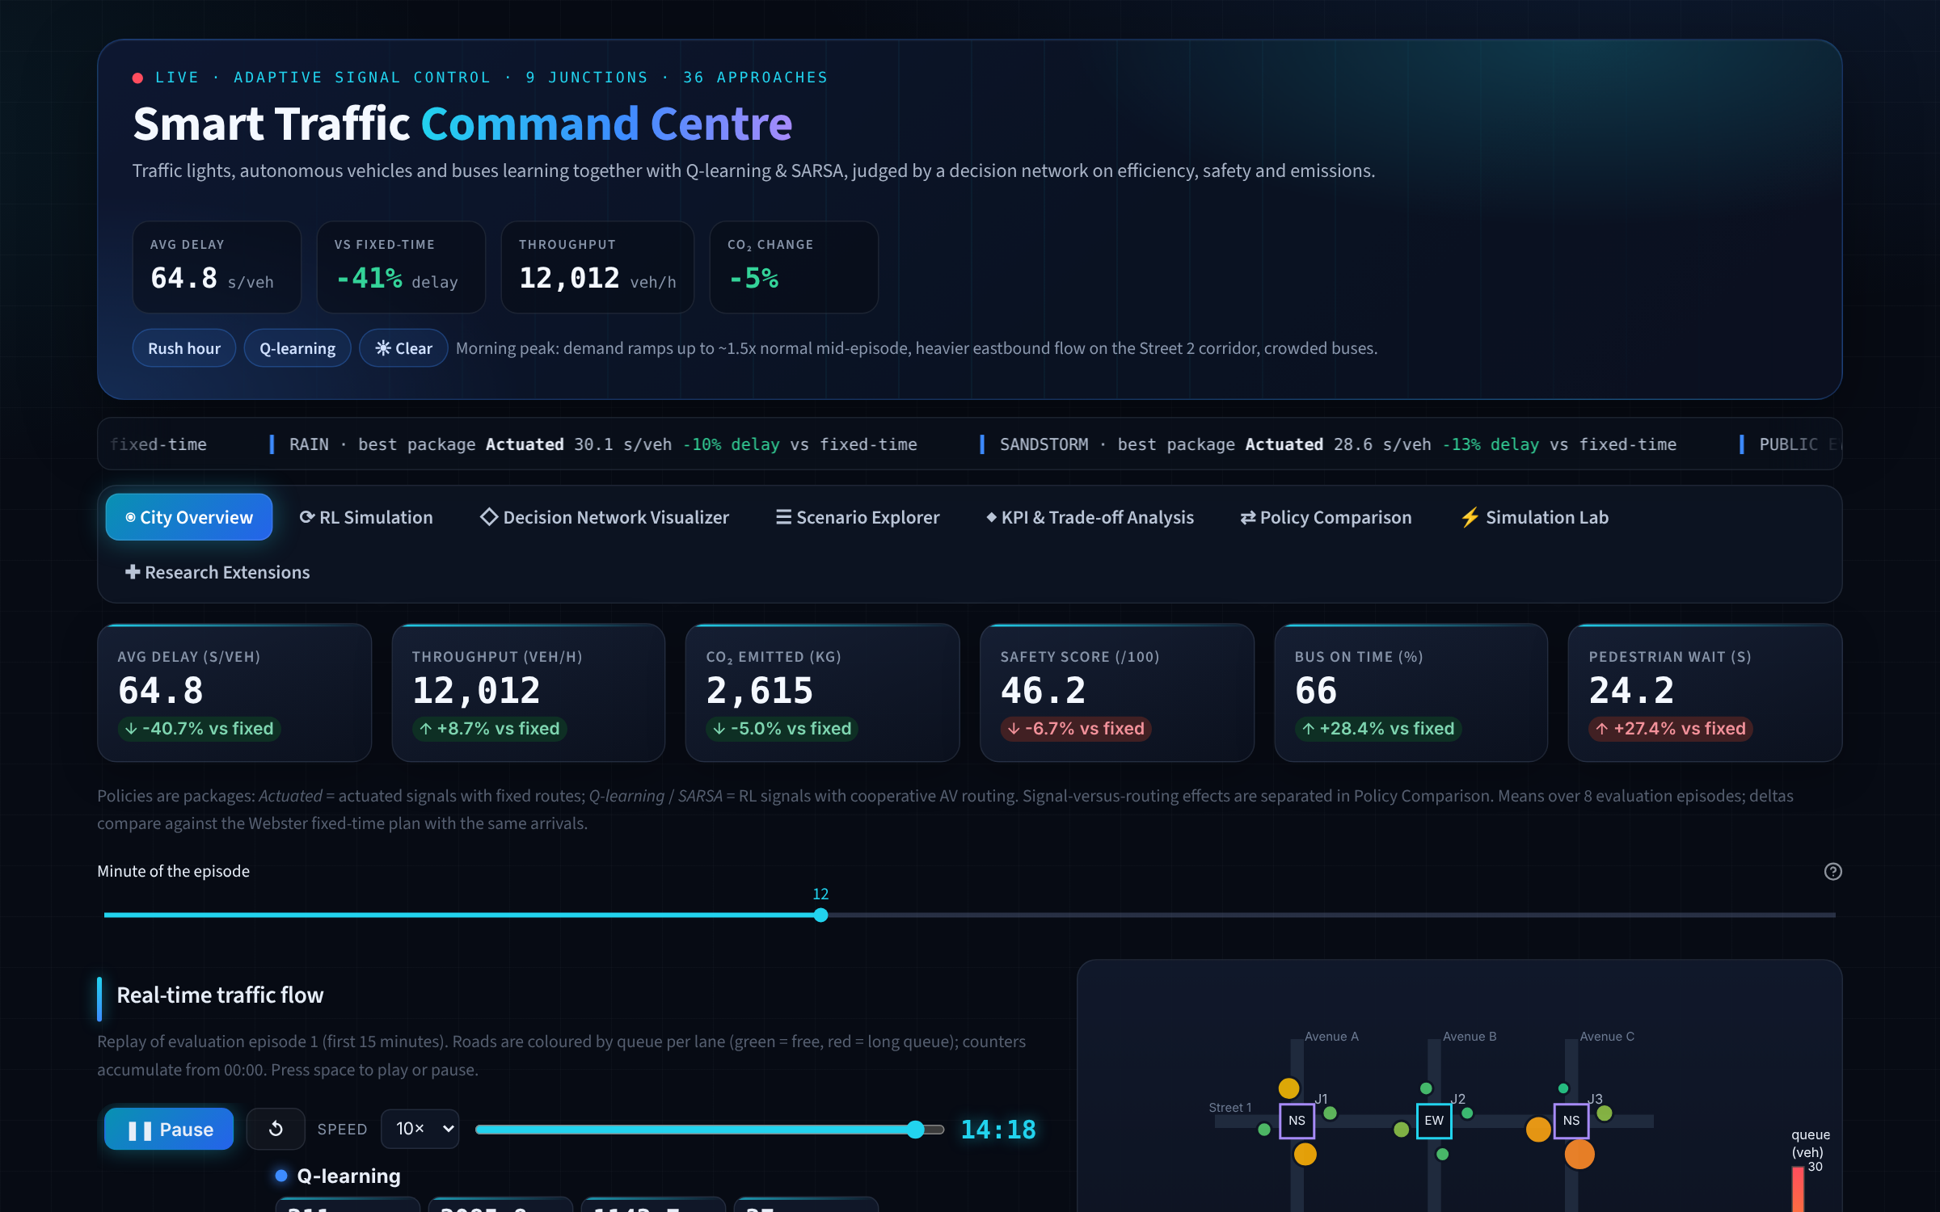
The dashboard: a live simulation of every result
GenAI-generated (Claude) · prompts in log
City Overview
live replay, KPIs, network map
RL Simulation
side-by-side replay, agent decisions, Q-tables
Decision Network
influence diagram and utilities
Scenario Explorer
seven conditions, distributions
KPI & Trade-offs
heatmaps, delay vs safety
Policy Comparison
signals × routing, statistics
Simulation Lab
live what-if with linked conditions
Research Extensions
six gap studies incl. sensing
Open it: https://smarttrafficu-mmzjikh5bg8frby3adzdc2.streamlit.app/ · if it shows “gone to sleep”, click the wake button and wait about a minute
Notes:
Call it a live simulation: it replays and re-runs simulated data, it is not a live city feed. Present it full screen (in a narrow window the KPI tiles shrink). The brief suggested six tabs; we built those plus a Simulation Lab and a Research Extensions view. Demo: City Overview, Rush hour, Q-learning, drag the minute slider to 12–15, where about 510 cars are queued under fixed timing against about 124 under Q-learning; then Policy Comparison for signals versus routing. Open the link a few minutes before the session so the app is awake.

Slide 14
What we would recommend to the city
GenAI-generated (Claude) · prompts in log
1
Deploy cooperative AV routing first
The largest gain (−16 to −24 % in rush hour) and it survives every fair comparison. Needs V2I communication.
2
Use RL signals where tuning is costly
They match a hand-tuned actuated plan without manual tuning and re-learn when conditions change.
3
Always run a safety supervisor
A pedestrian max-wait guard at high demand; switch it by demand level, not during an event surge.
4
Let the decision network choose
It recommends the combination for today's conditions and stakeholder weights, with value of information.
5
Add bus capacity, not just priority
In the peak, 3-minute headways remove almost all left-behind passengers.
Notes:
Close the results with a decision. The recommendation follows the evidence: routing first, RL signals as a self-tuning alternative to expert tuning, a safety supervisor always, the decision network to pick by condition, and bus capacity in the peak.

Slide 15
Limits we state openly
GenAI-generated (Claude) · prompts in log
Model
Scope
Safety is expected conflicts, a crash surrogate; the ranking is robust, absolute numbers are not crash rates
Agents were trained on exact counts; with biased or noisy counts RL loses more than actuated (verdict kept in 86 %)
Value of time is a U.S. figure (AED 51.8/h); NOx factors are order-of-magnitude
One synthetic 3 × 3 grid, not calibrated to observed Dubai counts
25 % AV share assumed; AV behaviours are V2I rules on top of learned routing
Tabular RL; deep RL would suit raw detector or camera inputs
Next: calibrate to RTA detector data, train on noisy counts, learn the speed advisory, and test a larger network.
Notes:
Being explicit about limits is part of the decision-science method. Every number is reproducible from the repository: run_experiments.py, robustness.py and extensions.py regenerate all data.

Slide 16
How we used GenAI (as the brief requires)
GenAI-generated (Claude) · prompts in log
Generated with Claude (Anthropic)
Code: simulator, agents, decision network, experiments, dashboard
Colab notebook text and the data it produces
First drafts of the specification, report and this deck
Every slide with AI content carries the amber dashed frame and the GenAI tag
Our own work
Problem framing and scope choices, review of every result, the decisions on what to keep and correct, and this presentation
[Group: add what each of you wrote or rewrote yourselves]
Prompts, verbatim, with dates
GenAI_disclosure_and_prompts.md in the submission
The brief: “encircle the GenAI generated content and share the prompt separately”.
Notes:
Be open about it: the brief allows GenAI if it is marked and the prompts are shared. Say what you checked and changed yourselves. (Group: complete the amber line.)

Slide 17
Thank you · Questions
GenAI-generated (Claude) · prompts in log
Live dashboard smarttrafficu-mmzjikh5bg8frby3adzdc2.streamlit.app/
Colab notebook colab.research.google.com/github/Sbot-c/Smart_Traffic_U/blob/main/Smart_Traffic_MARL_DecisionNetwork.ipynb
Code and data github.com/Sbot-c/Smart_Traffic_U
If the dashboard says “This app has gone to sleep”, click “Yes, get this app back up” and wait about a minute. No installation needed.
Notes:
Point to the links: the hosted dashboard (no installation) and the Colab notebook, both open for anyone with the link. Offer the live demo during questions: change a condition in the Simulation Lab and watch all four controllers re-run. Likely questions: 'Does RL beat normal signals?' Against fixed timing yes, −41 % delay in rush hour; signals alone tie a tuned controller; cooperative routing is the gain that holds up. 'What did you personally do?' Slide 3. 'Where is the uncertainty?' Slide 12.

Slide 18
Backup slides
For questions only: the pedestrian safety supervisor and the Simulation Lab.
Value of time (AED), AHP / TOPSIS and the other course techniques are in the dashboard and the notebook.
Notes:
Not part of the main talk. Use these only if asked.

Slide 19
A safety supervisor makes RL as safe as actuated control at extreme demand
GenAI-generated (Claude) · prompts in log
Diagnosis
At 1.6 × demand RL leaves pedestrians waiting 35 s on average, past the 30 s point where people jaywalk.
Fix
Serve a crossing once its first pedestrian has waited 30 s. Conflicts −43 %, still 13 % faster than actuated.
Stress condition: peak ramp at 1.6 × normal demand. The guard costs delay in ordinary rush hour (64.8 → 76.2 s) and should be off during an event surge: switch it by demand level.
Notes:
Our stress test found that RL's safety falls behind at very high demand. We traced it: the extra conflicts are jaywalking, because RL makes pedestrians wait too long. A simple supervisor on top of the learned policy, serve any crossing whose first pedestrian has waited 30 seconds, brings conflicts down to the actuated level while RL keeps most of its speed advantage. It is not free in ordinary rush hour, so it belongs in the operator's toolkit, switched on by demand level.

Slide 20
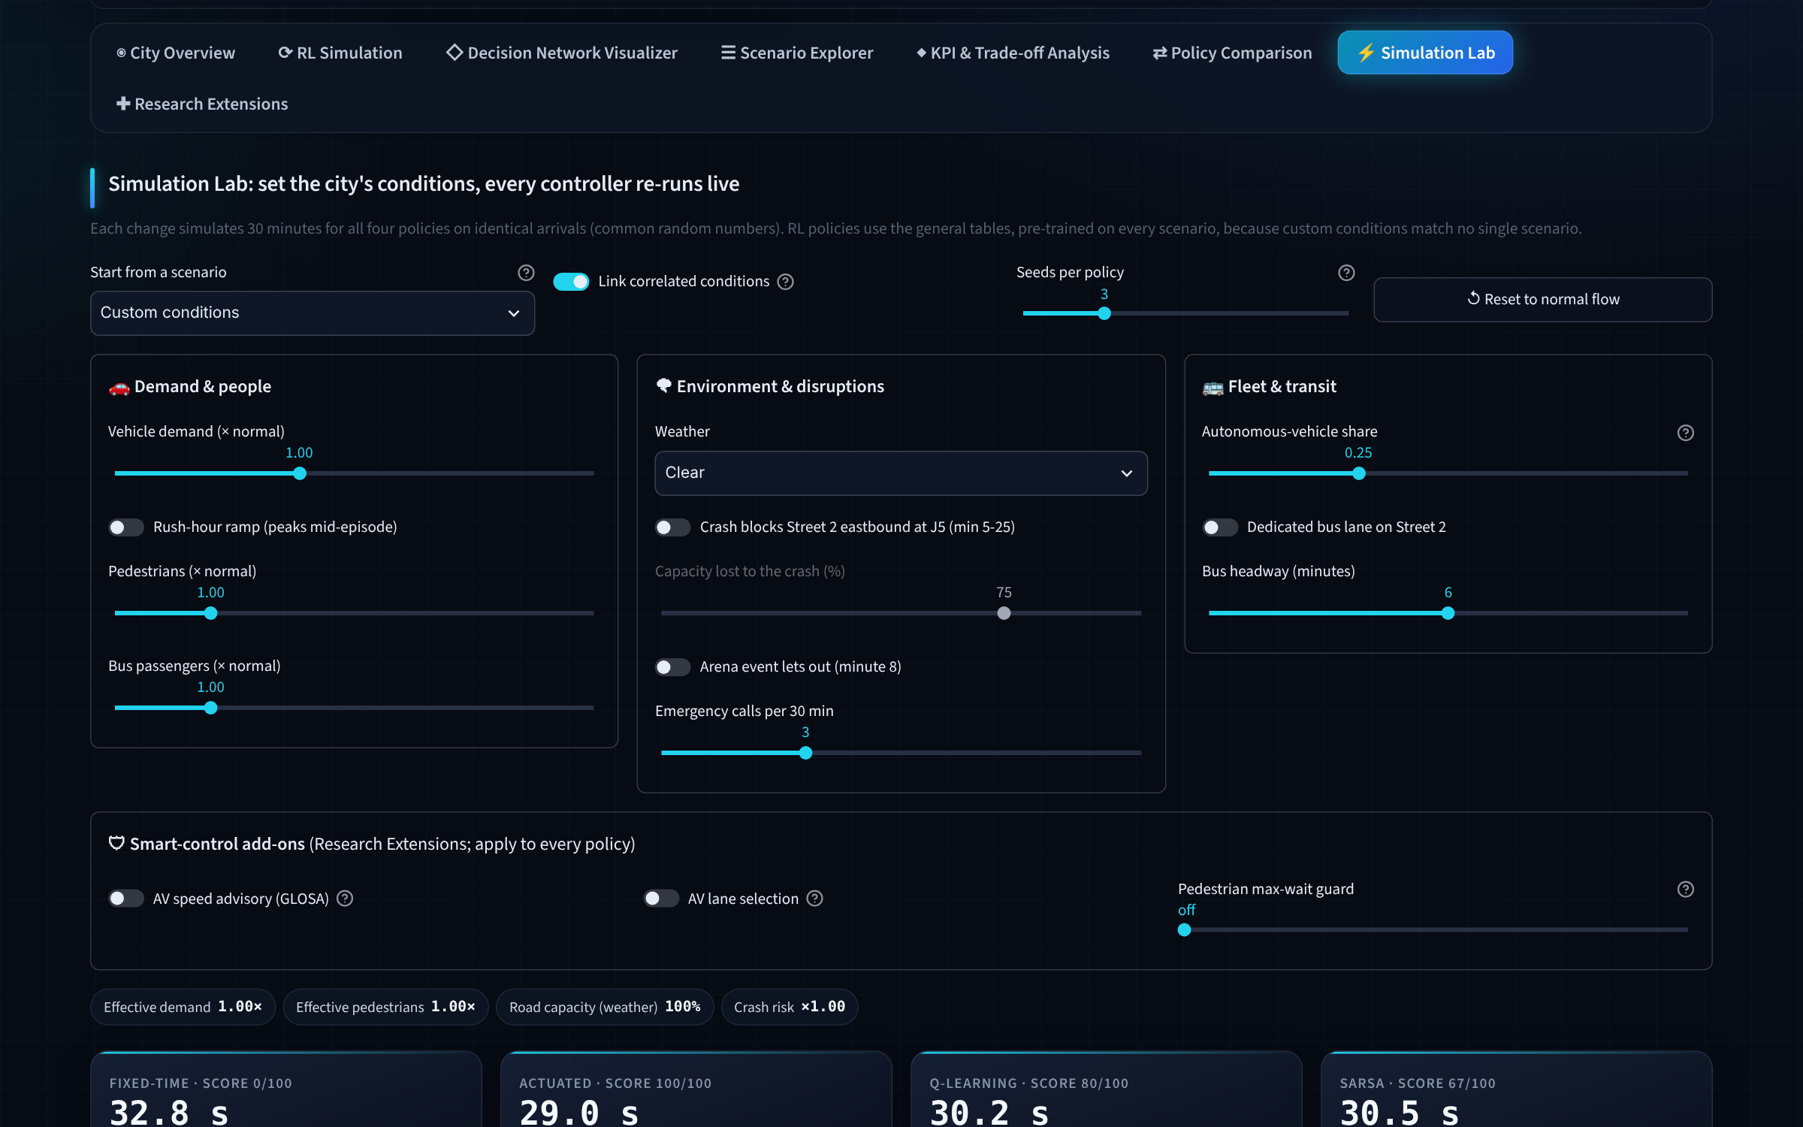
The Simulation Lab re-runs every controller live, with realistic linked conditions
GenAI-generated (Claude) · prompts in log
Eleven conditions, three add-ons
Demand, pedestrians, weather, crash, event, emergency calls, AV share, bus lane and headway; plus speed advisory, lane selection and the pedestrian guard.
Linked sliders move together
Rush hour → demand and pedestrians 1.3×
Demand → bus passengers (1.3 → 1.8×)
Rain, sandstorm, crash → more emergency calls
Bus lane → a bus every 3 minutes
Each change: simulation winner under the chosen weights next to the decision network's pick, a live replay and a stress test.
Notes:
The linked sliders use coefficients from our own scenario definitions, so loading a scenario reproduces it exactly: the rush-hour settings give 64.3 s against the published 64.8 s. Linking can be switched off to vary one condition at a time. Each run takes under a second.

