Slide 1
Maven
Maven is free and extensible and it’s distributed as a small core module. All features are implemented as plug-ins and are loaded on demand. These plug-ins are also stored in repositories. You (or other developers) can easily write plug-ins in Java or other scripting languages.
Maven is a powerful project management tool that is based on POM (project object model). It is used for projects build, dependency and documentation.

Slide 2
Maven as a Devops Tool
Apache Maven is an build tool mainly for Java applications to help the developer at the whole process of a software project.
What Maven does ?
Compilation of Source Code
Running Tests (unit tests and functional tests)
Packaging the results into JAR’s,WAR’s,RPM’s,etc..
Upload the packages to remote repo’s (Nexus,Artifactory)

Slide 3
Maven as a Devops Tool
We can easily build a project using maven.
We can add jars and other dependencies of the project easily using the help of maven.
Maven provides project information (log document, dependency list, unit test reports etc.)
Maven is very helpful for a project while updating central repository of JARs and other dependencies.
With the help of Maven we can build any number of projects into output types like the JAR, WAR etc without doing any scripting.
Using maven we can easily integrate our project with source control system (such as Subversion or Git).

Slide 4
Maven provides a simple way to set up projects that follow common best practices, including a default directory structure that makes it easier to understand how a project is structured. A consistent and unified directory structure simplifies software development and provides a standard based on industry best practices. Many Maven features, configurations, and settings are provided implicitly. You can change Maven’s default behavior at many points and can configure almost everything, but generally it’s better to stay with the commonly accepted conventions.

Slide 5
Lifecycles, phases, and goals
Maven requires that you describe what your project is doing. To this end, Maven offers lifecycles and individual phases that you can configure to tell Maven what to do in these phases.
→ Validate,Compile,Test,Package,Integration test,Verify,Deploy
compile — compiles the source code
test — executes unit test cases
package — bundles the compiled code (Ex: war / jar)
install — stores the built package in local Maven repository
deploy — store in remote repository for sharing

Slide 6
Maven and testing
Maven is ideally suited for running all your tests as part of your normal build setup. You don’t need a customized environment for different types of tests. Unit tests run by default, and integration tests are specified as a phase in the Maven build (between the packaging and the install phases). In this way, you can rely upon the previously built package, which can output a WAR file. To run your integration tests, you need to add and configure the dedicated plug-ins.

Slide 7
Maven component repositories
Maven repositories are essential for organizing build artifacts of varying types and their dependencies on each other. Two types of repositories are remote and local.

Slide 8
Core Concepts of Maven:
POM Files: Project Object Model(POM) Files are XML file that contains information related to the project and configuration information such as dependencies, source directory, plugin, goals etc. used by Maven to build the project. When you should execute a maven command you give maven a POM file to execute the commands. Maven reads pom.xml file to accomplish its configuration and operations.
Dependencies and Repositories: Dependencies are external Java libraries required for Project and repositories are directories of packaged JAR files. The local repository is just a directory on your machine hard drive. If the dependencies are not found in the local Maven repository, Maven downloads them from a central Maven repository and puts them in your local repository.
Build Life Cycles, Phases and Goals: A build life cycle consists of a sequence of build phases, and each build phase consists of a sequence of goals. Maven command is the name of a build lifecycle, phase or goal. If a lifecycle is requested executed by giving maven command, all build phases in that life cycle are executed also. If a build phase is requested executed, all build phases before it in the defined sequence are executed too.

Slide 9
4. Build Profiles: Build profiles a set of configuration values which allows you to build your project using different configurations. For example, you may need to build your project for your local computer, for development and test. To enable different builds you can add different build profiles to your POM files using its profiles elements and are triggered in the variety of ways.
5. Build Plugins: Build plugins are used to perform specific goal. you can add a plugin to the POM file. Maven has some standard plugins you can use, and you can also implement your own in Java.

Slide 10
Installation process of Maven
Verify that your system has java installed or not. if not then install java.
Check java Environmental variable is set or not. if not then set java environmental variable.
Download maven.
Unpack your maven zip at any place in your system.
Add the bin directory of the created directory apache-maven-3.5.3(it depends upon your installation version) to the PATH environment variable and system variable.
open cmd and run mvn -v command. If it print following lines of code then installation completed.

Slide 11
POM(Project Object Model)
Project Object Model (POM) is an XML file that has all the information regarding project and configuration details. The POM has the description of the project, details regarding the versioning, and configuration management of the project.
The XML file is located in the project home directory. When you execute a task, Maven searches for the POM in the current directory.

Slide 12
The Need for Maven
Maven is chiefly used for Java-based projects, helping to download dependencies, which refers to the libraries or JAR files. The tool helps get the right JAR files for each project as there may be different versions of separate packages.
After Maven, downloading dependencies doesn’t require visiting the official websites of different software. You can visit mvnrepository to find libraries in different languages. The tool also helps to create the right project structure which is essential for execution.

Slide 13
Steps/Process Involved in Building a Project
Add or write the code to create the application creation, and process it into the source code repository.
Edit any necessary configuration / pom.XML / plugin details.
Build the actual application.
Save your build process output as either a WAR or EAR file to a local server or other location.
Access the file from the local location or server and deploy it to the production or client site.
Update the application document by changing the date and updated application version number, if necessary.
Create and generate a report as requested for the application or the requirement.

Slide 14
Advantages of Maven
Helps manage all the processes, such as building, documentation, releasing, and distribution in project management
Simplifies the process of project building
Increases the performance of the project and the building process
The task of downloading Jar files and other dependencies is done automatically
Provides easy access to all the required information
Makes it easy for the developer to build a project in different environments without worrying about the dependencies, processes, etc.
In Maven, it’s easy to add new dependencies by writing the dependency code in the pom file

Slide 15
Disadvantages of Maven
Maven requires installation in the working system and the Maven plug-in for the IDE
If the Maven code for an existing dependency is unavailable, you cannot add that dependency using Maven itself.
Some sources claim that Maven is slow.

Slide 16
Companies Using Maven
Accenture
JPMorgan Chase & Co
Via Varejo
craft base
Red Hat
Mitratech Holdings, Inc.
KRG TECHNOLOGIES
Radio - Canada

Slide 17
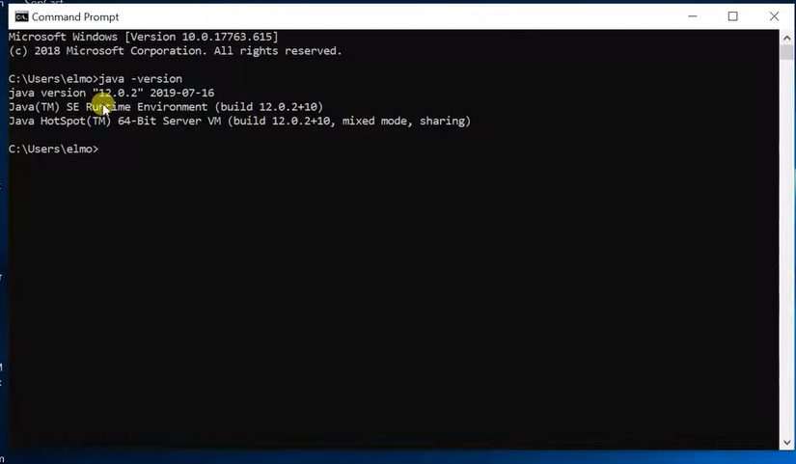

Slide 18
