Slide 1


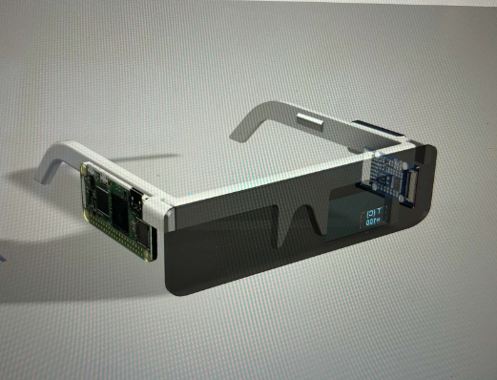
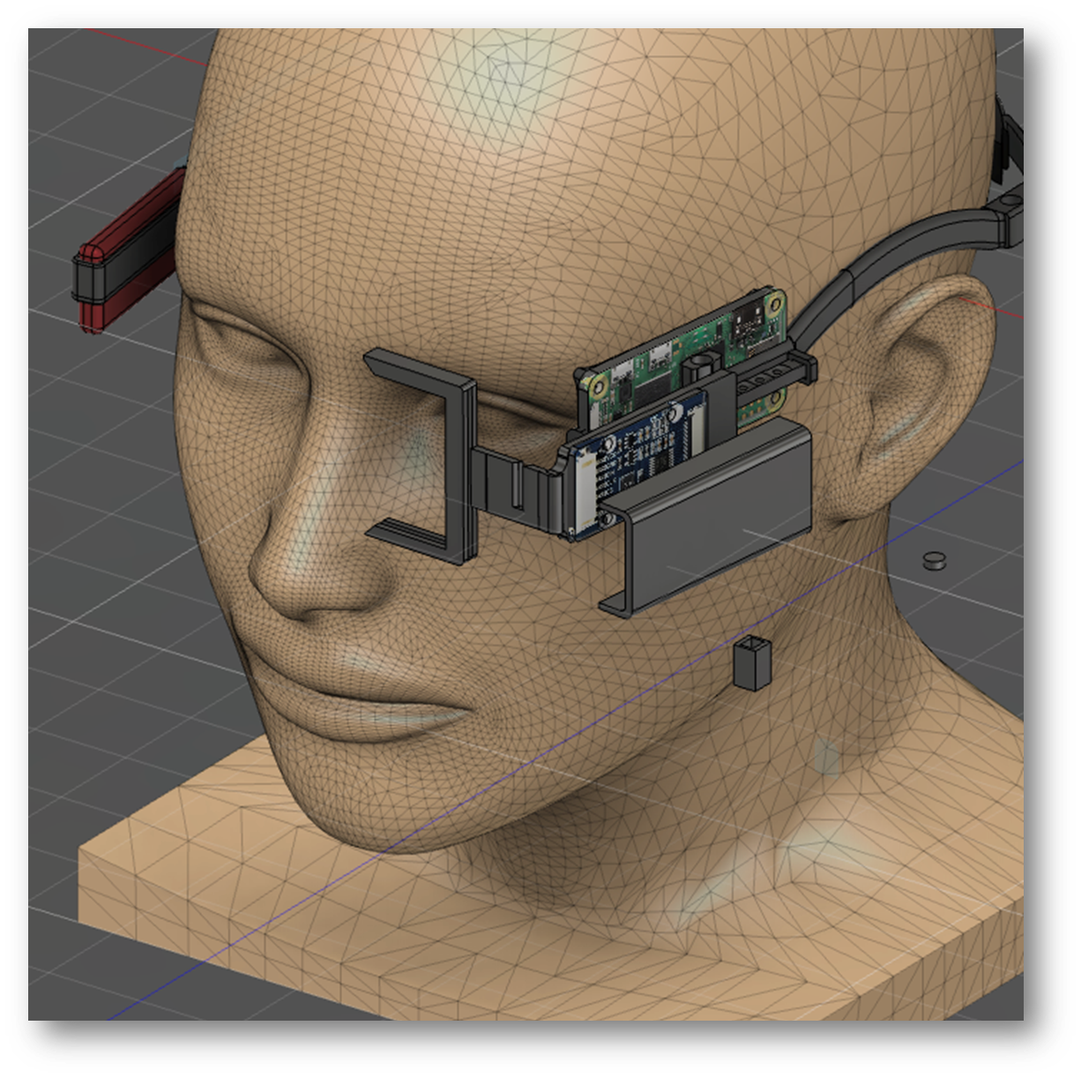

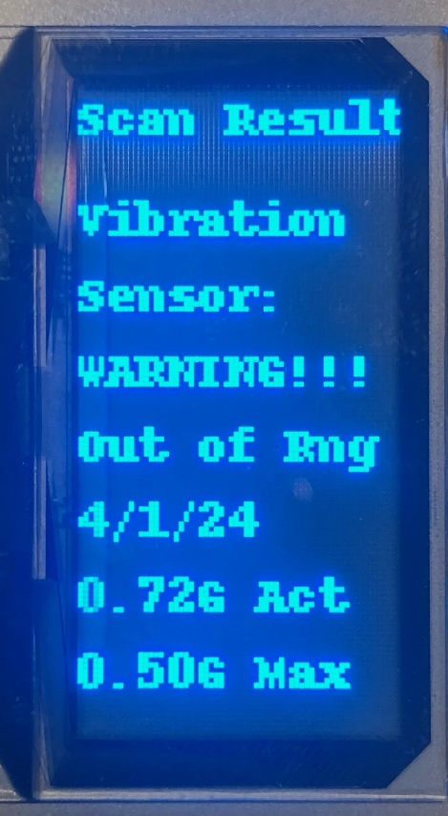
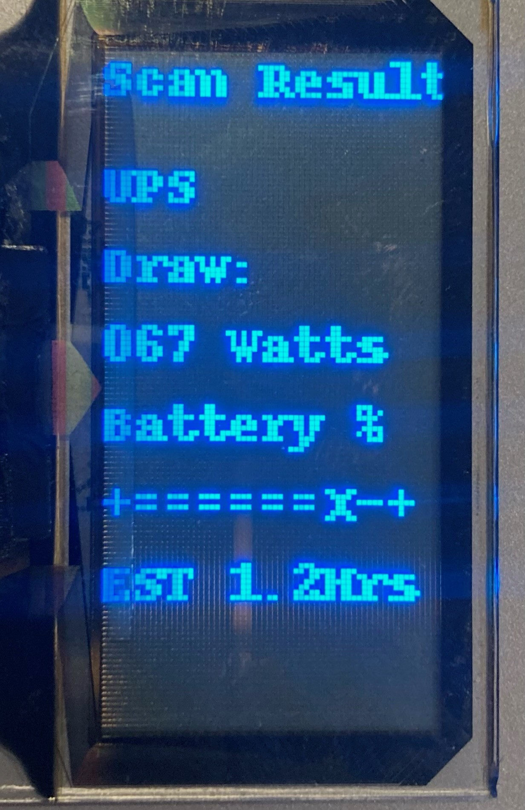
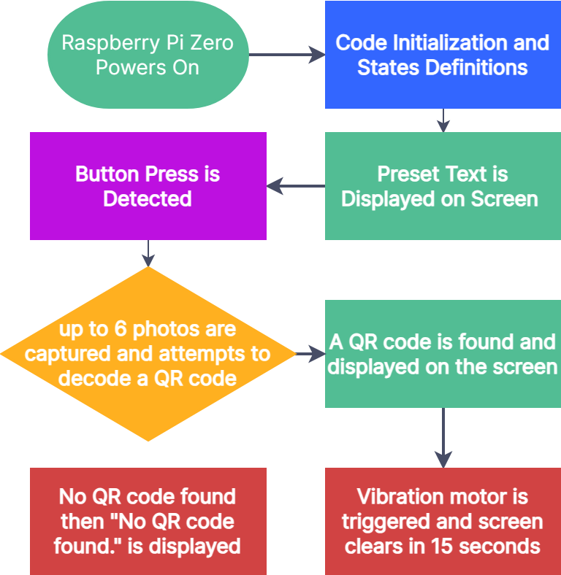


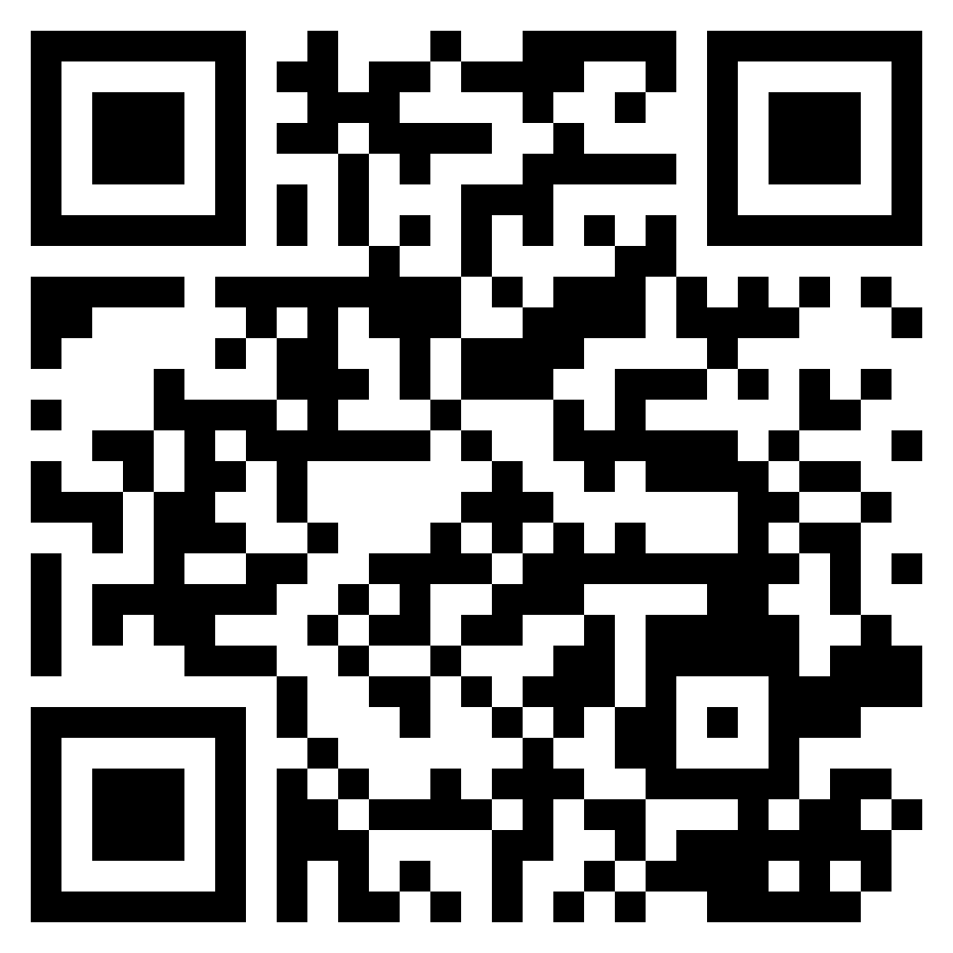
interactive IoT demonstrations
AR Smart headset A.R.S.H.
Project Objectives and Goals
Develop an AR headset capable of reading and displaying data through images.
Requirements:
Hardware:
Create a lightweight ergonomic headset for AR sensor integration
House a computer camera and battery without being intrusive to the wearer
Software:
Capture and Decode QR codes, Interpret external sensor data
Detect user input to execute the code
Output sensor data onto the Screen Efficiently
Design:
Our Final design incorporates an adjustable slider to in order to achieve the optimal distance from the users eyes. This design of the headset focuses on minimizing the impact on the wearer by providing a balanced and evenly distributed footprint.
Through our continued innovation, we’ve had to drastically change our initial design. We found that the most effective way to present data to the wearer is by positioning the screen just outside their direct line of sight, yet within their peripheral vision. Allowing users to access the information conveniently when they shift their focus, without it obstructing their primary field of view.
Code
The chart below serves as the translation of our Python code, enabling the AR glasses to interpret QR codes. This functionality provides a bridge between digital information and human perception. By scanning QR codes,
Uses
Our device is designed with ease of use in mind, making it an ideal match for Hartford Steam Boiler’s interactive IoT demonstrations. Equipped with Bluetooth and Wi-Fi capabilities, the Raspberry Pi Zero 2 W ensures inexpensive connectivity with industry support. Other projected uses of the headset include electricians with detecting live wires or monitoring energy usage.
QR code:
contains
mock sensor data corresponding to
“UPS” Uninterrupted
Power supply
Parts List:
Raspberry Pi Zero 2 W w/ SD card
Raspberry Pi Camera 2
1.51inch Transparent OLED Display
1000mah li-ion Battery
2 amp BMS with 5v out/in
3D Printer Filament
Button & Vibration Motor
Software:
Python3
Thonny IDE
Raspberry Pi OS
Fusion 360
Kiden Scruton
Programmer
Procurement Lead
Justin Niziolek
Co-Designer
Manufacturing Lead
David Cole
Co-Designer
Ergonomics Lead
Acknowledgements :
Thanks to the University of Hartford and Hartford Steam Boiler for Funding this Project and thanks to Prof. Obst for his help on this project
Scruton@hartford.edu
Niziolek@hartford.edu
Dcole@hartford.edu

