Slide 1
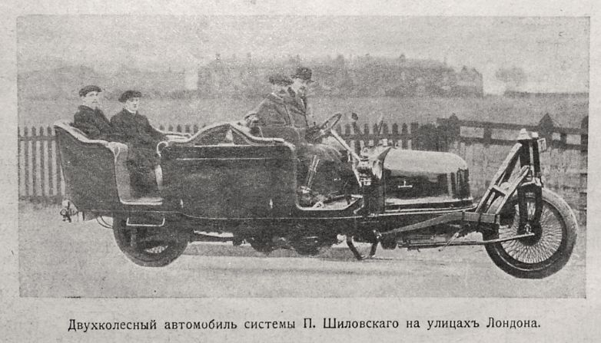
Gyro-Stabilized Inline Skateboard
By: Kiden, Evan, & Willona
Professor Campana ME 505 / 405: MW 6:30-7::45
May 12th, 2025

Slide 2
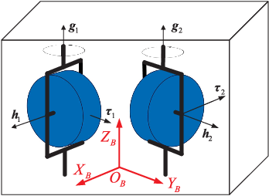
Project Background
Develop a self-balancing two-wheeled electric scooter.
Utilize dual counter-rotating gyroscopes for roll stabilization.
Implement a LabVIEW-based control system.
Applications:
- Urban personal transport
- Mobility innovation platforms

Slide 3
Sensor and Actuators
Sensor:
- IMU: MPU-6050
Actuators:
- 2 x Stepper motors Nema 17 Motor 42BYGH (for gimbal precession)
- 2 x DC/BLDC motors (for gyro spin)
Arduino Uno for data acquisition and LabVIEW

Slide 4
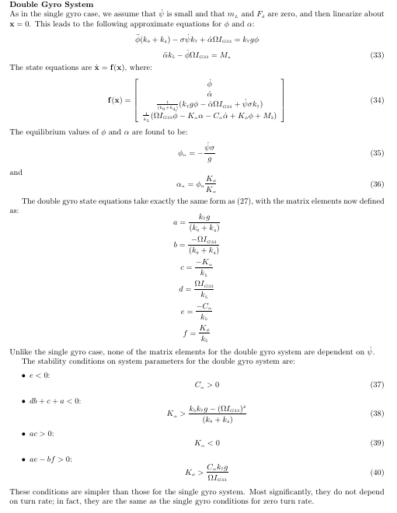
Mathematical Background
Dual counter-rotating gyroscope system
Gimbal frame assemblies
Stepper-actuated gimbal tilt mechanism
Scooter chassis with inline wheels

Slide 5
Governing Equation
(I_b)*​ϕ¨​+(2(I_s)​ω(K_d)​)ϕ˙​+(mgh+2(I_s)​ω(K_p)​)ϕ=0
As derived in “Gyrostabilizer Vehicular Technology” by Townsend and Shenoi. The equation above represents the governing equation for a contra-rotating gyroscopic stabilization system.
I_b​ = MOI of the vehicle about the roll axis
ϕ = Roll angle
ϕ˙​ ,ϕ¨​ = Roll rate and roll acceleration
I_s​ = Moment of inertia of one flywheel
ω = Flywheel spin rate (rad/s)
K_p​ , K_d​ = Control gains for position and velocity (PID-like gains)
mgh = Gravitational restoring torque (mass × gravity × height of CG)
(I_b)*​ϕ¨ -> This represents the internal resistance to change calculated by the roll acceleration and the MOI about the roll axis ie roll inertia
(2(I_s)​ω(K_d)​)ϕ˙​ -> This represents the damping and prevents overshooting and oscillation. To increase or decrease the damping you change the var K_d
(mgh+2(I_s)​ω(K_p)​)ϕ -> This Represents the centering force AKA now hard the device attempts to right itself upwards. To change the strength, change the value of the var K_p. This eq also shows the deviation from the desired roll angle.

Slide 6
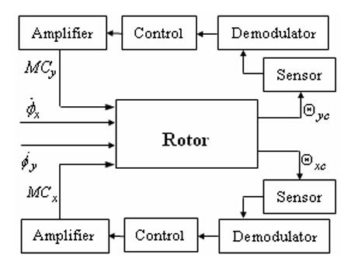
Block Diagram
DTG Control System Purpose:
Tracks rotor motion relative to the case while measuring angular rate.
The rotor acts as the plant controlled by two primary loops:
Direct channel control loop.
Inverse channel control loop (refer to Figure 3 in the paper).
Electronic Circuitry Components (see Figure 4):
Includes an oscillator that excites four primary pick-off coils (two per axis).
Coil voltages feed into a demodulator for:
Signal rectification.
Filtering.
Combination with complementary pickoff signals.
Key Functionality:
Ensures effective signal processing for precise rotor tracking.
Enables accurate angular rate measurement.

Slide 7
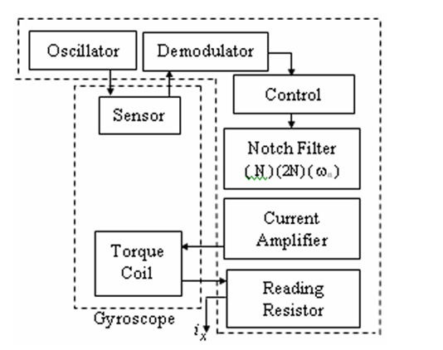
Fig. 4. Main Components of the Control System Electronics (Modeling and Analysis of a Dynamically Tuned Gyroscope)

Slide 8
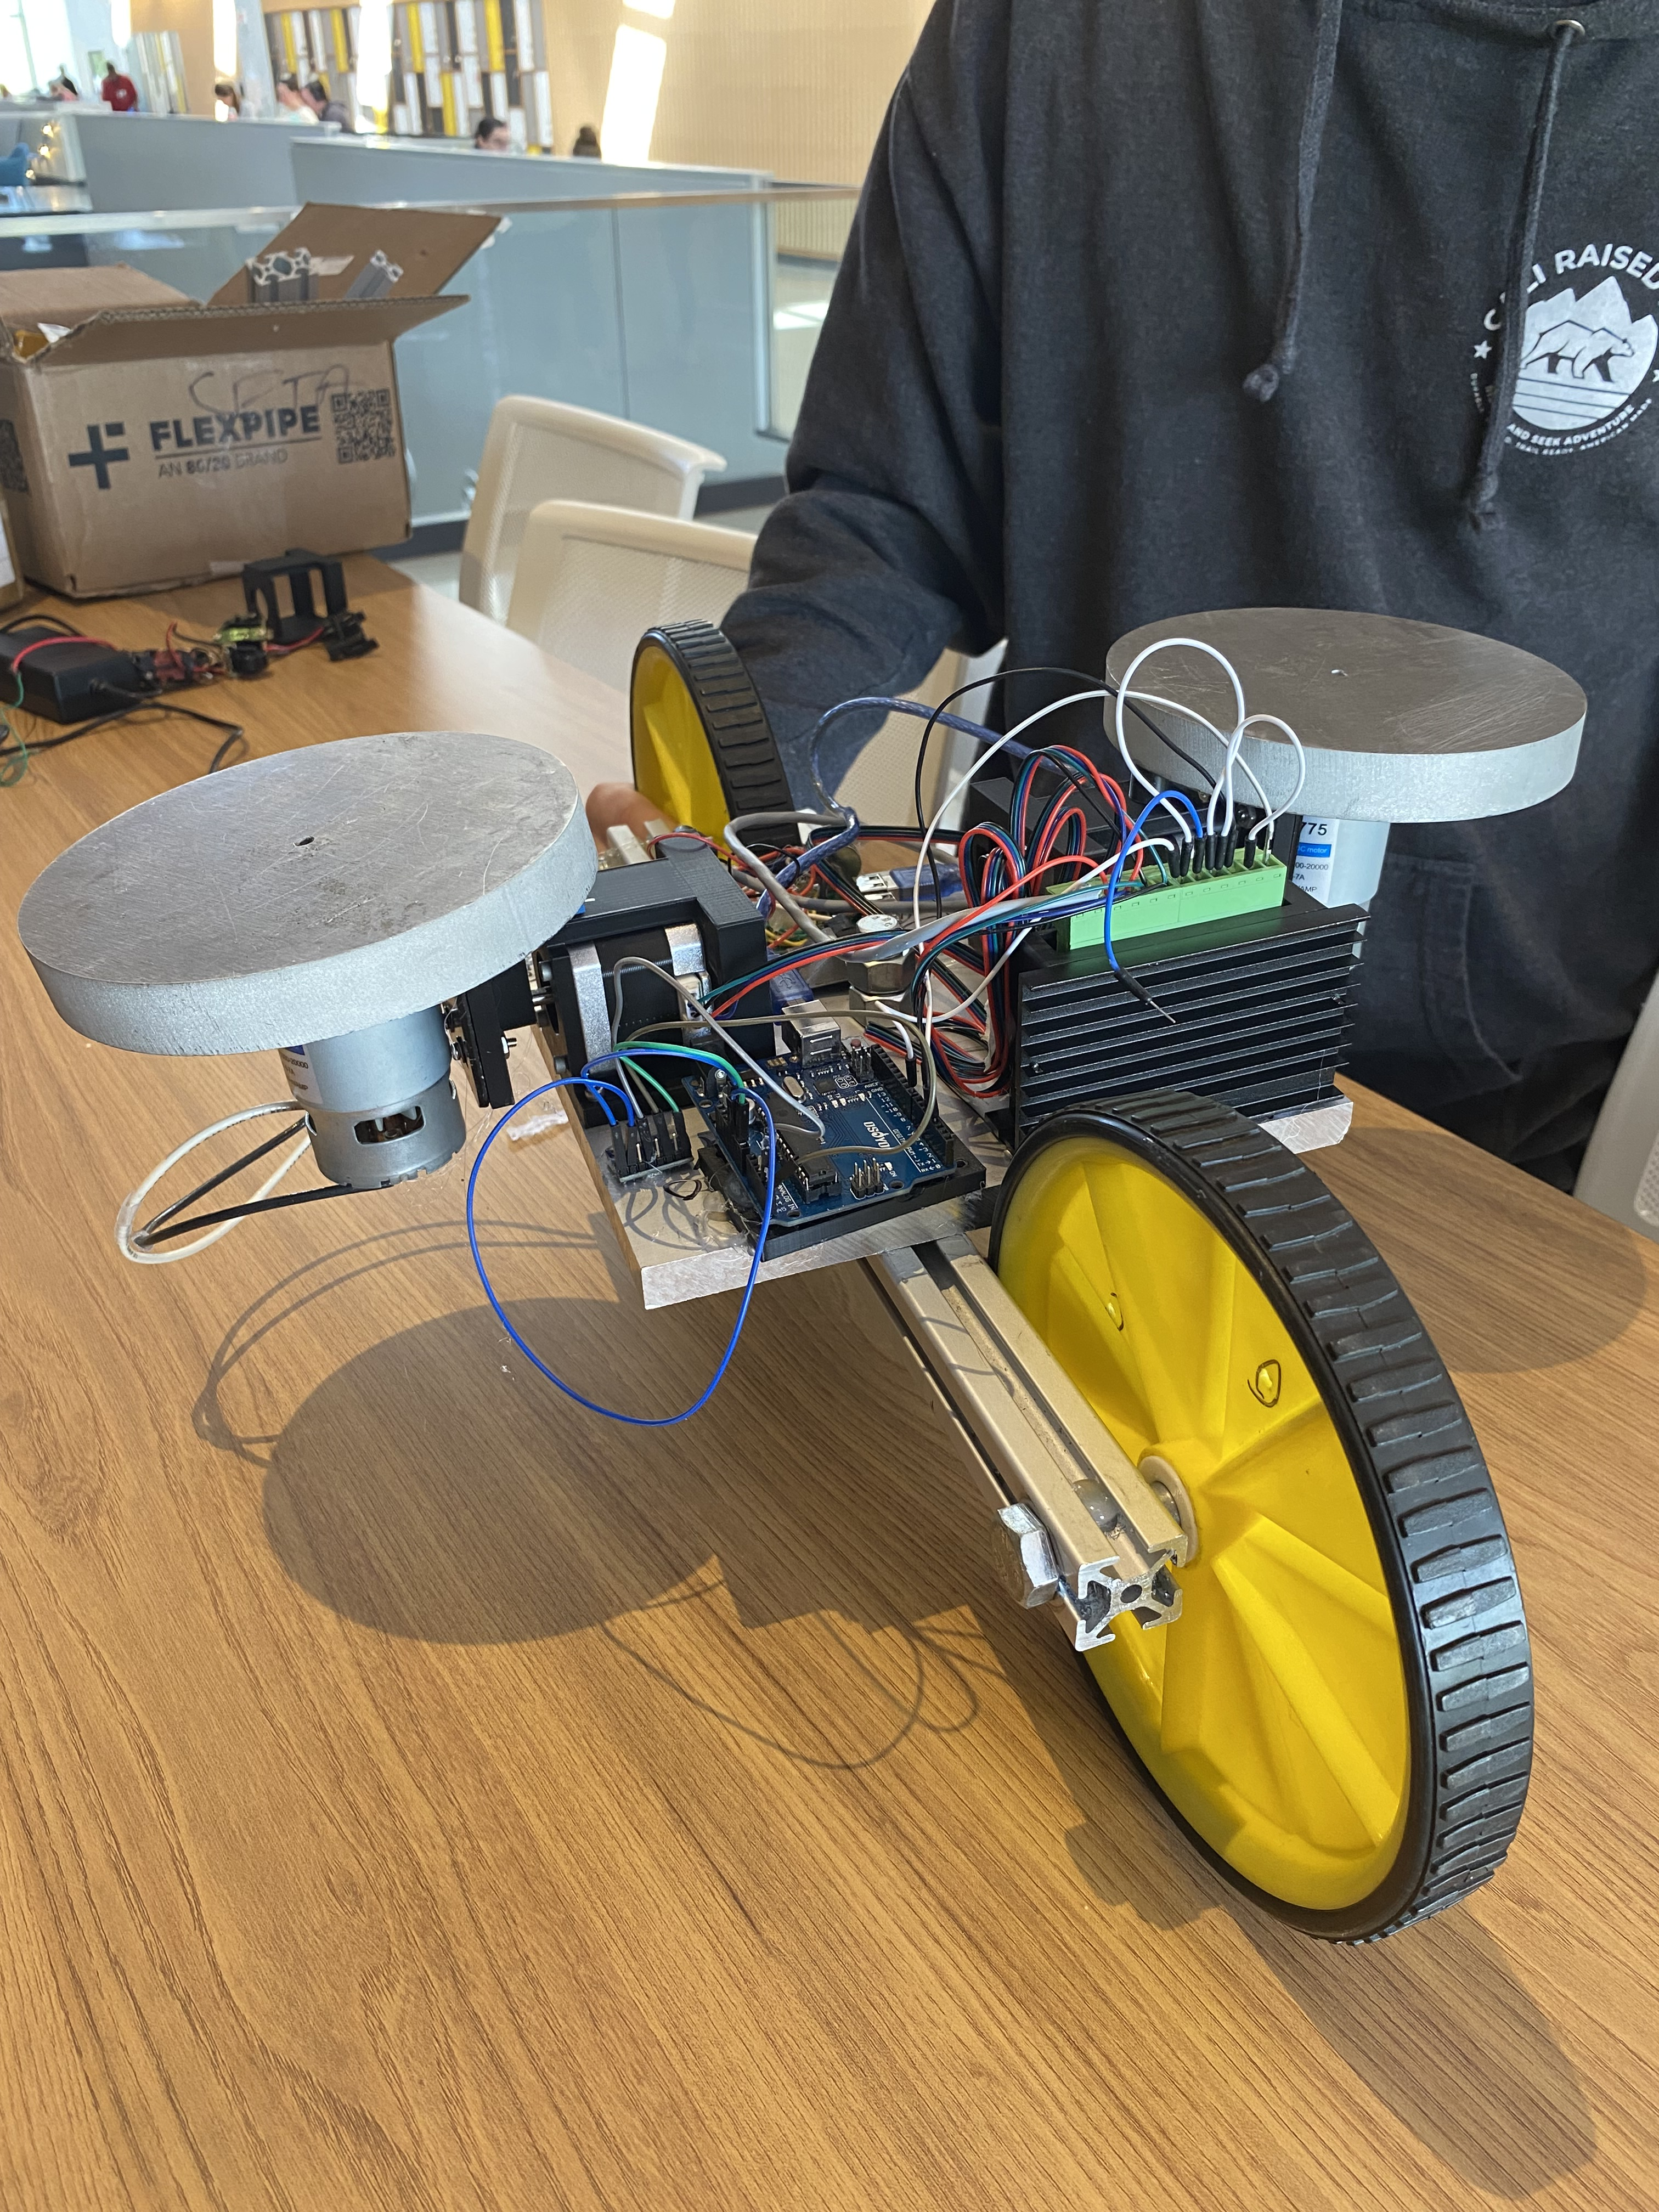
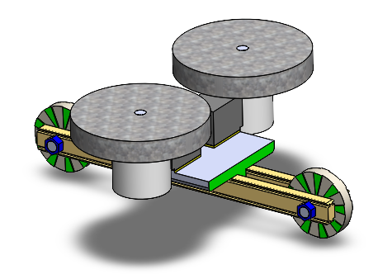
Design Process
Scooter Frame Concept
Gyro Mounting Assembly (CAD)
Gimbal Pivot System (CAD)

Slide 9


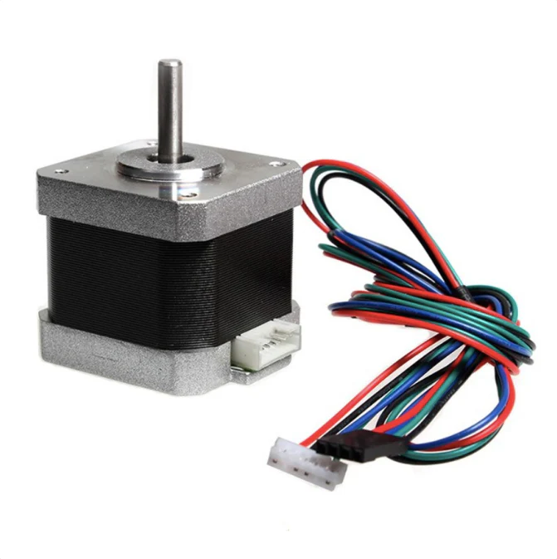
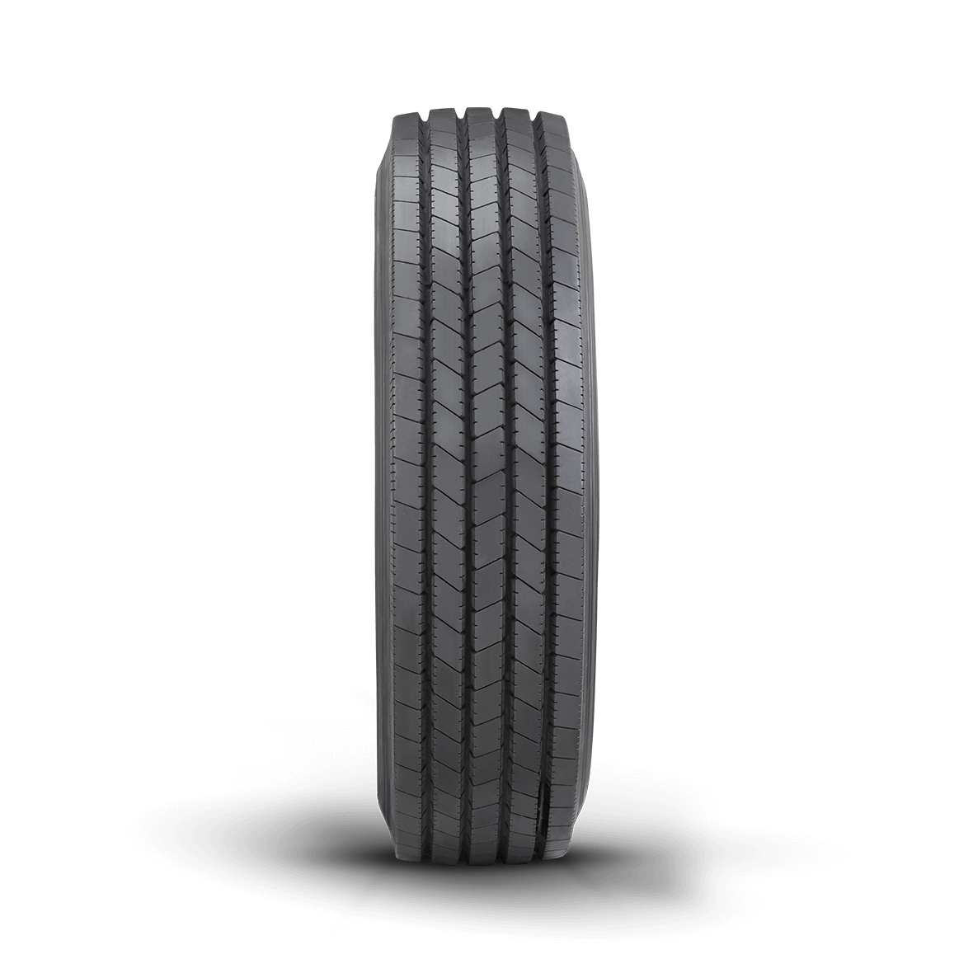
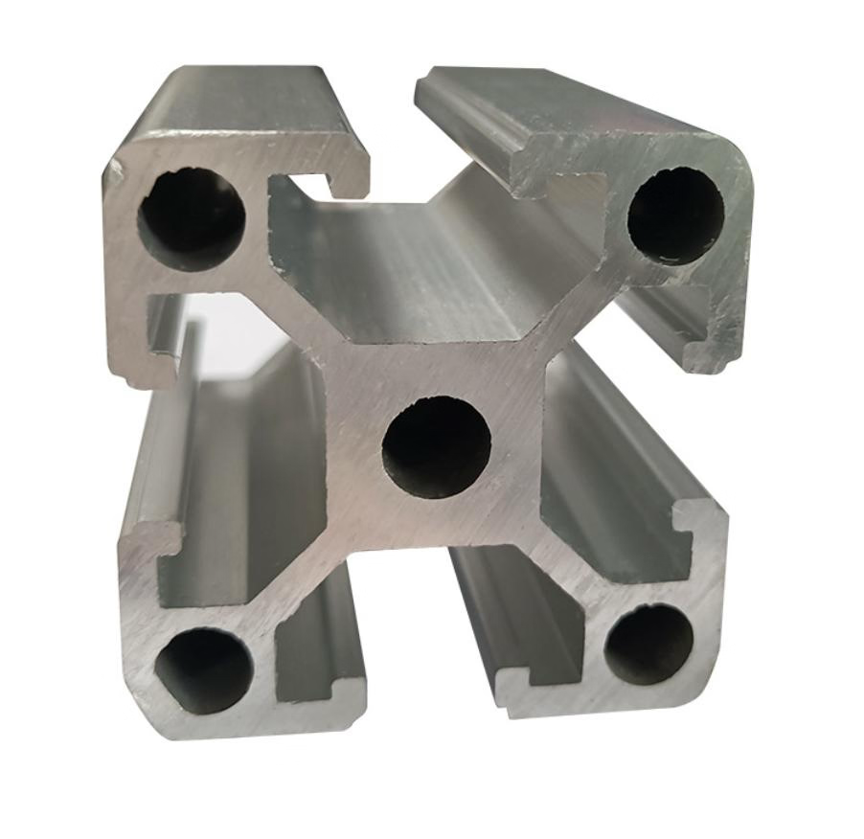
Mechanical Design

Slide 10
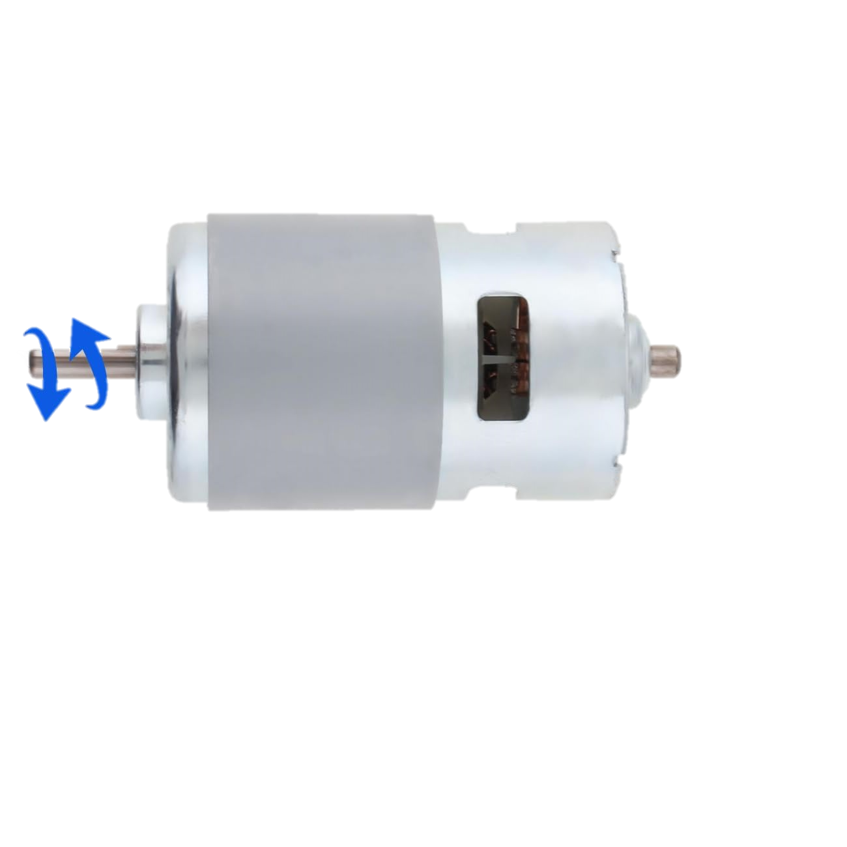
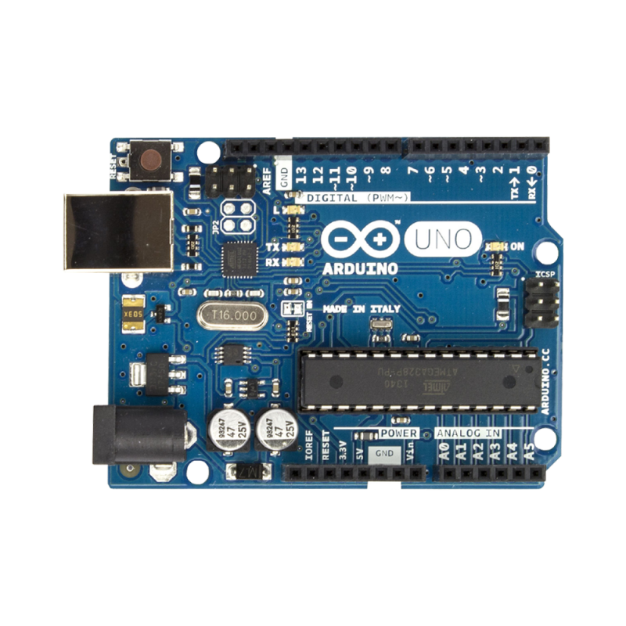
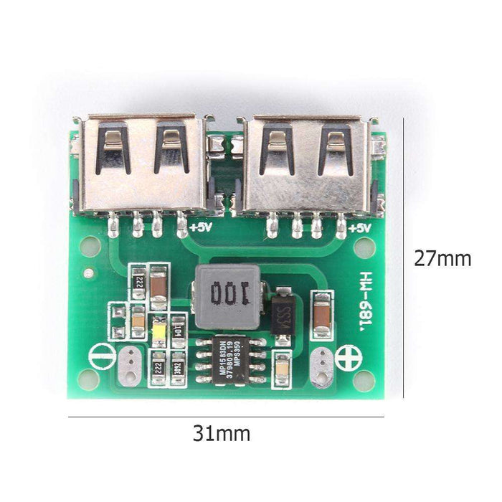
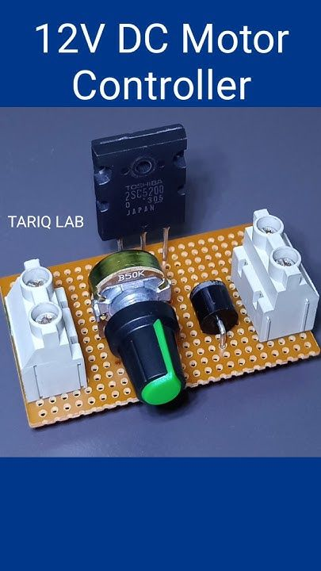
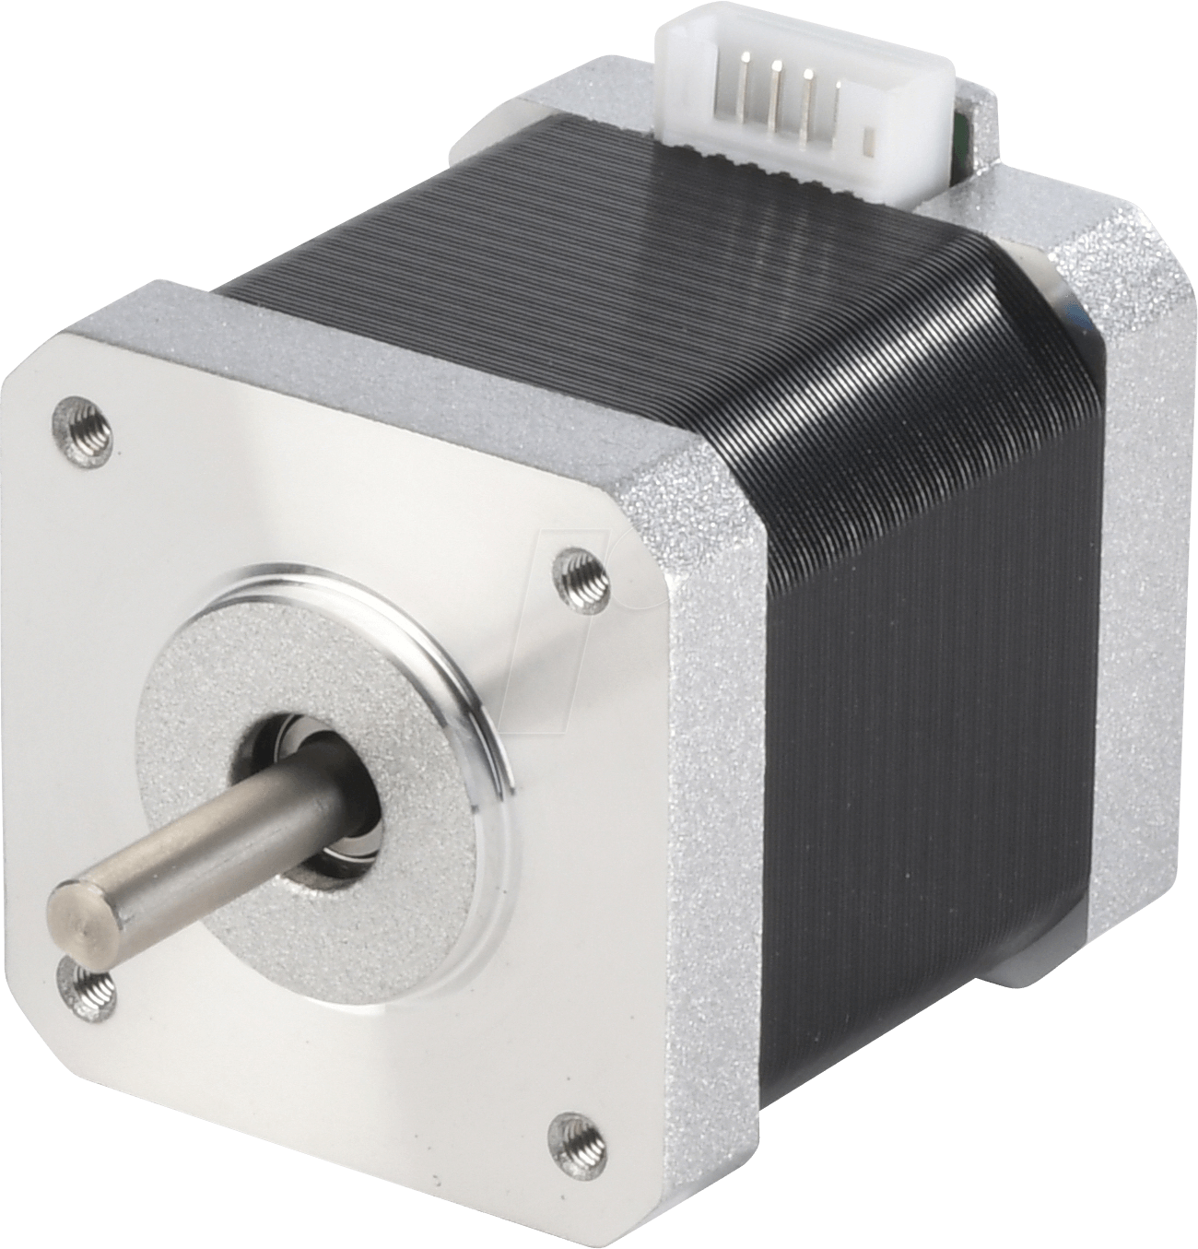
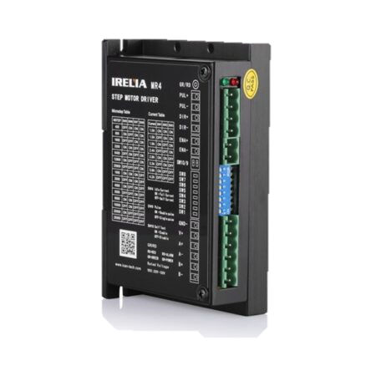
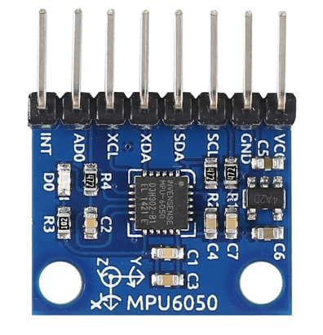
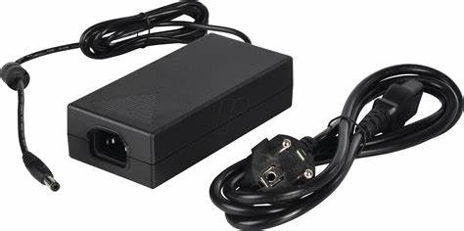
Plate 4 Functional Block Diagram (FBD)
Key
Blue – Data Red – Power
Black – GND
Yellow –I2C
Purple – Activation Signal
Arduino Uno
12v Power supply
MPU 6050

Slide 11

Experimental Setup & Validation
Validation Method:
Static balance tests
Dynamic perturbation tests (rider weight shifts, pushes)
Performance metrics: roll angle, gimbal deflection, correction speed
Success Criteria:
Stable within ±5° roll during static and dynamic trials

Slide 12
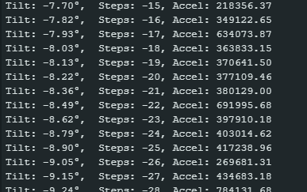
Experimental Data
This is the Arduino terminal output showing the tilt and action that is being taken to correct the tilt using the stepper motor angle shown as “Steps”

Slide 13
Experimental Data
2.37 | 45
2.32 | 45
2.27 | 45
2.23 | 45
2.19 | 45
2.14 | 45
2.09 | 45
2.07 | 45
2.06 | 45
2.03 | 45
1.98 | 45
1.97 | 44
1.93 | 43
1.9 | 42
1.85 | 41
1.8 | 40
1.78 | 39
1.76 | 38
1.75 | 37
1.74 | 36
1.71 | 35
1.72 | 34
1.71 | 33
1.67 | 32
1.65 | 31
1.63 | 30
1.62 | 29
1.6 | 28
1.6 | 27
1.61 | 26
1.58 | 25
1.57 | 24
1.56 | 23
1.54 | 22
1.54 | 21
1.54 | 20
1.55 | 19
1.57 | 18
1.58 | 17
1.59 | 16
1.57 | 15
1.55 | 14
1.59 | 13
1.56 | 12
1.54 | 11
1.58 | 10
1.58 | 9
1.58 | 8
1.58 | 7
1.58 | 6
1.62 | 5
1.61 | 4
1.62 | 3
1.61 | 2
1.58 | 1
1.57 | 0
1.55 | 0
1.53 | 0
1.51 | 0
1.47 | 0
1.45 | 0
1.42 | 0
1.41 | 0
Data Acquisition used is a CSV showing tilt of board and corresponding angle resulting
^ Threshold for __stepper __movement

Slide 14

Final remarks
Project Steps:
Idea Generation
Acquired all materials
3D Printed and machined parts
Created electrical circuits
Assembled all parts
Arduino and LabVIEW for controlling and data acquisition
Testing yielded our flywheels to heavy for the motors to keep upright
3D Printed addition flywheels for demonstration purposes
Future Steps:
Buy higher torqued/ powered stepper motors
Check stepper controller
Clean up setup and go into more testing

Slide 15
Future Work
Fix up controllers for better performance
Improve stepper motors
Create casing for electrical components
Balance flywheels (Bike weights)
Springs attached to flywheels for support

