Slide 1

STA 4164 Project: Predicting Household Income
Scott Brown & M. Oliver Bowman
Notes:
Both

Slide 2

The Data
Dependent variable: Average household income for 2012
Independent variables:
Predictor | Variables | Levels | Base level
Metro | x₁ | Inside | Outside
Region | x₂ – x₄ | Northeast, Midwest, South | West
Status | x₅ & x₆ | Single male, Single female | Married
Property | x₇ | Rent | Own
Work | x₈ & x₉ | None, Part-time | Full-time
School | x₁₀ – x₁₃ | High school, Associate’s, Bachelor’s, Graduate or above | Below High school
Age | Age (x₁₄) | -- | --
Earners | Earners (x₁₅) | -- | --
Household | Household (x₁₆) | -- | --
Data retrieved from US Census Bureau’s Current Population Survey (CPS), 2012
Notes:
Scott

Slide 3
Potential Models
Model 1: Simple Linear Model
E(y) = β_{i}x_{i}
Model 2: Linear Model with Interactions
E(y) = β_{i}x_{i} + β₁₇x₇x₈ + β₁₈x₇x₉ + β₁₉x₁₆x₁₅ + β₂₀x₁₄x₁₅
Model 3: Log-Transform of E(y)
ln[E(y)] = β_{i}x_{i}
Σ
Σ
Σ
Notes:
Oliver

Slide 4
Step-wise Reduction
Models 1 & 2:
Found β₄, β₆, β₇, β₁₀, β₁₆ to be insignificant
None of our chosen interaction terms were eliminated in model 2
Model 3:
Removed same terms as in models 1 and 2
Also found β₁₁ to be insignificant
Notes:
Scott

Slide 5
Model Comparisons
H₀: Model 1 fits the data best | T.S.: F = (5.18e11-4.91e11)/ (21-12) 886179145 = 12.162
H_{a}: Model 2 fits the data best
 | R.R.: p-value < 0.0001
p-value < α, Reject H₀: At the α = 0.05 significance level, there is sufficient evidence to indicate that the linear interaction prediction (model 2) fits the data more closely than the purely linear prediction (model 1). Therefore, the linear interaction prediction (model 2) fits the data best.
Notes:
Oliver

Slide 6
Model Comparisons
H₀: Model 3 fits the data best | T.S.: F = (233.51-26.92)/ (21-12) 20.602 = 1.0027
H_{a}: Model 2 fits the data best
 | R.R.: p-value = 0.4397
p-value > α, Do Not Reject H₀: At the α = 0.05 significance level, there is insufficient evidence to indicate that the linear interaction prediction (model 2) fits the data more closely than the log-transform prediction (model 3). Therefore, the log-transform prediction (model 3) fits the data best.
Notes:
Oliver

Slide 7
Multicollinearity
Check: Variance Inflation Factor
Before step-wise reductions:
Many VIF’s > 5, several very close to 10
After step-wise reductions:
No VIF’s > 3
Check: Signs of β’s
Predictor on ‘Age’ is negative, meaning earning less money when average age goes up? Would expect income to increase with age.
Other β’s seem to have appropriate signs
Overall: Weak (if any) multicollinearity.
Notes:
Scott

Slide 8
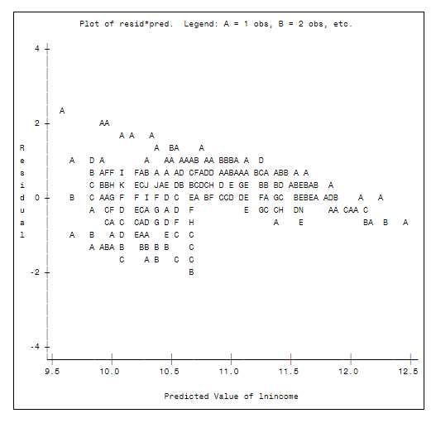
Model Assumptions
Zero Mean for Residuals:
Fairly even around zero, possibly weighted towards positive values
(Possibly violated)
Constant Variance:
Scatter is not the same before mid-value of income as after, reminiscent of a reverse fan
(Likely violated)
Notes:
Scott

Slide 9
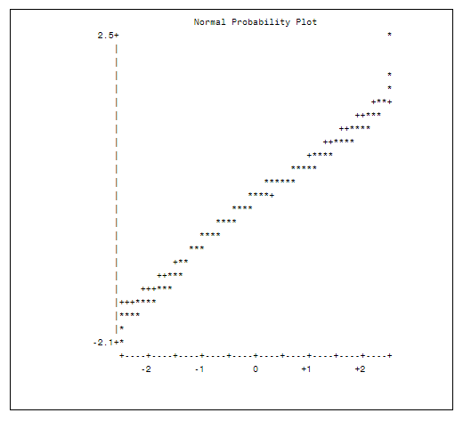
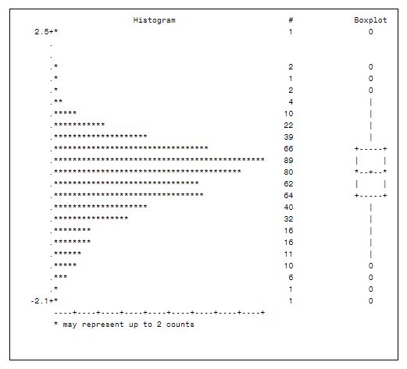
Model Assumptions
Normality Of Residuals:
Calculated residuals fit nicely to linear, theoretical values
(Not violated)
Distribution is centered on mean and is very Gaussian
(Not violated)
Notes:
Scott

Slide 10
Outlier Analysis
By Rstudent:
Flag if |z_{i}*|> 1.964
34 flagged, all near upper or lower limits of income
By leverage:
Flag if h > 0.0417
17 flagged, all but 3 near upper or lower limits of income
By Cook’s D:
Flag if D_{i} > 0.007
29 flagged, most near lower or upper limits
By Dffits:
Flag if > 0.2766
43 flagged, most near lower or upper limits
Dfbetas are fairly random, no noticeable trend
Notes:
Oliver

Slide 11
Model Conclusion
Summary of Model 3 (Log-Transform) analysis:
2 of 4 assumptions may be violated
Weak fit near upper and lower limits of Income due to number of potential outliers and large-influence observations
R² = 0.37 (but still passes F-test and individual t-tests)
Conclusion:
Model is not a good predictor overall, but may be
reasonable if only trying to predict mid-range
household incomes (approx. $20,000 to $70,000).
Notes:
Scott (summary), Oliver (conclusion)

