Slide 1
Bank discount & promissory note
Prepared by:
Mathematical Science Department

Slide 2
LEARNING OUTCOMES
By the end of this chapter, student should be able to
explain the meaning of a promissory note,
list the main features of a promissory note,
compute the face and maturity values of a promissory note,
explain the meaning of bank discount,
compute the bank discount and proceeds, and
compute simple interest rate that is equivalent to discount rate.

Slide 3
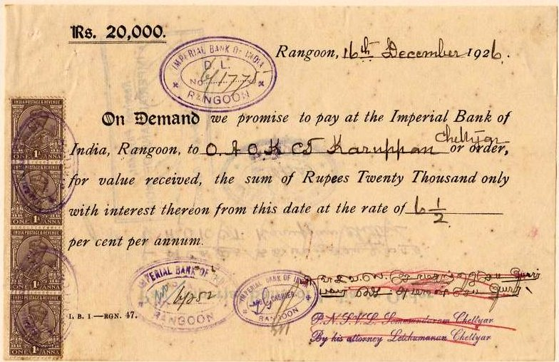
Promissory Note
Definition:
A signed document containing a written promise to pay a sum of money at specified date with or without interest.
There note can be with or without interest. In this course, the interest bearing note will be calculated as simple interest using Banker’s Rule.
Source: https://en.m.wikipedia.org/wiki/promissory_note.
A 1926 promissory note from the Imperial Bank of India, Rangoon, Burma for 20,000 rupees plus interest

Slide 4
Features on Promissory Note
Maker : The name of person that sign the note (debtor)
Payee : The name of person that receive the note (creditor)
Face Value : The amount stated on the note or the amount borrowed
Date Issue : The date of the note is signed
Time (Term) : The length of period (must have if maturity date not stated)
Interest rate : the rate charge for interest bearing note (simple interest)
Maturity Date : The date the debt must be paid (optional)
Maturity Value : The amount has to be paid including interest (optional)

Slide 5
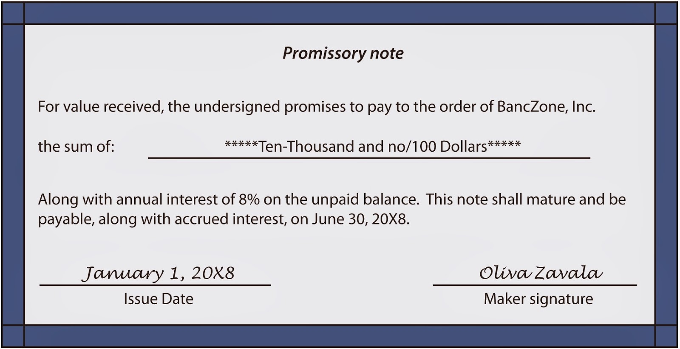
Features on Promissory Note
Payee
Face Value
Interest rate
Maturity Date
Date of Note
Maker
Source: https://nazarsudhakar.blogspot.com/2014/02/promissory-note-details.html

Slide 6
How to find the maturity value for interest bearing note?
In most situation, for an interest bearing note, the maturity value is not stated on the note. For this situation, the maturity value can be calculated using the simple interest amount formula, i.e.,
S = P(1 + rt)
Note: only simple interest using Banker’s Rule will be used in this lesson.

Slide 7
Example 1
Find the maturity value and the maturity date for a 75 days promissory note with face value RM 3,300 at 5% simple interest issued on the 12 Jun 2014.
i) P = 3300; r = 0.05; t = 75/360 ii)

Slide 8
SOLUTION
Example 2
A 180-day promissory note dated 8 June 2012 had a face value of RM2000. The simple interest rate charged was 6.6% per annum. Determine
the maturity date of the note
the maturity value

Slide 9
Bank Discount
It is a common practice by the bank to deduct charges from a loan in advance. This charges is called bank discount.
The money left receives by the borrower is called proceeds.
The maturity value is the value of the money actually borrowed.
Maturity value = Proceeds + Bank Discount.
It is different from the case of simple interest where the amount of maturity value is more than the amount borrowed.

Slide 10
To calculate the Bank Discount and Proceeds, we will use the following formula:
D = Sdt
where, D = Bank discount
d = discount rate
t = term of discount in years.
and,
Proceeds, H = Maturity value – Bank discount
H = S – D
H = S – Sdt
H = S( 1 - dt)

Slide 11
Interest Rate Equivalent To Discount Rate.
Some times, bank charged for their service with simple interest rate in mind. So, they will find the equivalent discount (service charge) rate to the intended simple interest rate that they want to obtain. Below are the two formulas that can be used to calculate these rates.
❶ ❷

Slide 12
Example 3
RM2000 was borrowed for 72 days at a discount rate of 8.75%. Determine
the amount received and the discount charged
the simple interest rate that is equivalent to the given discount rate
SOLUTION

Slide 13
Exercise
A loan of RM7,000 was made on 15 October 2012 at xYz Bank that charged a simple discount rate of d%. The discount charged was RM205 and the loan matured on 11 November 2012.
Find
i) the proceeds received,
ii) the discount period and the discount rate.
Try this question and check your work with your instructor.
Answers:
H=RM6795
Term=27 days
d= 39.05%
END OF LEARNING SLIDES
HOPE YOU HAVE MASTER THE MATERIALS COVERED
GOOD LUCK & ALL THE BEST

