Slide 1
Trade and cash discount
Prepared by:
Mathematical Science Department

Slide 2
LEARNING OUTCOMES
By the end of this chapter, student should be able to :
explain trade discount terms,
calculate trade discount and the net price of goods purchased,
explain chain discount,
find a single discount that is equivalent to a chain discount,
explain cash discount terms,
identify situations where a trader can take a loan to take advantage of cash discounts, and
solve problems involving trade and cash discounts.

Slide 3
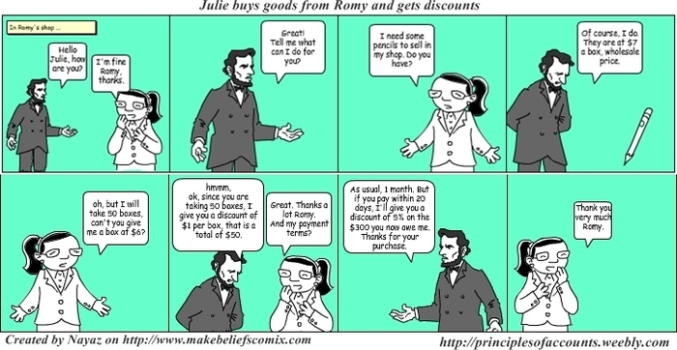
SITUATION OF TRADE DISCOUNT

Slide 4
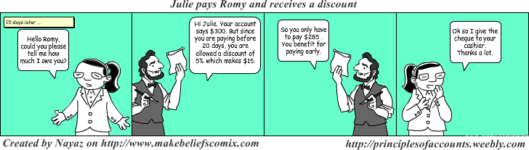
SITUATION FOR CASH DISCOUNT

Slide 5
Trade discount process
CONSUMERS
Buy goods
RETAILERS
Purchase goods
Pay goods at prices lower than list prices
WHOLESALERS/ MANUFACTURES
Issue catalogues describing products they sells including their list prices.
TRADE DISCOUNT AMOUNT = The amount of discount that retailers receive off the list price

Slide 6
Basic concept of trade discount
Net price = The prices that retailers pays after the reduction in prices.
Trade discount = The different between the list price and the net price.
A manufacturer quotes a discount rate in percentage to the retailer.
This is called trade discount rate and must be calculated on the list price.
TRADE DISCOUNT = LIST PRICE - NET PRICE
TD = LP - NP
AMOUNT OF TRADE DISCOUNT = LIST PRICE X TRADE DISCOUNT RATE
TD = LP x d

Slide 7
Example 1
The list price of handbag is RM1200. A trade discount of 40% is offered. What is the net price of the handbag?
List price = RM1200
Trade discount = 40% x RM1200
= RM480
Net price = List Price - Trade Discount
= RM1200 - RM480
= RM720

Slide 8
As an alternative method discussed earlier, this formula can be used to find the net price.
The derivation from this formula is:
Let, Net price = NP
List price = LP
Trade discount rate = d%
From Net Price = List Price – Trade Discount, thus we get
NP = LP - LPd
NP = LP(1 - d)
NP = LP(1 - d)

Slide 9
Example 2
A bill of RM500 including prepaid handling charge of RM50 is offered a trade discount 15%. What is the net price?
Solution:
Trade discount = 0.15 x RM450 = RM67.50
(It should be noted that the discount is based on the cost of the goods, excluding any other costs.)
Net price = (RM450 – RM67.50) + RM50
= RM432.50

Slide 10
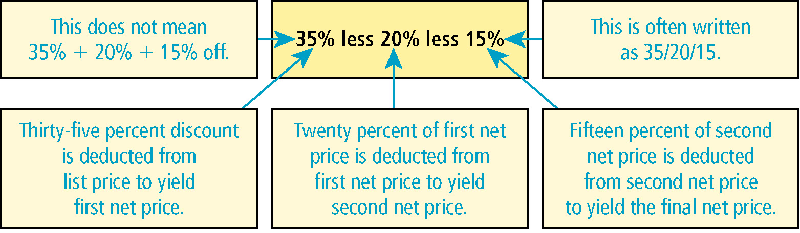
Chain discount
Prices of goods may go up and down within a time of period due to supply and demand.
As such, multiple discounts are offered to the retailers on the same goods by the manufacturers or wholesalers.
For example, a wholesalers may offer trade discounts of 35%, 20% and 15%.
This multiple discounts are called as chain discount or series discount.
In a chain discount, each discount rate is calculated on the successive net amount as illustrated in the diagram.

Slide 11
Net price of chain discount
We can calculate the final Net Price of a chain discount directly. For example, as an item listed at LP ringgit less a trade discount of d₁%, d₂% and d₃%, the net price is given by:
If there are only two discount rates, d₁% and d₂% in the chain discount, the formula becomes: NP = LP(1 - d₁)(1 - d₂).
NP = LP(1 - d₁)(1 - d₂)(1 - d₃)

Slide 12
Example 3 (October 2016)
Ali bought a computer listed at RM5,000. He was given trade discounts of 20%, 10% and 5%. Find the net price of the computer.
From
NP = LP(1 - d₁)(1 - d₂)(1 - d₃),
we get
Net price = 5,000(1 - 20%)(1 - 10%)(1 - 5%)
= 5,000(0.8)(0.9)(0.95)
= RM3,420

Slide 13
Alternatively, the net price can be obtained by calculating the trade discount at each stage as follows.
List price = RM5,000
Less 20%:0.2x RM5,000 = 1,000 –
4,000
Less 10%:0.1x RM4,000 = 400 –
3,600
Less 5%: 0.05x RM3,600 = 180 –
Net price = RM3420

Slide 14
Single discount equivalent to chain discount (sder)
Means a single discount which is equivalent to a chain discount.
The single discount equivalent SEDR, for a chain discount of d₁%, d₂% and d₃%, given by
SEDR = 1-(1-d₁)(1-d₂)(1-d₃)
Example 4
A wholesaler gives trade discounts 20%, 10% and 3% to his regular customers. Find the single discount equivalent to the given trade discounts.
Solution
From the Single Discount Equivalent formula:
SEDR = 1 - (1 - d₁)(1 - d₂)(1 - d₃), we get
= 1 - (1 - 0.2)(1 - 0.1)(1 - 0.03)
= 1 - 0.6984
= 0.3016 or 30.16 %

Slide 15
Cash discount
Wholesalers, manufactures and even retailers offer reductions on the amount due to customers who pay their bills within a stipulated period of time.
The credit terms which comprise the cash discount rate and the credit period are usually shown in the invoice.
For instance, a supplier offer terms 5/10, n/20 which means that a 5% discount is given for payment within 10 days or the full payment is due in 20 days from the date of the invoice.
Most business-to-business transactions begin with a purchase order from the buyer that identifies the goods ordered, the agreed upon price, and delivery terms.
The purchase order may be written or verbal. After the order is filled, the seller issues a sales invoice. Both documents include the details of the purchase.

Slide 16
CASH DISCOUNTS
Businesses frequently offer cash discounts as a way to encourage their business customers to pay their invoices early. Cash discounts are figured on the invoice price that is shown on the invoice as the total due. The terms of sale tell how much of a discount will be given.
Due Date: To find the due date of the invoice and the last day for receiving a discount, count ahead, from the date on the invoice, the number of days shown in the terms. Buyers who do not pay their bills by the due date may be charged interest on the amount owed or a late payment fee.

Slide 17
TERMS OF THE SALE
Terms of sale specify how and when an invoice will be paid. Usually businesses sell to other businesses on account. This means the customer will be billed later for purchases.
The time a purchaser has to pay a bill, usually 30 to 90 days, is called the credit period. The credit terms which comprise the cash discount rate and the credit period are usually shown in the invoice.
For instance, a supplier offer terms 5/10, n/20 which means that a 5% discount is given for payment within 10 days or the full payment is due in 20 days from the date of the invoice.

Slide 18
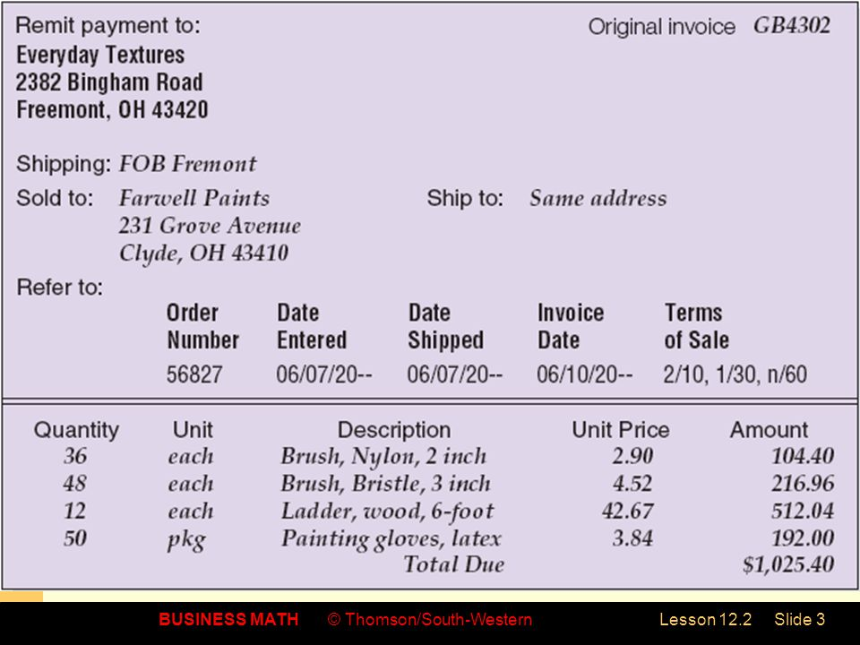
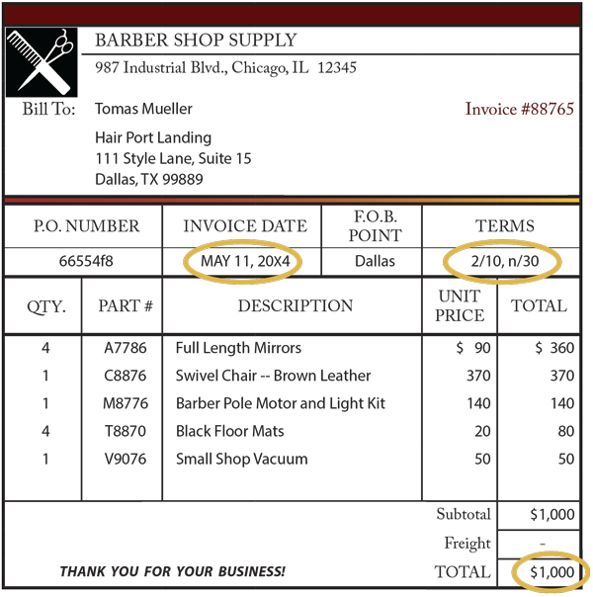
SAMPLE OF INVOICE

Slide 19
CASH PRICE
If the customer pays the invoice within the discount period and deducts a cash discount from the invoice price, the amount paid is called the cash price
Example 5 (March 2016)
A washing machine that cost RM3,000 is given a trade discounts of 20% and 15%. A further 3% cash discount will be given if it is paid within 5 days. Find the total discounts obtained if the payment is made within the cash discount period.
From the formula NP = LP(1 - d₁)(1 - d₂)(1 - c), where c = cash discount
Hence, we get
NP = 3000(1 - 20%)(1 - 15%)(1 - 3%)
= 3000(0.8)(0.85)(0.97) = RM1,978.80
Note: The new NP obtained after deducting the cash discount is sometime called as the cash price excluding any additional charges. The cash price including all the additional charges (packaging, transportation, etc.) is called Net Payment or Total Amount Paid.
Net Price = List Price – Total Discount, so
Total Discount = List Price – Net Price
= RM3000 - RM1978.80
= RM1021.20

Slide 20
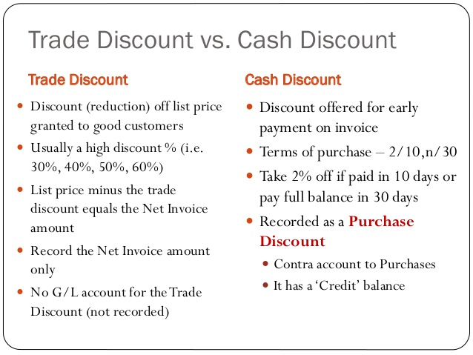
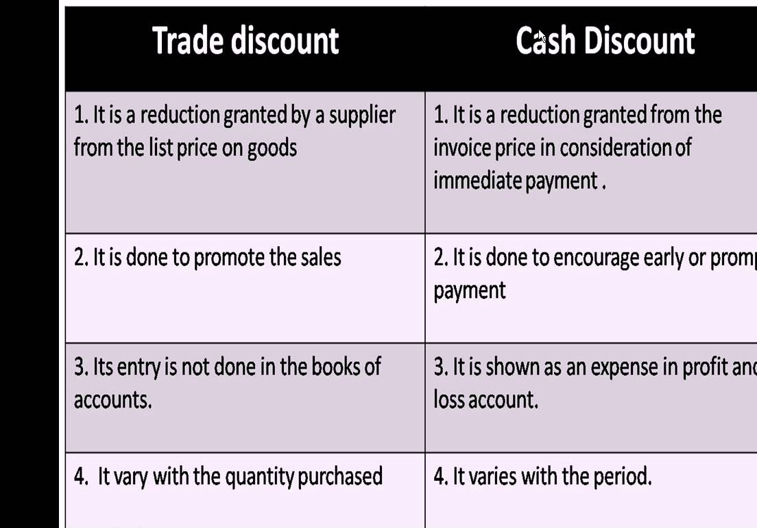

Slide 21
Example 6 (included transportation cost and other charges)
An invoice dated 11 March 2016 for RM5,300 inclusive of RM500 transportation charge was paid on 31 March 2016. if the trade discount were 20% and 15%, and the discount terms were 5/10, 4/30, n/60, find
The trade discount offered
The cash discount if entitled
The amount of payment.

Slide 22
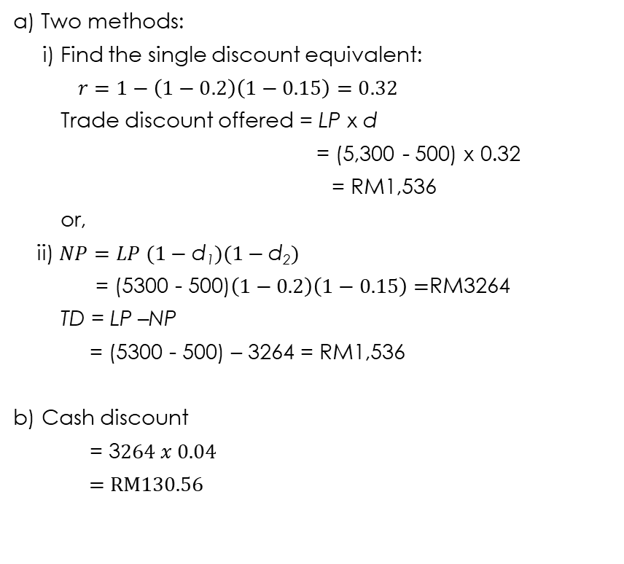
SOLUTION
Two methods:
i) Find the single discount equivalent:
$r=1−\left(1−0.2\right)\left(1−0.15\right)=0.32$
Trade discount offered = LP x d
= (5,300 - 500) x 0.32
= RM1,536
or,
ii)$NP=LP (1−\text{d}\text{1})(1−\text{d}\text{2})$
= (5300 - 500)$\left(1−0.2\right)\left(1−0.15\right)=$RM3264
TD = LP –NP
= (5300 - 500) – 3264 = RM1,536
b) Cash discount
= 3$264 x 0.04$
= RM130.56
c) Amount of payment
Two methods
i) List Price – Amount of Trade Discount - Amount of Cash Discount + Transportation Cost
= 5300-500-1536-130.56 + 500
= RM3,633.44
or,
ii) Net Price = LP (1 - d₁)(1 - d₂)(1 - c) + Transportation cost
= (5300 - 500)(1 - 0.2)(1 - 0.15)(1 - 0.04) + 500
= RM3,633.44
Note:
remember, the list price MUST NOT include any additional cost or charges
use Net Price after trade discount to calculate the cash discount
the Cash Discount rate is 4% because, it takes 20 days (31/3-11/3) to paid the invoice
the final amount paid must include all additional charges

Slide 23

Example 7
100 copies of IT books are purchased at RM69 each. The trade discounts given are 12% and 8%. The cash discount terms on the invoice are 5/10 and n/30.
i) Determine the single trade discount rate that is equivalent to the given trade discounts.
ii) Calculate the amount of payment to be made if the payment was made one week after the date of invoice.
S
O
L
U
T
I
O
N

Slide 24

Example 8
A salon owner buys 50 bottles of shampoo and receives an invoice of RM2550 including transportation cost of RM250. The date of invoice is 15 August 2016 and the cash discount term is 10/10, 8/20, n/30. If he receives trade discounts 7% and 5%, find
The net price after trade discounts
the net payment if payment is made on 31st August 2016
SOLUTION
ii) Pay on day 16 (31-15), entitled to get
8% cash discount.

Slide 25
Exercises
Q1. Explain the cash discount terms 10/15, 5/20,n/30.
Ans :
10% cash discount received if payment made within the first 15 days of the invoice date. 5% cash discount received if payment made between day 16 to day 20. Full payment need to be paid by 30th day.
Q2. An invoice of RM4,500 and dated 23 July 2016 is offered 6% trade discount and cash discount terms of 9/10, n/30. Find the net payment if the invoice is paid on 29 July 2016.
Ans : RM3849.30
Q3. The total of an invoice with cash discount terms 5/10, n/30 amounts to RM2,200 which excludes a prepaid freight charge of RM200. Find the amount that is needed to pay the invoice within the cash discount period.
Ans : RM2290
Notes:
Hide the answers (red in color)

Slide 26
Summary
Trade discount (TD) = List price (LP) – Net price (NP)
NP = LP – TD
For single discount,
NP = LP (1-d)
For chain discounts, d₁, d₂, d₃
NP = LP (1-d₁)(1-d₂)(1-d₃)
Single discount equivalent (SEDR) for chain discount of d₁, d₂ and d₃ is
SEDR = 1 – [(1-d₁)(1-d₂)(1-d₃)]
Cash discount 3/10, 2/20, n/30 means 3% of the net price may be deducted if the invoice is paid within ten days of the invoice date, 2% may be deducted if the invoice is paid between the 11th and 20th day, and the full amount must be paid by the 30th day.

Slide 27
Summary
Discounts (trade and cash) are applied only on price of the goods (LP) not on the charges.
Amount to be paid/ Total payment/Net payment
= Net price + charges
Note : Aware the word of ‘including’ or ‘excluding’
including --> LP - minus the charges
excluding --> LP - as given

Slide 28
Key Words to Know
list price - The price at which a business generally sells an item, also called the catalog price.
trade discount - A discount off the list price of an item.
trade discount rate - The amount of the discount of an item expressed as a percent of the list price.
net price - The price actually paid for a discounted item.
complement method - A way to find the net price of a discounted item by subtracting the discount rate from 100 percent.
chain discounts - A series of trade discounts a supplier may offer to sell out a discontinued item or to encourage a customer to place a larger order.
net price rate - The percent of the price paid for an item, found by multiplying the complements of the chain discounts.
single equivalent discount rate (SEDR) - One discount that is equal to a chain discount.
invoice - A bill listing the quantities and costs of items purchased.
cash discount - A discount a supplier grants if a bill is paid within a certain number of days.
ordinary dating - Terms of payment by a supplier which grants a cash discount if a bill is paid within a certain number of days.

Slide 29


