Slide 1
How to use the System
Pablo Scherer | Marcel Luis Thiel | Julian Lanfermann

Slide 2

Start the program in the Terminal using:
Important: You must be in the project folder
Pablo Scherer | Marcel Luis Thiel | Julian Lanfermann

Slide 3
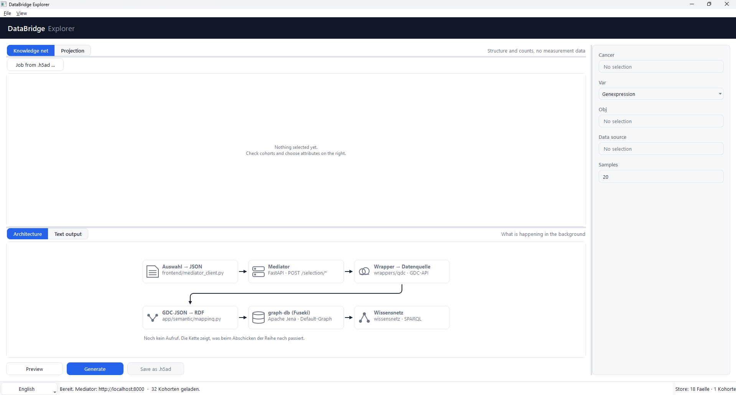
This is the interface
Pablo Scherer | Marcel Luis Thiel | Julian Lanfermann

Slide 4
You can set the languages here
Pablo Scherer | Marcel Luis Thiel | Julian Lanfermann

Slide 5
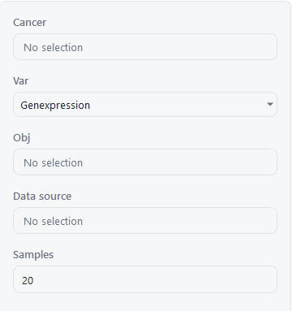
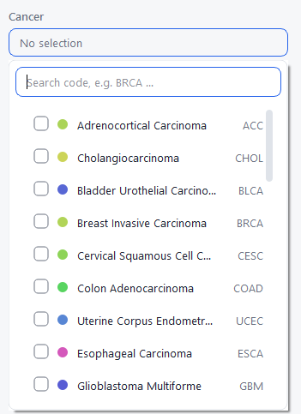
You can set the Cancer here
Pablo Scherer | Marcel Luis Thiel | Julian Lanfermann

Slide 6
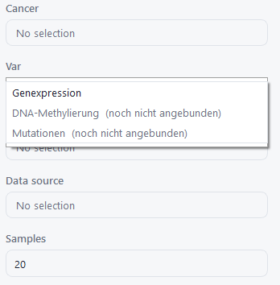
Pablo Scherer | Marcel Luis Thiel | Julian Lanfermann

Slide 7
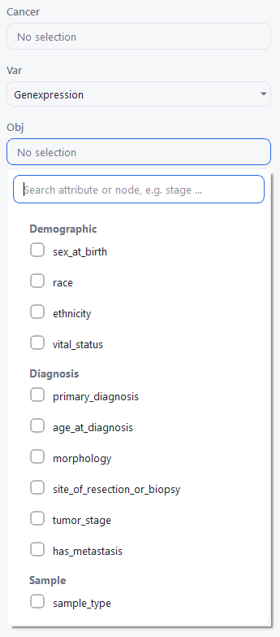
Pablo Scherer | Marcel Luis Thiel | Julian Lanfermann

Slide 8
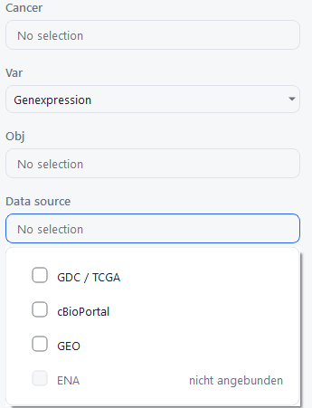
You can set the Data source here
But cBioPortal and GEO not available
Pablo Scherer | Marcel Luis Thiel | Julian Lanfermann

Slide 9
After you've set the variables, you can click “Preview” to see if the system has found anything.
Pablo Scherer | Marcel Luis Thiel | Julian Lanfermann

Slide 10
After setting the variables, you can click “Generate,” and the memory module next to it will become active,
allowing you to save the “Anndata.”
Pablo Scherer | Marcel Luis Thiel | Julian Lanfermann

Slide 11

You can also view the data using a projection, but only if you've saved the “Anndata” beforehand.
Pablo Scherer | Marcel Luis Thiel | Julian Lanfermann

