Slide 1
EOSC CZ Summer School for Data Stewards 2026 Python Toolbelt for Data Stewards in JupyterLab Introduction
Matthias Täschner A
Data Science Center ScaDS.AI, Leipzig University, Germany

Slide 2




About me
About my workplace
Research Associate at DSC ScaDS.AI, Leipzig University, Germany
Professional Background: IT systems technician, IT admin, data scientist
Responsibilities: Transfer projects, research and development, trainings, IT coordination
ScaDS.AI: National AI competence center, located at Leipzig University and Dresden University of Technology
Funded by German Government and the Free State of Saxony
Interdisciplinary research on AI and Data Science
Development of scalable, responsible, trustworthy, and efficient AI solutions
Transfer of research results to science, industry, and society

Slide 3
Agenda
Session 1 (June 16, 13:30–17:00)
Python projects with uv
JupyterLab and notebooks
AI assistant in JupyterLab
Data steward tasks in JupyterLab
“Get to know your tools”
General handling and understanding
Session 2 (June 17, 08:30–12:00)
Python-based toolkit and pipeline
Data exploration and preparation
Data validation and metadata
Documentation, DMP [Export via API usage, automation]
“Use your tools productively”
Detailed usage of the Python Toolbelt
Notes:
Common thread: A researcher just handed you a CSV. By end of Day 2, you'll have turned it into a documented, validated, deposit-ready package - using JupyterLab + an AI assistant + a Python toolbelt.

Slide 4
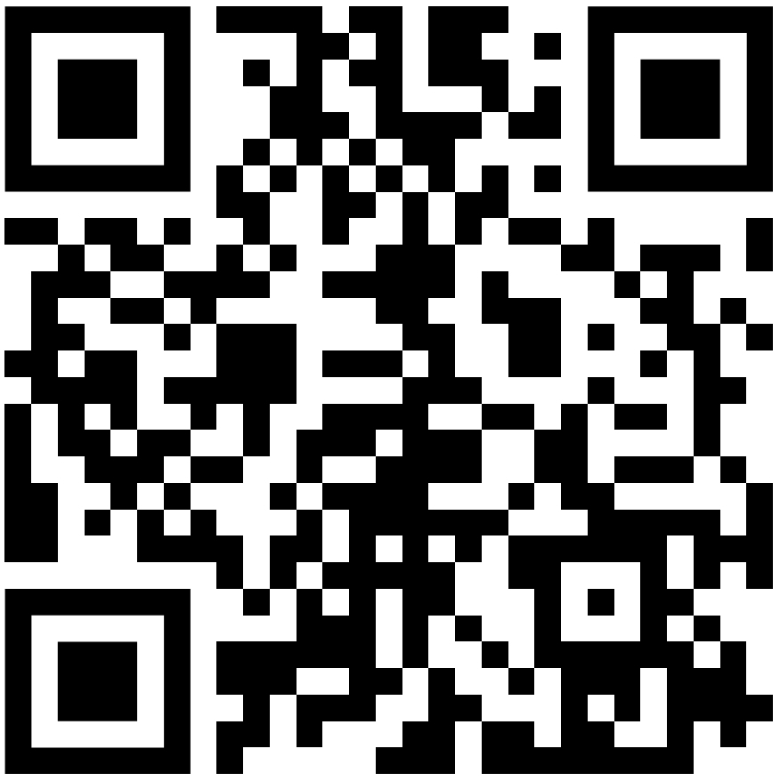
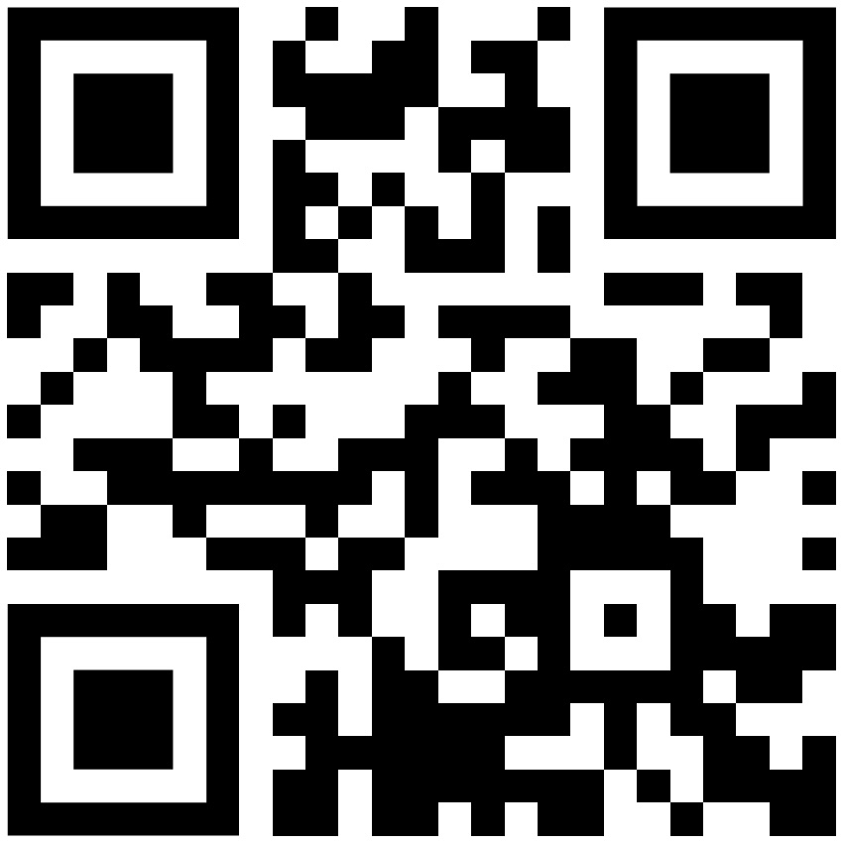
Training Materials
Public GitHub Pages
Notebooks and files for the sessions
https://scads.github.io/eosc-ssds-2026
Nextcloud Share
Additional helpful resources
https://urlr.me/qE92Ny
Notes:
Common thread: A researcher just handed you a CSV. By end of Day 2, you'll have turned it into a documented, validated, deposit-ready package - using JupyterLab + an AI assistant + a Python toolbelt.

Slide 5

Expectation management
Teaching the fundamentals as a foundation for further independent learning and application.
Python projects and virtual environments
JupyterLab and notebooks
LLMs and AI assistants
Python programming and libraries
Notes:
The sessions are designed to work from "never used Python" upwards. If you're more advanced, you'll find optional "stretch" prompts in the notebooks - feel free to take those instead.

Slide 6
Learning Objectives Session 2
Introduction to Python tools for:
bia-bob – AI coding assistant for JupyterLab
Data validation
Data quality reports
Data cleaning
Metadata and data packaging
[optional] API use for data deposition (Zenodo sandbox)

Slide 7
Agenda Session 2
Any Questions?
08:30 – 08:45 Welcome & Introduction
08:45 – 09:15 Technical Setup Check, uv
09:15 – 10:00 Toolbelt overview and dataset
10:00 – 10:30 ☕ Coffee Break
10:30 – 11:30 Tools for data validation, cleaning, reporting, metadata
11:30 – 11:50 DMP and data deposit [optional]
11:50 – 12:00 Wrap-Up

Slide 8
EOSC CZ Summer School for Data Stewards 2026 Python Toolbelt for Data Stewards in JupyterLab Data Steward Pipeline
Matthias Täschner A
Data Science Center ScaDS.AI, Leipzig University, Germany

Slide 9






Data Steward Pipeline
Raw data Messy CSV handover
Validate Schema = Data contract
Report Basic cleaning & Quality report
Package Metadata & FAIR data package
DMP & Deposit Documented & DOI
AI Assistant
Drafts the code for each step using the appropriate tools – you read, run & verify

Slide 10
EOSC CZ Summer School for Data Stewards 2026 Python Toolbelt for Data Stewards in JupyterLab Wrap Up
Matthias Täschner A
Data Science Center ScaDS.AI, Leipzig University, Germany

