Slide 1



Sperm Motility
Solution for the evaluation of sperm motility
Student : Ngô Thị Thu Hà
Trần Minh Hiếu

Slide 2
Table of contents
Part 1: Problem Statement
Part 5 : Future intention
Part 2: Motivation
Part 3 : Data preparation
Part 4: Related work

Slide 3
1.Problem Statement
1.1. Infertility
Male infertility : 20-30% of infertility cases, which is a great concern of men in maintaining family happiness and maintaining the breed.
In Vietnam: Infertility rate is equally between men and women. Of these, > 1/3 infertility cases stem from the man's side and are related to sperm production, abnormal sperm function or a blockage that prevents sperm transport.
(sources: TamAnhHospital.vn)
Notes:
Vô sinh nam : 20-30% các trường hợp vô sinh, đó là mối quan tâm lớn của nam giới trong việc duy trì hạnh phúc gia đình và duy trì giống. Tại Việt Nam: Tỷ lệ vô sinh là như nhau giữa nam và nữ. Trong số này, > 1/3 trường hợp vô sinh xuất phát từ phía người đàn ông và có liên quan đến việc sản xuất tinh trùng, chức năng tinh trùng bất thường hoặc tắc nghẽn ngăn cản sự vận chuyển tinh trùng.

Slide 4
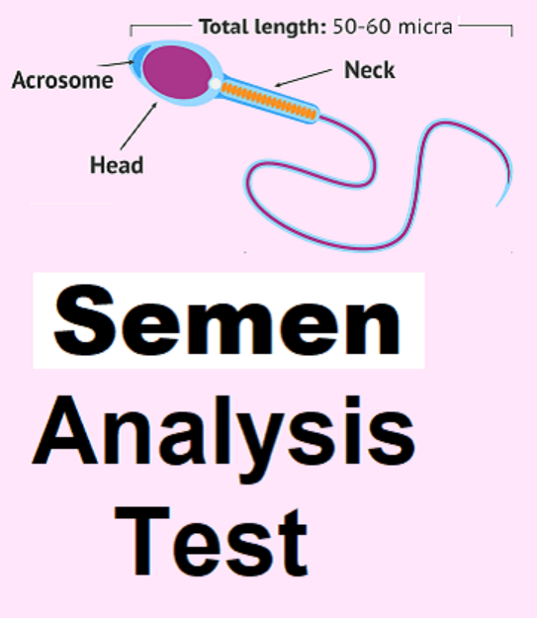
1.Problem Statement
1.2. Test for semen analysis
a. Sperm Viability Test
b. Sperm Motility Test
c. Sperm Morphology
d. Sperm DNA integrity

Slide 5

1.Problem Statement
Sperm Motility Test
b- slow progressive
sperms swim forward, but either in a curved or crooked line, or slowly (slow linear or nonlinear motility)
Types of sperm motility
c- nonprogressive: sperms move their tails, but do not move forward (local motility only). (<5 μm/s)
a- fast progressive: sperms are those which swim forward fast in a straight line – like guided missiles.): ie, >25 μm/s at 37°C and >20 μm/s at 20°C. (25 μm is approximately equal to 5 head lengths or half a tail length)
d- immotile: sperms do not move at all

Slide 6
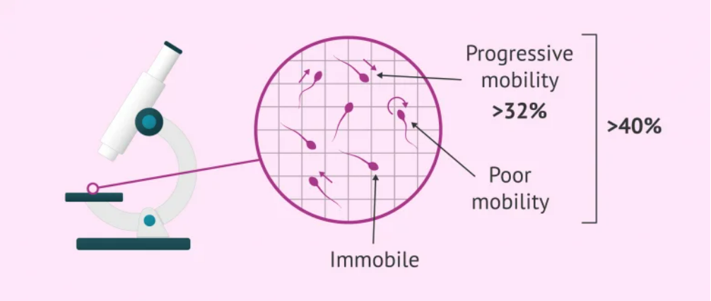
1. Problem Statement
Sperm Motility Test
A man suffers from asthenozoospermia when the number of progressively motile spermatozoa (type A + B) is less than 32% and when the total number of motile spermatozoa in the ejaculate (type A+B+C) is less than 40%.
Notes:
Theo Who standard đánh giá tt

Slide 7
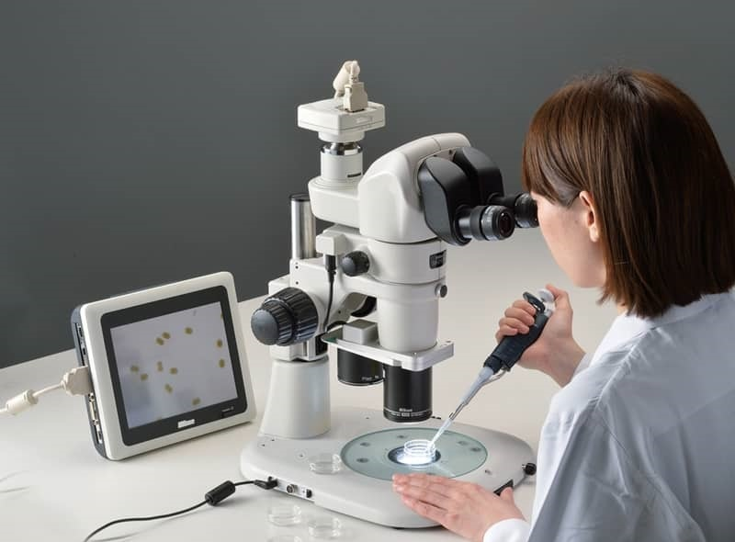
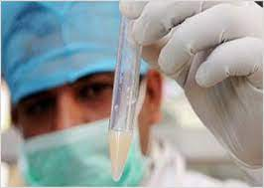
2. Motivation
Manual evaluation of a semen sample using a microscope is time-consuming and requires extensive training.
Limited reproducibility, and often high inter-personnel variation
Notes:
Đánh giá thủ công mẫu tinh dịch bằng kính hiển vi rất tốn thời gian
và đòi hỏi phải đào tạo chuyên sâu.
Khả năng tái tạo hạn chế

Slide 8
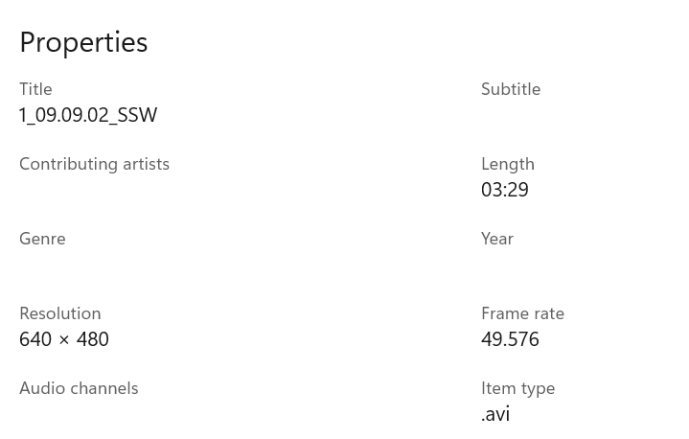
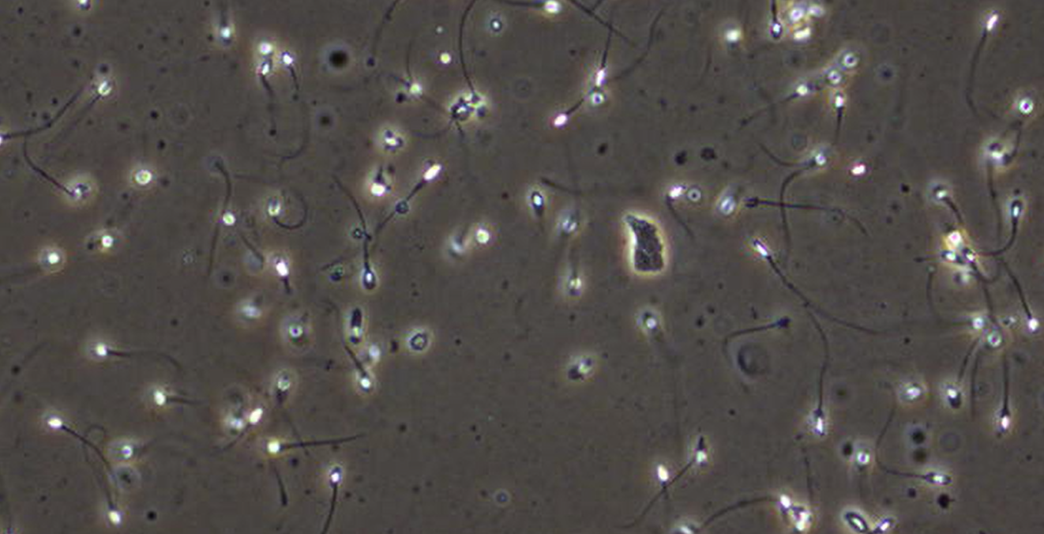
3.Data preparation
3.1.Video data for motility analysis
- Data from 85 male participants aged 18 years or older
Video folder : over 35 gigabytes of videos, 2-7 minutes/one
Figure 3.1.1.Properties of video
Figure 3.1.2. Image captured from a video

Slide 9
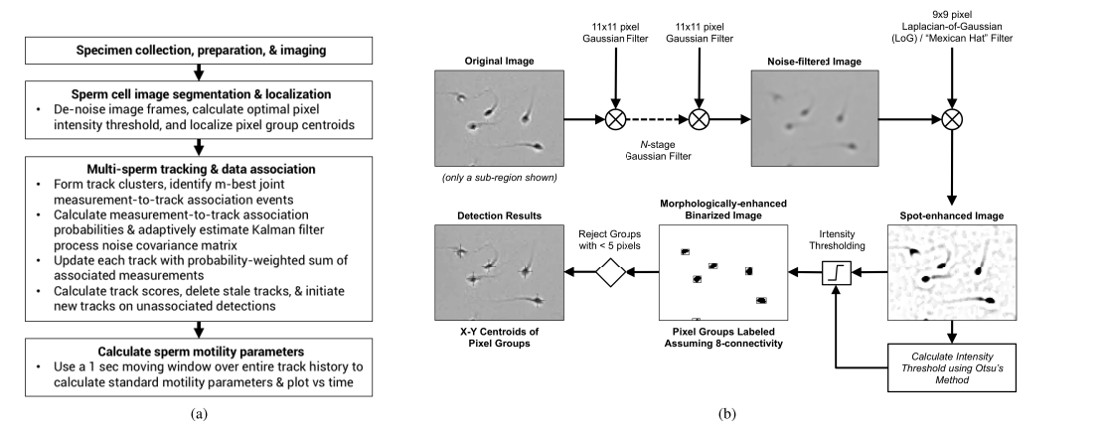
4. Related work
4.1.a.Automatic Tracking and Motility Analysis of Human Sperm in Time-Lapse Images
accurately measuring motility parameters over time and with minimal operator intervention
Figure 2.1. Illustration of the sperm segmentation and localization algorithm

Slide 10
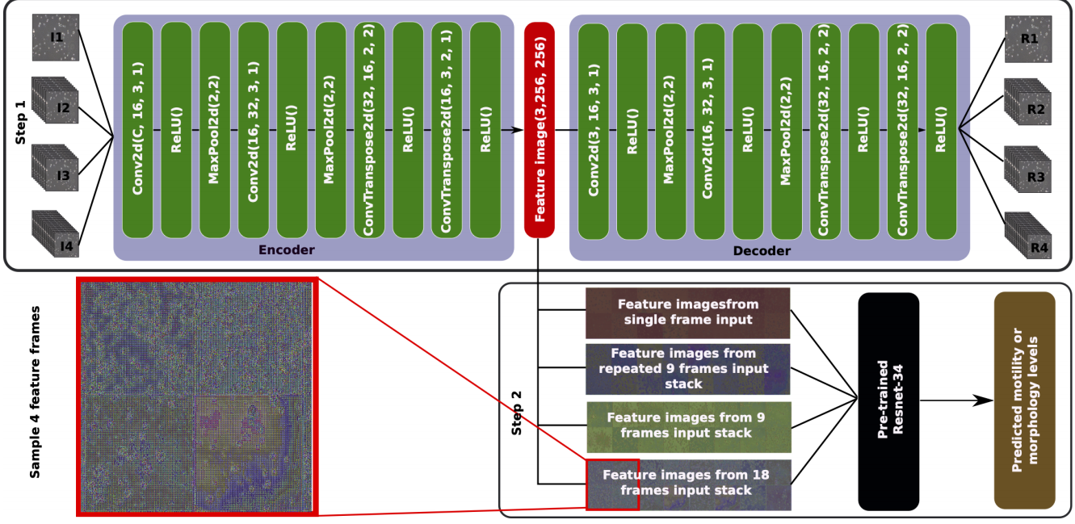
4. Related work
4.1.b. Extracting temporal features into a spatial domain using
autoencoders for sperm video analysis
Two-step deep learning method
Step 1: use an autoencoder to extract temporal features from multiple frames of a video into a feature-image
Step 2: pass the extracted feature-image into a standard pre-trained CNN to predict the motility
Dataset: VISEM

Slide 11
4. Related work
4.1.c. Machine Learning-Based Analysis
of Sperm Videos and Participant
Data for Male Fertility Prediction
Provide a description of the dataset used for both training and evaluation and the statistical analysis
Trained and evaluated the methods based on classical machine learning algorithms.
Approach of using deep learning-based algorithms( progressive, non-progressive, and immotile spermatozoa.)
5 different methods used to predict sperm motility ( Deep learning )
Single frame prediction
Greyscale frame stacking
Vertical frame matrix
Sparse optical fow
Dense optical fow
Notes:
Extract feature : the open-source library Lucene Image Retrieval (LIRE)
Tested all available features
One limitation of these algorithms is that they are only able to predict one value at a time
(Single : the change over time is an important feature.)

Slide 12
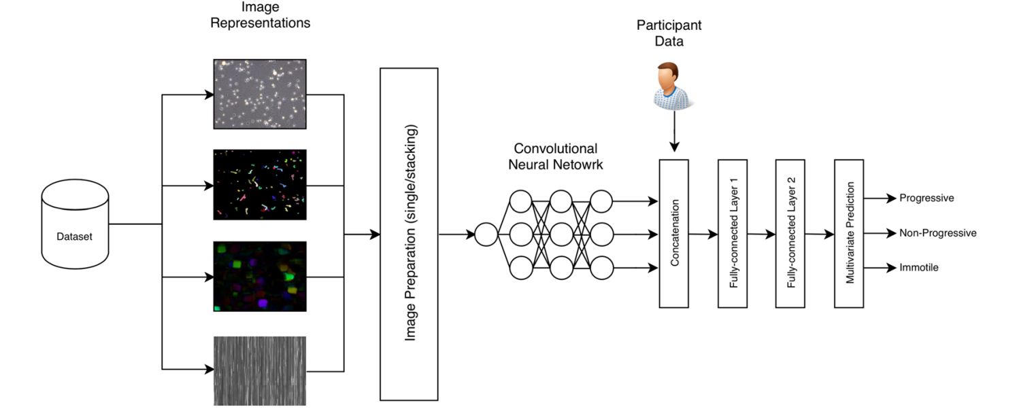
4. Related work
4.1.c. Machine Learning-Based Analysis
of Sperm Videos and Participant
Data for Male Fertility Prediction
Analyze raw frames to make a prediction.
Use optical flow to condense the information of the temporal dimension into a single image.
Combine the two previous methods
Notes:
(1)original video, (2) sparse optical fow, (3) dense optical fow, and (4) vertical frame matrix

Slide 13
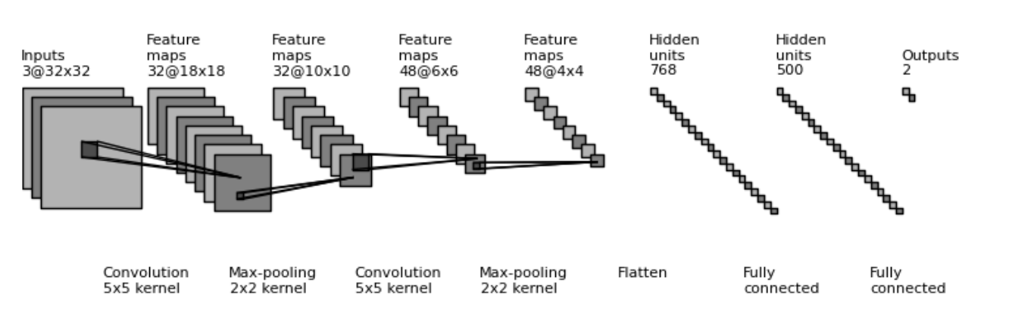
4. Related work
4.1.d. Predicting Semen Motility using three-dimensional Convolutional Neural Networks.
Notes:
Extract frame từ video
compiled these frames into a video tensor of 3 channels RGB.
converted each of them to channel-wise greyscale for colour isn’t an important feature in spermatozoa motility prediction and reducing the size of the video
xếp chồng these greyscale frames together and fed it to our models.
The output logits from the models were passed through the CrossEntropyLoss function

Slide 14
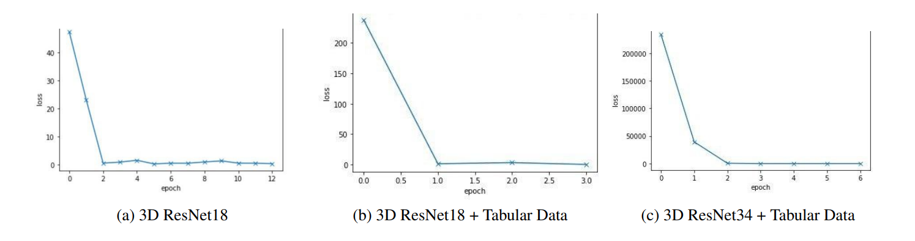
4. Related work
4.1.d. Predicting Semen Motility using three-dimensional Convolutional Neural Networks.
Notes:
ResNet18 100% accuracy on both validation and test sets.
The second ResNet18 + Tabular Databaccuracy of 100% on the validation set and 88.89on the test set.
The third ResNet34 + Tabular Data model accuracy 87.5% on the validation set and 77.78% on the test set.

Slide 15
5. Future intention
Read more related work
Clearly define the model
Continue data processing

Slide 16
THANK YOU !

