Slide 1
Toxic Comment Classification
MLoB

Slide 2
Outline
Team introduction
Competition
Methods
Results
Discussion

Slide 3
Team
Mick:
GCP
data cleaning
Roel:
LSTM
Bi-directional LSTM
Dennis:
Feature extraction,
GCP
Joost:
Report,
Bi-directional LSTM
Brian:
LSTM
Convolutional network

Slide 4
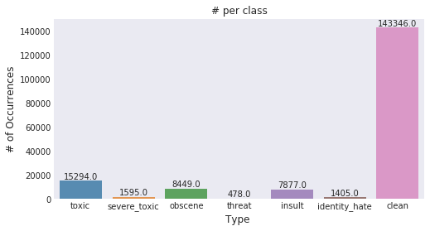
Toxic Comment Classification
Multi label classification
Imbalanced data set
Top x% vocabulary
Hand balancing
ROC AUC
Label wise
Jagan, Stop the S@#$ - Toxic Comments EDA, https://www.kaggle.com/jagangupta/stop-the-s-toxic-comments-eda

Slide 5
Methods
Feature models
SVM
MLP
Independent models
LSTM
1D convolutional network
Bi-directional LSTM

Slide 6
Feature Models
Feature extraction
Ratio of capitals vs total characters
Ratio of punctuation characters
Total length in characters, words and in sentences
Total amount of some special characters: ?, (, ), ! and some other characters.
Amount of unique words
Expanding feature set
Swear words, word2vec tf-idf scores
Dense Neural Network
SVM
Random Forest

Slide 7
Independent models
LSTM
Input 902 LSTM Layer, Dense Layer
Convolutional Network
Input 902 → 6 output, 2 convolutional layers (512 filters) , 2 Max Pooling Layers
Bi-directional LSTM
Bi-directional LSTM layer, Max Pooling, 2x Dense Layer with drop-out
Loss -> Binary Cross Entropy
Optimizer -> Adam

Slide 8
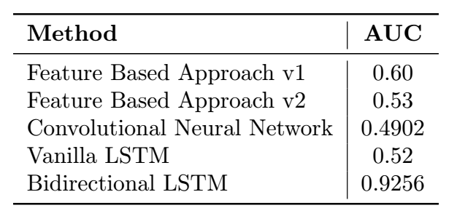
Results
Kaggle final place : 4090

Slide 9
Looking forward
Pre-processing
Ensemble

