Slide 1


HTTP in Python
Web tervers, Web Clients, Web APIs

Slide 2
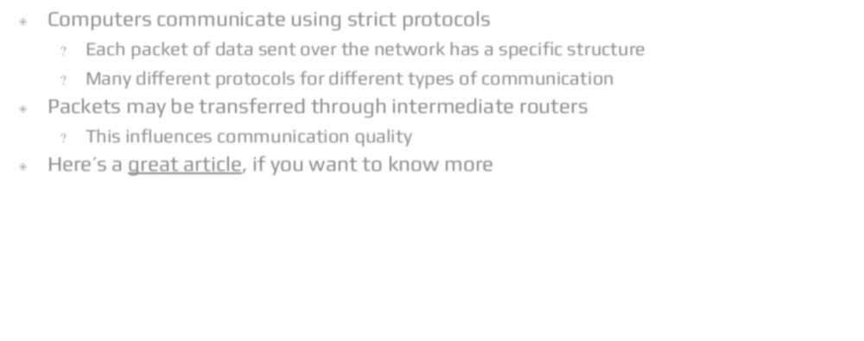


Computer Networks
◈ Computers communicate using strict protocols
? Each packet of data sent over the network has a specific structure
? Many different protocols for different types of communication
◈ Packets may be transferred through intermediate routers
? This influences communication quality
◈ Here’s a great article, if you want to know more

Slide 3
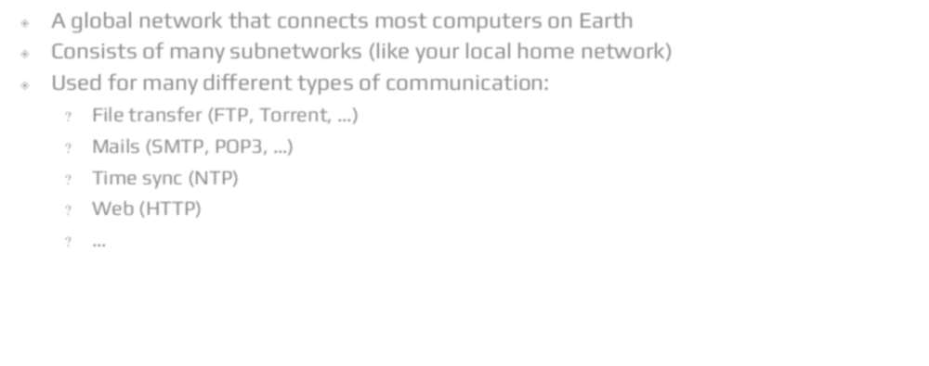


The Internet
◈ A global network that connects most computers on Earth
◈ Consists of many subnetworks (like your local home network)
◈ Used for many different types of communication:
? File transfer (FTP, Torrent, …)
? Mails (tMTP, POP3, …)
? Time sync (NTP)
? Web (HTTP)
? …

Slide 4
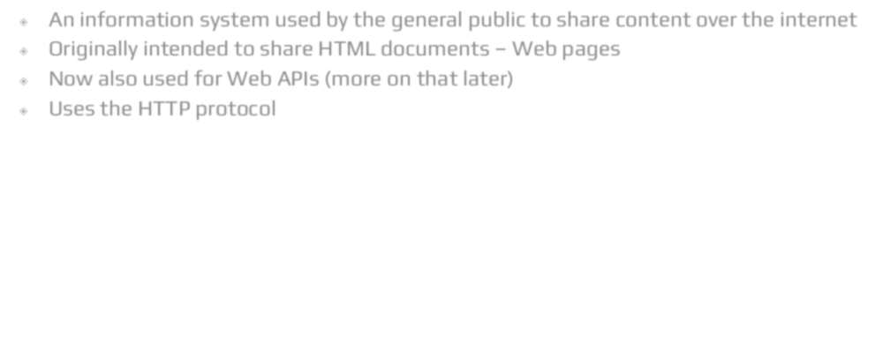


The Web
◈ An information system used by the general public to share content over the internet
◈ 0riginally intended to share HTML documents – Web pages
◈ Now also used for Web APIs (more on that later)
◈ Uses the HTTP protocol

Slide 5
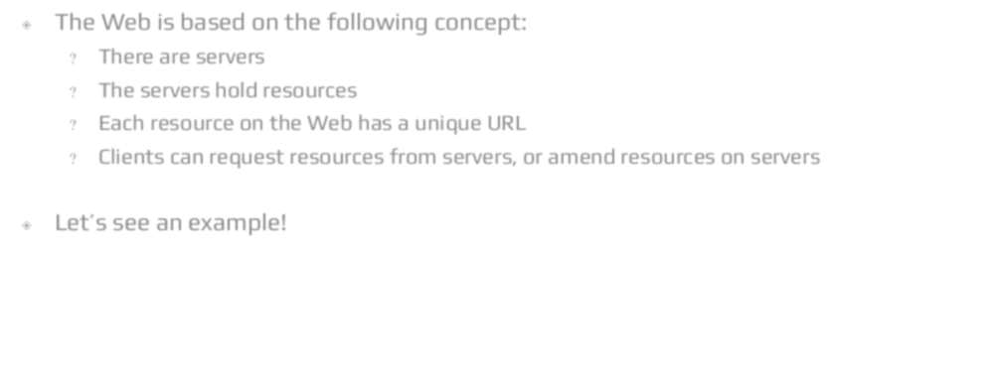









Client-terver Model
◈ The Web is based on the following concept:
? There are servers
? The servers hold resources
? Each resource on the Web has a unique URL
? Clients can request resources from servers, or amend resources on servers
◈ Let’s see an example!

Slide 6
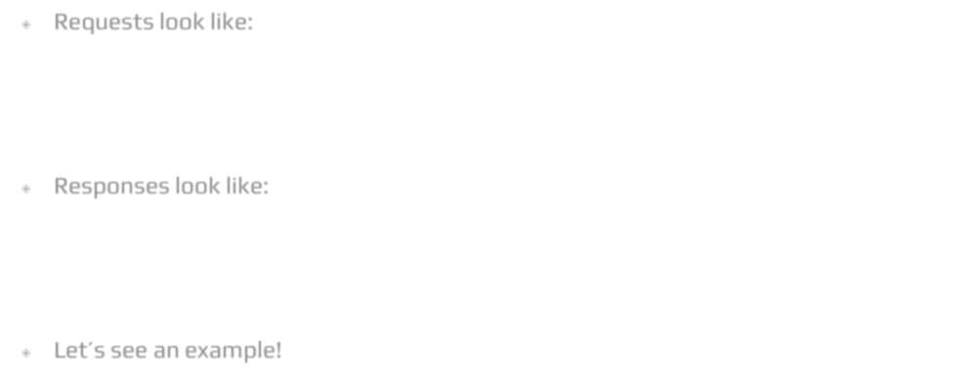


HTTP[t]
◈ Requests look like:
Method URL Version Header: value Header: value
…
Body
◈ Responses look like:
Version ttatus Header: value Header: value
…
Body
◈ Let’s see an example!

Slide 7
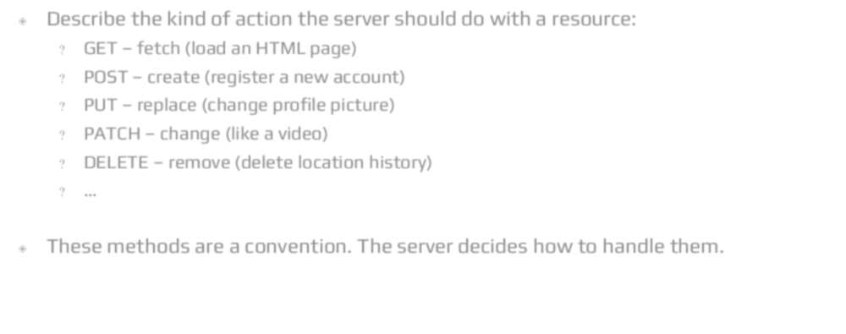
HTTP Methods
◈ Describe the kind of action the server should do with a resource:
? GET – fetch (load an HTML page)
? P0tT – create (register a new account)
? PUT – replace (change profile picture)
? PATCH – change (like a video)
? DELETE – remove (delete location history)
? …
◈ These methods are a convention. The server decides how to handle them.

Slide 8
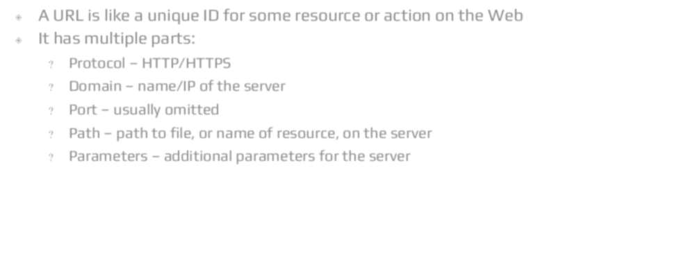
URLs
◈ A URL is like a unique ID for some resource or action on the Web
◈ It has multiple parts:
? Protocol – HTTP/HTTPt
? Domain – name/IP of the server
? Port – usually omitted
? Path – path to file, or name of resource, on the server
? Parameters – additional parameters for the server
https://stackoverflow.com/search?q=python+web+scrape

Slide 9
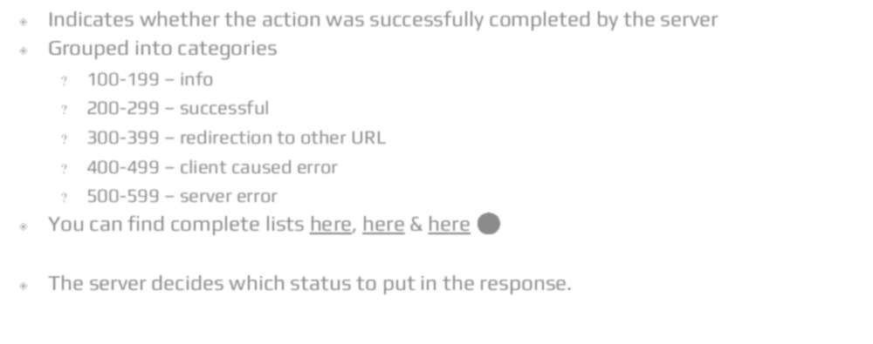



HTTP ttatus Code
◈ Indicates whether the action was successfully completed by the server
◈ Grouped into categories
? 100-199 – info
? 200-299 – successful
? 300-399 – redirection to other URL
? 400-499 – client caused error
? 500-599 – server error
◈ You can find complete lists here, here & here
◈ The server decides which status to put in the response.

Slide 10
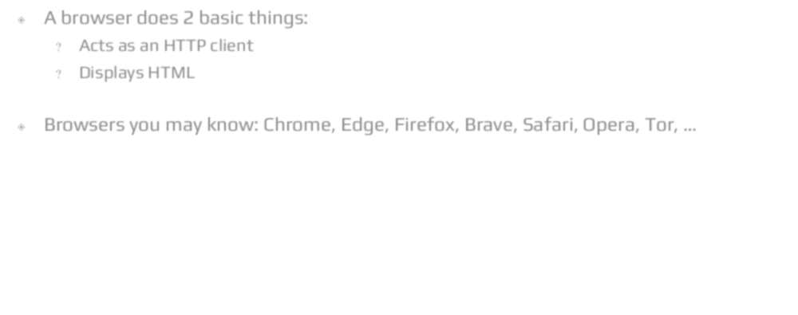

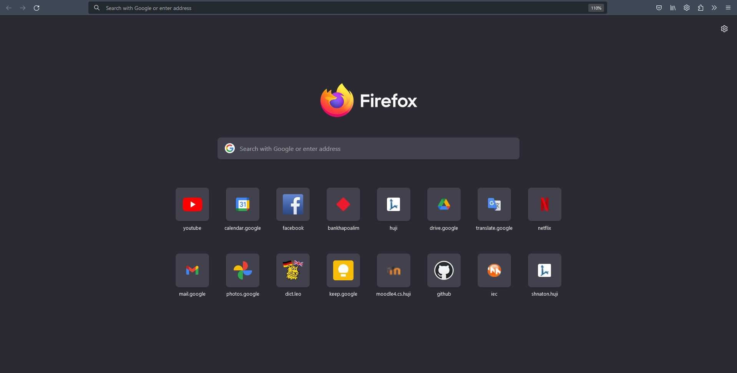
Browsers
◈ A browser does 2 basic things:
? Acts as an HTTP client
? Displays HTML
◈ Browsers you may know: Chrome, Edge, Firefox, Brave, tafari, 0pera, Tor, …

Slide 11
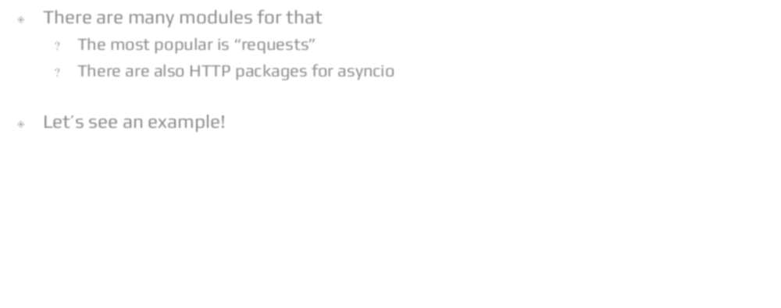
We Can Do HTTP in Python
◈ There are many modules for that
? The most popular is "requests”
? There are also HTTP packages for asyncio
◈ Let's see an example!

Slide 12

Web tervers

Slide 13
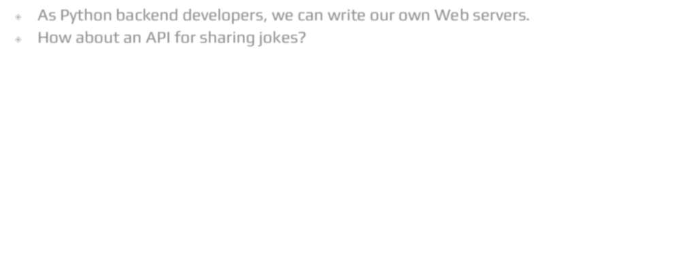
Let's Implement a Web terver!
◈ As Python backend developers, we can write our own Web servers.
◈ How about an API for sharing jokes?

Slide 14
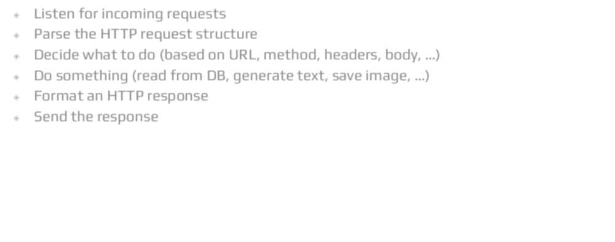
What a terver Needs to Do
◈ Listen for incoming requests
◈ Parse the HTTP request structure
◈ Decide what to do (based on URL, method, headers, body, …)
◈ Do something (read from DB, generate text, save image, …)
◈ Format an HTTP response
◈ tend the response

Slide 15
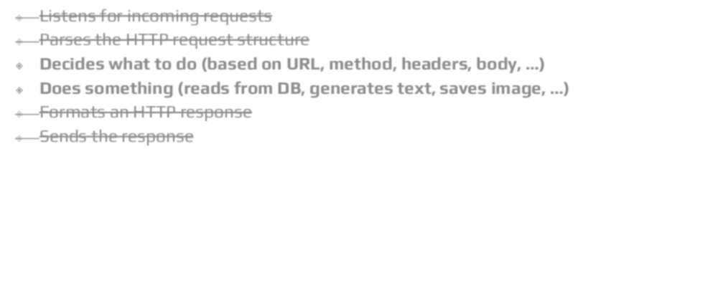
What a Backend Developer Wants to Do
◈ Listens for incoming requests
◈ Parses the HTTP request structure
◈ Decides what to do (based on URL, method, headers, body, …)
◈ Does something (reads from DB, generates text, saves image, …)
◈ Formats an HTTP response
◈ tends the response

Slide 16
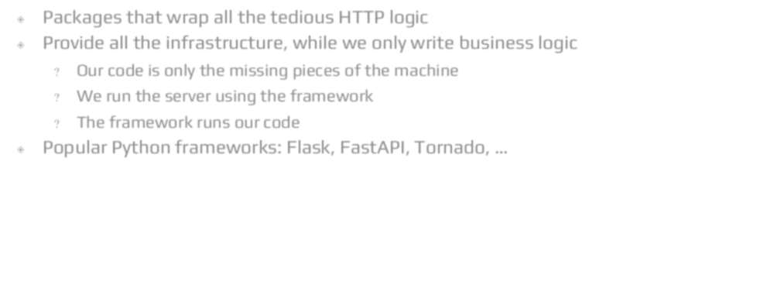
Web Frameworks
◈ Packages that wrap all the tedious HTTP logic
◈ Provide all the infrastructure, while we only write business logic
? 0ur code is only the missing pieces of the machine
? We run the server using the framework
? The framework runs our code
◈ Popular Python frameworks: Flask, FastAPI, Tornado, …

Slide 17
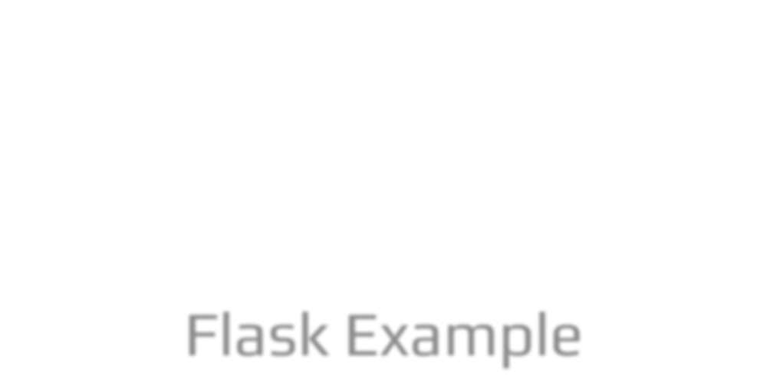

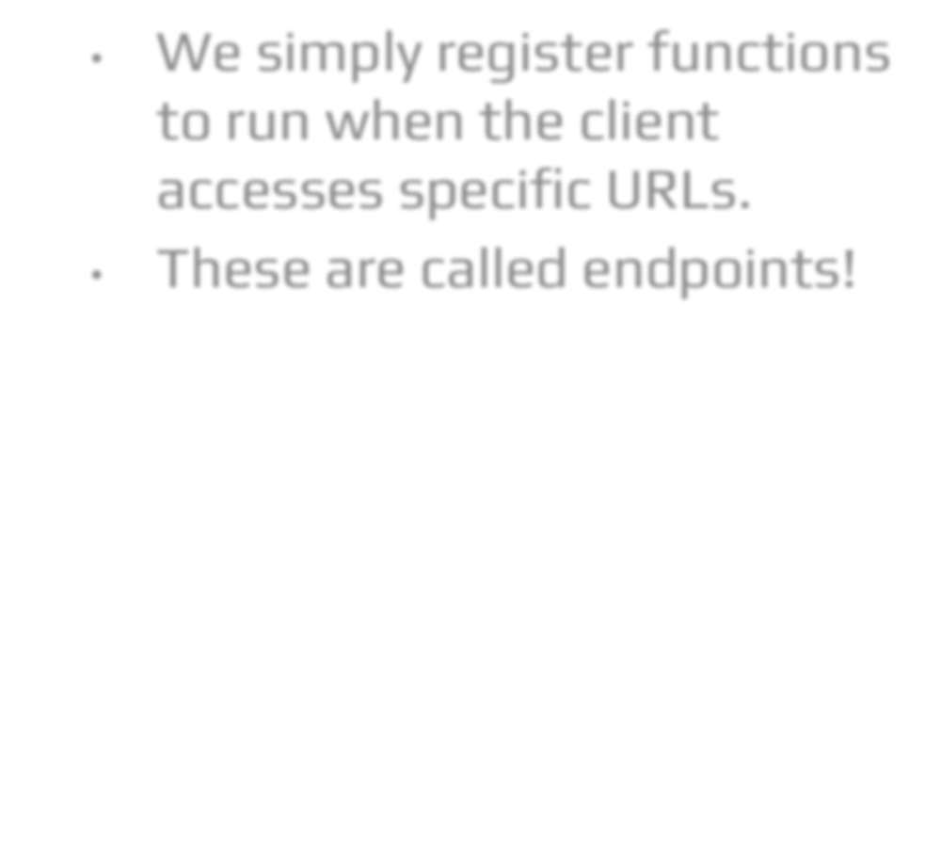
import random
from flask import Flask, request
# Instantiate a new Web app app = Flask( name )
Flask Example
We simply register functions to run when the client accesses specific URLs.
These are called endpoints!
# In reality this would be in a file jokes = [
"What do you call a magic dog? A labracadabrador.",
"Why did the hipster burn his mouth? He drank it before it was cool.",
]
@app.route('/random') def random_joke():
return random.choice(jokes)
actual business logic
@app.route('/save', methods=['POST']) def save_joke():
jokes.append(request.data.decode()) return "OK"
if name == ' main ': app.run(debug=True)

Slide 18
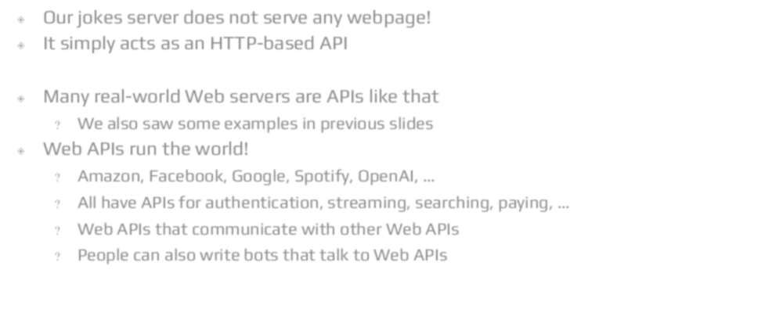
Web APIs
◈ 0ur jokes server does not serve any webpage!
◈ It simply acts as an HTTP-based API
◈ Many real-world Web servers are APIs like that
? We also saw some examples in previous slides
◈ Web APIs run the world!
? Amazon, Facebook, Google, tpotify, 0penAI, …
? All have APIs for authentication, streaming, searching, paying, …
? Web APIs that communicate with other Web APIs
? People can also write bots that talk to Web APIs

Slide 19
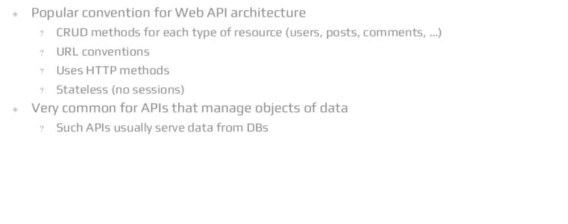
REtT API
◈ Popular convention for Web API architecture
? CRUD methods for each type of resource (users, posts, comments, …)
? URL conventions
? Uses HTTP methods
? ttateless (no sessions)
◈ Very common for APIs that manage objects of data
? tuch APIs usually serve data from DBs

Slide 20
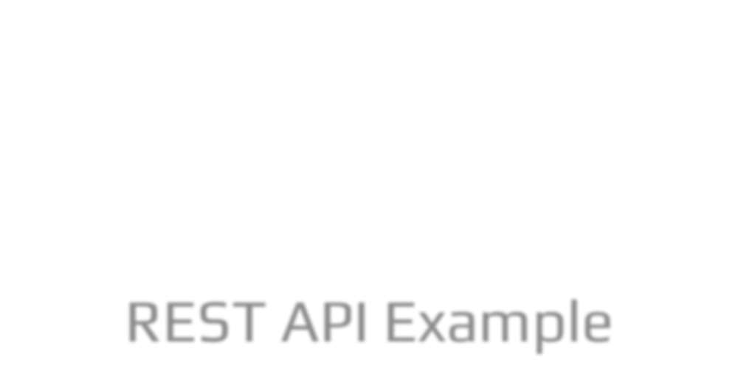

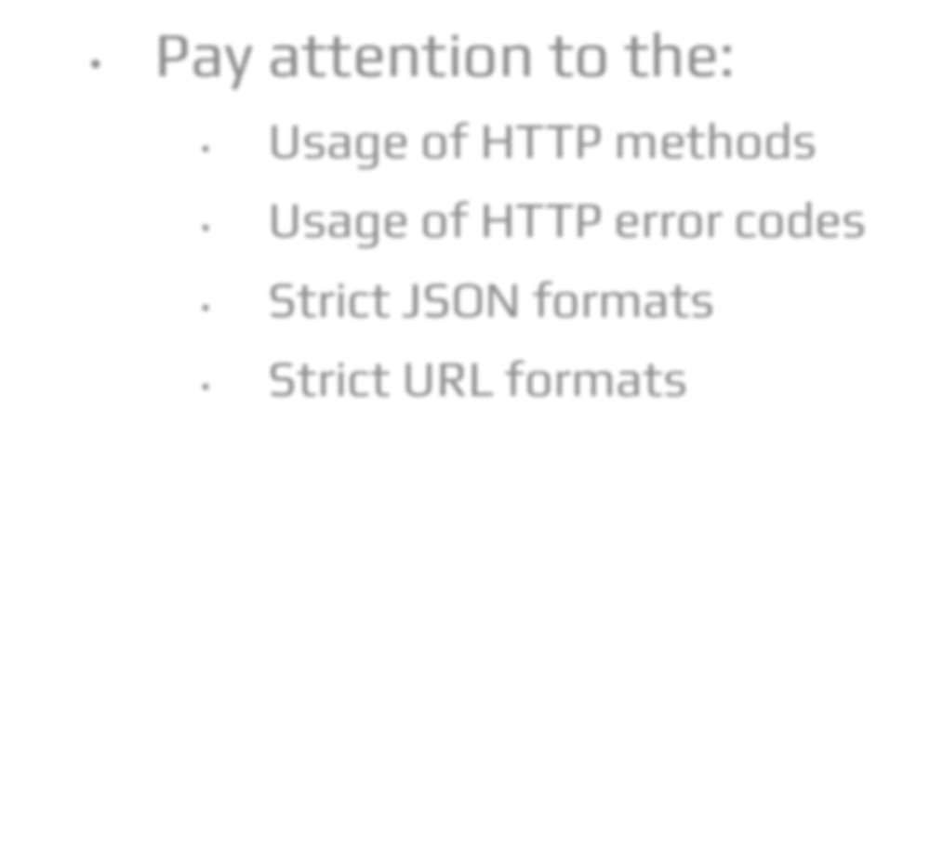
@app.route('/joke/random') def random_joke():
return jsonify(joke=random.choice(jokes))
REtT API Example
Pay attention to the:
Usage of HTTP methods
Usage of HTTP error codes
ttrict Jt0N formats
ttrict URL formats
@app.route('/joke', methods=['POST']) def save_joke():
jokes.append(request.json.get("joke")) return len(jokes)
@app.route('/joke/<id:int>') def get_joke(id_: int):
if 0 <= id_ < len(jokes):
return jsonify(joke=jokes[id_]) abort(404)
@app.route('/joke/<id:int>', methods=['DELETE']) def delete_joke(id_: int):
if 0 <= id_ < len(jokes):
return jsonify(joke=jokes.pop(id_)) abort(404)

