Slide 1

AsyincIO

Slide 2

Parallelism
Parallelism consists of performing multiple operations at the same time. Multiprocessing is a means to effect parallelism, and it entails spreading tasks over a computer’s central processing units (CPUs, or cores).
Multiprocessing is well-suited for CPU-bound tasks: tightly bound for loops and mathematical computations usually fall into this category.

Slide 3

Concurrency
Concurrency is a slightly broader term than parallelism. It suggests that multiple tasks have the ability to run in an overlapping manner. (There’s a saying that concurrency does not imply parallelism.)
Multiprocessing and Threading

Slide 4

Threading
Threading is a concurrent execution model whereby multiple threads take turns executing tasks. One process can contain multiple threads.
IOBound - threading is better for IO-bound tasks - a lot of waiting on input/output to complete.

Slide 5
Python supports it all
concurrency encompasses both multiprocessing (ideal for CPU-bound tasks) and threading (suited for IO-bound tasks). Multiprocessing is a form of parallelism, with parallelism being a specific type (subset) of concurrency.
The Python standard library has offered longstanding support for both of these through its multiprocessing, threading, and concurrent.futures packages.

Slide 6
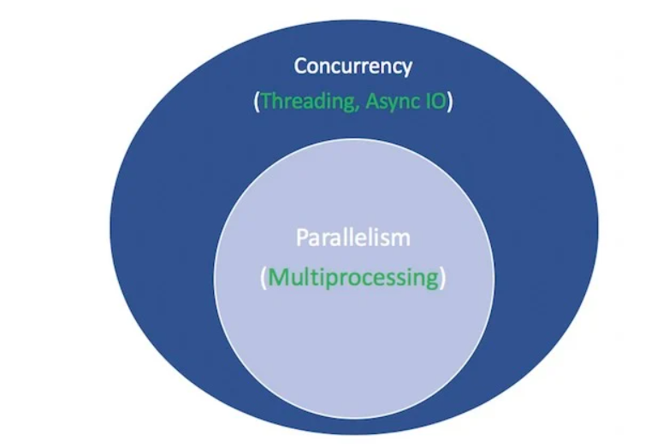

Slide 7
AsyincIO
Relatively new in python
existed or is being built into other languages and runtime environments, such as Go, C#, or Scala.
Not threading
Not multiproccesing
cooperative multitasking

Slide 8
AsyincIO2
Foundation for multiple Python asynchronous frameworks that provide high-performance network and web-servers, database connection libraries, distributed task queues, etc.
Asyncio is often a perfect fit for IO-bound and high-level structured network code.

Slide 9
Differences between threading and asynchronous I/O
Threads share data and resources - Asynchronous I/O operations do not.
Threads can be more efficient than asynchronous I/O operations when the tasks that are being executed share data or resources.
Asynchronous I/O operations can be more efficient than threads when the tasks that are being executed do not share data or resources.
Threading enables concurrency within a process and asyincIO enables concurrency inside a single thread only when it uses IO operations
“Use async IO when you can; use threading when you must”

Slide 10
Concurrency and asyncIO
synchronous I/O, where the thread is blocked while the I/O operation is performed. This means that only one I/O operation can be performed at a time, which can lead to poor performance when there are multiple I/O operations to be performed.
Asynchronous I/O allows multiple I/O operations to be performed simultaneously, even though they are all happening on the same thread. This is because asyncio allows I/O operations to be performed without blocking the thread. When an I/O operation is performed asynchronously, the thread is not blocked and can continue to run other tasks. The I/O operation will complete in the background and will notify the thread when it is finished.

