Slide 1
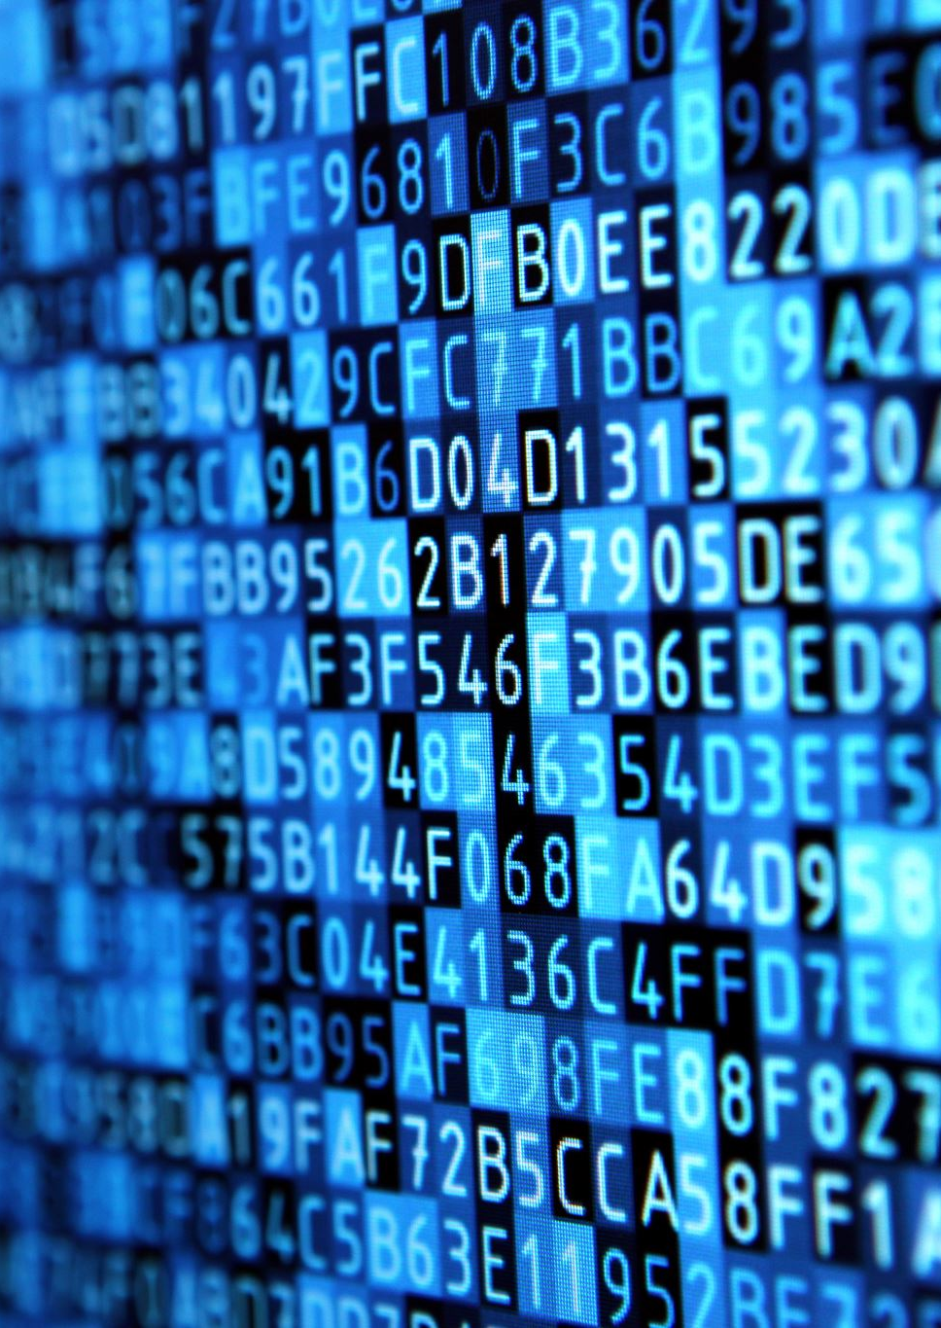
Generative AI and software development
What are the possible uses of generative ai, and natural language processing in software development?

Slide 2
Generative AI and software products
What are the possible uses of generative ai, and natural language processing in software products?

Slide 3

Real problem for students
Why?
Adding on features after the course is done
Understand the use case from you own experiences

Slide 4

Exercise Metadata
Hand In - About 3 weeks from now
Point will be taken for –
Ugly code (including lack of documentation)
Bad design
Bad Work methodology (git)
Ugly git hand in
Handing in late
Errors in code
No logs and tests - for now

