Slide 1
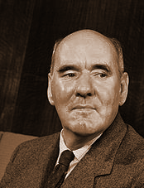
Parkinson's law
"Work expands so as to fill the time available for its completion."
Corollaries:
"If you wait until the last minute, it only takes a minute to do."
"In ten hours a day you have time to fall twice as far behind your commitments as in five hours a day."
"Programs expand to fill the memory available to them.

Slide 2
CPSC 457
Memory
Contains slides from Mea Wang, Andrew Tanenbaum and Herbert Bos
Notes:
Use Kahn’s algorithm for the asg4

Slide 3
Overview
address spaces – logical vs physical
address binding
memory management unit
swapping
memory management
fixed/dynamic partitioning
bitmaps, linked lists
placement algorithms: first fit, best fit, worst fit, next fit, quick fit
virtual memory & paging
pages, frames, demand paging, page table, page fault, effective access time
CPU Registers
Level 1 Cache Level 2 Cache
cost, speed
RAM
Hard Drive, SSD
(Virtual Memory)
capacity
Notes:
How to allocate memory to different resources

Slide 4
Addresses
programs need memory to run & we expect computers to run multiple programs simultaneously, so we expect OSes to manage memory for processes
some issues related to memory management:
OS must give each process some portion of available memory (address space)
Which part of memory? How much?
OS needs to protect memory given to one process from other processes
How?
If programmers do not know where the program will be loaded, how do they write code?
eg. how to write JMP instruction?
working with physical (direct) addresses is not a good solution …
Notes:
Programs only use logical address and something will translate it to a physical one

Slide 5
Working with physical addresses
we need to load two programs into physical memory…
RAM
0: | MOV
4: | MOV
8: | SUB
12: | JMP 20
16: | ADD
20: | MUL
24: | MOV
0: | ADD
4: | MOV
8: | CMP
12: | ADD
16: | ADD
20: | JMP 8
???

Slide 6
Working with physical addresses
we need to load two programs into physical memory…
can you spot the problem?
0000: | ADD
0004: | MOV
0008: | CMP
0012: | ADD
0016: | ADD
0020: | JMP 8
load at 0
0: | MOV
4: | MOV
8: | SUB
12: | JMP 20
16: | ADD
20: | MUL
24: | MOV
0: | ADD
4: | MOV
8: | CMP
12: | ADD
16: | ADD
20: | JMP 8
...
1000: | MOV
1004: | MOV
1008: | SUB
1012: | JMP 20
1016: | ADD
1020: | MUL
1024: | MOV
load at 1000

Slide 7

Working with physical addresses
0000: | ADD
0004: | MOV
0008: | CMP
0012: | ADD
0016: | ADD
0020: | JMP 8
0: | MOV
4: | MOV
8: | SUB
12: | JMP 20
16: | ADD
20: | MUL
24: | MOV
0: | ADD
4: | MOV
8: | CMP
12: | ADD
16: | ADD
20: | JMP 8
2nd program would not work, it would jump to the wrong address
...
1000: | MOV
1004: | MOV
1008: | SUB
1012: | JMP 20
1016: | ADD
1020: | MUL
1024: | MOV
another problem is lack of memory protection

Slide 8
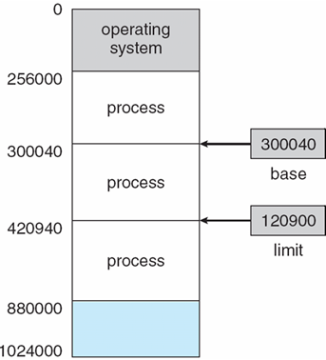
Base and Limit Registers ― address protection in hardware
a pair of base and limit registers define the allowed range of addresses available to CPU
base register = starting memory
limit register = size of memory
the base and limit registers can be modified only in kernel mode
CPU checks every memory access generated by a process
when process tries to access invalid address → CPU issues trap to OS routine
base & limit registers stored in PCB
Notes:
Base and limit registers provide protection
Swap the b and l
Base is were is the start memory
Limit what is the size

Slide 9
Base and Limit Registers ― address protection in hardware
base
base + limit
memory
address
≥
yes
<
yes
CPU
no
no
trap to OS ― addressing error
Notes:
Cpu gotta do checks
Memory bigger than base 1st
Memory smaller than base+limit 2nd

Slide 10
Address binding
problem: when programs are compiled, the physical address space of the process is not known
possible solution: programs could be expressed in a way that allows them to be relocated
when needed, we can bind the addresses to the actual physical memory location
addresses in a program are represented in different ways at different stages of a program’s life
source code addresses are usually symbolic
eg. int main()
addresses in compiled code can bind to relocatable addresses
eg. main = “14 bytes from beginning of this module”
before execution, the loader can bind relocatable addresses to physical addresses
eg. main = “14 bytes from beginning of this module” ⇒ "1000 + 14 = 1014"
each binding maps one address space to another

Slide 11
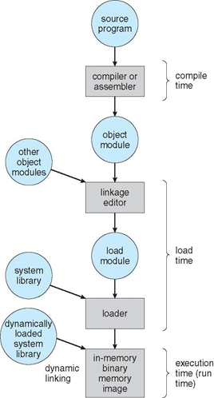
Binding of instructions and data to memory
address binding of instructions and data to memory addresses can happen at three different stages
at compile time - slowest
if memory location is known a priori, absolute code can be generated and stored
we must recompile code if starting location changes ☹
at load time - much faster
the compiled code must be stored as relocatable code
binding is done before program starts executing
we include position independent code (PIC) in this category
at execution time - fastest (with HW support)
if process can be moved during its execution, binding is done at run-time, dynamically
most flexible, but need hardware support for address maps (e.g., memory management unit) ☺
Notes:
Load time is faster than compile time but it may execute a little bit slower because you have to do something that the beginning
Execution time
no binding until you need to
need hardware support
memory management unit
does the binding for us

Slide 12
Logical & physical addresses
we can achieve execution-time address-binding and memory-protection by 'virtualizing memory'
OS gives each process a logical address space (aka virtual address space)
it is a contiguous space, ranging from 0 to MAX
as process executes, addresses generated by the CPU are logical addresses
if logical address does not fall into the logical address space range → violation (trap)
physical address - a real memory address
logical addresses are mapped to physical addresses before reaching memory via hardware device called memory management unit (MMU)
physical address space of a process is the subset of RAM allocated to a process
physical address space = set of all mappings from logical addresses
Notes:
Every process is going to think its being loaded into address 0 going to max 0-max is memory allocated to the process
jump and load instructions
Logical needs to in 0-max range
if outside the mmu or cpu can determine if its invalid
doesn’t matter
determined by transistors
technically it’s the mmu
Logical to physical address
is the actual space in RAM allocated to a process
The OS decides what the mapping is
but the hardware does the decoding
does not have to be continuous

Slide 13
Memory-Management Unit (MMU)
MMU is a hardware device that maps virtual addresses to physical addresses
needs to be super fast, so it is often part of the CPU
many possible implementations
CPU executing instructions only sees logical addresses, it never sees real physical addresses
execution-time binding occurs automatically whenever memory reference is made
logical address
physical address
CPU
MMU
Memory
Notes:
Cpu runs programs in logical address space and the address is automatically decoded by the MMU
So when switching processes the MMU gets to work

Slide 14
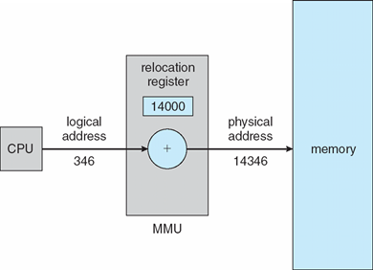
MMU ― Relocation Registers
a simple MMU implementation:
logical address space starts at 0, ie. programs are written assuming they start at address 0
CPU has a relocation register
value in the relocation register is added to every address generated by a CPU at the time it is sent to memory
but no memory protection ...

Slide 15
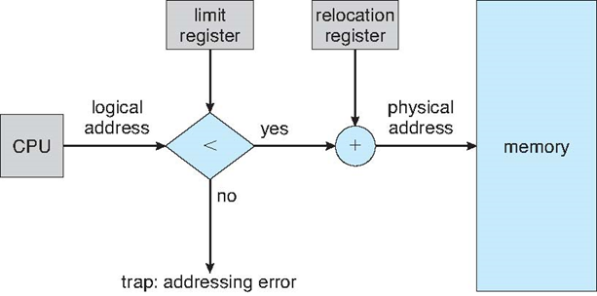
MMU ― Relocation and Limit Registers
combining relocation register and limit register
relocation (base) register = smallest allowed physical memory address
limit register = the size of the chunk of physical memory a process is allowed to use
achieves execution-time binding as well as memory protection
Notes:
Logical address is bigger than limit register we know that we are trying to access memory outside the max
To use this method the physical memory needs to be continuous

Slide 16
Hardware Support for Relocation and Limit Registers
0: | ADD
4: | MOV
8: | CMP
12: | ADD
16: | ADD
20: | JMP 8
0: | MOV
4: | MOV
8: | SUB
12: | JMP 20
16: | ADD
20: | MUL
24: | MOV
0: | ADD
4: | MOV
8: | CMP
12: | ADD
16: | ADD
20: | JMP 8
base register:
0
limit register:
512
...
1000: | MOV
1004: | MOV
1008: | SUB
1012: | JMP 20
1016: | ADD
1020: | MUL
1024: | MOV
base register:
1000
each process gets its own pair of base/limit registers
stored in PCB
limit register:
64
...

Slide 17
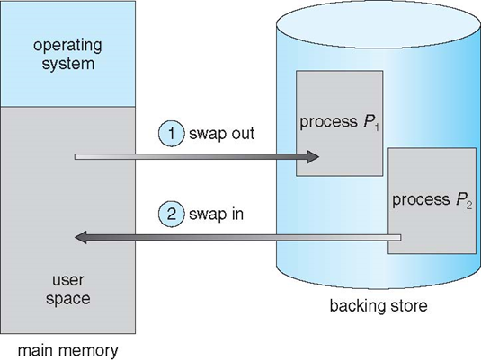
Swapping
a process can be swapped temporarily out of memory to a backing store, and then brought back into memory for continued execution
backing store – fast storage large enough to accommodate copies of all memory images for all processes
swapping allows the OS to load more processes than the available physical memory
why would we want that?!?

Slide 18
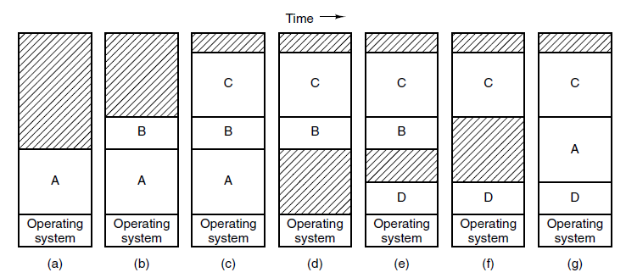
Swapping and memory
memory allocation changes as processes are swapped out and swapped in
the shaded regions are unused memory
A is swapped out
B is swapped out
A is swapped in

Slide 19
Swapping
does the swapped out process need to swap back into the same physical addresses?
depends on address binding method
much easier if MMU is used
must be careful with pending I/O, especially when using memory-mapped device registers
I/O results could be sent to kernel, then to the process (double-buffering)
context switch time can be extremely high
standard swapping not used in modern operating systems
note: Linux uses the term 'swapping' to mean paging
paging is similar to swapping, but paging can swap out parts of a process
we will discuss paging in lot more detail in the near future
Notes:
Context switching can be high because it can involve memory in and out of the disk
paging came out to help this
so is swaps parts of memory instead of all of it

Slide 20
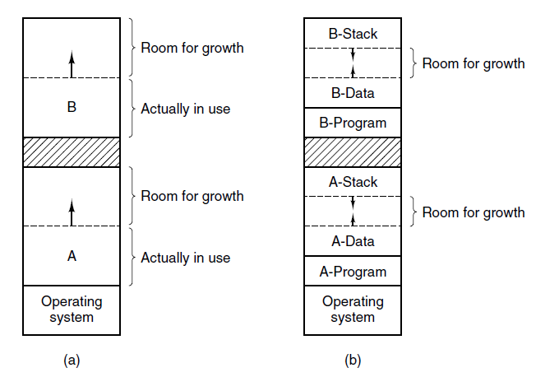
Memory allocation
how much memory should OS allocate to each process?
fact: most programs increase their memory usage during execution
possible solution: swap process out, find a bigger free memory chunk, swap it back in
another improvement: OS proactively allocates extra memory for each process

Slide 21
Memory allocation
at some point OS needs to
find a free chunk of memory
then mark it as used
and later free it up
simple approaches can lead to memory fragmentation
lots of tiny free chunks of memory
none of them big enough to satisfy any requests
OS needs to manage the memory in an efficient way
fast (searching, allocating, freeing, …)
minimize fragmentation
two general approaches: fixed partitioning and dynamic partitioning
Notes:
Memory fragmentation can never be avoided.
*malloc* can cause this

Slide 22
Fixed partitioning
memory is divided into partitions of equal size
example:
total memory = 64MB, partition size = 8MB → 8 partitions
OS usually reserves some memory for itself (eg. 1 partition, or 8MB)
let's load 3 processes: P1 (4MB), P2 (8MB), P3 (10MB)
8MB
8MB
8MB
8MB
8MB
8MB
8MB
8MB

Slide 23
Fixed partitioning
memory is divided into equal-sized partitions
example:
total memory = 64MB, partition size = 8MB → 8 partitions
OS usually reserves some memory for itself (eg. 1 partition, or 8MB)
let's load 3 processes: P1 (4MB), P2 (8MB), P3 (10MB)
Problems:
8MB
8MB
8MB
8MB
8MB
8MB
8MB
8MB
OS
P1 4M
P2
8MB
P3
10MB

Slide 24
Fixed partitioning
memory is divided into equal-sized partitions
example:
total memory = 64MB, partition size = 8MB → 8 partitions
OS usually reserves some memory for itself (eg. 1 partition, or 8MB)
let's load 3 processes: P1 (4MB), P2 (8MB), P3 (10MB)
Problems:
internal fragmentation: memory internal to a partition becomes fragmented
leads to low memory utilization if partitions are big
8MB
8MB
8MB
8MB
8MB
8MB
8MB
8MB
OS
P1 4M
P2 8MB
P3
10MB
Actual free memory: 34 MB
Usable free memory: 24 MB

Slide 25
Dynamic partitioning
create partitions that can fit requests perfectly
example:
total memory = 64MB, minus 8MB taken by OS
load 3 processes: P1 (4MB), P2 (8MB), P3 (10MB)
64MB

Slide 26
Dynamic partitioning
create partitions that can fit a request perfectly
example:
total memory = 64MB, minus 8MB taken by OS
load 3 processes: P1 (4MB), P2 (8MB), P3 (10MB)
no more internal fragmentation, but what if P2 finishes, and P4 (18MB) gets added?
34MB
OS
P1
4M
P2
8MB
P3 10MB
Usable free memory: 34 MB
Actual free memory: 34 MB

Slide 27
Dynamic partitioning
create partitions that can fit a request perfectly
example:
total memory = 64MB, minus 8MB taken by OS
load 3 processes: P1 (4MB), P2 (8MB), P3 (10MB)
no more internal fragmentation, but what if P2 finishes, and P4 (18MB) gets added?
external fragmentation: the memory that is external to all partitions becomes increasingly fragmented, leading to low memory utilization
eg. P5 (17MB) could not start, despite having enough free RAM
8MB
16MB
OS
P1
4M
P3
10MB
P4
18MB
Usable free memory: 24 MB
Actual free memory: 24 MB
Largest free chunk: 16 MB

Slide 28

Memory compaction
memory compaction is a mechanism to deal with external fragmentation
from time to time, the OS re-arranges the used blocks of memory so that they are contiguous
free blocks are merged into a single large block
CPU intensive operation
8MB
16MB
OS
P1
P3
P4
24MB
OS
P1
P3
P4

Slide 29
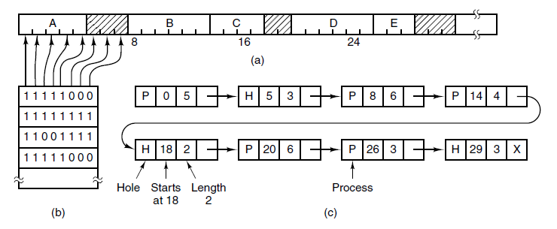
Implementation
how do we keep track of free memory and allocated memory?
we need a data structure
that is efficient at searching free space
that is efficient at reclaiming free space
"deals" with fragmentation

Slide 30
Bitmaps & fixed partitions
memory is divided into equal partitions as small as few words and as large as several KB
OS maintains a bitmap, 1 bit per partition, where 0=free, 1=occupied
Problems:
searching is O(N), N = size of bitmap
smaller partitions ⇒ less fragmentation, but larger bitmap
larger partitions ⇒ smaller bitmap, but more fragmentation
compromise between efficiency and fragmentation
note: larger bitmap also implies more wasted memory

Slide 31
Linked lists & dynamic partitioning
memory is divided into partitions of dynamic size
OS maintains a list of allocated and free memory partitions (holes), sorted by address
searching is O(N), where N = number of segments in the linked list
reclaiming free space can be O(1)
if doubly-linked list is used and linked-list data is stored within segments

Slide 32
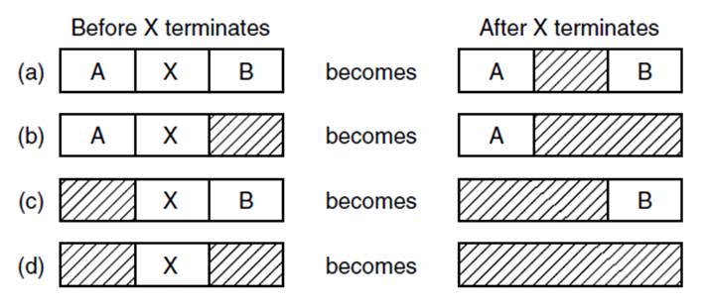
Memory management with linked lists - reclaiming space
two way merge
two way merge
three way merge

Slide 33
Memory allocation
algorithms for finding a free space (hole) in a linked list:
first fit - find the first hole that is big enough, leftover space becomes new hole
best fit - find the smallest hole that is big enough, leftover (tiny) space becomes new hole
next fit - same as first fit, but start searching at the location of last placement
worst fit - find the largest hole, leftover (big) space is likely to be usable
quick fit - maintain separate lists for common request sizes
leads to faster search, but more complicated management
example: request is to find memory for 2 units
hole
last placement
next fit
3
5
2
first fit
worst fit
best fit

Slide 34
Questions?

