Slide 1
CPSC 457
Paging
Contains slides from Mea Wang, Andrew Tanenbaum and Herbert Bos

Slide 2
Overview
page table implementations - simple, hierarchical, inverted, hashed inverted
frame allocation algorithms - equal / proportional / priority
page replacement algorithms - FIFO, Optimal, LRU, Clock
thrashing
copy on write

Slide 3
Review: memory management unit
logical address
physical address
page number replaced with frame number
CPU
MMU
Memory
p
d
f
d

Slide 4
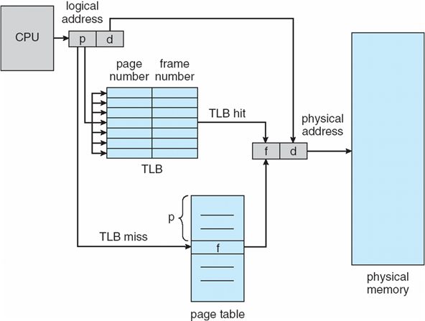
Review: paging hardware
MMU

Slide 5
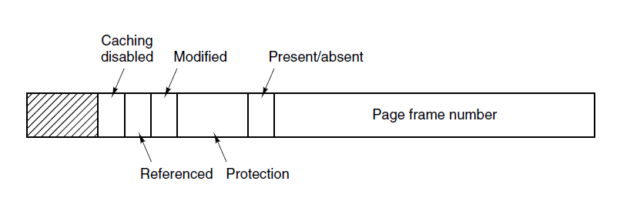
Review: typical structure of page table entry
aka dirty bit
set by hardware automatically on write access
aka valid/invalid bit
invalid → page fault
set by hardware automatically on any access
protection bit(s), eg. read/write/execute...

Slide 6
Shared Pages
sometimes it can be useful for processes to share some memory with other processes
this can be implemented using shared pages
example 1:
running multiple instances of the same program, or programs using a shared library
only one copy of the executable code needs to be in physical memory
implemented using shared read-only pages, with read-only bit set in page table entry
example 2:
shared read/write memory for interprocess communication
implemented using shared read-write pages

Slide 7
Shared Pages Example
process 1
0
1 | data 1
2 | data 3
3 | editor 1
4 | editor 2
5
6 | editor 3
7 | data 2
8
editor 1
editor 2
editor 3
data 1
3
4
6
1
PT
process 2
editor 1
editor 2
editor 3
data 2
3
4
6
7
PT
shared
pages (frames)
process 3
editor 1
editor 2
editor 3
data 3
3
4
6
2
PT

Slide 8
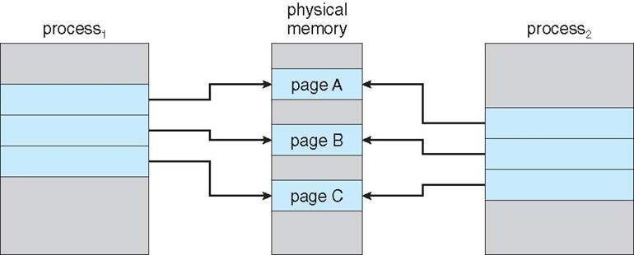
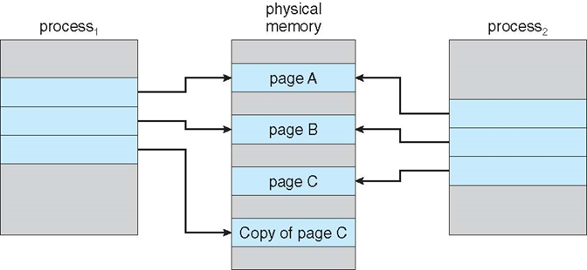
Copy-on-Write
Copy-on-Write (COW) allows parent and child processes to initially share the pages in memory
if either process tries to modify a shared page, the page is copied first, then modified
page table entries need a copy-on-write bit
COW allows very efficient process implementation of fork(), since only modified pages are copied - on demand
Before process 1 tries to modify page C
After process 1 tries to modify page C

Slide 9
Page Table Size
page tables can get huge using straightforward methods
consider a 64-bit logical address space (most common)
page size of 4 KB (2¹²)
page table would have (2⁶⁴ / 2¹² = 2⁵²) entries
52 bits to address it → each entry would need to be at least ⌈52/8⌉=7 bytes long
page table would need at minimum 2⁵² entries * 7 bytes/entry → petabyte range
some solutions:
hierarchical paging
inverted page tables
hashed inverted page tables

Slide 10
Hierarchical Page Tables
observation: most programs do not use all virtual address space at the same time
instead, only some entries in the page table are used at any given time
also, the used entries tend to be grouped together into multiple groups of consecutive pages
so let's break up the page table into multiple smaller page tables
with the hope that not all of the smaller page tables will be used
the ones that are not used, don't have to be in memory
x
x
x
x
x
x
x
x
x
page table with unused entries in the middle

Slide 11
Two-Level Page-Table Example
a simple technique is a two-level page table ― think of it as paging the page table
we save space by not storing small page tables if all their entries are invalid …
inner page table
x
x
x
x
x
x
x
x
x
x
x
x
outer page table
x
x
x
x
x
x
x
x
x
table with 16 entries, unused entries in the middle
two level page table 20 entries in total !!!
two level page table with 12 entries

Slide 12
Two-Level Page-Table Example
a 32-bit logical address with 4K page size is divided into:
a page number consisting of 20 bits
a page offset consisting of 12 bits
since the page table is paged, the page number is further divided into:
a 10-bit outer page number p1
a 10-bit inner page number p2
p1 is an index into the outer page table
p2 is an index into an inner page table
also known as forward-mapped page table
page #
offset
page number
page offset
p₁
p₂
d
10 bits
10 bits
12 bits

Slide 13
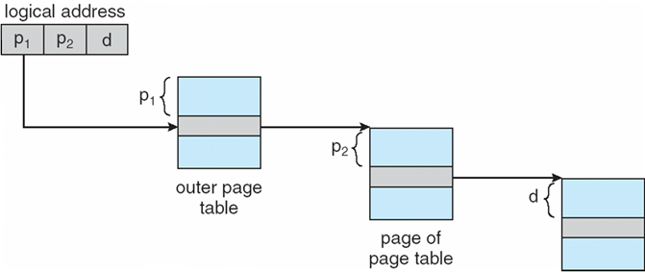
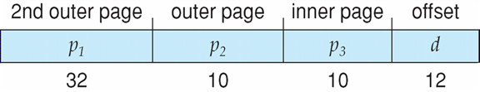
Address-Translation Scheme
3 memory accesses per request
on 64-bit system outer page table would still have 2⁴² entries
we could add 2nd outer page table
2³² entries for outer PT
4 memory accesses per req.
outer page table
inner page table
frame

Slide 14
Multi-level page table example
consider a 64-bit system, with 4KiB page size (2¹² bits), and 8 bytes per entry
single page table → 2^52 entries x 8B/entry → 2^55 bytes → ~36 petabytes
how many page table levels do we need if we want each page table fit inside a page?
a page can fit 4KiB/8B = 512 entries = 2⁹ entries
with 12-bit offsets, that means we need ⌈52bits/9bits-per-level⌉ = 6 levels!!!
with 6-level hierarchical PT each memory request would require 7 memory accesses
6 accesses for translating logical address → physical address
1 access for the actual memory location
this would be way too slow
p₁
p₂
p₃
p₄
p₅
p₆
d
7 bits
9 bits
9 bits
9 bits
9 bits
9 bits
12 bits

Slide 15
Inverted Page Table
rather than each process having its own page table, let's track all physical pages in one global inverted page table (IPT)
this global IPT has one entry for each real page of memory, containing:
virtual address, and
owning process ID
IPT decreases memory needed to store a page table:
IPT size is proportional to the amount of physical memory available
eg. 16GB memory with 4KB page size and 8B/entry → only 32MB page table
but IPT increases time needed to search the table when a page reference occurs
with above example, page table has ~4 million entries, on average a translation would require ~2 million memory accesses !!!
TLB could help accelerate the lookup somewhat, but TLB is very tiny ...
another (smaller) problem: shared pages are problematic with IPT

Slide 16
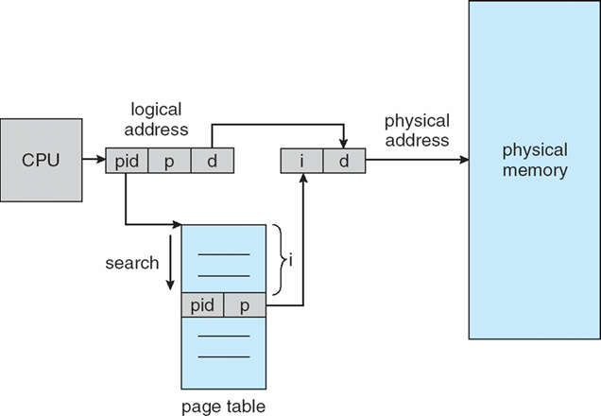
Inverted Page Table Architecture

Slide 17
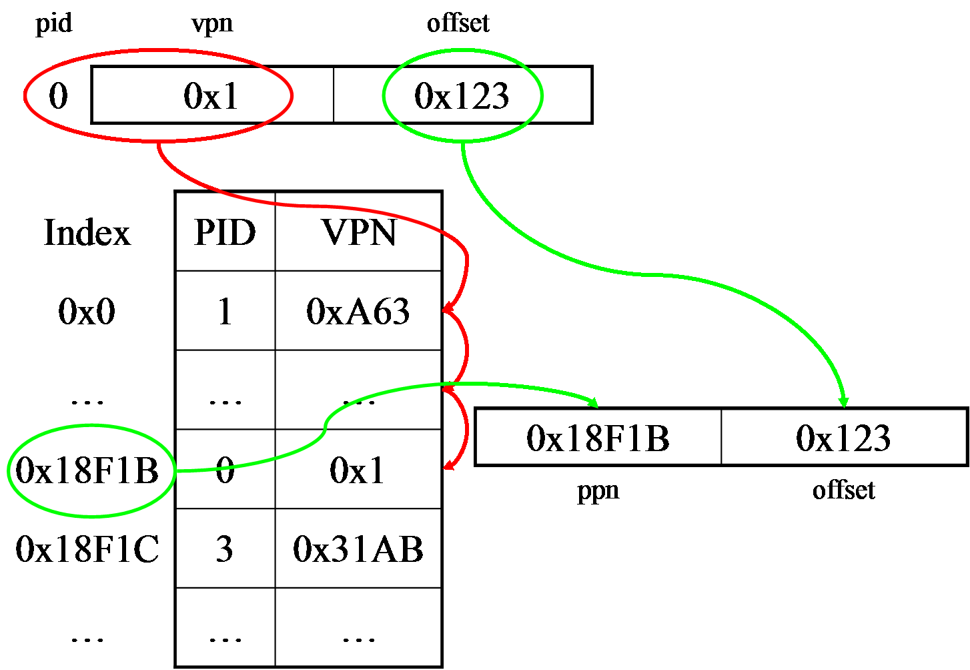
Hashed Inverted Page Table
found in some 64-bit systems
the virtual page number and process ID is hashed into a page table
this page table contains chains of elements which hash to the same location
each element contains: PID, virtual page number and a pointer to the next element
virtual page numbers are compared in the chain until a match is found
if a match is found, the corresponding physical frame is extracted, otherwise page fault
with a good hash function → average access time is O(1)

Slide 18
Page fault handling
page fault - exception raised when a process accesses a page not currently mapped by MMU
eg. entry in page table marked invalid
note: with demand paging, first reference to a page always results in a page fault
general page fault handling:
operating system looks at another table to decide:
invalid reference → abort
reference valid, but page not in memory, eg. it's in a backing store
find a free frame
load page from backing store into frame by scheduling appropriate disk operation
when done, reset page tables to indicate page now in memory
set validation bit to valid
restart the instruction that caused the page fault

Slide 19
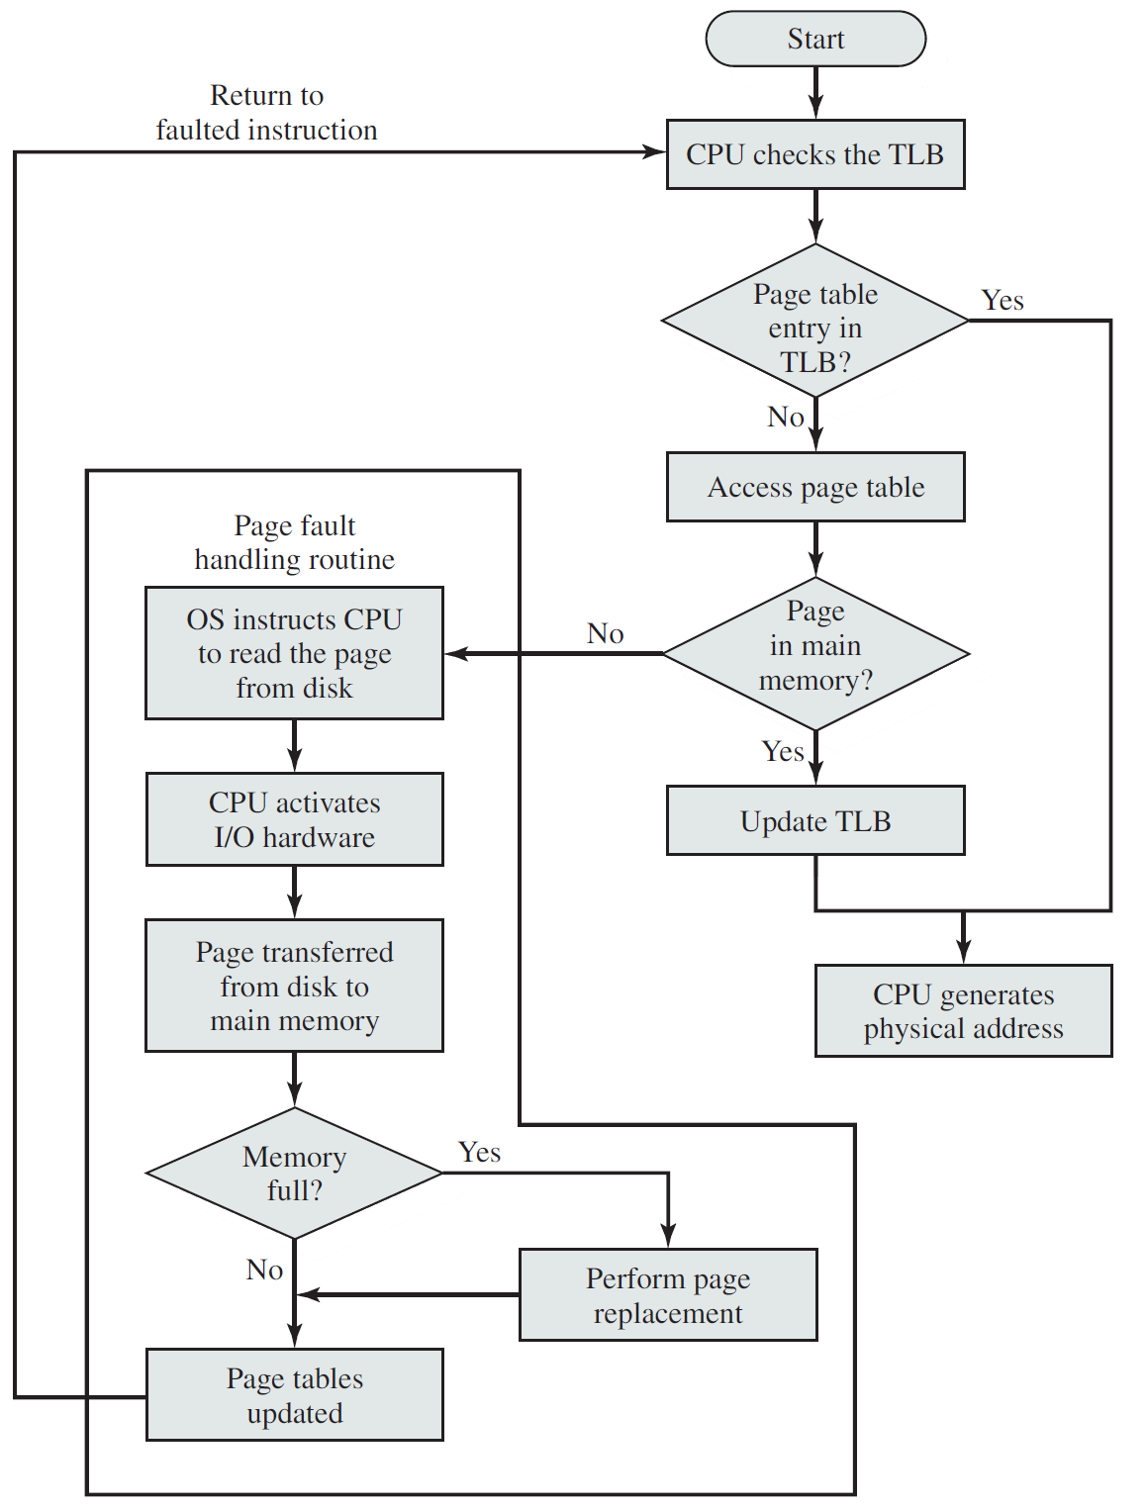
Operating Systems: Internals and Design Principles, 9th Edition, William Stallings ©2018 Pearson

Slide 20
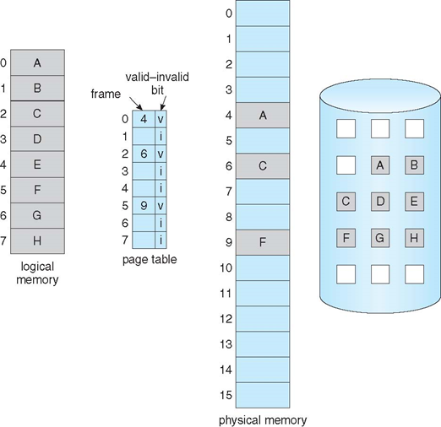
Page table with some pages not in main memory

Slide 21
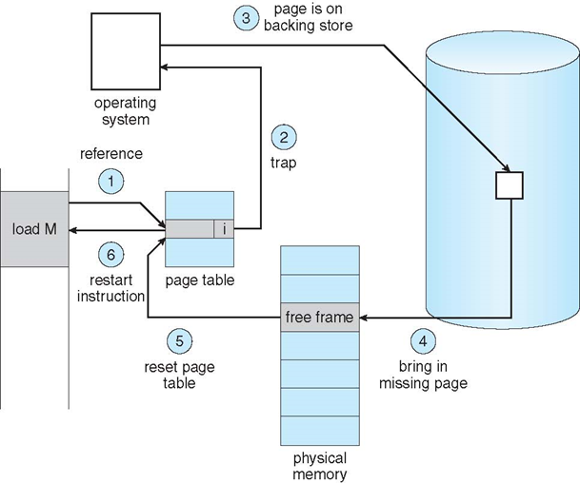
Page fault handling

Slide 22
What happens if there are no free frames?
how does OS deal with over-allocation of memory?
OS needs to make room by evicting an existing frame
OS finds an occupied (victim) frame in memory and pages it out
saves it to backing store, and remembers it so that it can find it later i.e. update page table & other relevant data structures
can use the modify (dirty) bit in a page table entry to reduce overhead of page transfers, so that only modified pages are saved to the backing store
remember: dirty bit is automatically set by hardware on write access
but which frame do we evict?
we need an algorithm to find a victim page
this algorithm must be fast, cannot afford to be too fancy
also, the algorithm should minimize the overall number of page faults
we will need a page replacement algorithm

Slide 23
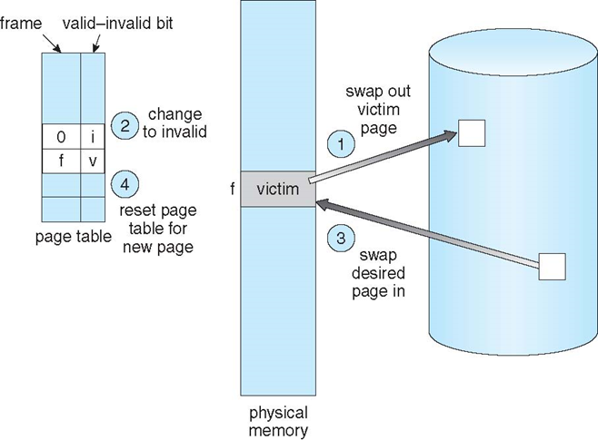
Basic page replacement

Slide 24
Basic page replacement
find the location of the desired page on disk
find a free frame:
if there is a free frame, go to step 3
if there is no free frame, use a page replacement algorithm to select a victim frame
if victim frame is dirty, write it to backing store
set the invalid bit in page table corresponding to victim frame
load desired page into the free frame and update the page and frame tables
frame table is a (simple) data structure that keeps track of free frames
restart the instruction that caused the trap
Note: now potentially 2 page transfers for page fault, further increasing EAT

Slide 25
Frame allocation
frame allocation algorithm determines
how many frames to give to each process
for a single-process system:
the OS claims some frames and leaves the rest to the running process
for a multiprogramming system:
each process needs a minimum number of frames (OS/architecture dependent)
maximum depends on available physical memory
two major allocation schemes:
fixed allocation (equal and proportional)
priority allocation

Slide 26
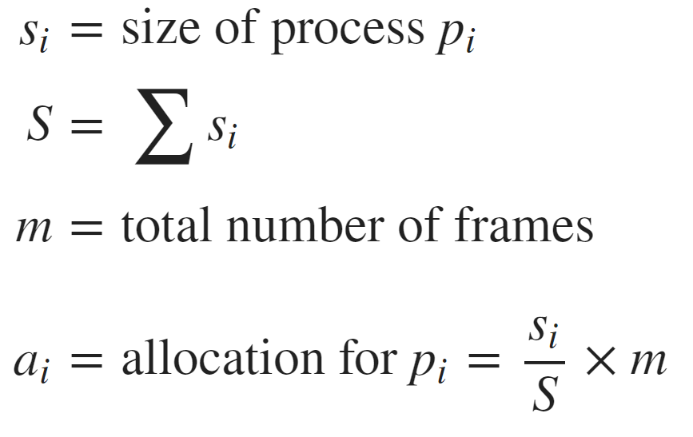
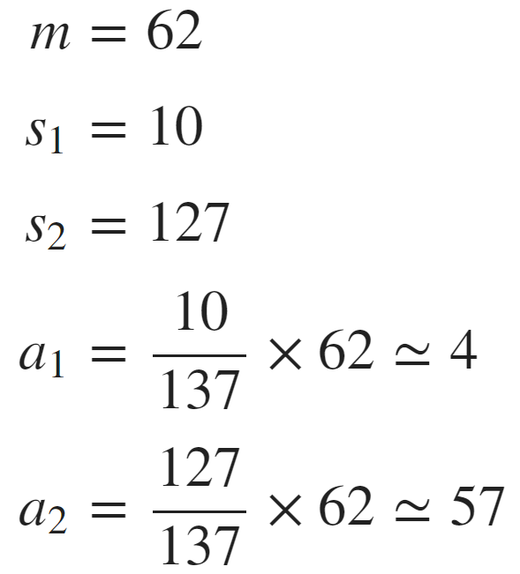
Fixed allocation
equal allocation – for example, if there are 100 frames (after allocating frames for the OS) and 5 processes, OS gives each process 20 frames
proportional allocation – allocate according to the size of process
dynamic ― as degree of multiprogramming and process sizes change
example with 2 processes:

Slide 27
Priority allocation
similar to proportional allocation scheme
but using priorities rather than size
the higher the priority of a process, the more frames it gets
the lower the priority of a process, the less frames it gets

Slide 28
Global vs. Local Replacement
if a process generates a page fault, and no free frames available, OS needs to replace a frame
global replacement
OS selects a replacement frame from the set of all frames
that means one process can steal a frame from another
disadvantage: process execution time can vary greatly
advantage: greater throughput, so more common
local replacement
each process selects only from its own set of allocated frames
more consistent per-process performance
but can lead to underutilized memory

Slide 29
Page replacement algorithms
page replacement algorithm
used when OS needs a frame, but all frames are occupied
determines the victim frame
in a way that minimizes number of page faults
we will look at different algorithms by running them on a particular string of memory references (reference string) and computing the number of page faults on that string
reference string is just a list of page numbers, not full addresses
repeated access to the same page does not cause a page fault
results will change based on number of frames available
in all our examples, the reference string will be:
7,0,1,2,0,3,0,4,2,3,0,3,0,3,2,1,2,0,1,7,0,1

Slide 30
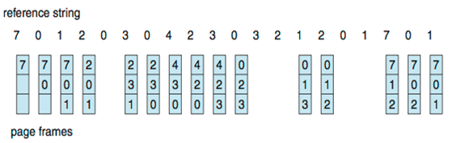
First-In-First-Out (FIFO) Algorithm
FIFO - replaces page that has been in memory for the longest time
can be implemented using a FIFO queue
example: reference string is 7,0,1,2,0,3,0,4,2,3,0,3,0,3,2,1,2,0,1,7,0,1
3 available frames (3 pages can be in memory at a time per process)
# page faults varies:
by reference string, eg. consider rstring 1,2,3,4,1,2,5,1,2,3,4,5
by number of frames available
15 page faults

Slide 31
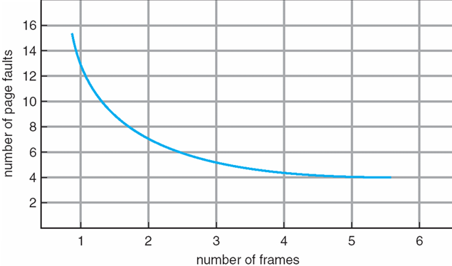
Graph of Page Faults Versus The Number of Frames

Slide 32
FIFO example 2
example 2:
reference string is 7,0,1,2,0,3,0,4,2,3,0,3,0,3,2,1,2,0,1,7,0,1
this time with 4 available frames
only 10 page faults (compared to 15 faults with 3 available frames)
7 | 0 | 1 | 2 | 0 | 3 | 0 | 4 | 2 | 3 | 0 | 3 | 0 | 3 | 2 | 1 | 2 | 0 | 1 | 7 | 0 | 1
7 | 7 | 7 | 7 |  | 3 |  | 3 |  |  | 3 |  |  |  |  | 3 | 2 |  |  | 2
 | 0 | 0 | 0 |  | 0 |  | 4 |  |  | 4 |  |  |  |  | 4 | 4 |  |  | 7
 |  | 1 | 1 |  | 1 |  | 1 |  |  | 0 |  |  |  |  | 0 | 0 |  |  | 0
 |  |  | 2 |  | 2 |  | 2 |  |  | 2 |  |  |  |  | 1 | 1 |  |  | 1

Slide 33
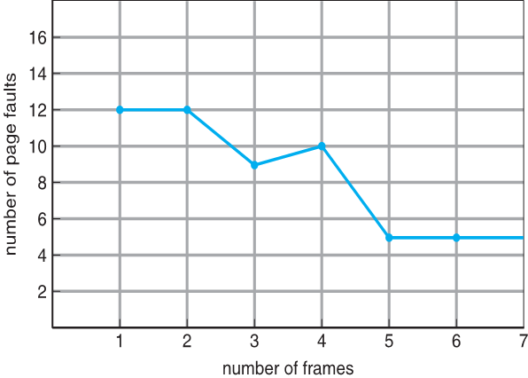
Bélády's anomaly
Bélády's anomaly occurs when increasing the number of page frames results in an increase in the number of page faults for certain memory access patterns
example:
rstring 0 1 2 3 0 1 4 0 1 2 3 4
FIFO with 3 frames → 9 page faults
FIFO with 4 frames → 10 page faults
Notes:
BELADY’S ANOMALYIS WHEN THE NUMBER OF PAGE FUALTS INCREASES WITH THE NUMBER OF PAGE FRAMES

Slide 34
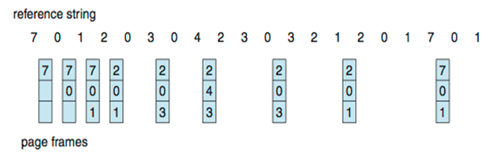
Optimal algorithm (OPT)
replaces page that will not be used for longest period of time
not practical ― requires knowing the future
but useful for measuring how well other non-optimal algorithms perform
eg. no algorithm can do better than 9 page faults for the above reference string and 3 available frames
9 page faults
Notes:
We replace 7 with two because it is the farthest away when it is accessed again
We use this as a benchmark tool
All page replacement algorithm should be compares with this optimal one

Slide 35
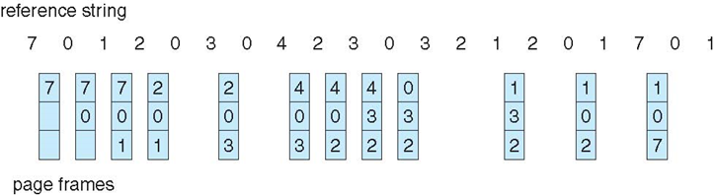
Least Recently Used Algorithm (LRU)
uses past knowledge to predict future
replaces page that has not been used in the most amount of time
associates time of last use with each page
12 faults
better than FIFO but worse than OPT
generally good algorithm and frequently used
but how can we implement it?
Notes:
We replace the page that hasn’t been accessed in the longest time
Optimal measures future which CANT be implemented
LRU uses past and can be implemented but isnt as good as the optimal

Slide 36
LRU implementation
counter implementation
every page entry has a counter
every time page is referenced through this entry, copy current clock into the counter
when a page needs to be changed, look at the counters to find smallest value
requires search through table
stack implementation
keep a stack of page numbers (eg. doubly linked list)
when page referenced - move it to the bottom
stack top contains the least recently used page
each update is more expensive than counter-based implementation
although no search needed for replacement
LRU and OPT are examples of replacement algorithms that don’t exhibit Belady’s Anomaly
pure LRU needs special hardware and is still slow, but there are fast approximations of LRU
Notes:
Count –
This would be really slow
The biggest problem would be searching all the different counters.
Implementation can be done but would slow the system a lot
Stack-
we grab the page at the bottom of the stack
not exactly a stack because you cant remove from the bottom of the stack
The performance is the biggest problem
LRU isn’t completely useless but there are approximations of LRU that can be implemented

Slide 37
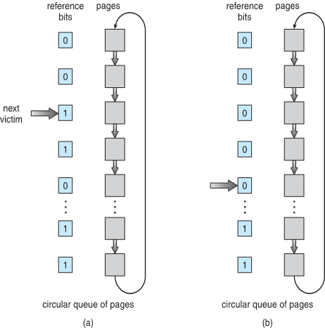
CLOCK replacement algorithm
clock replacement is an approximation of LRU
uses the reference bit in page table entry, which is automatically set by hardware any time page is accessed
frames are organized as a circular buffer
maintain one pointer (clock hand) pointing to the page to be replaced next
if page has reference bit = 0, replace it
otherwise set reference bit to 0 and advance pointer to the next page
this essentially gives a page a 'second chance'
very simple and good performance, can be extended/improved if more bits available
many more page replacement algorithms, eg. WSClock, Aging LRU
Notes:
A FIFO algorithm a second chance before its replaced
Can be implemented really efficiently
Aging algorithm and ws clock
When simulating you have to set the reference to 1
on hardware it doesn’t matter because when its accessed the process automatically sets it to 0

Slide 38
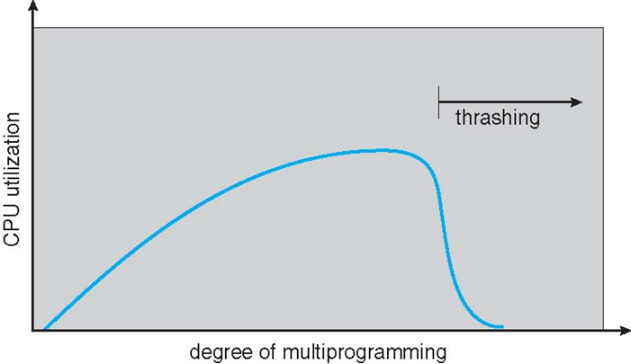
Thrashing
if a process does not have “enough” pages, the page-fault rate is very high
page fault to get page
replace existing frame
but quickly need replaced frame back
thrashing process = process is progressing slowly due to frequent page swaps
a process spends more time waiting for page faults than it spends executing
this can lead to an entire system thrashing:
many processes thrashing → low CPU utilization
OS thinks that it needs to increase the degree of multiprogramming
OS adds another process to the system making things even worse
Notes:
If your program is running really slow due to page faults then its called thrashing
process thrashing might cuase the whole system to thrash
How is a page fault processed?
accessing the disk
cpu is sleeping when when that happens so then cpu utilization will decrease
and some systems are programed to add more jpbs into mem when cpu utilization is low
so then that increases the time page faults take increasing the thrashing and so on
cycle

Slide 39
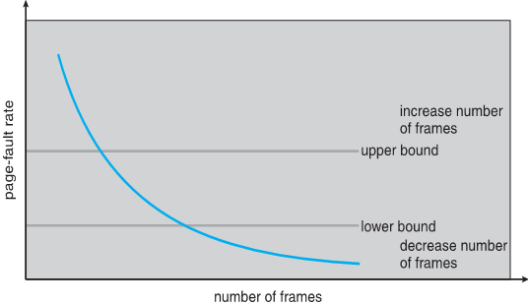
Dealing with thrashing
local page replacement
when a process is thrashing, OS prevents it from stealing frames from other processes
at least the thrashing process cannot cause the entire system to thrash
working set model
OS keeps track of pages that are actively used by a process (working set)
working set of processes changes over time
OS periodically updates the working set for each process, using a moving time window
before resuming a process, OS loads the entire working set of the process
page fault frequency
establish acceptable bounds on page fault rate
if actual page fault rate of a process too high → process gains a frame
if actual page fault rate of a process too low → process loses a frame
Notes:
Local page replacement –
not that great
Working set model –
Page fault frequencing
upperbound is the acceptable amount of thrashing willing to accept
given an extra page
lowerbound is when programming running to fast (this number is super low)
page is taken away

Slide 40
Summary
virtual memory and paging
page table implementations - simple, hierarchical, inverted, hashed IPT
frame allocation algorithms - equal / proportional / priority
page replacement algorithms - FIFO, Optimal, LRU, Clock
thrashing
shared pages, copy on write
Reference: 3.3, 3.4.1 - 3.4.8, 3.5.1 (Modern Operating Systems) 9.2, 9.4, 9.6 (Operating System Concepts)

Slide 41
Review
Which one of the following page replacement algorithms requires future knowledge about memory referencing? A. FIFO B. Optimal C. LRU
What is Belady’s Anomaly?
Which one of the above page replacement algorithms suffers from Belady’s Anomaly?
What is thrashing?
Describe copy-on-write.
Notes:
B
More pages, things get worse
FIFO
Spends more time waiting for page-faults to be serviced
Delay the copy until you actually need to modify the copy and that’s when you do the copy

Slide 42
Questions?

