Slide 1
CPSC 457
Filesystems
Contains slides from Mea Wang, Andrew Tanenbaum and Herbert Bos, Silberschatz, Galvin and Gagne

Slide 2
Overview
using filesystems
file structure, types, file access, attributes, operations
mount points, path names
implementation of filesystems
vfs
file block allocation, contiguous, linked / FAT, inodes
free space management
UNIX permissions

Slide 3
Long term storage
What properties do we want in a long-term information storage?
It must be possible to store a very large amount of information.
Information must survive termination of a process using it.
Multiple processes must be able to access information concurrently.
Easy search / management.
we need a lot of things out of long term storage
Notes:
We use disk as a storage
Disk survives power off

Slide 4
Disks without filesystems
Think of a disk as a linear sequence of fixed-size blocks and supporting two operations:
read-block i
write-block i
Similar to memory, but
block addressable,
We can only access blocks of data so we cant ask for single bits
We need load the whole block and get the specific bit and then save it back to the disk
persistent, and
much slower. One million times slower
Questions that quickly arise:
How do you find information?
How do you know which blocks are free?
How do you keep one user from reading another user’s data?
How do programs/users share data?
How do you (re)organize data?
The answer: implement a filesystem.

Slide 5
Files
file is an abstraction of long term storage, implemented by OS
OS allows processes to see a file through contiguous logical address space
file contains a sequence of bytes, which can be individually addressed
OS maps files onto physical devices
OS (generally) does not care about the contents of files
file's creator decides on the contents of the file (file format / internal structure)
can create an even higher level abstraction eg. treat file as a sequence of bits, numbers, records, …
decides on the meaning of the file's contents
what can be in a file?
anything, as long as it can be organized into a sequence of bytes
eg. source code, executable, images, movies, text, ...

Slide 6
File attributes
files have contents but also attributes
file attributes vary from one OS to another but typically consist of these:
filename: the symbolic file name is the only information kept in human readable form
identifier: unique tag that identifies the file within the FS
special type: needed for systems that support different file types (eg. block device)
location: a pointer to the location of the file contents on the device
size: size of the file
time/date: time of creation/last modification/last access, used for usage monitoring
user ID, group ID: identifies owner(s) of the file
protection information: access control information (eg. read/write/execute)
many variations, including extended file attributes ― such as file checksum
this information is usually kept separate from file contents, for example in the directory structure

Slide 7
File naming
names are given to files at creation time, but usually can be changed later as well
different file-naming rules on different systems, eg.:
maximum filename length
allowed/restricted characters
Cannot use “/” in UNIX
capitalization
filename extensions, enforced vs conventions

Slide 8
Special file types
most systems have special file types eg.:
Special files have that weird letter in from of the permissions
regular files: both text or binary
directories: special files for maintaining FS structure
character special files: for I/O on character devices, eg. /dev/random
block special files: for I/O on block devices, eg. /dev/sdb0
links: "pointers" to other files
sockets, pipes, ...
$ ls -l /dev
crw-rw-rw- 1 root root 1, 8 Apr 17 2017 random
brw-rw---- 1 root disk 8, 0 Apr 17 2017 sda
brw-rw---- 1 root disk 8, 1 Apr 17 2017 sda1
lrwxrwxrwx 1 root root 15 Apr 17 2017 stderr -> /proc/self/fd/2
drwxr-xr-x 2 root root 60 Apr 17 2017 raw

Slide 9
File format (file type)
regular files can have custom types as well (aka. file format or file type)
determined by file creator
if OS recognizes the file format, it can operate on the file in reasonable ways eg. automatically using an appropriate program to open a file
Windows uses file extension to determine file format, eg. ".jpg", ".xls"
UNIX uses magic number technique to determine file format, extension is only a convention
format inferred by inspecting the contents of the file, often first few bytes
eg. #!/bin/bash as the first line → file contains a bash script, %PDF → pdf file, ...
$ file file.c file /dev/hda . file.c: C program text file: ELF 32-bit LSB executable
/dev/hda: block special (3/0)
.: directory
$ man file
$ man magic

Slide 10
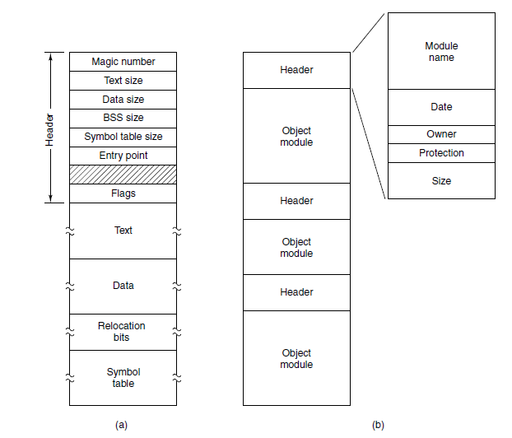
Example file formats
file name
#include <stdio.h> main()
{ printf("Hello World"); }
Header 1
file size
permissions
File 1 contents
owner ID
group ID
Header 2
File 2 contents
Header 3
# | i | n | c | l | u | d | e
 | < | s | t | d | i | o | .
h | > | \n | \n | m | a | i | n
( | ) | \n | { | \n
 | p | r | i | n | t | f | (
" | H | e | l | l | o |  | W
o | r | l | d | " | ) | ; | \n
} | \n
File 3 contents
≈
≈
Header n
File n contents
executable file
archive
text file

Slide 11
File operations
Most systems allow the following operations on regular files:
create ― empty file is created, with no data
delete* ― files can be deleted to free up disk space
open ― before using a file, a process must open it. OS can fetch and cache file attributes, such as list of disk addresses into main memory, for rapid access on subsequent calls
close ― free up space in memory associated with open file, flush unwritten data
read ― read contents of an opened file from current position
write ― overwrite data of an opened file at current position
append ― write new data at the end of file, results in file growing, usually implemented via write
seek ― change current position, affecting subsequent reads/writes
get attributes* ― eg. size
set attributes* ― eg. permissions
rename* ― change filename
* operation could be on a directory rather than a file

Slide 12
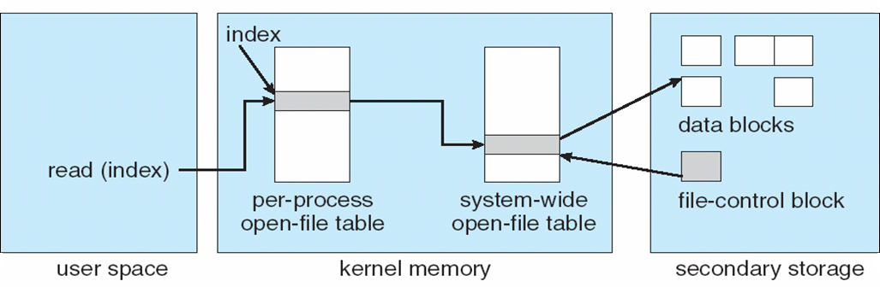
Open files
OS needs to manage open files, and allow fast access to data in these files
to this end OS keeps several data structures in memory
open-file table: tracks open files, per-process tables, and a system-wide table
file pointer: pointer to last read/write location, per process
file-open count: number of times a file is open – to allow removal of data from open-file table when last processes closes it, system wide
permissions, pointer to file contents, system wide

Slide 13
More on in-memory structures
OS keeps various bits of information related to filesystems in various data structures (in memory), to make FS management possible as well as to improve performance
examples:
system-wide open-file table: entry for each open file, eg. starting block #
per-process open-file table: eg. pointers into system-wide open-file table + file pointer
mount table: information about each mounted volume
buffer cache: caches FS blocks, to reduce the number of raw reads/writes to files, to speed up access to frequently accessed directories, etc.

Slide 14
Sequential and random file access
two general types of accessing files: sequential & random
apply to both reading and writing
sequential access - most common
bytes in the file are accessed sequentially, from beginning to end
no skipping, no out-of-order access, although files usually can be rewound
eg. open, read, read, read, rewind, read … close
random access
can access any byte in any order
usually implemented using seek(position) API
eg. open, read, read, read, seek, read, read, seek, read, … close
sequential
random
rewind
seek
seek

Slide 15
Directories
a filesystem is a collection of files, where files are the basic units in a filesystem
to help us with organizing files, we use the concept of directories
directories allow us to organize files hierarchically in a directory structure, a tree structure with one or more levels
root node of the tree is the root directory
internal nodes = directories, leaf nodes = files
path in a tree = filepath

Slide 16
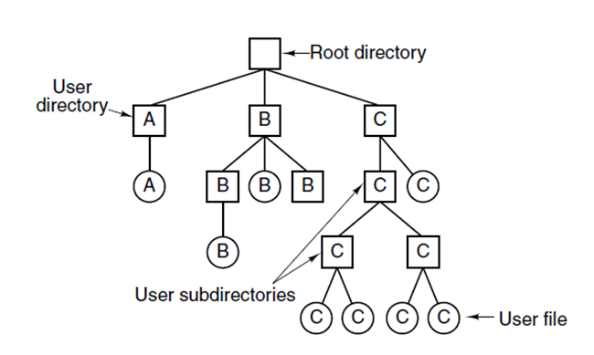
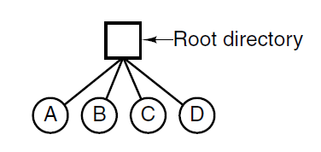
Directory
a directory is usually implemented as a special file
directory file contains directory entries (dentry)
dentry contains file attributes, such filename, size, etc.
dentry can represent a file or a directory (subdirectory)
if subdirectories not allowed → single-level directory system (limited use, eg. cameras)
if subdirectories allowed → hierarchical directory system (widespread use)

Slide 17
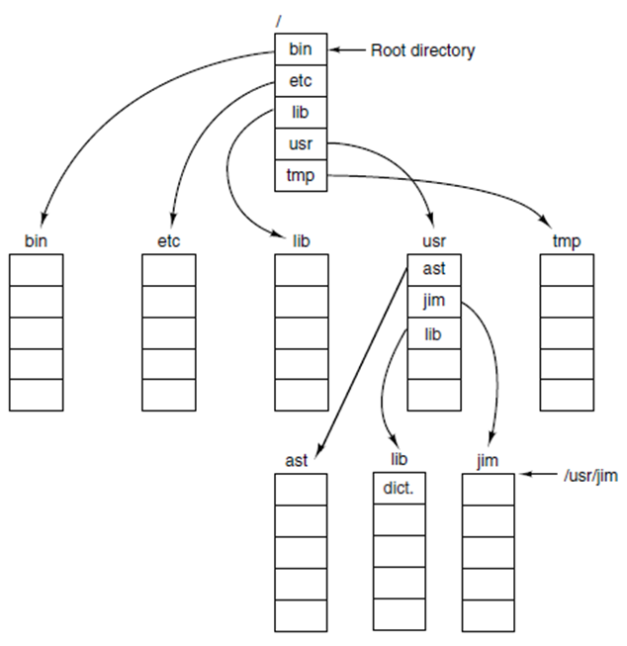
Pathnames in a UNIX directory tree
path separator: / (forward slash)
pathname: dir1/dir2/.../dirn/filename
root directory path: /
an absolute path name begins at root, eg:
/usr/jim
a relative path name defines a path from the current directory, eg.
./banker or ../../bin/cat or 1.txt
every process has a working (current) directory
can be changed using chdir() sys. call: int chdir(const char *path);

Slide 18
Pathnames in a UNIX directory tree
every directory has at least 2 entries:
pointer to current directory: . (dot)
pointer to parent directory: .. (dotdot)
dot and dotdot entries:
cannot be deleted
they are just pointers
directory containing only . and .. entries is considered empty
weird but true example:
/usr/jim
/./etc/../lib/./../usr/pavol/../jim
../../../../../../../usr/jim
all refer to the same file

Slide 19
Directory operations in UNIX
create ― an empty directory is created (with . and .. entries)
delete ― only empty directories can be deleted ( '.' and '..' entries do not count )
opendir ― analogous to open for files
closedir ― analogous to close for files
readdir ― returns the next entry in an open directory
rename ― just like file rename
link ― technique that allows a file to appear in more than one directory
unlink ― a directory entry is removed. If the file being unlinked is only present in one directory (the normal case), it is removed from the file system. If it is present in multiple directories, only the path name specified is removed. In UNIX, the system call for deleting files (discussed earlier) is, in fact, unlink.

Slide 20
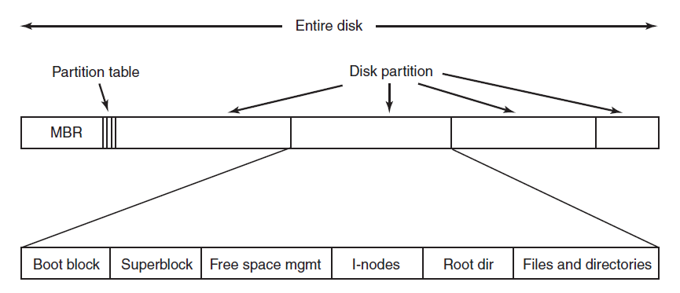
Disk partitions
a physical disk can be subdivided into separate regions, called partitions
partition is an abstraction, creating the illusion there are more disks
OS can manage partitions independently, as if they were separate disks
information about partitions is stored in a partition table
start/end of each partition
master boot record

Slide 21
Typical filesystem layout
bootstrap program
FS parameters eg. type
free blocks
per file/dir
info re. which blocks belong to which files
entries in /
contents of files and subdirectories

Slide 22
Partitions and mounting
partition can be:
formatted to contain a filesystem, it must be mounted to access
or it can be a raw partition (unformatted)
root partition with a filesystem contains the OS
mounted at boot time as root directory '/'
other partitions can hold other OSes, other file systems, or be raw
can mount automatically during boot, or manually after booting
at mount time, file system consistency is checked
Is all metadata correct?
If not, fix it, try mounting again
If yes, add to mount table, allow access

Slide 23
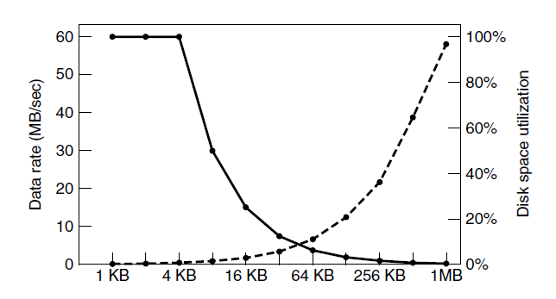
Filesystem blocks
nearly all filesystems split files up into fixed-size blocks
must round file size up to the nearest multiple
most filesystems suffer from internal fragmentation
filesystem block size is usually a multiple (2^{n}) of the underlying disk block size
FS blocks of one file not necessarily adjacent
fragmented file
seek time performance issues
performance and space utilization are inherently in conflict
performance
utilization

Slide 24
Virtual File Systems
Virtual File Systems (VFS) provides an 'object-oriented' way of implementing file systems (Linux)
VFS allows the same system call interface (the API) to be used for different file systems
VFS separates generic file-system operations from implementation details
VFS implementation can be disk filesystem, RAM FS, archive FS, or even network based FS ...
VFS dispatches operation to appropriate filesystem implementation routines

Slide 25
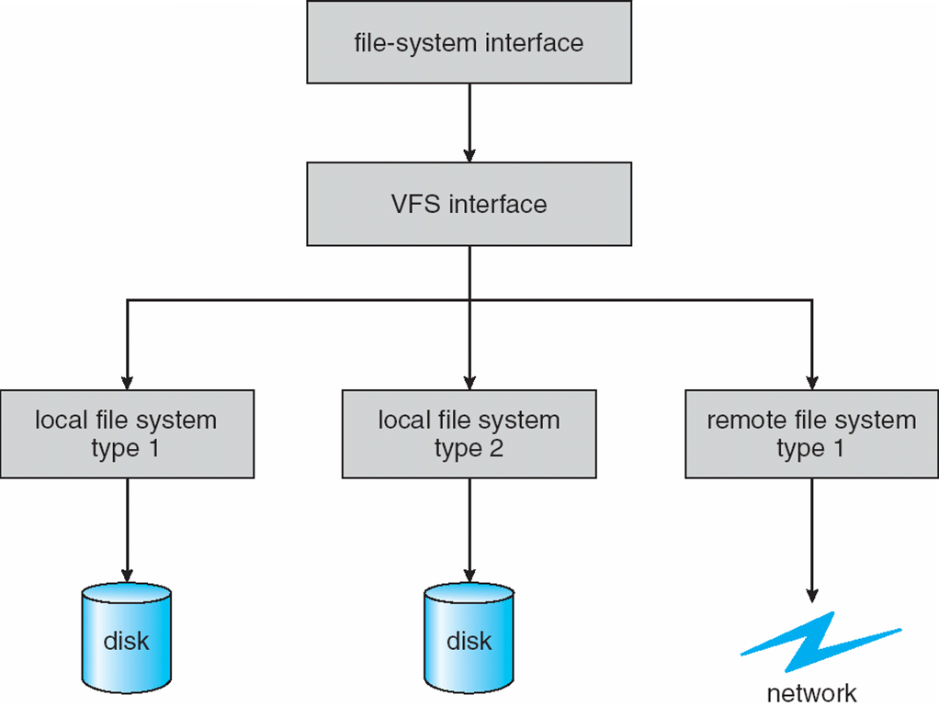
Virtual File Systems
OS accesses all filesystems through the same VFS interface
OS talks to all filesystems through VFS APIs
eg. FAT32
eg. SAMBA
eg. ext4
eg. spinning harddrive
eg. USB stick

Slide 26
Virtual File System Implementation
for example, Linux has four object types:
inode, file, superblock, dentry
VFS defines set of operations on the objects that must be implemented
every object has a pointer to a function table
function table contains addresses of routines that implement that function on that object
example:
int open(...) — open a file
int close(...) — close an already-open file
ssize_t read(...) — read from a file
ssize t write(...) — write to a file
int mmap(. . .) — memory-map a file
a developer of a new FS only needs to implement VFS API
then the FS can be mounted by Linux

Slide 27
Directory implementation
linear list of file names with pointer to the file blocks
simple to program
but O(n) search time
could be maintained in sorted order eg. using B+ tree, then O(log n) search
hash table – linear list with hash data structure
potentially O(1) search time
needs good hash function to limit collisions, and the 'right' size table
big table → lot of wasted space, small table → too many collisions
dynamically resizable hash table could be used to solve this
Linux (ext3/4) - use special data structure called htrees

Slide 28
File allocation methods
a file allocation method refers to how disk blocks are allocated to files
we will discuss:
contiguous allocation
linked allocation
indexed allocation

Slide 29
Contiguous allocation
contiguous allocation – each file occupies a set of contiguous blocks
results in best performance in most cases
simple – only starting location (block #) and length (number of blocks) are required
problems include
finding space for file,
either knowing file size at creation, or complications with growing a file
external fragmentation after file deletion,
need for compaction off-line (downtime) or on-line (reduced performance)
aka defragmentation
not very common
useful for tapes & read-only devices such as CD-ROMs

Slide 30
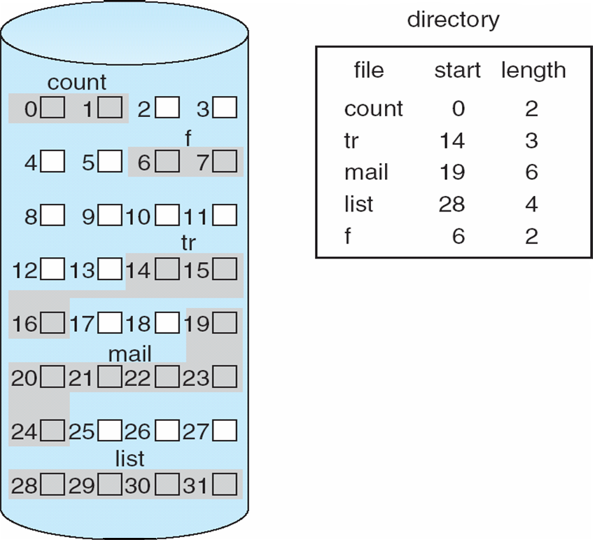
Contiguous allocation
mapping from logical to physical address: assuming block size is a power of 2
logical address:
q = upper bits
r = lower bits
physical address computation:
block = q + "address of first block"
displacement within block = r
q
r

Slide 31
Linked allocation
in linked allocation each file is stored in a linked list of blocks
each block contains file content, plus a pointer to the next block
file ends at a block with NULL pointer
no external fragmentation → no compaction needed
separate free space management needed - eg. linked list of free blocks
reliability can be a problem – imagine losing a block due to disk failure
major problem: locating a block can take many I/Os and disk seeks
logical address to physical address mapping requires traversing the list
we could cache the 'next' pointers, but would still need to read entire file first
we could improve efficiency by clustering blocks into larger groups but that increases internal fragmentation

Slide 32
Linked allocation example
Example directory entry:
contents of test.txt spread over blocks:
10, 11, 14, 5, 17
Why do we need 'size' in dentry?
because 5 * 512 != 2100
files can have arbitrary sizes
block:
data
filename | start block | size
test.txt | 10 | 2100
512 bytes
pointer
0:
1:
2:
3:
4:
5:
17
6:
7:
8:
9:
10:
11
11:
14
12:
13:
14:
5
15:
16:
17:
-1
18:
19:

Slide 33
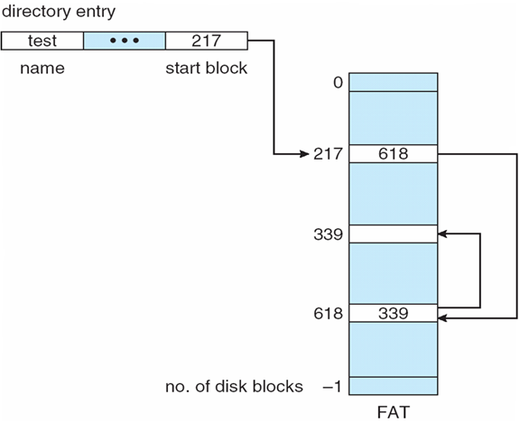
File Allocation Table (FAT)
FAT (File Allocation Table) is a variation of linked allocation
all 'next' pointers are stored in a separate table (FAT)
FAT can be located eg. at the beginning or end of the FS volume
FAT is indexed by block number, you can think of it as an array
fat[N] = next pointer for block N, where "-1" could denote NULL ptr
one FAT for the entire disk
directory entry contains index into FAT

Slide 34
File Allocation Table (FAT)
much like a linked list, but because all pointers stored together, FAT is faster and cache-able
easier random access than linked allocation
issues with FAT:
the entire table must be in memory at all times to achieve efficient random access
table can be quite big for large disks

Slide 35
Indexed Allocation (inodes)
basic idea behind indexed allocation is to:
store a per-file FAT-like structure
then we don't need to cache pointers for all files, only the open files
each file has its own index block(s), called inodes
an inode block contains:
direct pointers to blocks with file contents, or more indirect pointers to even more inodes
optionally, inode can contain various file attributes:
file size in bytes, device ID, owner, permissions, timestamps, link count, …
however, inode does not contain a filename
dentry is used to associate filename with the inode
dentry = filename + pointer to inode
possible to have different filenames associated with the same inode
called hard links

Slide 36
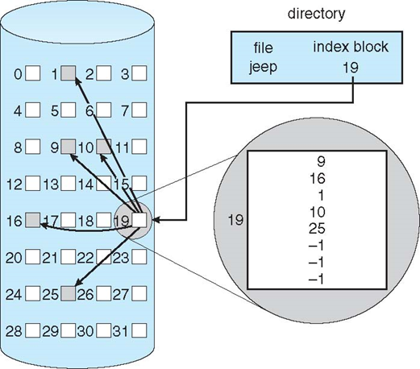
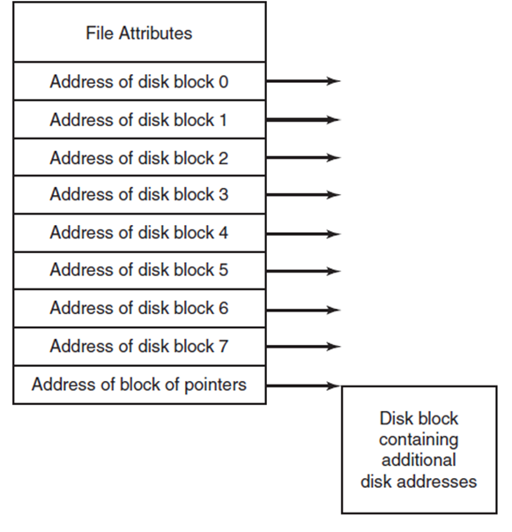
Example of Indexed Allocation
inode
inode

Slide 37
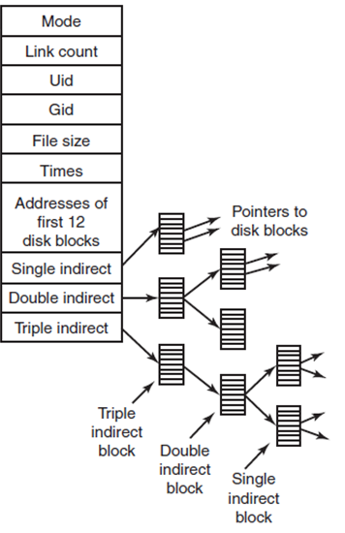
inodes in Linux (ext2)
example: block size 1KB, block address 4 bytes
single inode with 12 direct entries → max file size 12KB
if we add a single indirect pointer to inode: 1KB block can have 1KB/4B=256 entries → max file size 256+12 blocks = 268KB
adding double indirect pointer as well: or 256 blocks each with 256 addresses → max file size ~ 2¹⁶ blocks ~= 64MB
adding triple indirect pointer: → max file size ~ 2²⁴ blocks ~= 16GB
ext3 max file size = 2TB
ext4 max file size = 16TB (using 48bit addresses)

Slide 38
inodes
advantages:
random access reasonable ― only need to keep the inodes for opened files in memory
file size is not limited (practically)
files can have holes
disadvantages:
at least one additional block is required for each file

Slide 39
Hard link vs soft link
create file.txt $ echo "Hello" > file.txt
create hard link file1.txt that points to file.txt $ ln file.txt file1.txt a hard link points to the same inode if we delete file.txt, file1.txt will still work file.txt and file1.txt are indistinguishable
create soft link file2.txt that points file.txt $ ln -s file.txt file2.txt soft link points to a filename if we delete file.txt, file2.txt will be broken
1
2
3
file2.txt
soft link
file.txt
file.txt
file.txt
inode → "Hello"
inode → "Hello"
inode → "Hello"
file1.txt
file1.txt

Slide 40
Hard link vs soft link
hard links can be created only to regular files
cannot hard-link directories, because it could lead to cycles in FS
symbolic links can link anything, including directories, special files and other symbolic links $ ln -s file2.txt file3.txt
symlinks can lead to cycles and broken links $ ln -s file4.txt file4.txt
file.txt
inode
file1.txt
hard link
file2.txt
soft link
file3.txt
soft link
file4.txt
soft link

Slide 41
Performance
newer CPUs (2016) can do ~300,000 MIPS
typical disk drive (7200RPM) can do about 100 IOPS
CPU can do ~3 billion instructions during one disk I/O
fast SSD drives can deliver ~100,000 IOPS
still ~3 million instructions during one disk I/O
expensive SSD arrays can deliver ~10,000,000 IOPS
still about 30,000 instructions during one disk I/O
important to try to minimize the number of I/O operations
try to group and combine reads/writes

Slide 42
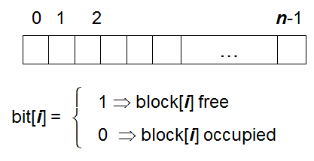
Free space management - bitmaps
file systems maintain free-space list to track available blocks
can be implemented as a bit vector or bitmap
OS can reserve some blocks for the bitmap
example
block size = 4 KiB = 2¹² bytes
disk size = 1 TiB = 2⁴⁰ bytes
total number of blocks = 2⁴⁰/2¹² = 2²⁸ blocks
we need 2²⁸ bits in bitmap = 2²⁵ bytes = 32 MiB bitmap, or 2¹³ reserved blocks
if using clusters of 4 blocks instead → only 2¹¹ reserved blocks
cons: requires searching the bitmap to find free space, wastes some blocks
pros: fairly straightforward to obtain contiguous blocks

Slide 43
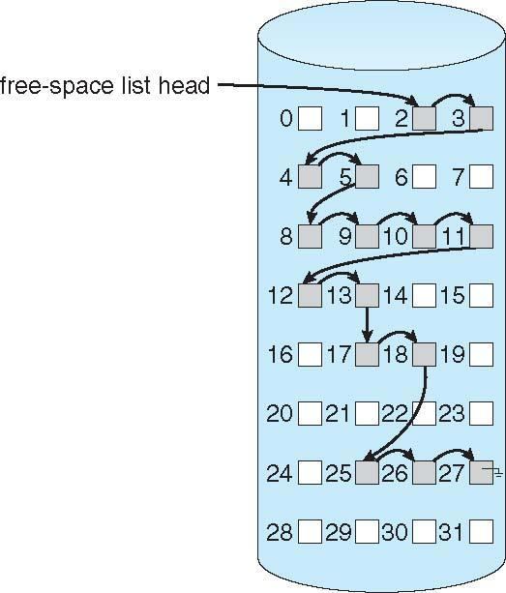
Free space management - linked list
linked free space list (free list)
all free blocks are linked together
pointers stored inside the blocks
pros: no waste of space
cons: cannot get contiguous space easily

Slide 44
Free space management - linked list
grouping
instead of storing just one pointer, utilize the space of the entire free block
store addresses of next n-1 free blocks in first free block, plus a pointer to next block that contains more free-block-pointers (like this one)
counting
takes advantage of the fact that space is frequently contiguously used and freed
so keep address of first free block plus the count of following free blocks
free space list then has entries containing addresses and counts
space maps
divides device space into metaslab units, each representing a chunk of manageable size
within each metaslab a counting algorithm is used to keep track of free space

Slide 45
File locking
provided by some operating systems and/or file systems
similar to reader-writer locks
shared lock similar to reader lock – several processes can acquire concurrently
exclusive lock similar to writer lock
mediates access to a file to multiple processes during open()
types:
mandatory – access is denied depending on locks held and requested
advisory – processes can find status of locks and decide what to do

Slide 46
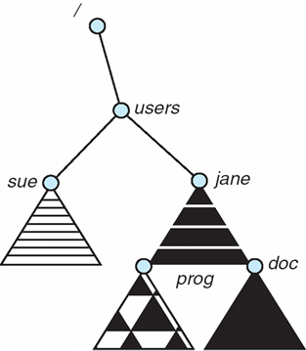
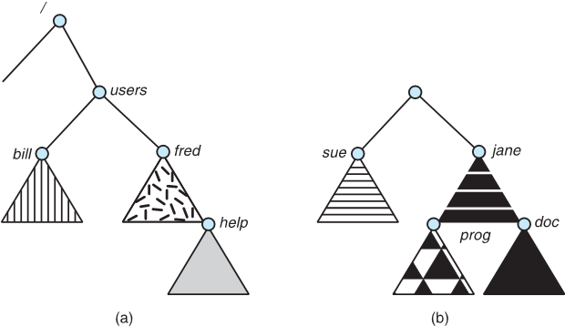
File System Mounting
a filesystem must be mounted before it can be accessed
OS boots with (essentially) empty root filesystem
other filesystems are later mounted into it, during or after boot
all mounted filesystems appear as part of one big filesystem
$ mount /dev/sdc1 /users
root filesystem before mounting filesystem 2
filesystem 2 on /dev/sdc1
root filesystem after mounting filesystem 2

Slide 47
Unix File System & Permissions
every file is owned by a user and a group
permissions often displayed in compact 10-character notation
$ ls -l /home/profs/pfederl
-rw-r----- 1 pfederl profs 134 Oct 13 13:02 test.py
drwx------ 2 pfederl profs 4096 Jan 5 18:04 tmp
filename
modified timestamp
file/directory
permissions
link count
owner
group owner
size

Slide 48
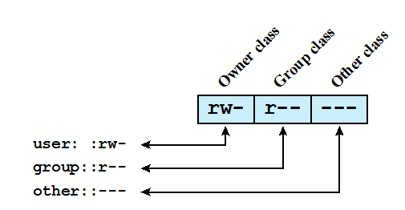
Unix File System
9 permission bits per file: specify Read, Write, and eXecute permission for the owner of the file, members of the group and all other users (aka world)
The owner ID, group ID, and protection bits are part of the file’s inode

Slide 49
Examples - permissions for files
-rw-r--r-- | read/write for owner, read-only for everyone else
-rw-r----- | read/write for owner, read-only for group, forbidden for everyone else
-rwx--x--x | read/write/execute for owner, execute-only for everyone else
-r--r--r-- | ready-only for everyone
-rwxrwxrwx | read/write/execute for everyone (bad idea)
----rwxrwx | yes it’s possible, owner has no rights, everyone else does...

Slide 50
Examples - permissions for directories
permission bits are interpreted slightly differently for directories
read bit allows listing of file/directory names
write bit allows creating aand deleting files in directory
execute bit allows entering the directory and getting attributes of files in the directory
not all combinations make sense: eg. read without execute
drwxr-xr-x | all can enter and list the directory, only owner can add/delete files
drwxrwx--- | full access to owner and group, off limits to world
drwx--x--x | full access to owner, while group & others can access only known files
drwxrwxrwx | anyone can do anything

Slide 51
Linux File System
permission check algorithm for given user, filepath
step 1:
make sure all parent directories in path have appropriate execute permissions
step 2:
if file.owner == user then
use file.userPermissions
else if file.group in user.groups then
use file.groupPermissions
else
use file.worldPermissions

Slide 52
Linux File System
Set user ID (SetUID) bit, only on executable files
system temporarily uses rights of the file owner in addition to the real user’s rights when making access control decisions
enables privileged programs to access files/resources not generally accessible
eg. passwd
Set group ID (SetGID) bit
on executable files → similar effect to SetUID but for groups
on directories → new files/subdirectories will inherit the group owner
Sticky bit (12th bit)
When applied to a directory it specifies that only the owner of a file in the directory can rename, move, or delete that file.
Usually set on /tmp and /scratch or similar directories.

Slide 53
Root ( superuser, UID = 0 )
is exempt from usual access control restrictions
has system-wide access
dangerous, but necessary, and actually OK with good practices
how to become root:
su (requires root password)
changes home dir, PATH and shell to root, leaves environment variables intact
su -
logs in as root
su - <user>
become someone else <user>
sudo <command> (requires user password)
run one command as root ― recommended way, leaves an audit trail
what does “sudo su -” do?

Slide 54
Changing permissions
permissions are changed with chmod or via a GUI
only the file owner or root can change permissions.
if a user owns a file, the user can use chgrp to set file's group to any group of which the user is a member
root can change file ownership with chown (and can optionally change group in the same command)
chown, chmod, and chgrp can take the -R option to recursively apply changes through subdirectories.

Slide 55
Changing Permissions Examples
chown -R root dir1 | changes owner of dir1 to root, and recursively everything inside dir1
chmod g+w,o-rwx f1 f2 | adds group write access to files f1 and f2, and removes all access to f1 and f2 for the world
chmod -R o-rwx . | removes access for the world to current directory and everything inside it (recursively)
chmod u+rw,g+rw,u-x,g-x,o-rwx f1 | f1 will allow read/write to owner & group, everyone else will have no access
chmod 660 f1 | same as above but makes you look “pro”
chmod +x f1 | f1 will be executable to everyone
chmod og-rwx f1 | disable all group/world access from f1

Slide 56
Limitations of Unix/Linux Permissions
Unix standard/basic permissions are great, but not perfect
not expressive enough
eg. user 'bob' cannot easily give user ‘john’ read access to his files
most Linux based OSes support POSIX ACLs
builds on top of traditional Unix permissions
several users and groups can be named in ACLs, each with different permissions
allows for much finer-grained access control
each ACL is of the form type:name:rwx
type is user or group
name is user name or group name
rwx refers to the bits set
setuid, setgid and sticky bits are not possible

Slide 57
Linux Access Control Lists ( ACLs )
getfacl lists the ACL for a file
setfacl command assigns ACLs to a file/directory
any number of users and groups can be associated with a file
read, write, execute bits
a file does not need to have an ACL
$ setfacl -m u:bob:rw proxy.py
$ getfacl proxy.py
# file: proxy.py
# owner: pfederl
# group: pfederl
user::rw-
user:bob:rw
group::rw-
mask::rwx
other::r--
$ ls -l proxy.py
-rw-rw-r--+ 1 pfederl pfederl proxy.py
$ ls -l proxy.py
-rw-rw-r-- 1 pfederl pfederl proxy.py
$ getfacl proxy.py
# file: proxy.py
# owner: pfederl
# group: pfederl
user::rw-
group::rw-
other::r--

Slide 58
Default ACLs
a directory can have an additional set of ACLs, called default ACLs
default ACLs will be inherited by files & directories created inside directory
subdirectories inherit the parent directory's default ACLs as both their default and their regular ACLs
files inherit the parent directory's default ACLs only as their regular ACLs, since files have no default ACLs
the inherited permissions for the user, group, and other classes are logically ANDed with the traditional Unix permissions specified to the file creation procedure

Slide 59
NTFS
each file/directory has
an owner
zero or more ACEs (access control entries)
ACE format: <principal> <operation> (allow|deny)
principal = user or group
operation = read, write, execute, full control, list, modify
ACEs support inheritance
directory's ACEs can propagate to children
similar to UNIX with ACLs, but
NTFS also supports 'deny' ACE entries, UNIX has only 'allow' ACL entries
NTFS file permission algorithm only checks the file's ACEs, UNIX checks entire path
NTFS is more expressive, but also more complicated
Prof: can Bob access this file in my directory?

Slide 60
Summary
using filesystems
file structure, types, file access, attributes, operations
mount points, path names
implementation of filesystems
vfs
file block allocation, FAT, inodes, links
free space management*
UNIX permissions*
* if time permits
Reference: 4.1 - 4.3.3 (Modern Operating Systems) 10.1 - 10.3 , 11.1 - 11.8 (Operating System Concepts)

Slide 61
Review
Which file block allocation scheme suffers from external fragmentation?
Contiguous or Linked
Describe the main difference between FAT and inode.
After deleting a file, all hard links to the file will report an error when accessed.
True or False
After deleting a file, all soft links to the file will report an error when accessed.
True or False

Slide 62
Questions?

