Slide 1
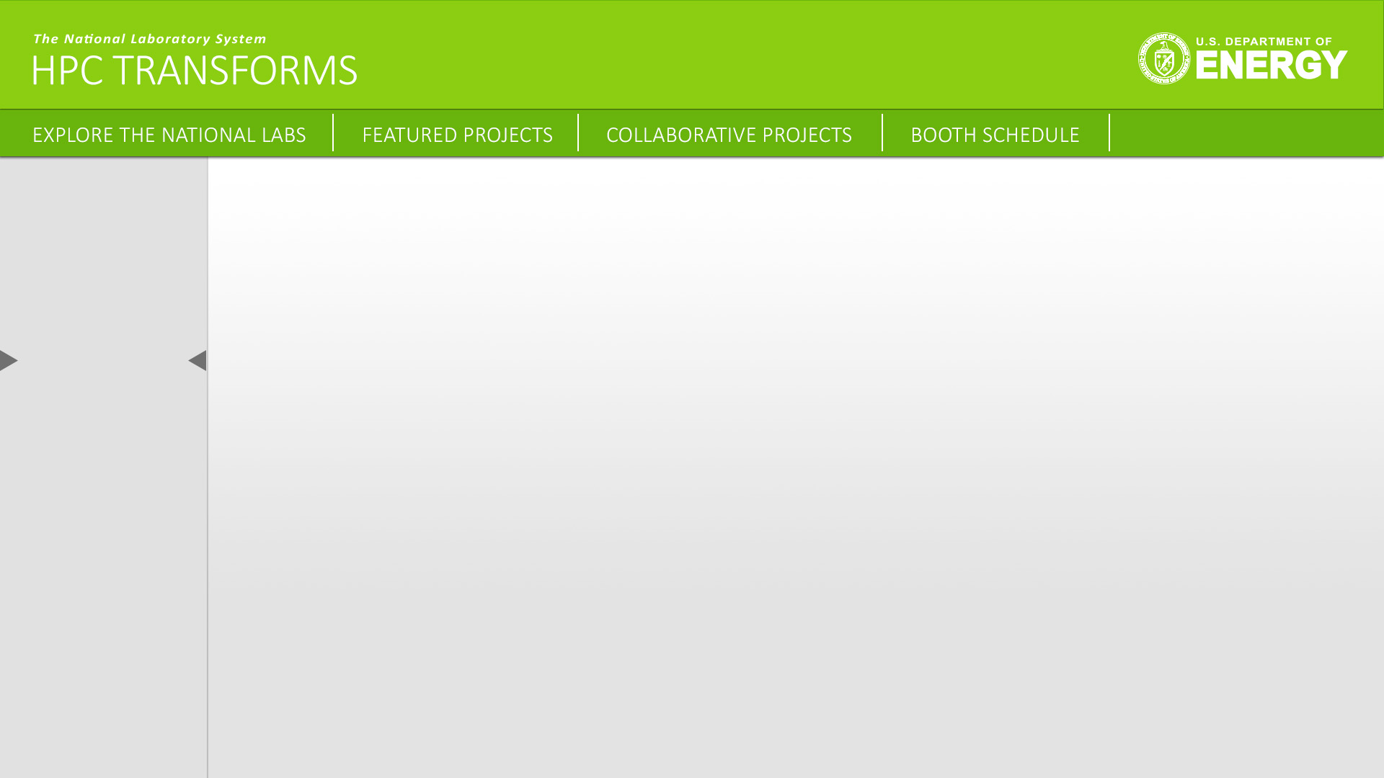
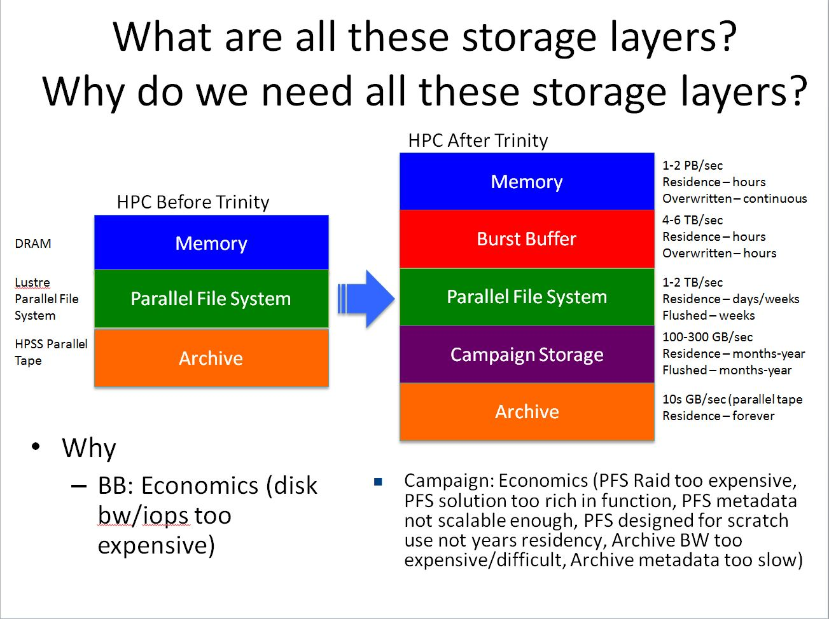

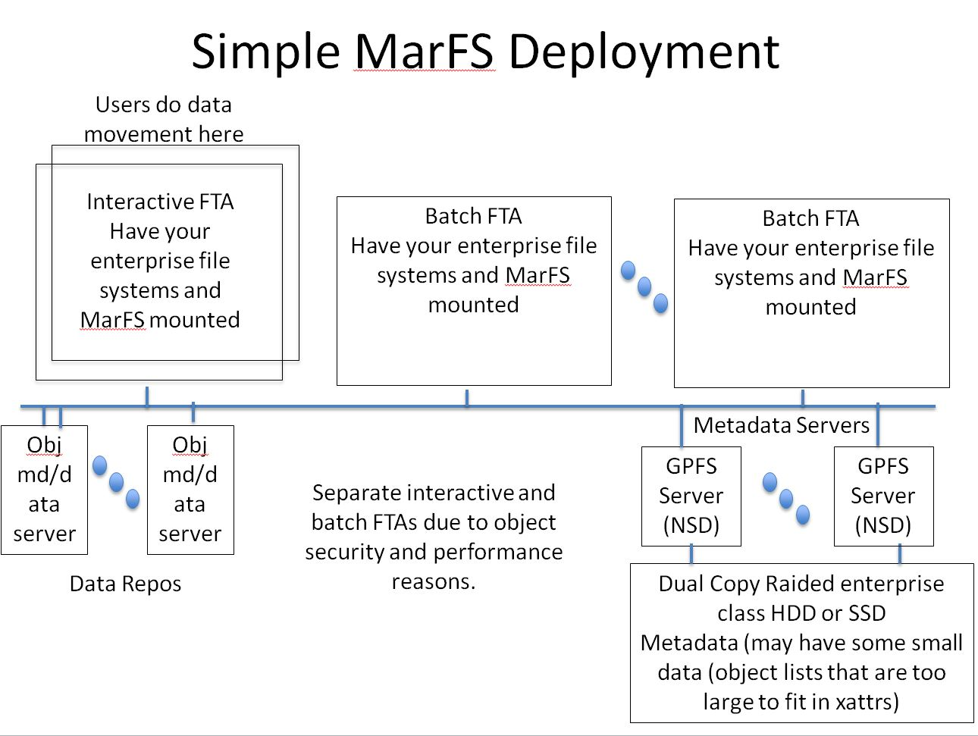
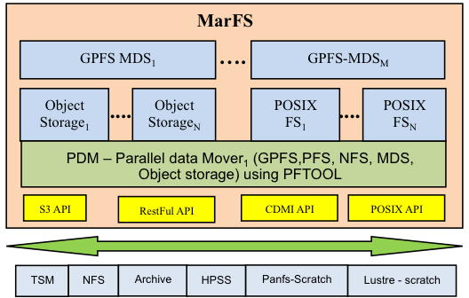
Lab Logo
MarFS - A Scalable Near-Posix Name Space over Cloud Objects
Why do we need MarFS ?
What is MarFS? Near-POSIX global scalable name space over many POSIX and non POSIX data repositories (Scalable object systems - CDMI, S3, RestFul API, etc.)
It scales name space by sewing together multiple POSIX file systems both as parts of the tree and as parts of a single directory allowing scaling across the tree and within a single directory
It is small amount of code (C/C++/Scripts)
A small Linux Fuse
A pretty small parallel batch copy/sync/compare/ utility
A set of other small parallel batch utilities for management
A moderate sized library both FUSE and the batch utilities call
Data movement scales just like many scalable object systems
Metadata scales like NxM POSIX name spaces both across the tree and within a single directory
It is friendly to object systems by
Spreading very large files across many objects
Packing many small files into one large data object
How about a Scalable Near-POSIX Name Space over Object Erasure ?
Best of both worlds
Objects Systems
Provide massive scaling and efficient erasure techniques
Friendly to applications, not to people. People need a name space.
Huge Economic appeal (erasure enables use of inexpensive storage)
POSIX name space is powerful but has issues scaling
The challenges
Mismatch of POSIX an Object metadata, security, read/write semantics,
efficient object/file sizes.
No update in place with Objects
How do we scale POSIX name space to trillions of files/directories
SC15 Presentation and talk schedule
SC15 BOF, Two Tiers Scalable Storage: Building POSIX-Like Namespaces with Object Stores
Wed Nov. 18th,2015 , 5:30-7:00PM, Hilton Salon A
Brighttalk – webinars, Nov.10th, 2015, Speaker: Gary Grider, MarFS: A Scalable Near-POSIX Name Space over Cloud Objects
Study 1
Mar(Spanish)- Sea(English): MarFS: A Scalable Near-Posix File System to Manage Sea of Data
Study 2
We need capacity tier – Campaign Storage
Study 3
Study 4
Study 5
Study 6
More Links
Funding: DOE

