Slide 1

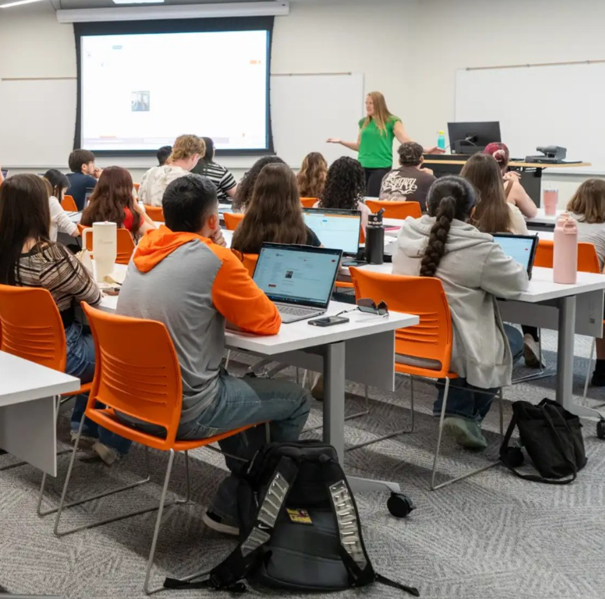
Hero screenshot: Schedule page weekly grid
COSC 3320 · FINAL PROJECT
UTPB Course Scraper
& Scheduler
A local Python + Flask app that scrapes UTPB course data and turns it into a working term planner.
Your Name · Spring 2026
Notes:
Hi, I'm <name>. For my COSC 3320 final project I built a local Python + Flask app that scrapes UTPB's catalog, registrar, and academic calendar and turns them into a working term planner. I'll show the architecture, the database, and then a short live demo. Total time: about 10 minutes.

Slide 2





FEATURE TOUR
What it does
Schedule builder screenshot
Catalog + wishlist screenshot
Transcript import screenshot
Degree progress screenshot
Planner + AI advisor screenshot
Schedule builder
Catalog + wishlist
Transcript import
Degree progress
Planner + AI advisor
Search/filter sections, drop them on a weekly grid. Conflict + prereq warnings.
Browse all courses with subject/level/term filters. Save courses to your wishlist.
Upload a UTPB PDF. Parsed in memory with pypdf — never written to disk.
Completed / in-progress / remaining cards with a manual override flow.
Multi-term roll-up, graduation forecast, .ics export, optional Anthropic advice.
UTPB Course Scraper & Scheduler
3 / 10
Notes:
Five features in one tour. The Schedule and Planner pages are the two I'll spend the most time on in the live demo. Catalog, Profile, and Progress all hang off the same SQLite database with a JSON API.

Slide 3









HOW IT FITS TOGETHER
System architecture
UTPB Sources
scrapers/
data/courses.db
scheduler/
Browser
Three layers, one DB
SmartCatalog
• Scrapers feed SQLite — stdlib only, no requests / bs4.
• Flask reads SQLite, serves JSON + HTML.
• Vanilla JS pages call the JSON API.
• Anthropic call is optional and falls back to local rules.
• Data flows left → right; control stays on your machine.
Registrar
catalog.py
SQLite
app.py
pages/*.html
Academic Cal.
sections.py
single file
db.py
static/*.js
Falcon Maps
session_dates.py
8 tables
conflict.py
style.css
infer_terms.py
catalog + app data
transcript_pdf.py
vanilla JS only
program_reqs.py
stdlib only
the hub
Flask · JSON API
Anthropic API
Powers AI assistnat
UTPB Course Scraper & Scheduler
4 / 10
Notes:
Five scrapers feed one SQLite file. Flask reads from that same file, which keeps everything in one place. The frontend is plain HTML and vanilla JS — no React, no Jinja templating. The AI advisor is the only network dependency at runtime, and the endpoint falls back to rule-based advice when no API key is configured.

Slide 4
LIBRARIES & WHY
Tech stack
Backend & scraping
Frontend & tooling
• Flask 3.1 — page routes + ~50 JSON endpoints in app.py
• Werkzeug — password hashing, secure session cookies
• sqlite3 (stdlib) — single file at data/courses.db
• pypdf — transcript parsed in memory, never saved to disk
• urllib + html + re + json — scrapers run on stdlib only
• Anthropic Messages API — optional advisor, .env key
• Vanilla HTML + CSS + JS — no React/Vue/Jinja
• Bootstrap utility classes for layout polish only
• Custom CSS palette in scheduler/static/style.css
• pytest / unittest — see tests/ for the suite
• python -m venv + pip — two-line setup in README
• git for version control; .env.example for secrets layout
Why stdlib scrapers? Portable, deterministic, zero install pain on a grader's machine.
Why no JS framework? Course is graded on Python; the frontend stays small enough to read.
UTPB Course Scraper & Scheduler
5 / 10
Notes:
Two short lists. The most interesting choice on the left is that the scrapers use the standard library only — no requests, no BeautifulSoup. On the right, no JS framework: the frontend is intentionally small so a Python-class grader can read it.

Slide 5
ONE FILE · DATA/COURSES.DB
Database schema
users
schedule_scenarios
courses
8 tables, 1 SQLite file
id
PK
id
PK
id
PK
username
TEXT
user_id
FK
code
TEXT
• Catalog: courses + sections + session_calendar
• Auth: users (Werkzeug-hashed passwords)
• Profile: user_profiles holds parsed transcript JSON
• Schedules: schedule_scenarios + user_schedules per term
• Wishlist: course_wishlist
• Scrapers update only their tables — accounts and saved schedules survive a re-scrape.
password_hash
TEXT
term
TEXT
name
TEXT
name
TEXT
prereqs
TEXT
created_at
TS
is_active
BOOL
term_inferred
TEXT
user_profiles
user_schedules
sections
user_id
PK/FK
id
PK
id
PK
major
TEXT
scenario_id
FK
term
TEXT
minor
TEXT
user_id
FK
section_code
TEXT
days/times
TEXT
transcript_json
JSON
section_id
FK
session
TEXT
course_wishlist
session_calendar
id
PK
term
TEXT
user_id
FK
session
TEXT
start_date
DATE
course_id
FK
end_date
DATE
UTPB Course Scraper & Scheduler
6 / 10
Notes:
All eight tables live in one SQLite file. Catalog data and app data co-exist on purpose — backups are a single file copy. The catalog scraper only touches the courses table, so re-running scrapers never wipes a user account or saved schedule.

Slide 6
LIVE DEMO
Switching to the running app
1
Schedule
Pick a term, search/filter, add a section, trigger a conflict.
2
Profile
Upload a transcript PDF — parsed in memory only.
3
Progress
Completed / in-progress / remaining + manual override.
4
Planner
Multi-term roll-up, graduation forecast, AI advisor button.
5
Export .ics
Download the active schedule and open it in a real calendar.
UTPB Course Scraper & Scheduler
7 / 10
Notes:
I'll be on the app for the next 4 minutes. The path is on the slide as a safety net — if anything goes wrong I jump to the next step. Watch for the conflict warning on Schedule and the graduation forecast on Planner; those are the two moments that show the data is actually wired up.

Slide 7
THE INTERESTING BITS
Python design highlights
Half-semester aware conflict detection
AI advisor with graceful fallback
scheduler/conflict.py
scheduler/app.py · _call_ai_planner_advisor
if is_half_semester(a['session']) \
and is_half_semester(b['session']):
a_w1 = 'W1' in a['session']
b_w1 = 'W1' in b['session']
if a_w1 != b_w1:
return False # 8W1 and 8W2
# never overlap
return start_a < end_b and start_b < end_a
api_key = os.environ.get('ANTHROPIC_API_KEY')
if not api_key:
return None # caller uses local rules
payload = {
'model': model,
'messages': _messages_for(context),
'max_tokens': 450,
}
Two 8-week sessions in the same term don't actually run at the same time, so the app refuses to false-flag them.
No key, no problem: the endpoint switches to rule-based advice so the feature still works in a live demo or on a grader's machine.
UTPB Course Scraper & Scheduler
8 / 10
Notes:
Two design choices I want to call out. First, conflict detection knows that the two 8-week sessions don't overlap, so I don't get bogus warnings when stacking a first-half and second-half class. Second, the AI advisor degrades gracefully — no key just means the user gets local rule-based advice. That keeps the demo deterministic.

Slide 8
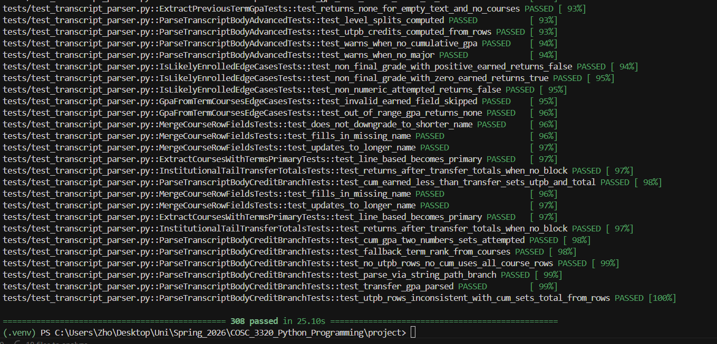
QUALITY
Testing & data safety
What the suite covers
Last green run
• tests/test_prereqs.py — prereq parser ('SUBJ ####' forms, AND/OR)
• tests/test_planner_api.py — overview, target credits, term timeline
• tests/test_scenarios.py — create / duplicate / rename / delete / activate
• tests/test_progress_overview.py — degree-progress summary endpoint
• tests/test_account_api.py — register / login / change password / delete
• tests/test_program_requirements.py — scraped program review tables
Screenshot: `python -m pytest tests/ -v` (green run)
Data safety
• --backup-db copies the whole SQLite file before a catalog refresh.
• Scrapers update only their own tables — accounts, schedules, profiles stay put.
• Transcript PDFs are parsed in memory and discarded; only the parsed JSON is stored.
python -m pytest tests/ -v
UTPB Course Scraper & Scheduler
9 / 10
Notes:
Six test files cover the parts of the app most likely to break silently — prereq parsing, the planner overview, scenarios, degree progress, accounts, and program-requirement scraping. The right side calls out the data-safety guarantees: scrapers don't wipe the database, and transcripts never touch disk.

Slide 9
WRAP
Wins, limits, what's next
What worked
Limits
Next
• One SQLite file = trivial backups, easy grading.
• No JS framework — frontend stayed readable.
• Stdlib scrapers survived a registrar redesign mid-semester.
• Conflict detection respects 8-week sessions.
• Scrapers are HTML-shape sensitive; selectors break on redesigns.
• Prereq parser only handles 'SUBJ ####' patterns — free text is treated as unparseable.
• No mobile layout pass yet.
• AI advisor uses a single prompt template — no chat memory.
• Switch scrapers to a small HTML-tolerant parser layer.
• Add iCal subscription URL, not just .ics export.
• Cache program requirements per program version.
• Mobile-first restyle of Schedule and Planner.
Thanks — questions?
github.com/<you>/utpb-scheduler
UTPB Course Scraper & Scheduler
10 / 10
Notes:
Three columns: what worked, what didn't, and what I'd do next. The recurring theme is that I traded scrape robustness for transparency — every scraper is short enough to read in a sitting. The biggest follow-up is a tolerant HTML parser layer so a registrar redesign doesn't take the app down. Happy to take questions.

