Slide 1
Group 12
Homework 2 Presentation

Slide 2
Introduction
We were inspired by Team UCLANESL.
Uses a GAN architecture with a Generator and a Discriminator.
  Generator: generating synthetic data samples that mimic the structure of the original data.
  Discriminator: distinguishing real data from synthetic data samples.

Slide 3
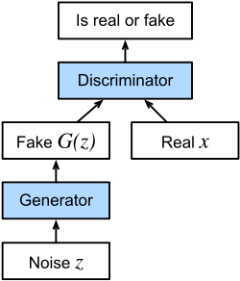
What is a GAN?
The principle of the GAN model is to oppose two
neural networks so that the loser can be improved based
on the result of the confrontation, the Generator will try
to “fool” the discriminator and so on, resulting in better
and better results over time.

Slide 4
Differential Privacy
Opacus library applying Differential Privacy Stochastic Gradient Descent (DP-SGD) to the discriminator.
DP-SGD protects the update of the discriminator by gradient clipping and noise addition, this ensures that any leakage of a single true data sample is prevented during training.
Generator remains non-private and learns to generate realistic data samples based on the feedback from the differential privacy-protected discriminators.

Slide 5
Dataset
Adult Census Income Dataset
  Contains multiple attributes such as age, job type, education, and income as the target variable.
  The raw dataset contains 30,163 rows and 12 raw attributes.
Data preprocessing
  Numerical features are normalized using StandardScaler.
  Encoding of class features using one-hot encoding.
  These transformations extend the original 12 features to higher dimensional space.

Slide 6
Training Process
Training epochs: 100
Batch size: 64
Learning rate: 1e-4
Noise multiplier for DP: 1.0
Dimension of the noise vector input to the generator: 100
Generated synthetic data is the same size as the original dataset.
Optimizer: Adam for both generator and discriminator
Max gradient norm: 1.0

Slide 7
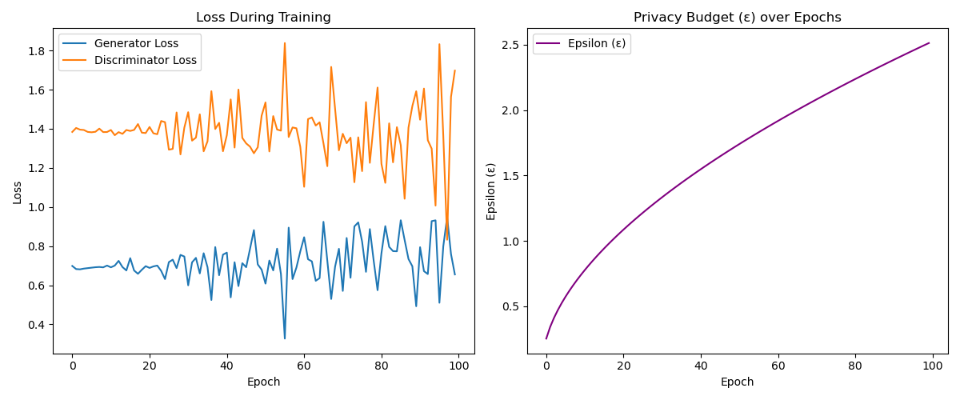
Result: Synthetic Data Privacy Budget
For DP-SGD, resulted in a final privacy budget of ε ≈ 2.51 with δ = 1e-5.

Slide 8
Result: Utility Evaluation via SVM
We trained support vector machines (SVMs) on three datasets:
  The original cleaned dataset (baseline)
  The k-anonymized dataset (from k-anonymity)
  The synthetic dataset (generated in this project)
Since the synthetic dataset does not contain class labels, we only compare with original and k-anonymity.

Slide 9
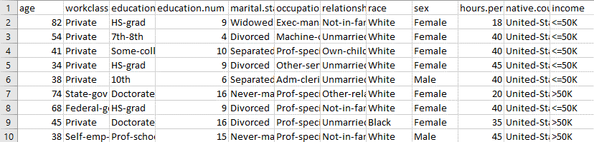
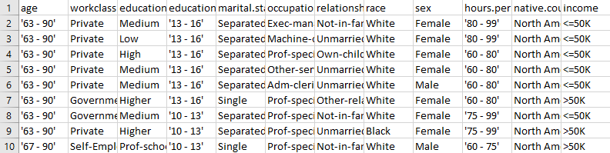
Comparison with HW1
Original Data:
K-anonymity(k=5):

Slide 10
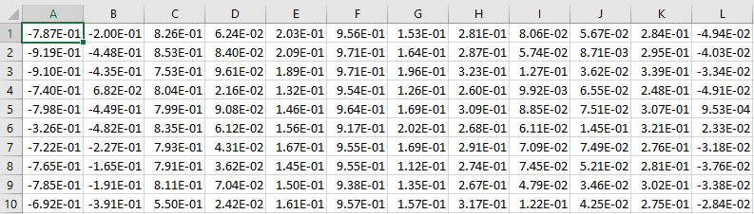
Comparison with HW1
Original Data:
DP Synthetic Data:

Slide 11
Comparison with Mid-term
Mid-term and HW2 demonstrate that differential privacy can be flexibly applied to different stages in the machine learning pipeline.
Mid-term: DP protects the model by ensuring that models trained from private data do not leak personal information.
HW2: DP protects the data, which can be shared and analyzed without exposing the original data by generating synthetic datasets with privacy guarantees.

Slide 12
Conclusion
Generated differentially private synthetic data using a GAN-based architecture, achieved a final privacy budget ε ≈ 2.51, δ = 1e-5.
The synthetic dataset preserved the statistical properties of numercial features, while categorical features were more challenging due to one-hot encoding.
Compared to k-anonymity, the synthetic data approach avoided overgeneralization and enabled greater flexibility for downstream tasks.
Future work can focus on improving categorical feature reconstruction and enhancing the interpretability of synthetic data.

Slide 13
Responsibility
MENDEZ SALGADO LUIS ANDRES | Report and python script
Guérin Ulysse | Edits and modification of report and PPT
謝尚恆 | Presentation(PPT)
吳浚瑋 | modify PPT

