Slide 1
StyleAttnGAN for Text-to-Image Synthesis
- DeepFusion

Slide 2
Introduction
The project focuses on improving the StackGAN (Stacked Generative Adversarial Network) model by evolving it into a Style Attention GAN (SAGAN) for enhanced text-to-image retrieval.
This work builds upon a series of advancements in GAN-based image generation models, including Progressive GAN (ProGAN) and Attention GAN, which have significantly improved the quality and resolution of generated images.

Slide 3
StackGAN
Objectives
Text to Image Retrieval
Generate high resolution images based on text description.
Reproduce results of StackGAN: Text to Photo-realistic Image Synthesis with Stacked Generative Adversarial Networks
GAN
Generator -
Creates realistic images from noise to fool the Discriminator.
Discriminator-
Returns the likelihood that the input image is real

Slide 4
StackGAN
Conditional GAN (condition - text description)
Two GANs stacked
Stage 1
Low resolution image (64*64)
Text embedding input with noise
Captures the basic shape and colour of the text
Stage 2
High resolution image (256*256)
Stage 1 result and embed input
Rectifies defects and adds details

Slide 5
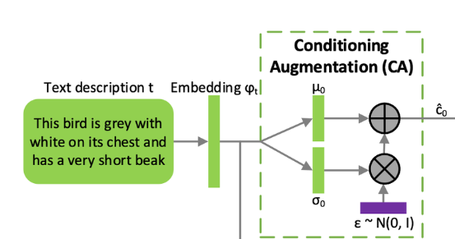
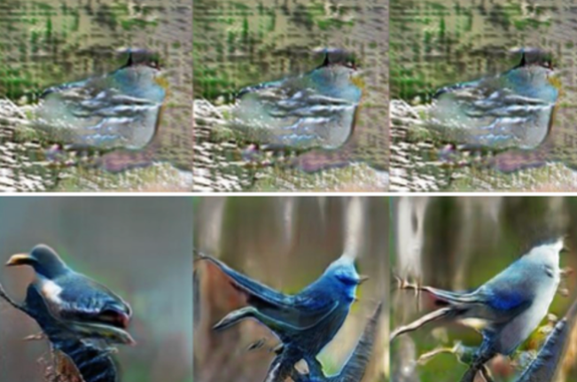
Conditioning Augmentation
Without CA
With CA
(1,1024)
(1,256)
(1,128)
Linear
CA

Slide 6
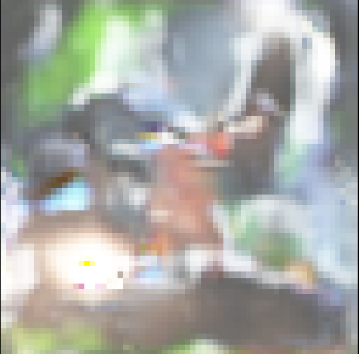
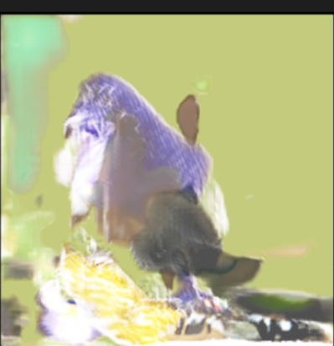
Results
Stage 1
Stage 2
Challenges in StackGAN
Mode Collapse: Limited diversity in generated images.
Training Instability: Difficulties during early training stages.
High Computational Costs: Long training times and resource requirements.
Limited Detail Generation: Inadequate fine detail, especially in complex scenes.

Slide 7
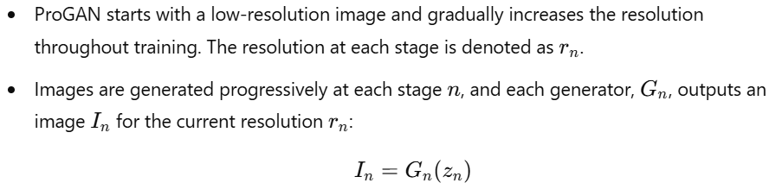
ProGAN: Progressive Growing of GANs
Progressive Training

Slide 8
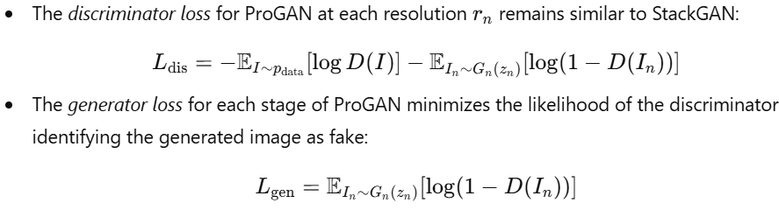
ProGAN: Progressive Growing of GANs
Loss Function

Slide 9
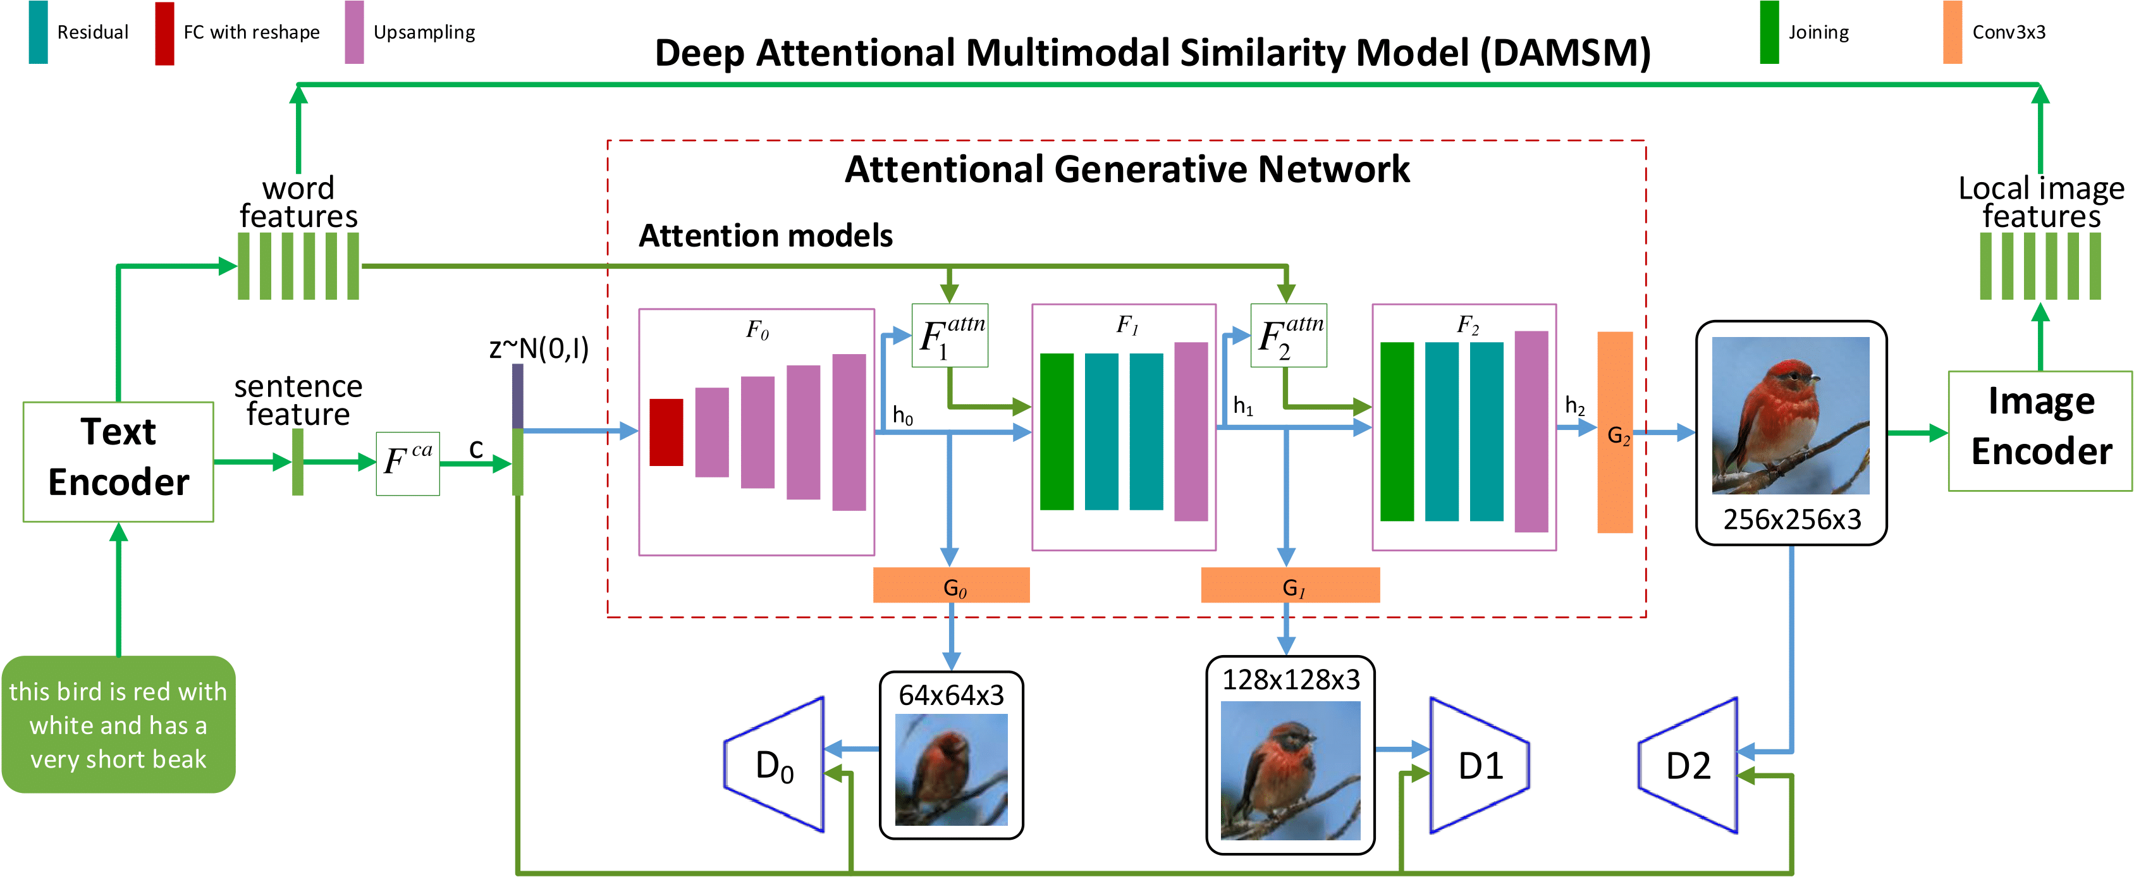
AttnGAN: Attention GAN

Slide 10
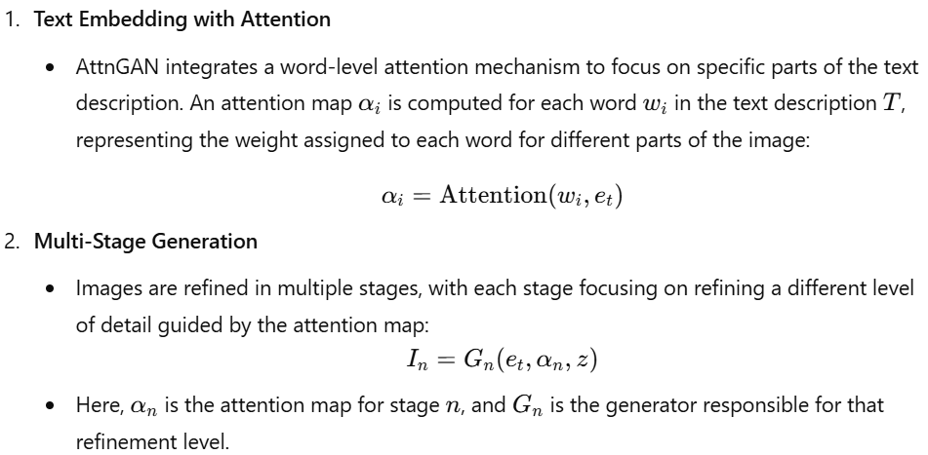
AttnGAN: Attentional GAN

Slide 11
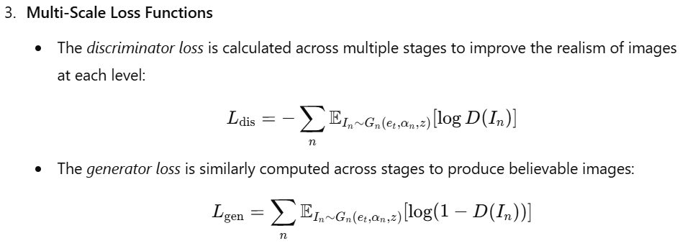

Slide 12
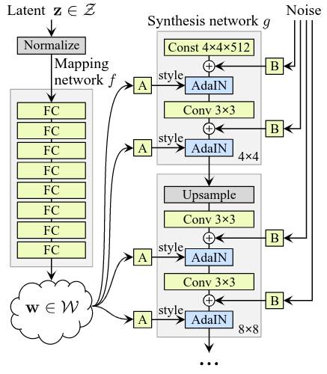
Style-AttnGAN
StyleGAN generator architecture

Slide 13
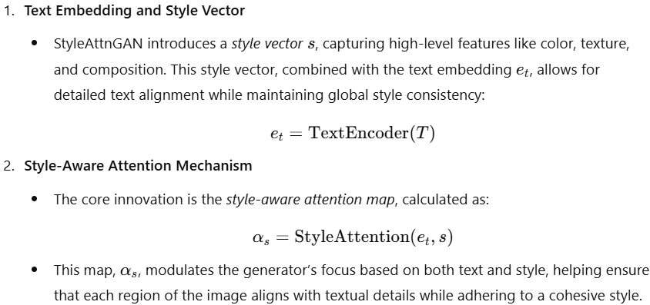

Slide 14
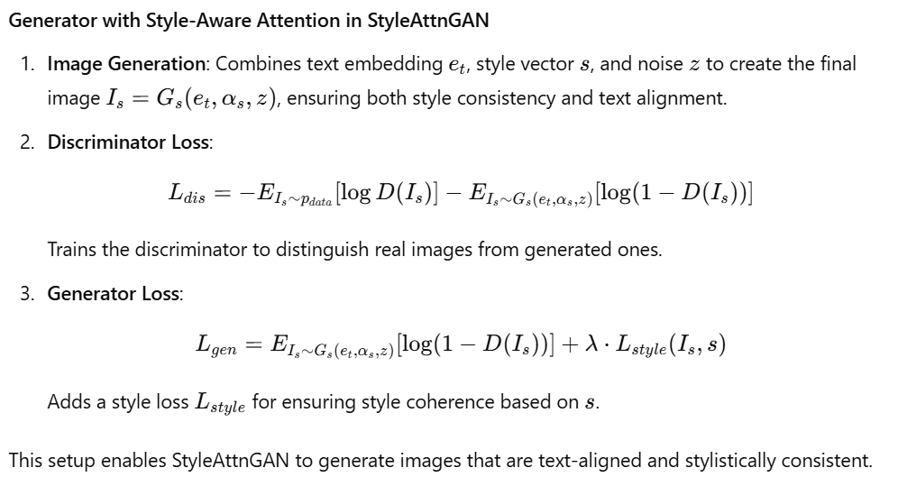

Slide 15
Conclusion
StyleAttnGAN advances text-to-image synthesis by combining text alignment with global style coherence, building on models like StackGAN, ProGAN, and AttnGAN.
Its unique style-aware attention mechanism integrates text embeddings with a style vector, producing images that are both semantically accurate and aesthetically cohesive.
Through multi-stage generation and style-guided loss functions, StyleAttnGAN achieves higher-quality, detailed images that effectively reflect both text and desired style.
This model sets a strong foundation for future work in enhancing style control and handling complex text inputs in generative modeling.

Slide 16
Github Repo
https://github.com/cheekuag/DEEP-FUSION/tree/main/AttnGAN-Tensorflow-master

