Slide 1
“Automated Smart Waste Segregation System with Live Monitoring and Intelligent Bin Alerts"
ADITYA COLLEGE OF ENGINEERING AND TECHNOLOGY(A)
Project Review
on
Presented By:
D. Siddu Maheswara rao 21MH1A04E1,
J. S. S. D. Veerendra 21MH1A0425,
K. S. V. Vasu 21MH1A0430,
P. Satya Krishna 21MH1A0453
Under the guidance of:
P. Ramesh M.Tech., (Ph.D.)
Assistant Professor
Department of ECE

Slide 2
Introduction
Waste management is a crucial aspect of environmental sustainability, yet traditional waste segregation methods are inefficient, labor-intensive, and error-prone. Improper waste disposal leads to increased pollution, inefficient recycling, and adverse health impacts.
Our Smart Waste Segregation System leverages automation, IoT, and sensor-based detection to streamline the process. By integrating real-time monitoring, automated classification, and minimal human intervention, this system enhances waste segregation efficiency and contributes to a cleaner environment.

Slide 3
Abstract
The system automates waste segregation to streamline waste management.
Combines multiple sensors and microcontroller for precise sorting.
Aims to minimize human intervention and enhance environmental sustainability.
A mobile app lets users check bin status.

Slide 4
Literature Review
Waste Management System using Waste Classification on Mobile Application(2024)
Authors: Mujalin Polchan; Ampai Pukao; Tapana Cheunban; Somnuek Sinthupuan • The study classified waste into four bins—blue (general), yellow (recyclables), green (wet), and red (hazardous)—for efficient segregation. A mobile app was developed to inspect and analyze waste distribution, showing wet waste was the highest, followed by general, recyclables, and hazardous waste.
Smart Garbage Segregation & Handling System Using IoT (2023)
Authors: Chaitali Bhangale, Sinh Viralkumar Ganesh, Punetkar Ronak Vijaybhai, Patel Ronak Shaileshbhai • It provided insights into how capacitance and infrared sensors can improve waste segregation. Their study highlighted the importance of cloud-based monitoring for efficient waste collection. Based on this, I considered the integration of real-time data transmission and notifications in my system.

Slide 5
Literature Review
Smart Waste Segregation Dustbin(2022)
Authors: S. Brinthakumari, Nilima Deorukhkar, Pratik Bhat, Atharv Gharge
• The study proposed an IoT-based waste segregation system equipped with wet and dry sensors on the top of the lid. When waste is placed on the lid, the sensors detect the type of waste, and the lid automatically opens to the corresponding waste slot in the bin, ensuring proper segregation. This approach enhances efficiency and accuracy in waste management.

Slide 6
Existing vs Proposed Model
Existing Model: The existing waste management system relies on manual segregation, making it labor-intensive, time-consuming, and prone to human error. This often leads to improper waste disposal, contributing to inefficiencies in recycling. Although some systems incorporate basic waste classification, they lack advanced sensor-based detection, mobile integration, and real-time monitoring, making waste management less effective.
Proposed Model: Utilizes sensors and automation to detect, classify, and segregate waste efficiently. The system ensures accurate classification, eliminates human error, and enhances recycling efficiency. Real-time monitoring via a mobile app allows users to track bin levels, receive alerts, and manage waste disposal remotely. This improves waste management, reduces manual effort, and promotes a cleaner environment.

Slide 7
Objective
Develop an automated waste segregation system.
Implement sensor-based classification of waste.
Reduce human involvement in waste sorting.
Integrate a mobile app and cloud-based system for remote monitoring.
Improve waste recycling efficiency and promote sustainability.

Slide 8
Methodology
Waste Detection: Moisture, Metal, and ultrasonic sensors classify waste.
Conveyor Belt Operation: Controlled by an L298N driver and DC motor.
Bin Rotation Mechanism: Servo motor rotates bins for proper segregation.
Bin Level Monitoring: Ultrasonic sensor detects bin level and alerts when bins are full.
Mobile App Integration: Displays waste levels and allows system control.

Slide 9
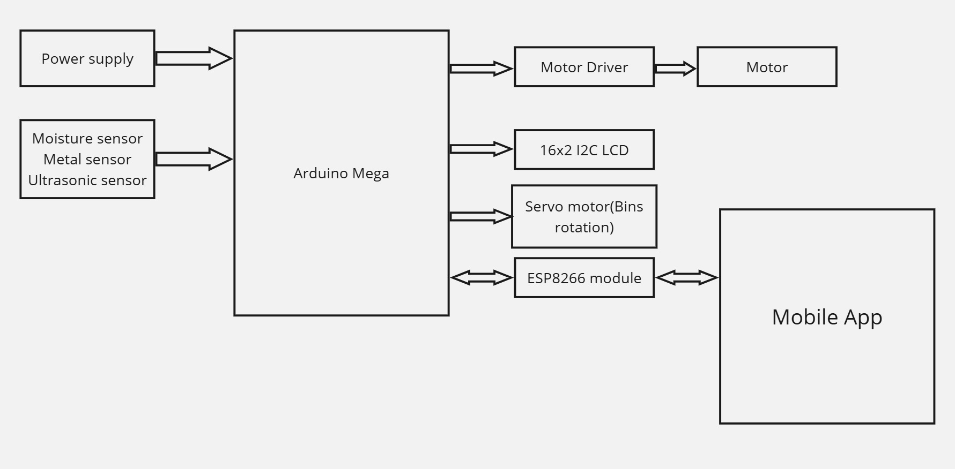
Block Diagram

Slide 10
Hardware and Software Used
Software:
Arduino IDE: Used for programming the microcontrollers (Arduino Mega, NodeMCU).
Google Flutter: Provides real-time monitoring and control through a mobile interface.
C++: Programming languages for firmware development.
Libraries: Includes necessary sensor libraries for interfacing components (e.g., LiquidCrystal_I2C, Servo, etc.).

Slide 11
Hardware and Software Used
Hardware:
Arduino Mega, ESP8266, 12V SMPS
Sensors: Moisture, Metal Sensor, Ultra Sonic Sensor
Conveyor belt, DC motor, Servo motors, DC motor driver (L298N), Bearings
LCD 16x2 with I2C interface, Buzzer

Slide 12
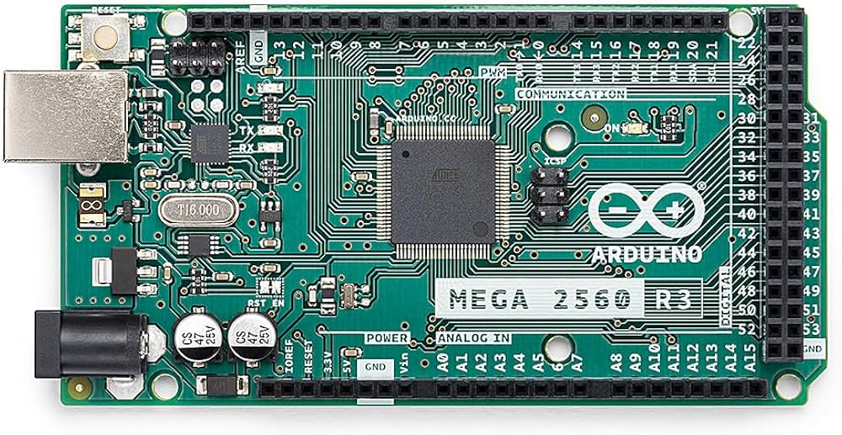
Hardware Description
Arduino Mega: The Arduino Mega 2560 is a microcontroller board based on the ATmega2560, featuring 54 digital I/O pins, 16 analog inputs, and 4 UARTs, making it ideal for complex projects like robotics and automation. It operates at 16 MHz with 5V logic and supports I2C, SPI, and UART communication. While it lacks built-in Wi-Fi, it can connect to external modules for network capabilities and is programmed via USB using the Arduino IDE.

Slide 13
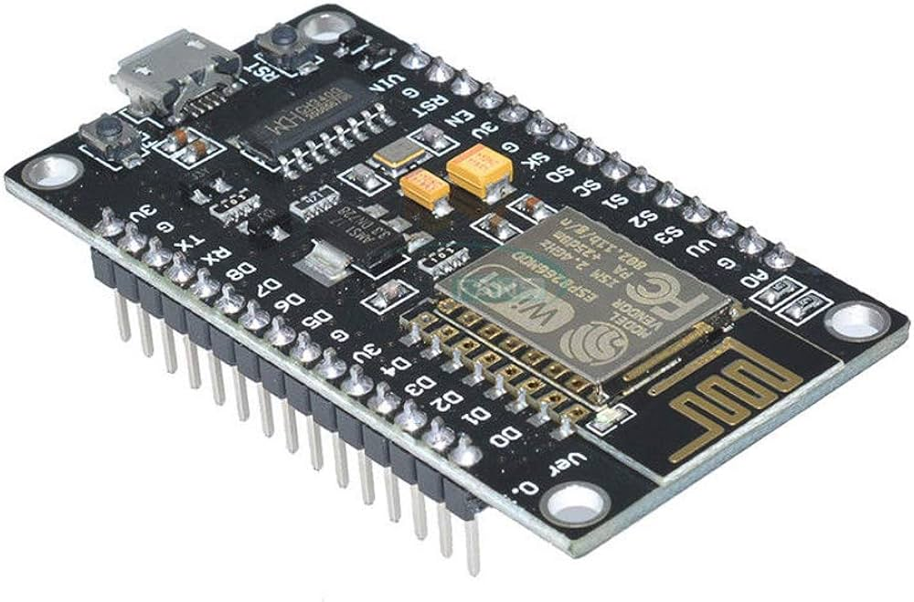
ESP8266:The ESP8266 is a low-cost, Wi-Fi-enabled microcontroller by Espressif Systems, ideal for IoT projects. Running at 80/160 MHz with 3.3V logic, it has a built-in TCP/IP stack for internet connectivity. Different modules offer varying GPIO pins, and it supports programming via Arduino IDE, MicroPython, and AT commands, making it versatile for automation and remote monitoring.

Slide 14
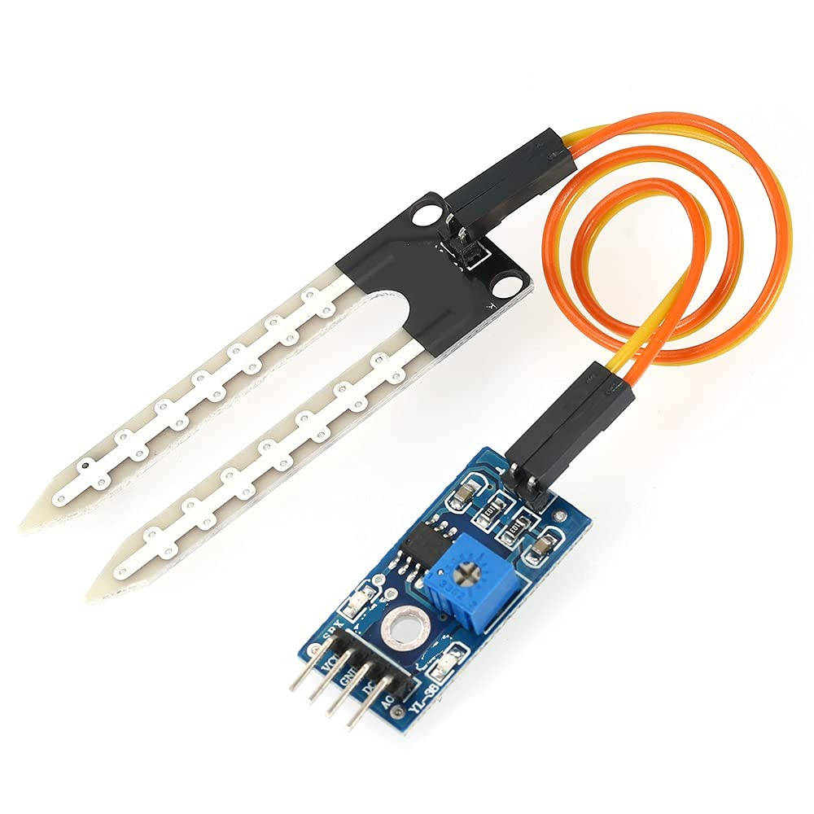
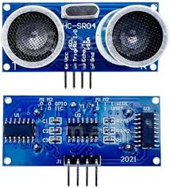
Moisture Sensor: A moisture sensor in a waste management system detects moisture levels in waste materials using resistance or capacitance. It helps in waste segregation, composting, and landfill monitoring, enabling efficient disposal and recycling.
Ultra Sonic Sensor: An ultrasonic sensor in a waste management system measures waste levels using sound waves.

Slide 15
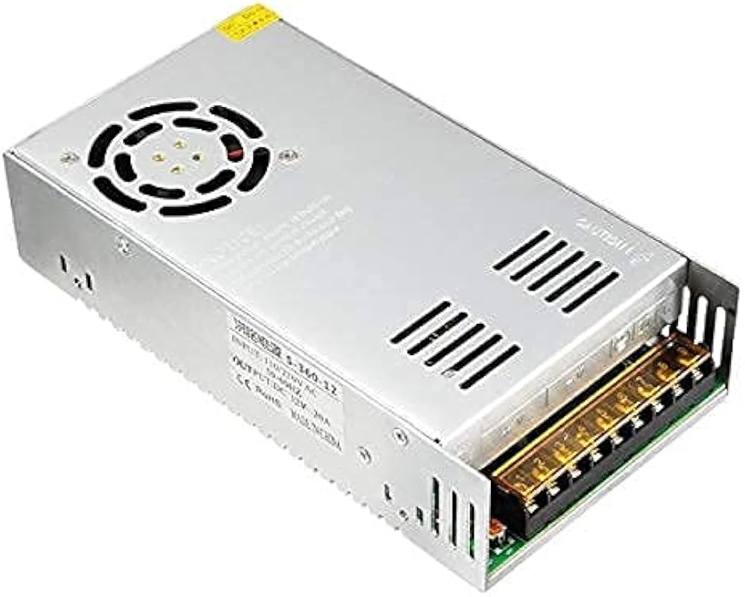
12VSMPS:A 12V SMPS converts AC to 12V DC efficiently, with low heat and high reliability. It is used in LEDs, CCTV, and automation, offering safety features like short-circuit protection.
Metal Sensor: A custom built metal sensor used to detect the metal waste.

Slide 16
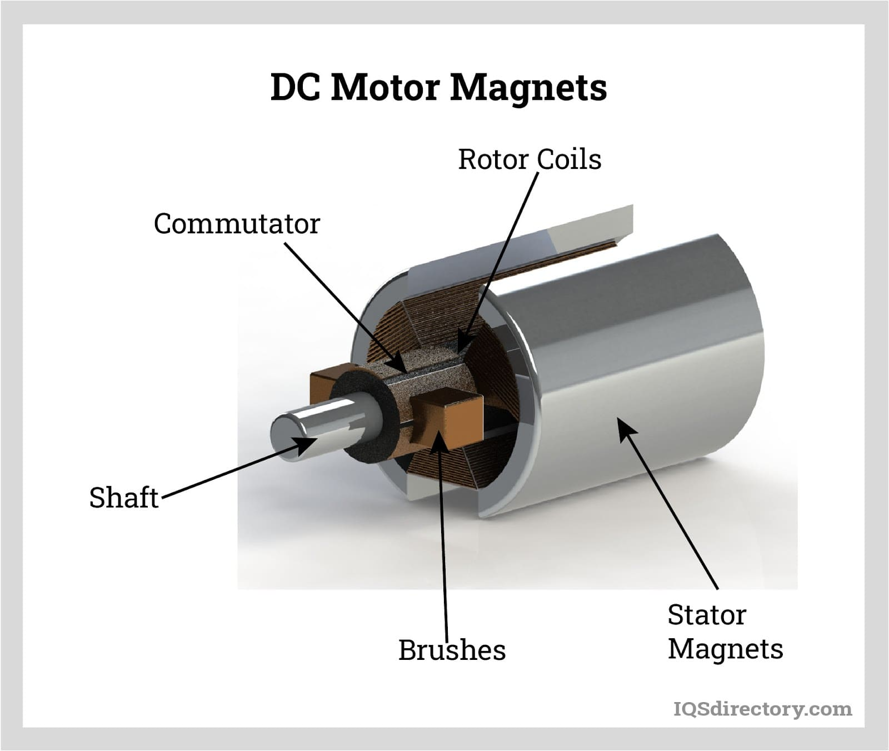
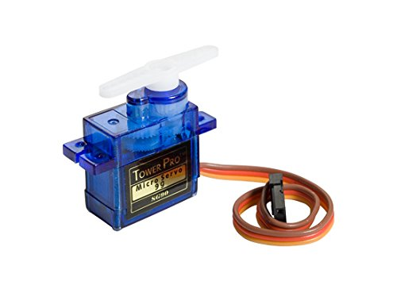
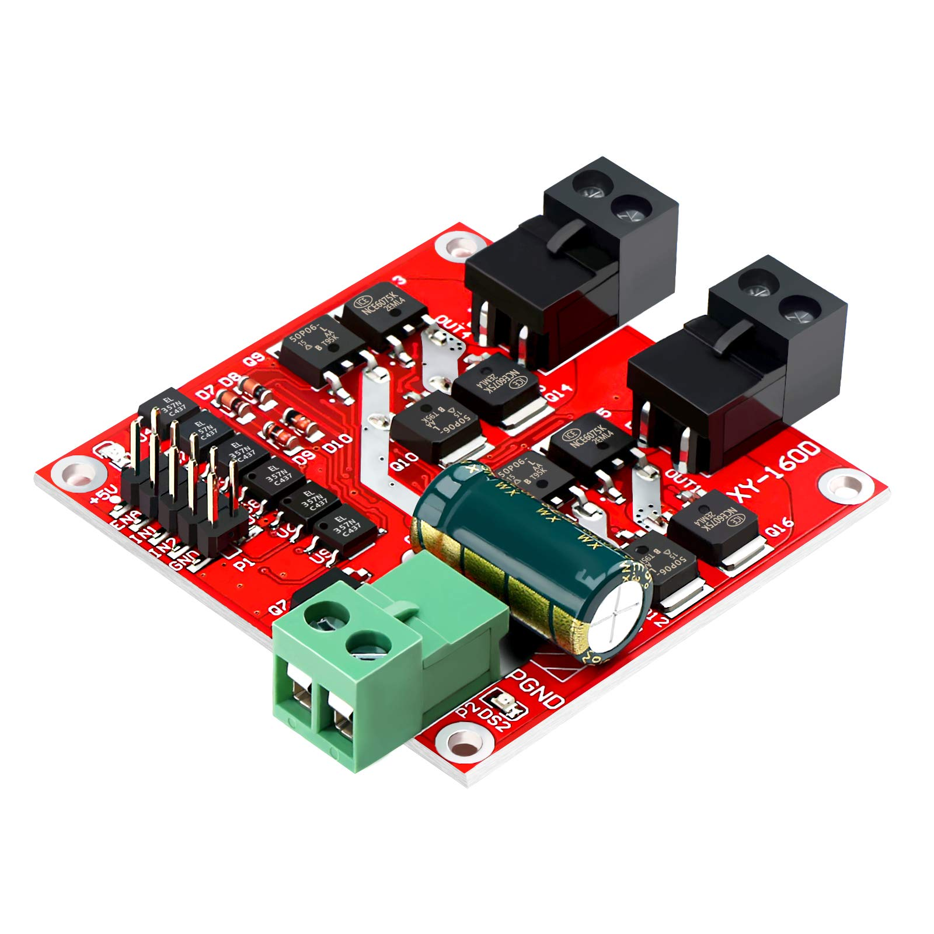
DC motor: DC motor is used to driving conveyor belt.
Servo motor: A servo motor enables precise sorting and waste disposal, improving automation in a waste management system.
DC motor Driver:It controls motor movement, enabling automated waste sorting in a waste management system.

Slide 17
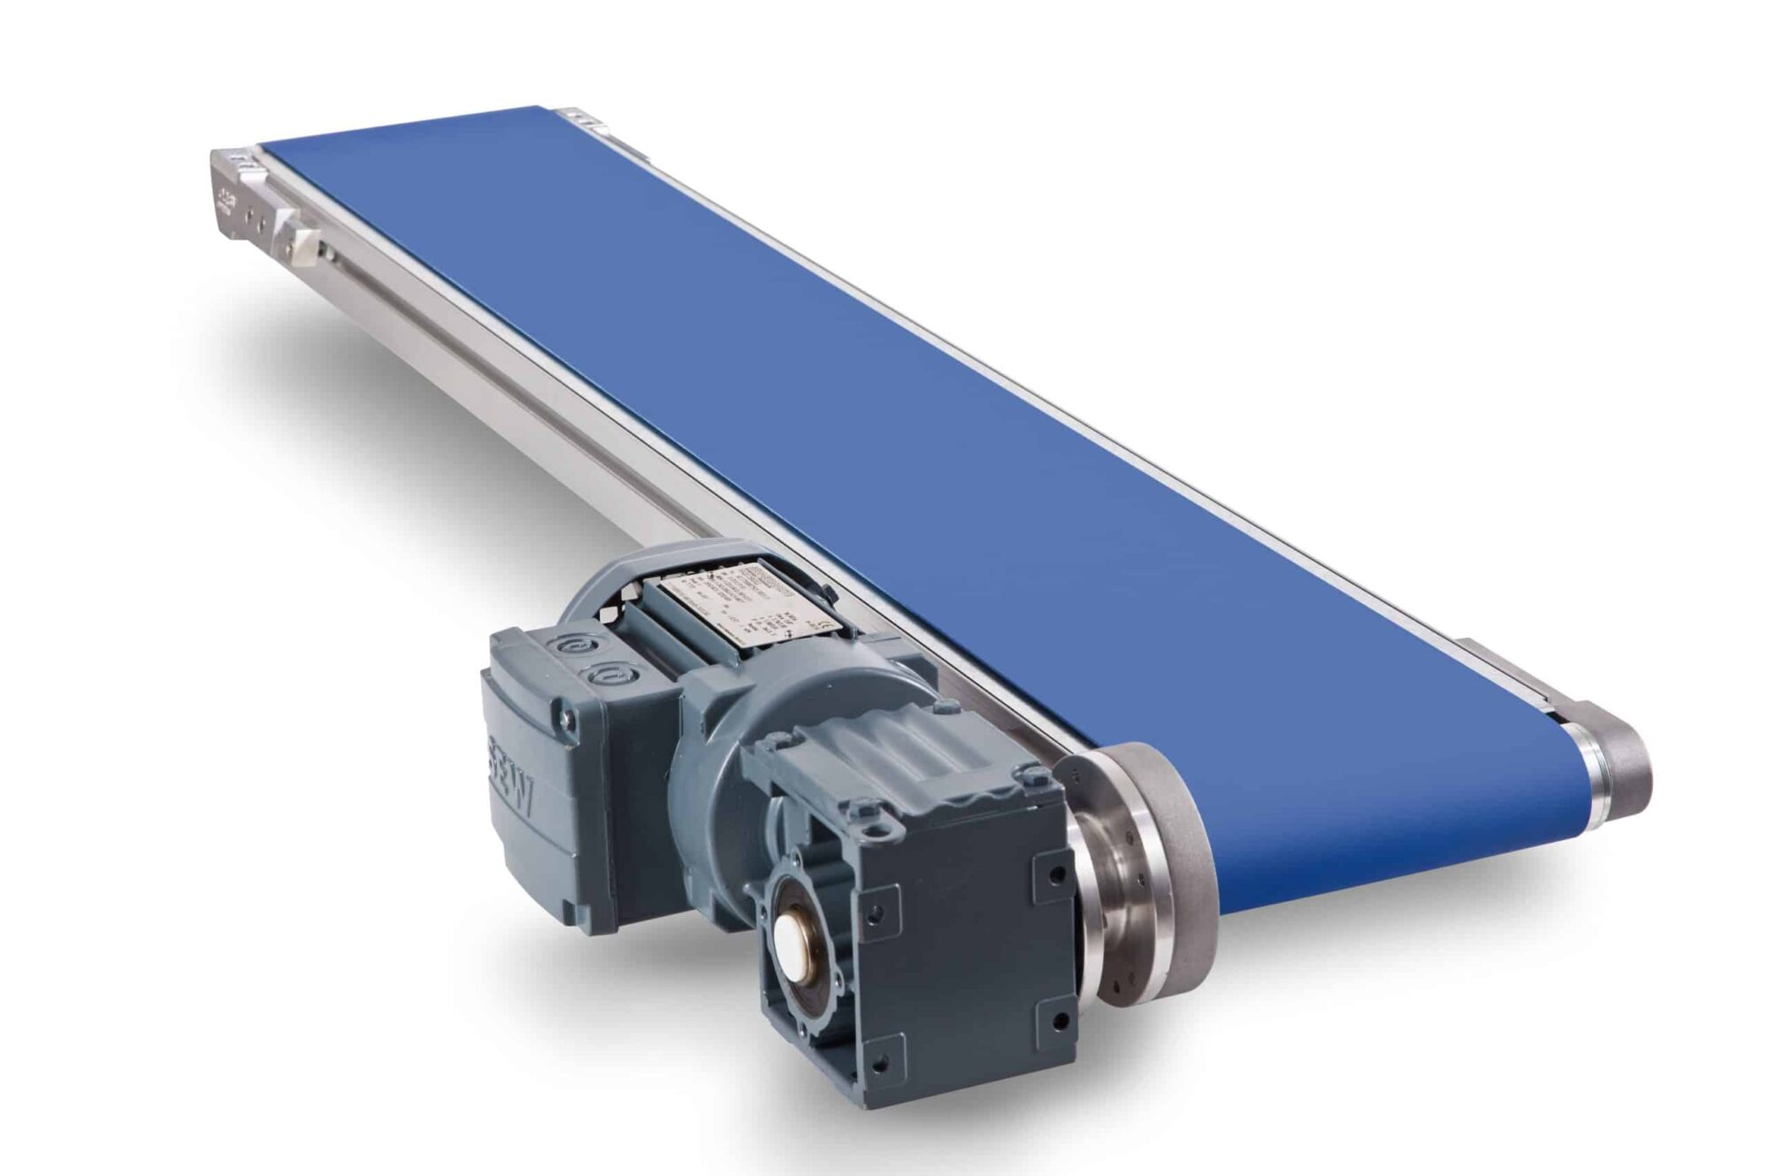
Conveyor belt: A conveyor belt transports waste for automated sorting and disposal, enhancing efficiency in waste management.

Slide 18
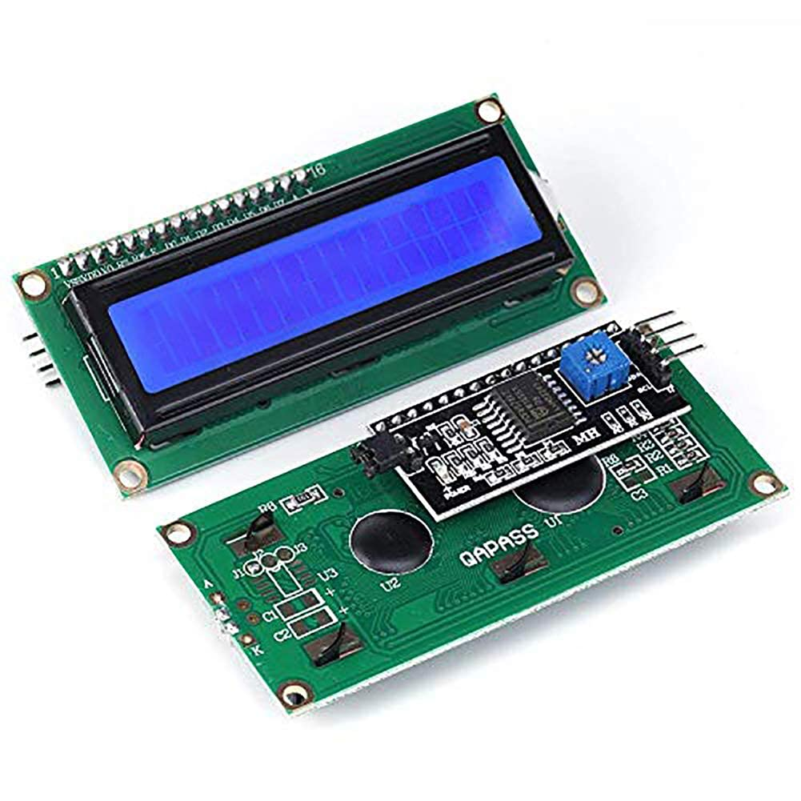
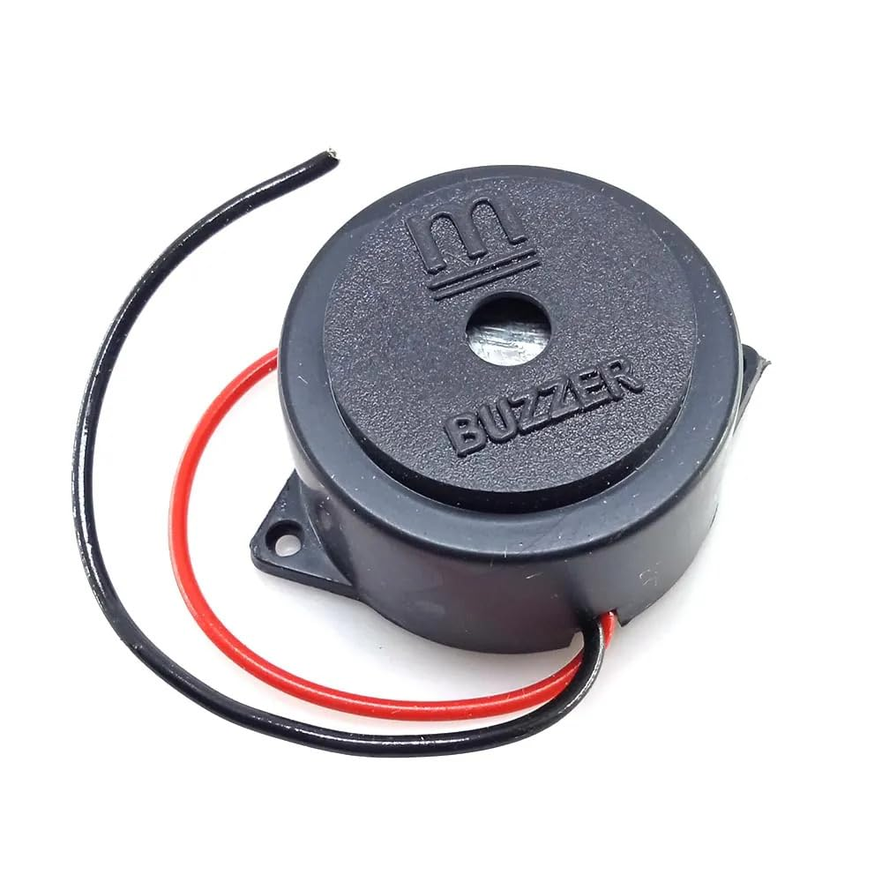
LCD 16x2 with I2C interface: An LCD 16x2 with I2C in a waste management system displays waste levels, system status, and alerts, improving monitoring and user interaction with minimal wiring.
Buzzer: A buzzer and button in a waste management system provide alerts and user control, enabling notifications for waste levels and manual operations when needed.

Slide 19
System Work Flow
Waste is placed on the conveyor belt.
Sensors analyze waste properties.
The microcontroller processes the data and categorizes waste.
Actuators(Servo motors) direct the waste to appropriate bins.
The mobile app provides real-time monitoring and control.

Slide 20
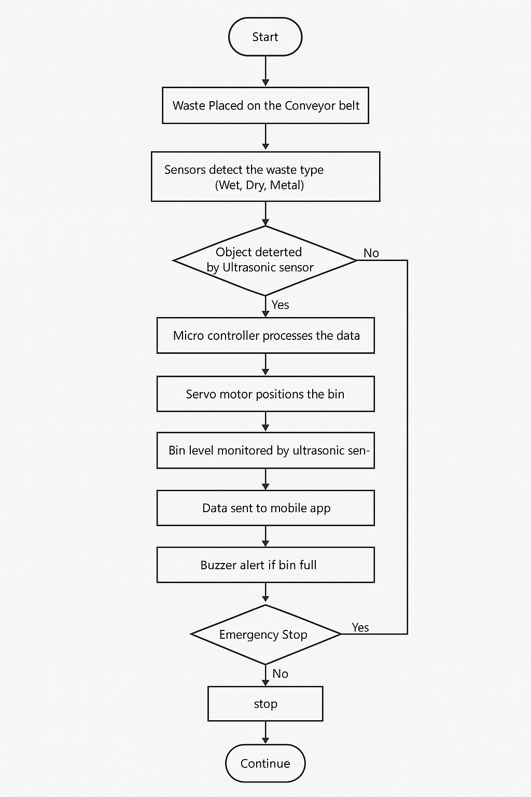
Flow Chart

Slide 21
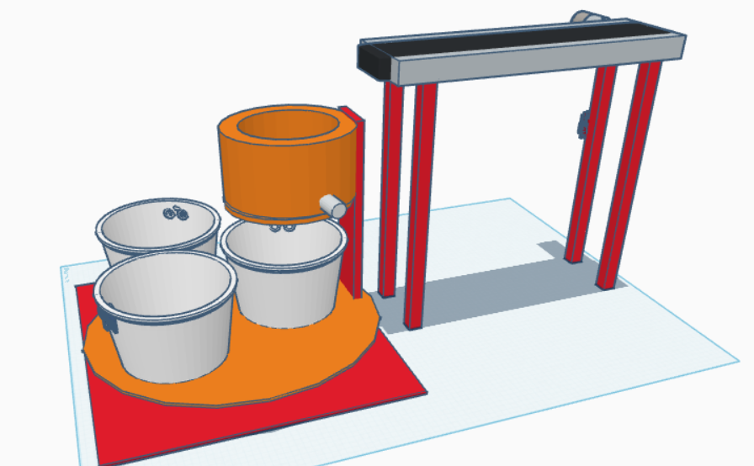
System Prototype / 3D model

Slide 22
Results
Improved waste segregation accuracy.
Reduced manual effort in waste management.
Increased recycling efficiency.
Real-time data access for better decision-making.

Slide 23
Future Scope
AI-based waste detection for enhanced classification.
Solar-powered system for energy efficiency.
Expansion to more waste categories.
Smart alerts for collection scheduling.

Slide 24
Conclusion
The Smart Waste Segregation System automates waste sorting efficiently, reduces human intervention, and supports sustainable waste management practices. Real-time monitoring enhances waste management efficiency.

Slide 25
Thank You

