Slide 1

Internship
By Loris Tomassetti
Tuesday, 26 January 2021

Slide 2
Table of Contents
General information
Types of Internships
Job shadowing
Internships for a fee
Benefits of internships
Benefits of internships for the employer
Aspects influencing your internship Application

Slide 3
General Information
Internships exist in a wide variety of fields
Part time or
Full time
May last between one to four months
Internship vs Apprenticeship
Notes:
To get into the topic I will provide some general information about internships.
Internships exist in a wide variety of industries and settings. Internships may be part time or full time and are commonly flexible with students‘ schedules.
A typical internship lasts between one and four months, but can also be shorter or longer depending on the organization involved
Some people may confuse internships with ápprenticeships and the main difference is that in internships the goal is to get new people into the field and attract their interest in some way whereas an apprenticeship particularly aims to train a new generation of practitioners
German word for Internship is: Praktikum
German word for apprenticeship: Lehre / Ausbildung

Slide 4
Types of Internships
General types of internships:
Insights
Work research, virtual research or dissertation
Virtual internship
Types of internships depending on payment:
Paid internships
Unpaid internships
Partially-paid internships
Notes:
Insights: Many large corporations, particularly investment banks, have "insights" programs that serve as a pre-internship event numbering a day to a week, either in person or virtually.^{[9][10]}
Work research, virtual research (graduation) or dissertation: This is mostly done by students who are in their final year of school. With this kind of internship, a student does research for a particular company.^{[13]} The company can have something that they feel they need to improve, or the student can choose a topic in the company themselves. The results of the research study will be put in a report and often will have to be presented.^{[13]}
Another type of internship growing in popularity is the virtual internship, in which the intern works remotely, and is not physically present at the job location. It provides the capacity to gain job experience without the conventional requirement of being physically present in an office. The internship is conducted via virtual means, such as phone, email, and web communication.
This is particularly popular in times of COVID-19 as working with the company locally is hardly possible while still respecting rules like social distancing.
Paid internships are common in professional fields including medicine, architecture, science, engineering, law, business (especially accounting and finance), technology, and advertising.^{[11]} Work experience internships usually occur during the second or third year of schooling. This type of internship is to expand an intern's knowledge both in their school studies and also at the company. The intern is expected to bring ideas and knowledge from school into the company.^{[12]}
Unpaid internships are typically through non-profit charities and think tanks which often have unpaid or volunteer positions.^{[5]} State law and state enforcement agencies may impose requirements on unpaid internship programs under Minimum Wage Act. A program must meet criteria to be properly classified as an unpaid internship.
Partially-paid internships is when students are paid in the form of a stipend. Stipends are typically a fixed amount of money that is paid out on a regular basis. Usually, interns that are paid with stipends are paid on a set schedule associated with the organization.^{[5]}

Slide 5


Job shadowing
A program consisting of
Work with a supervisor
On-the-job learning,
career development,
and leader development
Helps to learn new aspects of the job
Notes:
Job shadowing or work shadowing is a program consisting of on-the-job learning, career-development and leadership development
Job shadowing involves working with another employee who might have a different job in hand, have something to teach or be able to help the person shadowing them to learn new aspects of the job, organization, certain behaviours or competences

Slide 6
Job shadowing
Types of Job-Shadowing:
New job training
Career development
Developing expertise
Leadership development
Notes:
Job shadowing or work shadowing is a program consisting of on-the-job learning, career-development and leadership development
Job shadowing involves working with another employee who might have a different job in hand, have something to teach or be able to help the person shadowing them to learn new aspects of the job, organization, certain behaviours or competences

Slide 7
Internship for a fee
Students in unpaid internships get charged a fee
Fee is promised to be returned if no internship is found
Aims to provide internship placements at reputable companies
Notes:
Companies in search of interns often find an place students in mostly unpaid internships, for a fee.
These companies charge students to assist with research, promising to refund the fee if no internship is found.
Programs vary and aim to provide internship placements at reputable companies
Some companies may even provide controlled housing in a new city, mentorship, support, networking activities and academic credit

Slide 8
Benefits of internships
Gain valuable work experience
Explore a career path
Give yourself an edge in the job market
Develop and refine skills
Receive financial compensation
Network with professionals in the field
Gain confidence
Transition into a job
Notes:
The hands-on work experience interns receive is invaluable and cannot be obtained in a classroom setting, making this one of the most important benefits of internships
Exploring is an important part of the college experience, and internships are a great way for students to acquaint themselves with the field they are interested in.
One of the most important internship benefits is that college graduates who already have some work experience in the form of an internship stand out to potential employers
You can learn a lot about your strengths and weaknesses during an internship.
Many internships are paid which means you can gain valuable work experience and make money at the same time.
In the working world, it’s all about who you know. As an intern, you will be surrounded by professionals in the industry.
Internships allow you to test out specific techniques learned in the classroom before entering the working world.
Many companies use internships as a way to enhance their recruitment efforts. In some cases, a company may decide to hire an intern at the end of the assignment.

Slide 9
Benefits for the employer
Establish a relationship with the college and university
Increase productivity
Bring in fresh perspectives
Enhance supervisory skills of your staff
Create company visibility
Develop student/graduate skill sets
Cut down on recruitment costs
Help to keep college educated talent in our region
Give back to the community

Slide 10
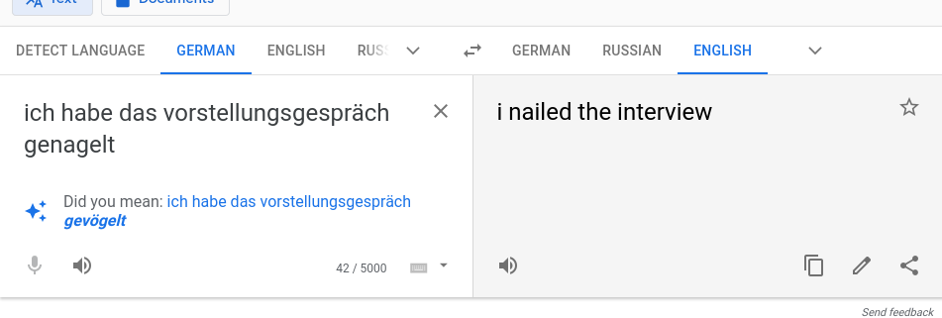
Aspects influencing your internship Application
Network
Social Media
An Impressive Resume
Relevant Experience
Nail the Interview
Follow Up
Notes:
To get an internship, you have to find one first. This is where networking comes in. Whether you’re asking your favorite professor, a family friend, or even your academic advisor—everyone knows someone. Never underestimate the power of networking to not only find internships, but to also have someone put in a good word for you.
Social media is a great way to find internships and also present yourself. Employers often check a candidate’s social media pages, so it’s vital to keep those pages clean and positive. If you don’t already have one, created a LinkedIn page to search for internship opportunities and have people search for you as well.
The resume is often your very first impression. This is the place to highlight your skills, experience, interests, goals, and awards/accolades. A resume should be neat, 1–2 pages, have proper spelling and grammar, and be eye-catching.
Employers will want an intern that has some experience related to their job title or duties. This could be previous work, volunteer experiences, or even related classes. Companies will understand that not every intern will have a long list of previous work history, but some relevant experience is ideal.
The all-important interview is another key element to earning an internship. Either by phone or in-person, we have already covered this part of applying for an internship extensively in earlier classes
The presentation has the expression “nail the interview” and someone came to me earlier and asked me what that means
So, I prepared this translation I got from google. And as we all know, google is always right
After the interview, be sure to send an email thanking them for their time. If you think of any other questions afterward, feel free to include it in that email as well. After a week or so, follow up with another email or call, inquiring about your candidacy. Following up can earn you kudos.

Slide 11
Thank you for your attention

