Slide 1
Enhanced Model
By: Team 6 (Gharib, Mandy, Yug, Zimo)

Slide 2


Original Model
The original model starts off with loading the dataset.
Then, the model selects the necessary features to cluster and clusters them into 5 clusters using K-means.
After that, it assigns a cluster to a track and makes a new dataset with those clusters.
Then, it asks the user for input on their favorite songs. Which it then uses to find the favorite cluster of the user, so it can recommend songs from that cluster.

Slide 3
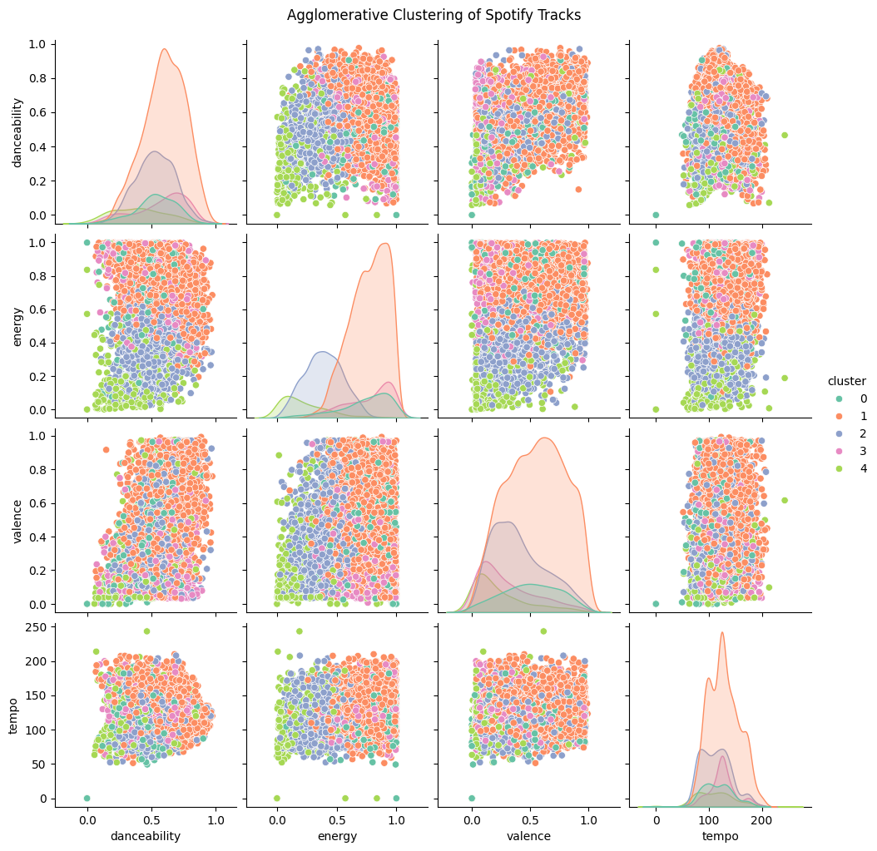
Enhancements+Benefits
In order to improve the clustering quality, we utilized the IQR method to remove outliers, so they wouldn’t distort the distance-based clustering algorithms.
We used the Silhouette Analysis method to figure out the optimal amount of clusters which was 4-5 (depending on what type of clustering algorithm you use).

Slide 4
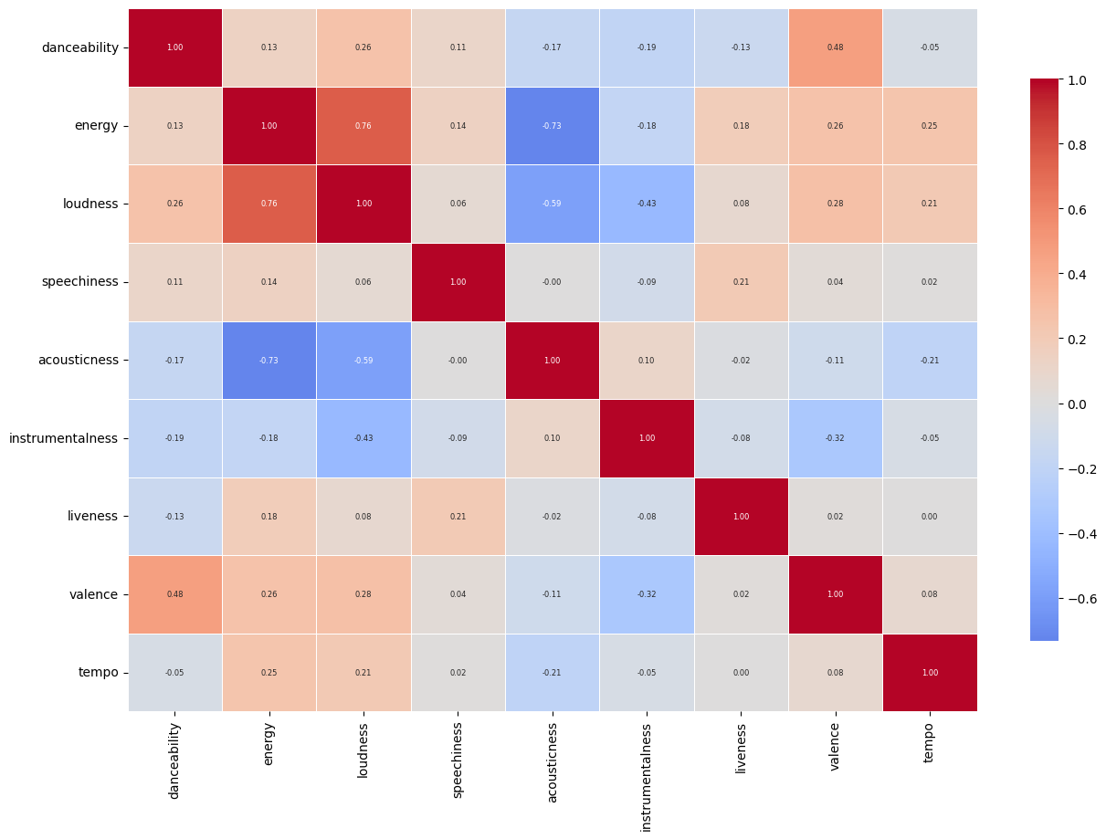
Data Exploration
There were many correlations, some include:
A 0.76 positive correlation between loudness and energy of the song
A -0.73 negative correlation between the energy of the song and the acousticness.
We think that it would be appropriate to add a few more variables because it seems that many variables don’t have any strong correlation, positive or negative.
Some variables that would be beneficial to add are skips, saves, playlist adds, etc. because they help measure user interactions.

Slide 5
Clustering Algorithms Comparison
Due to slow loading from the large dataset, a random sample of 5000 was taken for the measurements.
DBSCAN: 4 clusters, identified 231 noise points, with a silhouette score of around 0.14 to 0.17 which is fairly low meaning the clusters found are somewhat overlapping
Agglomerative Clustering: 5 clusters, silhouette score of about 0.19 which is slightly better than DBSCAN meaning the clusters are a bit more cohesive in comparison
Both silhouette scores are below 0.25, which suggests that the clustering structure is not very strong or the data may have been inherently noisy or complex for these two algorithms.
DBSCAN’s noise points indicate that it detects outliers while KMeans and Agglomerative do not, but it might struggle with cluster shape or density variations.

Slide 6
User Feedback
Allow the user to enter several favorites, which provides a richer profile for personalized recommendations.
For each favorite song, recommend several similar tracks, which broadens the variety and will improve user satisfaction
Following giving recommendations, prompt the user to rate the suggestions(like/dislike), which can be utilized to tune future recommendations by adjusting weights or retraining the model.
Such a loop would allow the system to be adaptive, user-centric, and would be able to improve over time, which would result in better personalization and engagement.

Slide 7

Future Enhancements
A future enhancement that could help improve the model is better feature representation.
This would help because it can help more accurately recommend the user songs that they would like.
The 5 Technologies That Will Change The Future Of The Human Race. 7 Feb. 2022.Forbes, 7 Feb. 2022, www.forbes.com/sites/bernardmarr/2022/02/07/the-5-technologies-that-will-change-the-future-of-the-human-race/. Accessed15 July 2025.

