Slide 1
Movie Project
5500 movies from 1980 to 2019

Slide 2
Business Task
How to make a best-selling movie

Slide 3
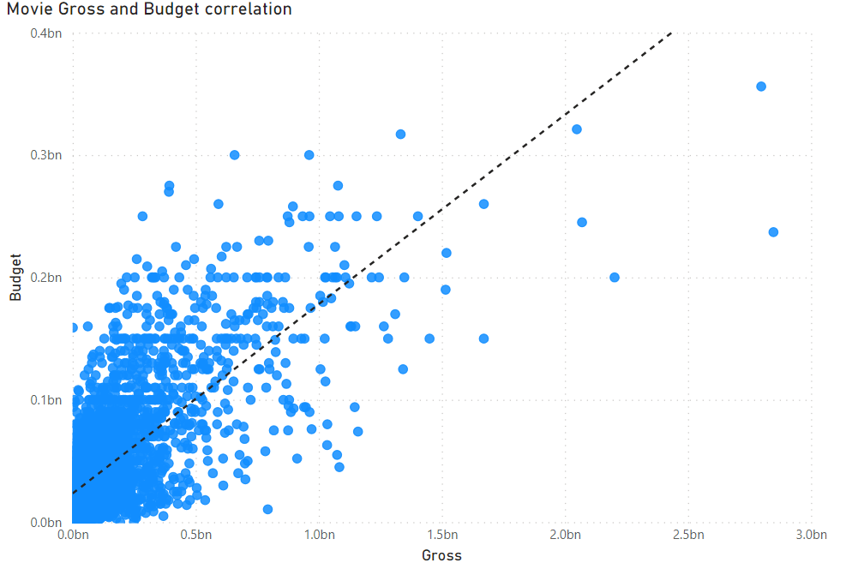
As budget increases, gross increases.
Using Rstudio, the Pearson Correlation between budget and gross was 0.74041.
The Pearson Correlation scale is -1 to 1, with 1 being a total positive correlation.

Slide 4
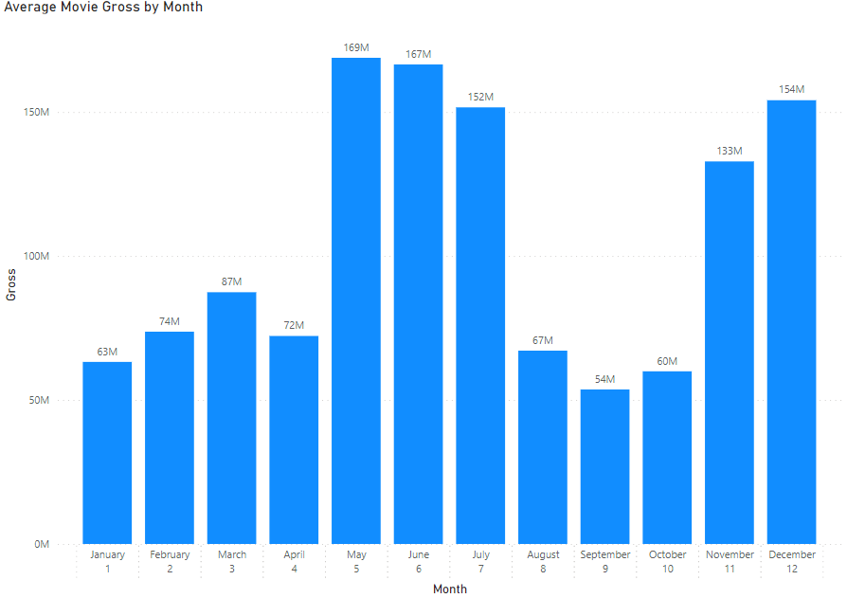
The top three highest average grossing months:
May(169M)
June(167M)
December(154M)
The bottom three average grossing months:
January(63M)
October(60M)
September(54M)

Slide 5
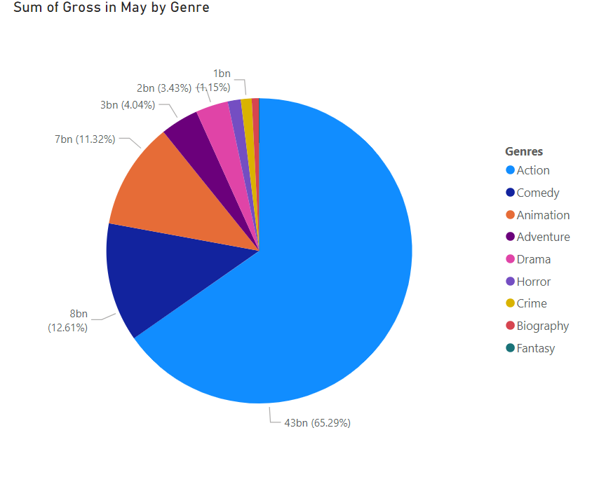
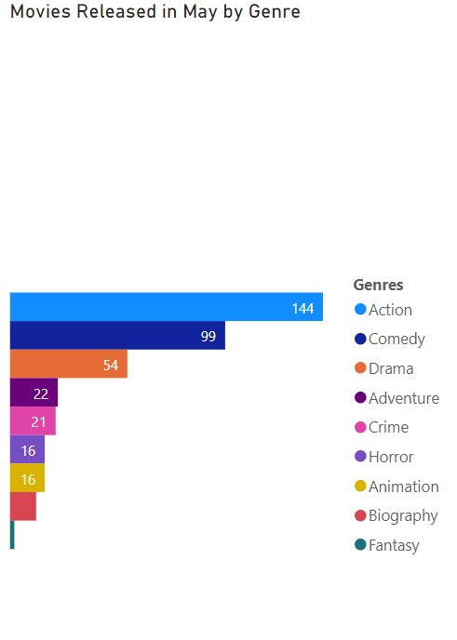
Action made 65% of the profit and 37% of the movies released.
Animation made 11% of the profit and 4% of the movies released.
Comedy made 13% of the profit and 26% of the movies released.
Adventure made 4% of the profit and 6% of the movies released.
Drama made 3% of the profit and 14% of the movies released.
Horror made 1% of the profit and 4% of the movies released.
Crime made 1% of the profit and 5% of the movies released.
Biography made 0.8% of the profit and 3% of the movies released.
Fantasy made 0.02% of profit and 0.5% of the movies released.

Slide 6
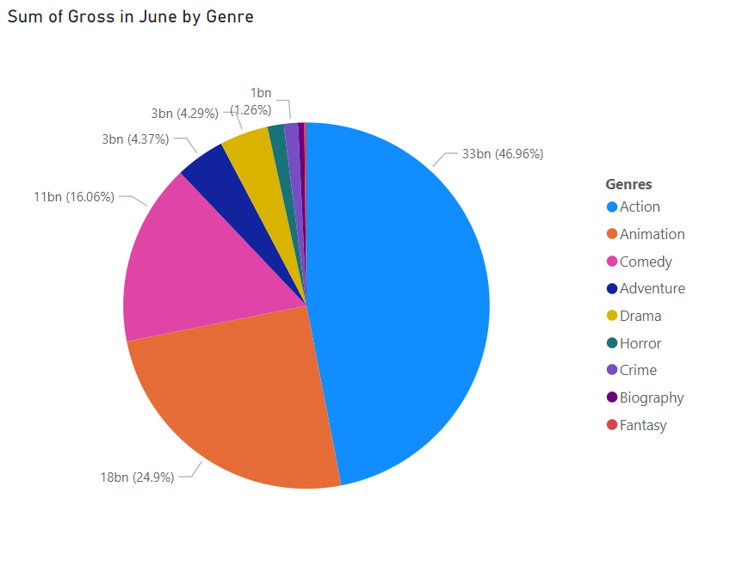
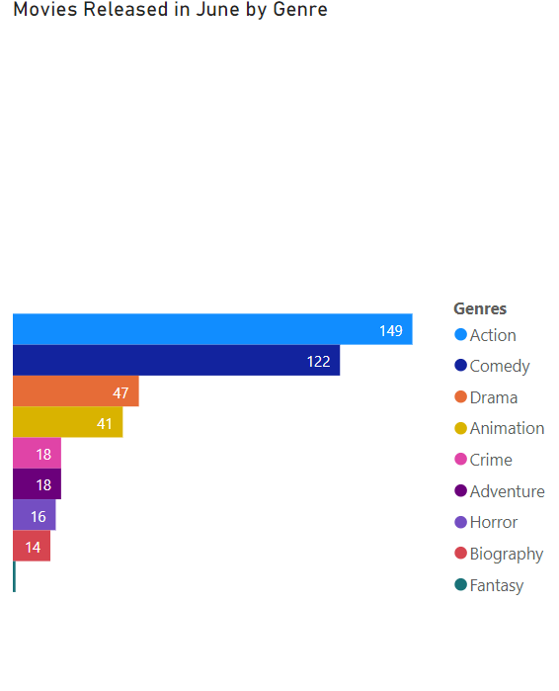
Action made 47% of the profit and 35% of the movies released.
Animation made 25% of the profit and 10% of the movies released.
Comedy made 16% of the profit and 29% of the movies released.
Drama made 4% of the profit and 11% of the movies released.
Adventure made 4% of the profit and 4% of the movies released.
Horror made 1% of the profit and 4% of the movies released.
Crime made 1% of the profit and 4% of the movies released.
Biography made 0.5% of the profit and 3% of the movies released.
Fantasy made 0.2% of the profit and 0.2% of the movies released.

Slide 7
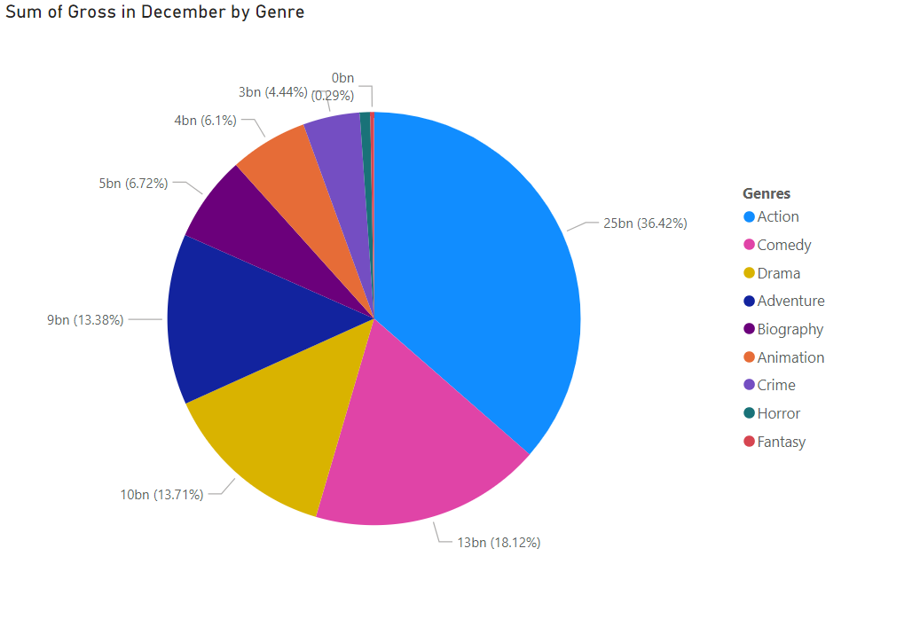
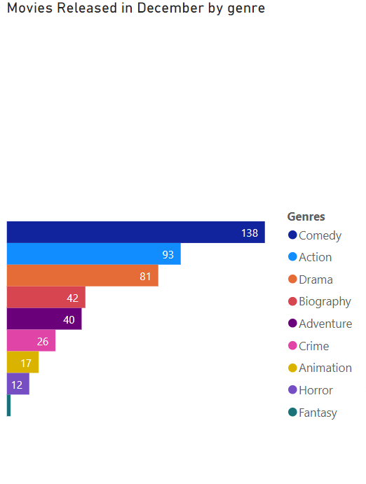
Action made 36% of the profit and 21% of the movies released
Comedy made 18% of the profit and 31% of the movies released.
Drama made 14% of the profit and 18% of the movies released.
Adventure made 13% of the profit and 9% of the movies released.
Biography made 7% of the profit and 9% of the movies released.
Animation made 6% of the profit and 4% of the movies released.
Crime made 4% of the profit and 6% of the movies released.
Horror made 0.8% of the profit and 3% of the movies released.
Fantasy made 0.3% of the profit and 0.4% of the movies released.

Slide 8
Data Conclusions
The more money you put into your budget, the more money you will get in gross revenue.
The best months to release a movie are May, June and December.
The worst months to release a movie are in January, October and September.
Action movies are the highest grossing genre.
On average, Action and Animation movies earn more profit per film.
Although Comedy makes high profit, it makes a poor profit per film on average.

Slide 9
Recommendations
Put as much money as you can into your movie budget.
Release your film in May for highest gross revenue.
Create an action film movie for highest profit.

Slide 10
Sources
Daniel Grijalva, Movie Industry data set on Kaggle.com: https://www.kaggle.com/datasets/danielgrijalvas/movies

