Slide 1
Comparing Occupations
Men and women, black and white

Slide 2
Objective:
Find the differences in job occupation and pay for black men, white men, black women and white women

Slide 3
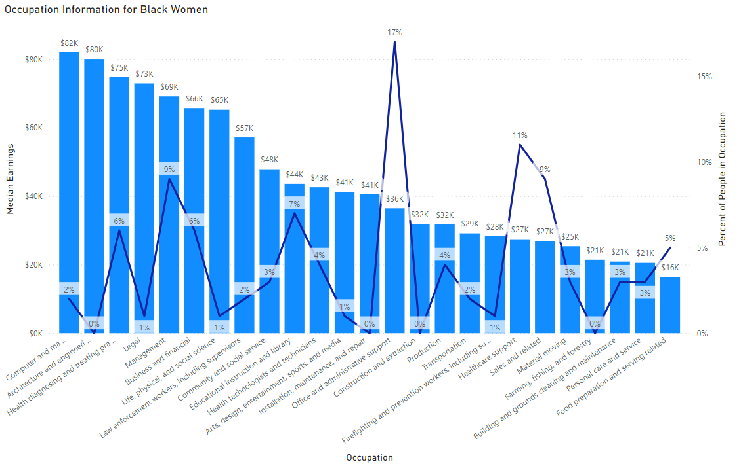
27% black women work in an occupation where the median income is 50k or more
37% black women work in an occupation where the median income is 31k or less

Slide 4
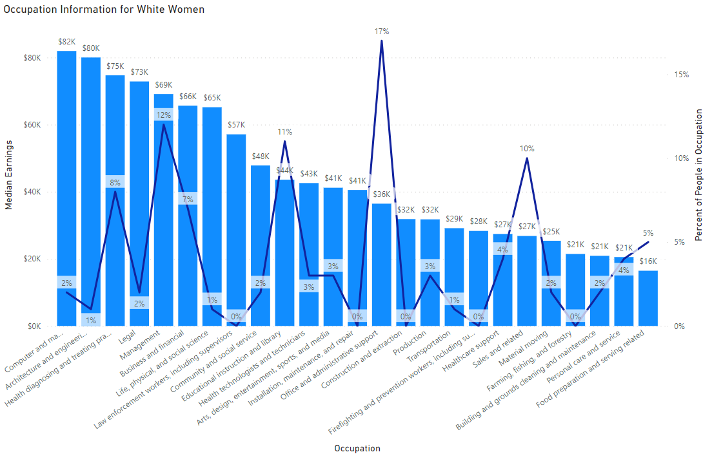
33% white women work in an occupation where the median income is 50k or more
28% white women work in an occupation where the median income is 31k or less

Slide 5
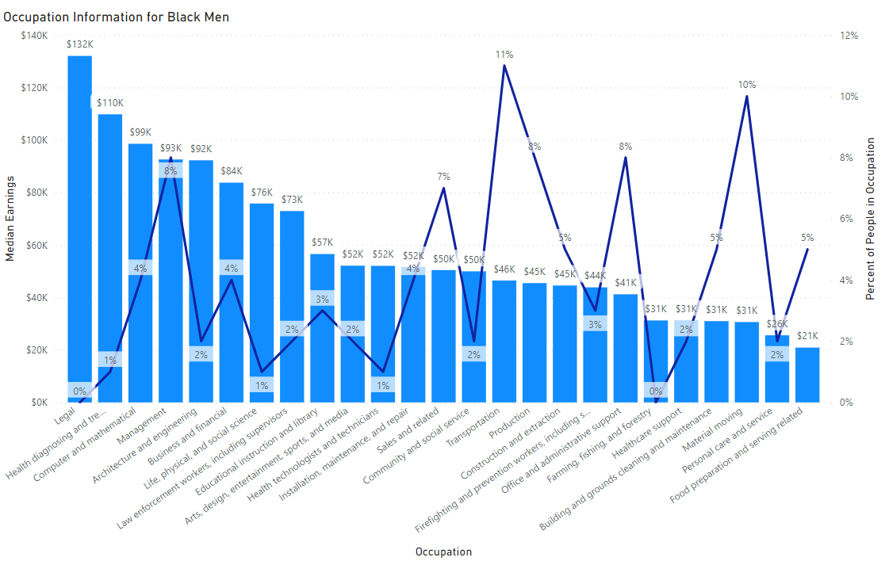
41% black men work in an occupation where the median income is 50k or more
24% black men work in an occupation where the median income is 31k or less

Slide 6
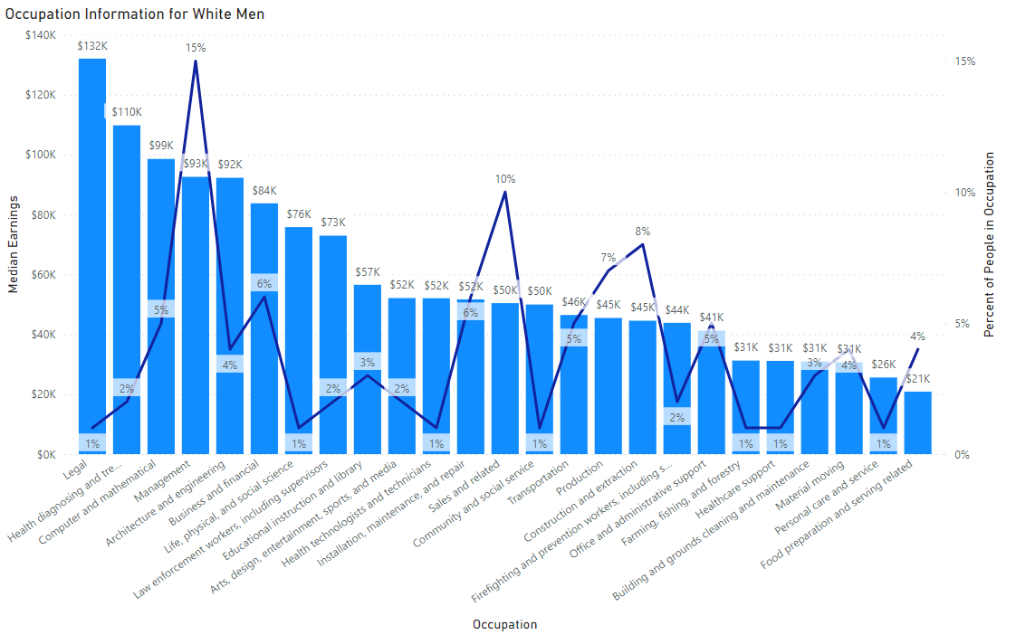
59% white men work in an occupation where the median income is 50k or more
14% white men work in an occupation where the median income is 31k or less

Slide 7
Data Conclusions
White men are 32% more likely than black women, 26% more likely than white women, and 18% more likely than black men to be in occupations whose median earning is 50k or more
Black women are 23% more likely than white men, 13% more likely than black men, and 9% more likely than white women to be in occupations whose median earning is 31k or less
On average, men get paid a 24% higher median income for the same occupations women work in
Black men are 10% more likely to be in a 31k or lower median income occupation than white men

Slide 8
Sources
B24010B | Sex by Occupation for the Civilian Employed Population 16 Years and Over (Black or African American Alone) https://data.census.gov/table/ACSDT1Y2022.B24010B?q=United+States&t=Black+or+African+American:Employment
B24010A | Sex by Occupation for the Civilian Employed Population 16 Years and Over (White Alone) https://data.census.gov/table/ACSDT1Y2022.B24010A?q=United+States&t=Employment:White
B24012 | Sex by Occupation and Median Earnings in the Past 12 Months (in 2022 Inflation-Adjusted Dollars) for the Civilian Employed Population 16 Years and Over https://data.census.gov/table/ACSDT1Y2022.B24012?t=Occupation&g=010XX00US

