Slide 1
Google Capstone Project
Chicago Cyclists: Annual Members versus Casual Riders

Slide 2
Business Task
Determine how Casual Riders and Annual Members differ in their use of Cyclist bikes.
Use the discovered information to create marketing strategies that will help convert Casual riders to Annual members.

Slide 3
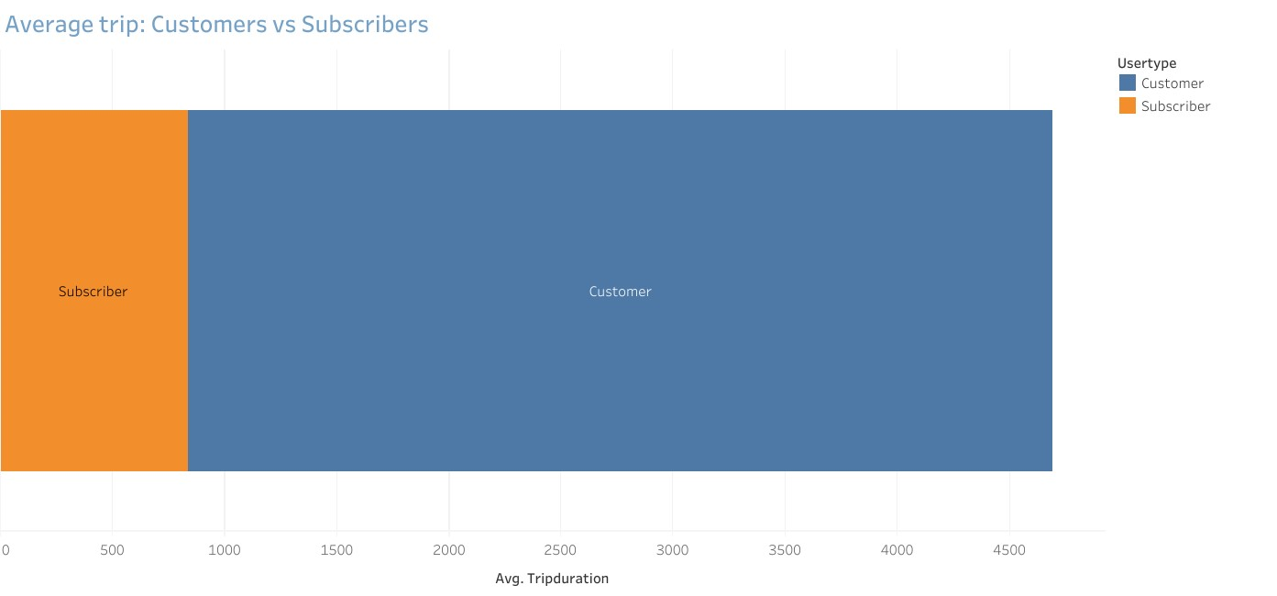
Annual Subscribers: Average trip time: 14 minutes
* Tripduration is displayed in seconds
Casual Riders:
Average trip time: 64 minutes

Slide 4
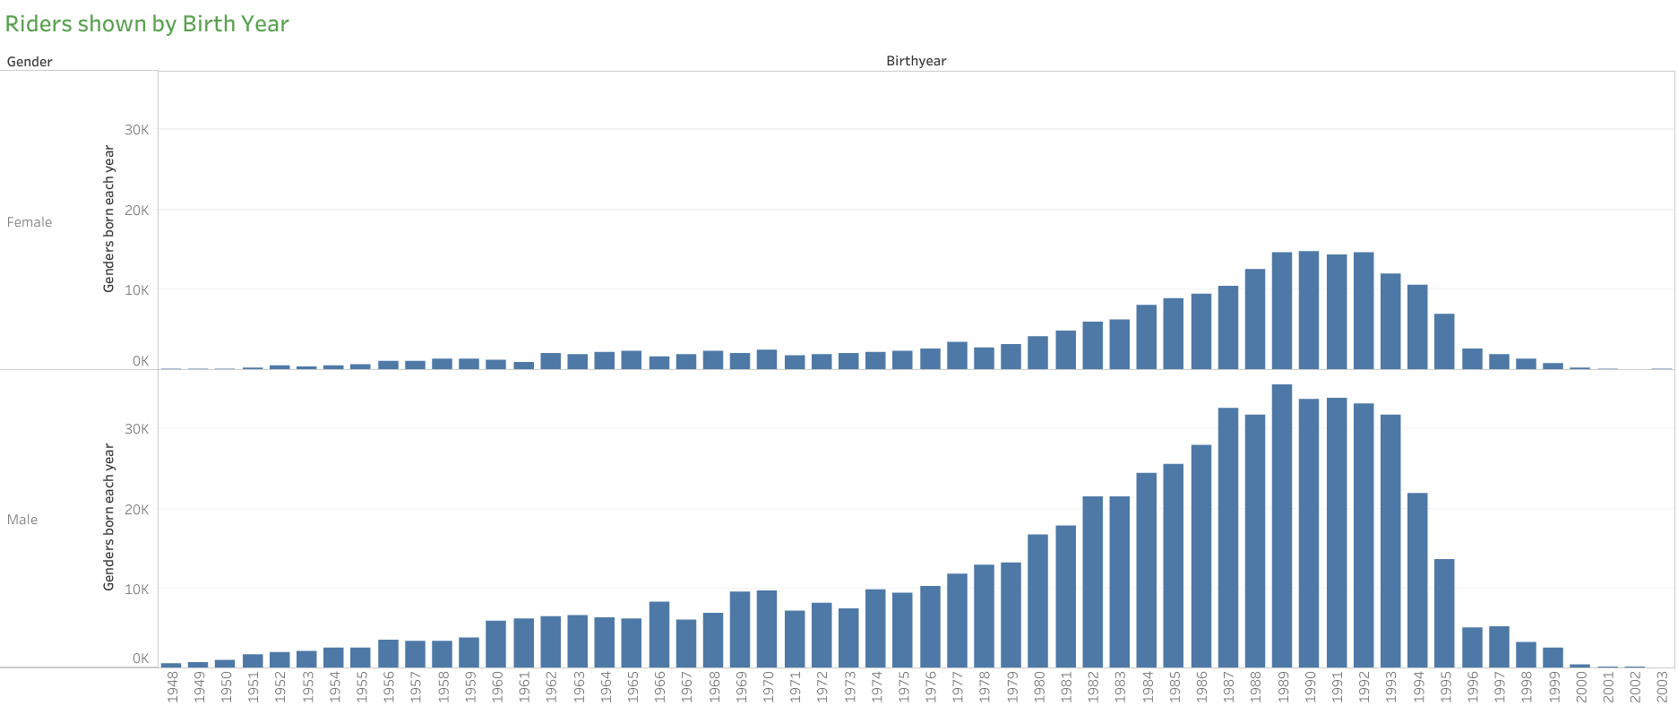
44% of Annual Subscribers are ages 25-35
43% of Casual Riders are ages 25-35
*This dataset is from the year 2018

Slide 5
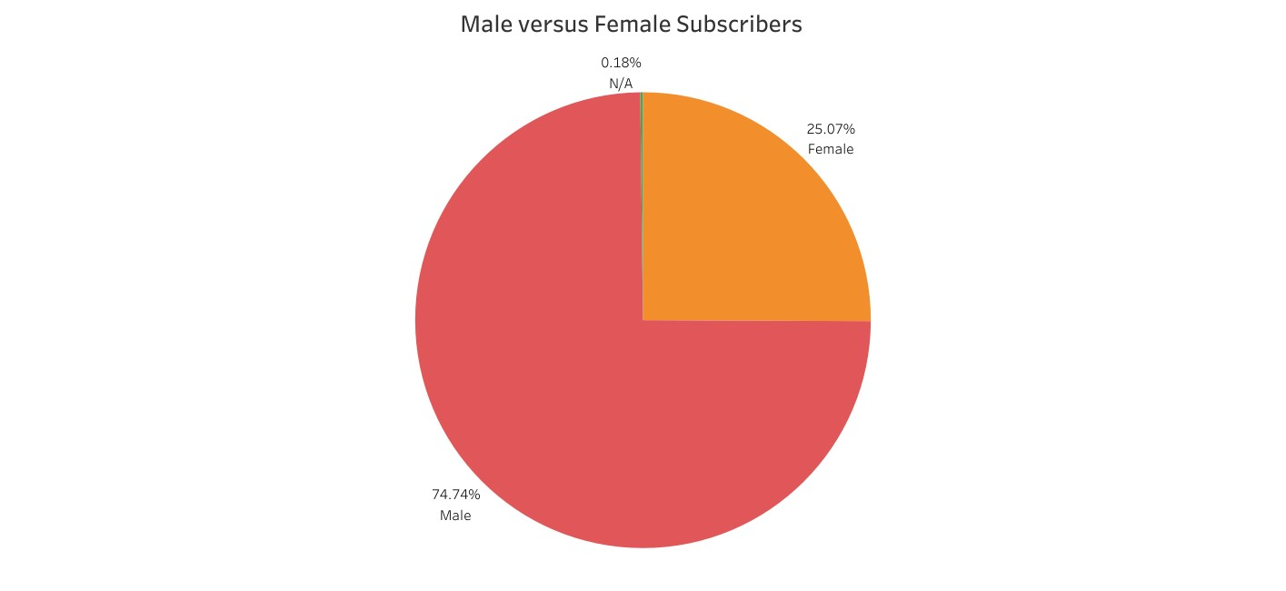
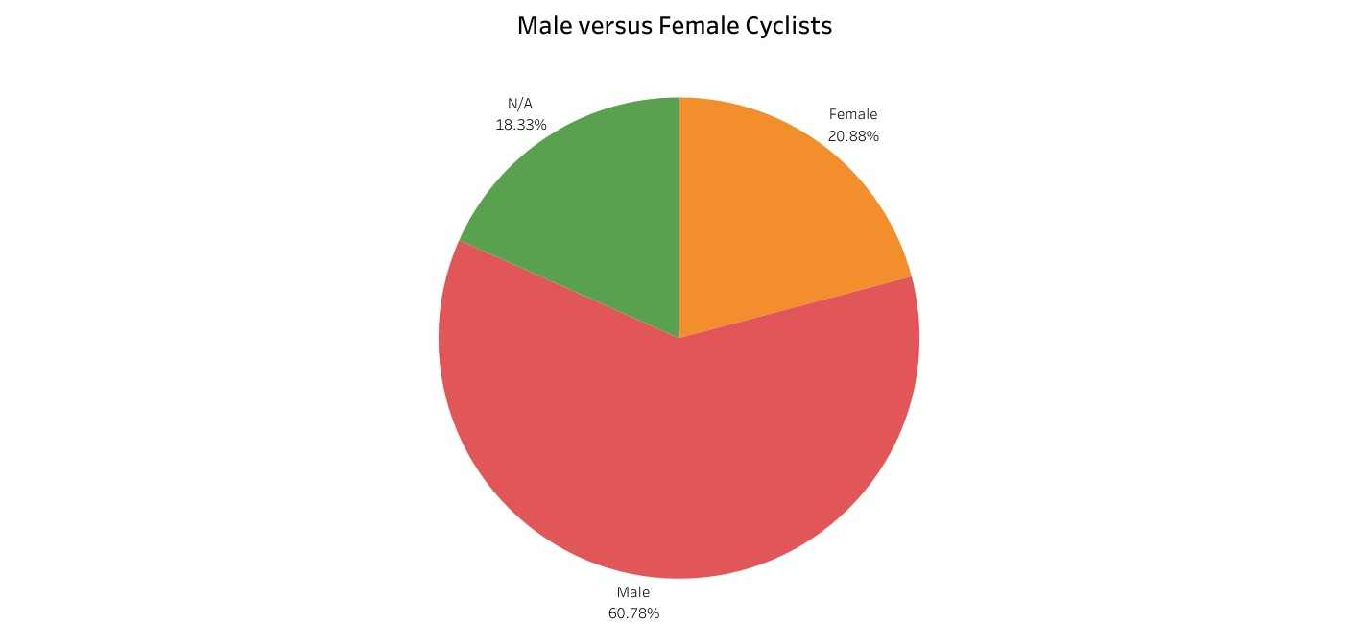
Males make up 75% of Annual Subscribers and 61% of all cyclists.

Slide 6
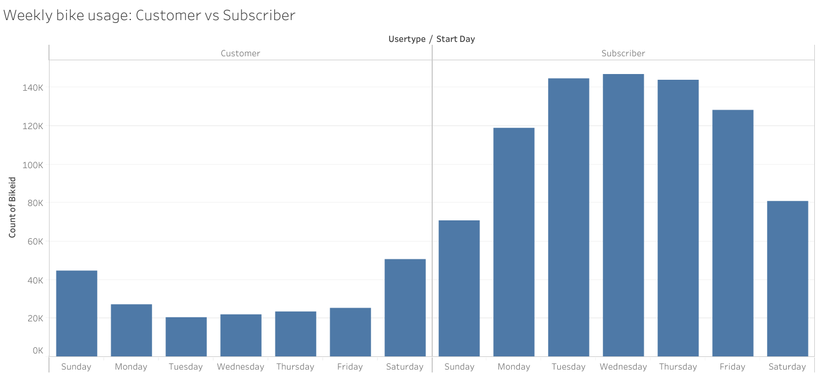
Annual Subscribers made up 85% of weekday rides.
Annual Subscribers only made up 61% of the rides during the weekend.

Slide 7
Data Conclusions
Males between ages 25-35 are the majority rider type for Annual Subscribers
Casual Riders mostly use bikes on weekends whereas Annual Subscribers mostly use them during the weekdays
Annual Subscribers use bikes for short periods of time whereas Casual Riders use bikes for long periods of time

Slide 8
Recommendations
Target audience should be males 25-35
Create annual subscription that is cheaper but only allows use on weekends
Put advertisements on social media used by targeted demographic

Slide 9
Sources
Google Data Analytics course on Coursera provided: The divvy trip 2018 Quarter 2 dataset, which was gathered from Lyft bikes and scooters and owned by the city of Chicago.

